Slide 1
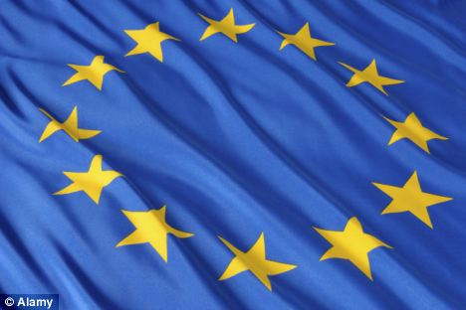
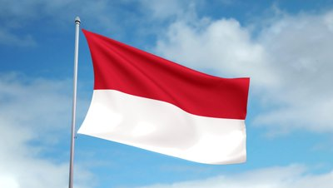
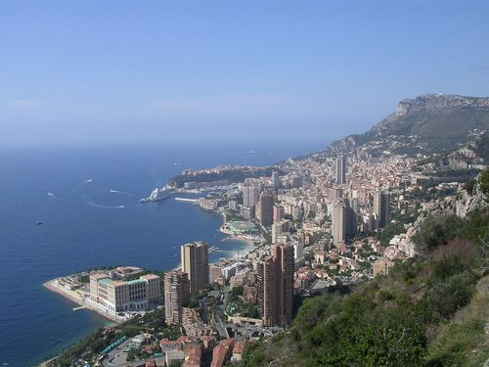
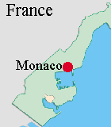
BY
IMAN

Slide 2
Content
Fast facts on Monaco
Food
The Cities
Currency
Weather
The countries history
The Grimaldi family
Monaco’s highest point
Monaco’s lowest point
Translator
Quiz

Slide 3
Fast facts on Monaco
Monaco is the second smallest country in the world
In Monaco you speak English, Italian and French
Monaco became independent on the 19th November
The population in Monaco is 71015.
Monaco has no airport they use helicopters, private jets, cars, trains and buses.

Slide 4
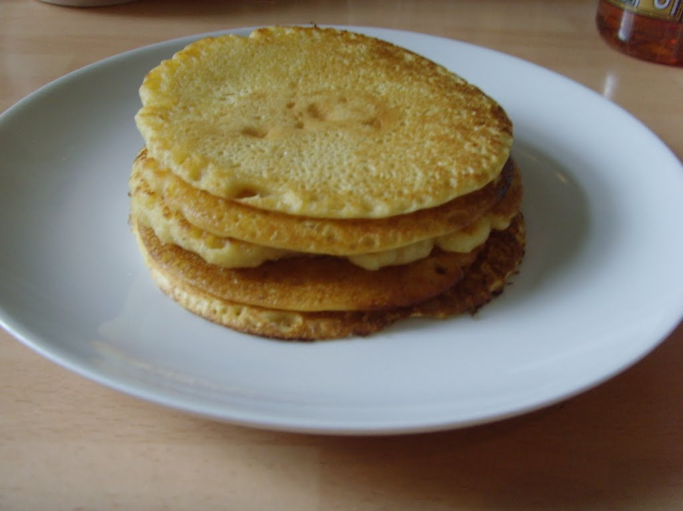
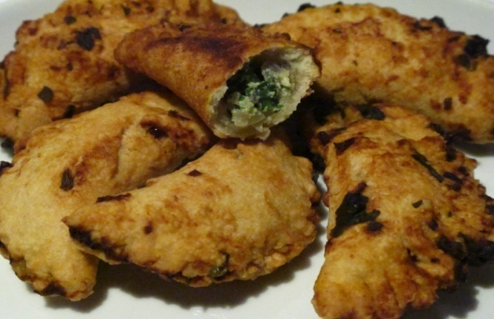
Food
Most Monaco food is cooked with olive oil and Most healthy Monaco dishes are mad from seafood.
These are some dishes:
Barbaguian is a sweet pastry filled with rice, cheese, leeks and pumpkin or spinach.
Fougass is another sweet pastry but this pastry is made from orange and decorated with nuts.
Socca is pancakes made with a special kind of flour.
Stocafi is dried cod cooked in tomato sauce.
Socca
Barbaguian

Slide 5
Monaco’s Main Cities
Monaco has a lot of cities but the main ones are: Monaco-ville-32,965
Monte Carlo-16,012
La condamin-12,167
Fortvieille-3,880
Saint Roman-3,000
Moneghetti-3,000

Slide 6
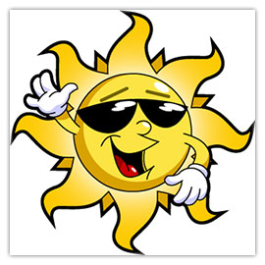
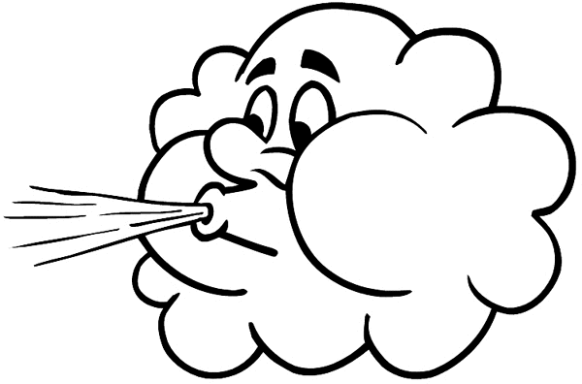
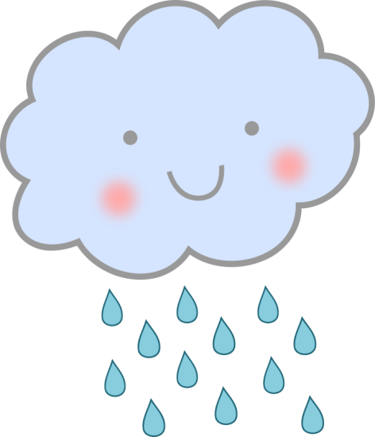
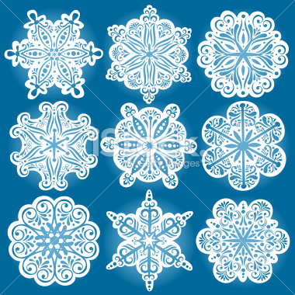
Weather
During the year Monaco’s weather in normally warm.
July and August are the hottest month in Monaco and the coldest time in the year is January and February.
Rain mostly falls during the coldest months which are January and February.

Slide 7
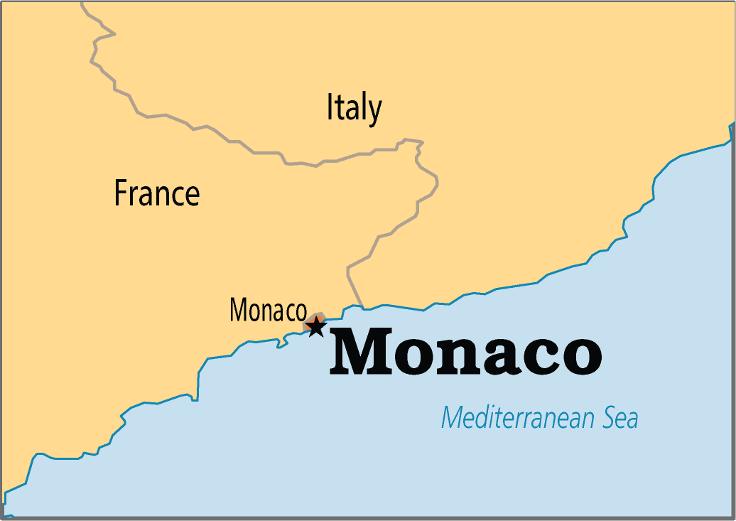
The countries History
In 1956 the American actress grace Kelly married prince rainier the third and in recent history ,Prince Rainier the third sadly died and on April 6th 2005 and his son Prince Albert the 2nd became ruler of Monaco on July 12th 2005.

Slide 8
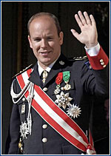
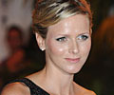
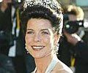
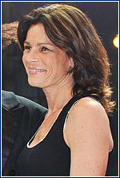
The Grimaldi family
The Grimaldi family have been on the throne of Monaco for 800 years. It all began when Francois Grimaldi became in charged.
The Royal Grimaldi Family
Prince Princess Princess Princess
Albert Caroline Stefanie Charlene
the 2nd

Slide 9
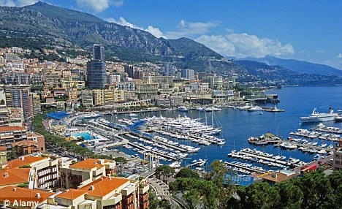
Monaco's Highest Point
Monaco’s highest point is Mont Angel which is 528 feet high. Mont Angel is at the very end of Monaco,(right beside France) and the Grimaldi family’s farm is located on
mont Angel.

Slide 10
Monaco’s Lowest Point
Monaco’s Lowest Point is the Mediterranean sea. The Mediterranean sea is joins to the Atlantic ocean. The Romans called the meditearen sea the Mare Nostrum and the Mare Nostrum means our sea. The Name Meditearen sea is a Latin word and it comes from the word Mediterraneus and that means in the middle of land

Slide 11
Translator
The word | French | Italian
Hello | Bonjour | ciao
How are you | Comment son vouse | Come sons vio
I’m fine | Je suis amende | io sono fine
What’s your name | Qu’est-ce votre nom | Cio che e sei nome

Slide 12
Quiz
How long has Grimaldi family ruled Monaco?
What is Monaco’s highest point?
What is Monaco’s lowest point?
Where is the Gramaldi family farm Located?
Who died on April 6th 2005?
When does rain mainly fall, is it:
A-July and August
B-January and February

Slide 13
