Slide 1
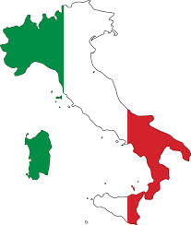

Slide 2
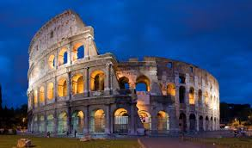
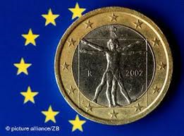
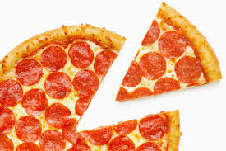
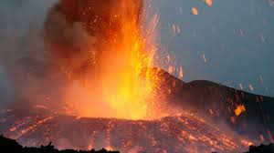
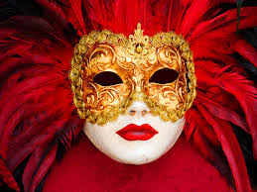
HISTORY ECONOMY
FOOD
GEOGRAPHY CULTURE

Slide 3
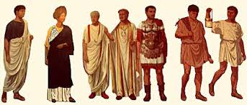
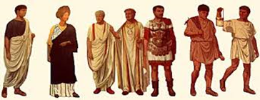
ITALY HAS A LONG LONG HISTORY, GOING BACK 2,100 YEARS .
THE CAPITAL ROME WAS FOUNDED IN 753BC AND IT HELPED SHAPE THE MODERN WORLD WITH MANY INVENTIONS LIKE SCIENCE, GOVERMENT AND LAW.
AFTER THE FALL OF THE ROMAN EMPRE IN 395AD ITALY BROKE INTO SEVERAL SEPARATE KINGDOMS AND STATES.
ITALY BECAME ONE SINGLE NATION STATE IN 1861
THE ITALIAN FLAG IS CALLED ‘IL TRICOLORE’ WHICH MEANS THE 3 COLOURS AND WAS FIRST USED IN 1948 WHEN ITALY WAS DECLARED A REPUBLIC, IT REPRESENTS HOPE-GREEN, FAITH -WHITE AND CHARITY - RED.
ITALY FOUGHT BESIDE THE ALLIES IN WW1 AND BESIDE GERMANY IN WW2.
ITS GOVERNMENT BETWEEN 1922 – 1946 WAS A FASCIST DICTATORSHIP LED BY BENITTO MUSOLINI, NOW IT IS A DEMOCRACY WITH A CO-ALITION GOVERNMENT.
ITALY WAS A FOUNDING MEMBER OF THE EUROPEAN UNION IN 1993 AND A MEMBER OF NATO (North Atlantic Treaty Organization) FROM 1948.

Slide 4
ITALYS ECONOMY IS A MIX OF AGRICULTURE, MANUFACTURING AND TOURISM. THE ECONOMY IS CURRENTLY IN RECESION.
THE MAIN EXPORTS ARE ENGINEERING PRODUCTS LIKE SHIP BUILDING, CARS, AND CHEMICALS. AS WELL AS AGRICULTURAL PRODUCTS LIKE FRUIT, VEGETABLES, OLIVE OIL AND WINE.
ITALY ALSO EXPORTS AND IS HOME TO SOME OF THE MOST FAMOUS LUXURY BRANDS IN THE WORLD EG; GUCCI, ARMANI, FERRARI, D&G, ALFA ROMEO, VERSACE AND PRADA
THE MAIN IMPORTS ARE METALS, PETROLEUM, CLOTHING AND RAW FOODSTUFFS.
ITALYS MAIN TRADING PARTNERS ARE THE EU EG; GERMANY, FRANCE AND BRITAIN.

Slide 5
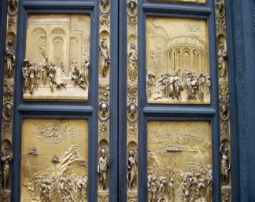
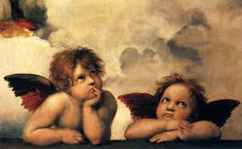
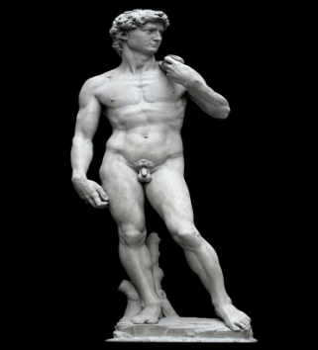
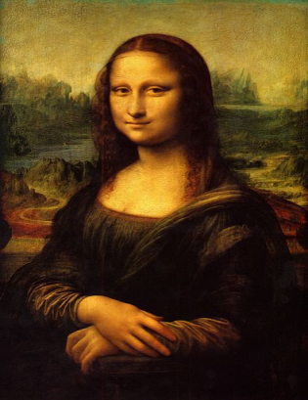
ITALY IS CONSIDERED THE BIRTHPLACE OF WESTERN CIVILISATION AND IS EXTREMLEY RICH IN CULTURE.
ITALY HAS BEEN RESPOSIBLE FOR SOME OF THE MOST IMPORTANT CULTURAL CHANGES IN THE HISTORY OF THE WORLD FROM THE ANCIENT ROMAN EMPIRE AND THE RENAISSANCE TO THE ROMAN CATHOLIC CHURCH.
DURING ITS HISTORY IT GAVE BIRTH TO SEVERAL FAMOUS PEOPLE.
THE MOST FAMOUS PARTS OF ITALIAN CULTURE ARE ITS PAINTINGS, ARCHITECTURE, SCUPTURE, FASHION, MUSIC AND FOOD. OPERA WAS INVENTED IN ITALY.

Slide 6
ITALY IS A LONG BOOT SHAPED PENINSULA IN SOUTHERN EUROPE AND IS SURRONDED BY THE MEDITERRANEAN SEA AND THE ADRIATIC SEA
THE MAJORITY OF ITALYS 60 MILLION POPULATION LIVE IN AND AROUND THE MANI CITIES.
IT IS MAINLY A MOUNTANOUS COUNTRY WITH THE ALPS IN THE NORTH WHICH IS GREEN AND FERTILE TO THE SOUTH WHICH IS HOT AND DRY WITH ACTIVE VOLCANOES AND EARTHQUAKES.
ITALY ALSO INCLUDES 2 LARGE ISLANDS, SCICILY IN THE VERY SOUTH AND SARDINIA THE BIGGEST ISLAND IN THE MEDITERRANEAN SEA.
ITALY ALSO HAS TWO INDEPENDENT COUNTRIES WITHIN ITS BORDERS, THE VATICAN CITY IS THE HOME OF THE CATHOLIC CHURCH IN THE CENTER OF ROME AND SAN MARINO AN INDEPENDENT REPUBLIC.
THE MAIN CITIES ARE ROME THE CAPITAL, MILAN THE CENTRE FOR ITALIAN INDUSTRY, FLORENCE WHICH IS FAMOUS FOR ITS GALLERIES AND ARCHITECTURE AND VENICE AND VENICE WHICH IS BUILT ON A SYSTEM OF CANALS.

Slide 7
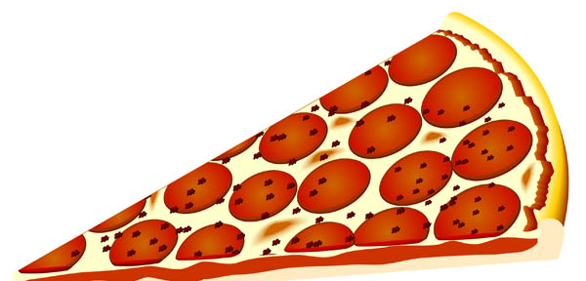
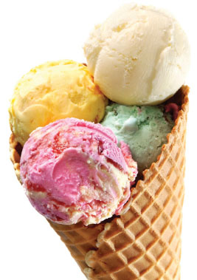
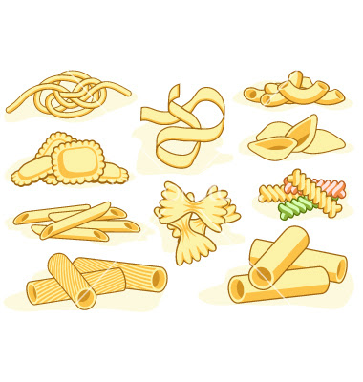
ITALIANS TAKE THEY’RE FOOD VERY SERIOUSLY AND IT IS FAMOUS ALL AROUND THE WORLD.
THE MAIN MEAL OF THE DAY IS LUNCH AND CAN LAST AS LONG AS 4 HOURS.
YOU START A MEAL WITH ANTIPASTI WHICH ARE NIBBLES LIKE OLIVES SALAMI, SALADS AND BREAD, FOLLOWED BY IL PRIMO WHICH IS PASTA, RISOTTO OR SOUP, THEN IL SECONDO WHICH IS MEAT OR FISH, THEN THERE IS FRUIT FOR PUDDING.
PASTA IS THE MOST IMPORTANT FOOD IN ITALY. IT TRANSLATES AS PASTE BECAUSE IT IS A PASTE OF EGGS AND FLOUR OR SOMETIME JUST FLOUR AND WATER. IT CAN BE EITHER FRESH OR DRIED IN A PACKET. THERE ARE HUNDREDS OF DIFFERENT SHAPES AND TYPES OF PAST.
ITALY IS ALSO FAMOUS FOR ITS VARIETIES OF ICE-CREAM OR GELATOS.
THE PIZZA WAS INVENTED IN NAPLES 200 YEARS AGO, IT WAS AT FIRST A DRY, FLAT BREAD AND WAS CONSIDERED FOOD FOR POOR PEOPLE UNTIL QUEEN ‘MARGHERITA’ ASKED FOR SOME TOMATO SAUCE AND CHEESE TO BE ADDED.

Slide 8
Dictionary for food
Pizza :the most famous italian dish, it was invented around 1860.
Calzone :folded up pizza bread filled with tomatoes, Ham,cheese and all kinds of filling.
Pesto : thick green sauce with olives , herbs and olive oil , pine kernals and parmiggiano cheese.
Gelato : ice cream is an italian invention.
Mozzarella : italian cheese balls originally made from buffalo milk.

Slide 9
ITALY HAS WON THE WORLD CUP 4 TIMES .
ONE MAJOR FESTIVAL IN ITALY IS BASED ON VENETIAN MASKS.
ITALIANS DO NOT USE A SPOON WHEN EATING SPAGHETTI .
ALL THE NAMES OF THE TEENAGE MUTANT NINJA TURTELS ARE NAMES OF FAMOUS ARTISTS WHO LIVED IN ITALY .
KINDER IS AN ITALIAN PRODUCT.

Slide 10
My websites
Wiki
Understanding italy
Travel italy
Fun facts for kids italy

Slide 11
Any questions
Does anyone have questions .

