Slide 1
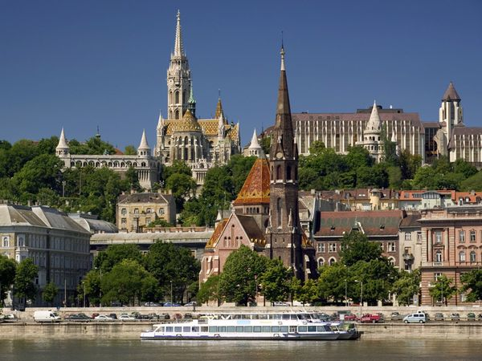
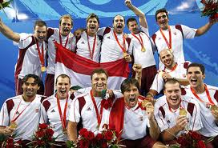
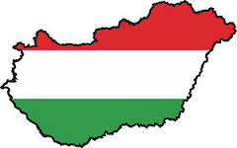
Hungary
BY RACHEL

Slide 2
Contents
Fast facts.
Cities.
Currency.
Sports played in hungary.
Population and tourism.
Food.
Languange
Words in Hungarian.

Slide 3
Fast facts

Slide 4
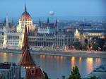
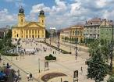
Cities
Budapest is the capital city and largest.
Debrecen is the second largest city and its the regional centre of the northern great plain.
Gyor is the most important city in the northwest of Hungary. It is situated on one of the most important roads of central europe.

Slide 5
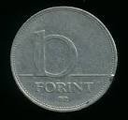
Currency
The Forint is the currency of Hungary It is divided into 100 filler
The introduction of the Forint was on August 1 1946.

Slide 6
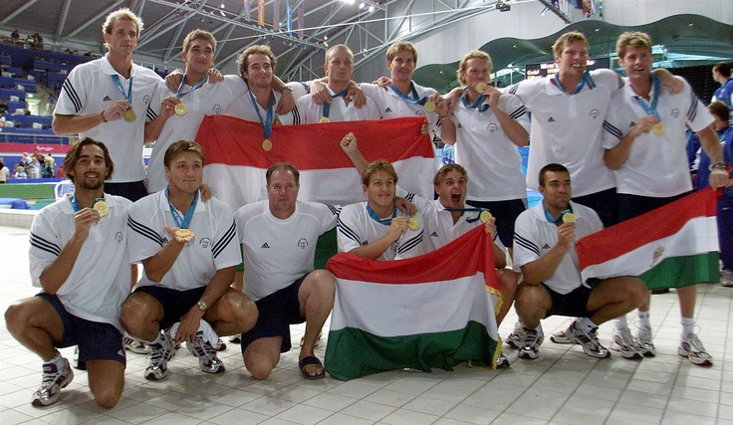
Sports played in Hungary (1)
One of the sports played in Hungary is water polo. The mens water polo team is considered the best in history.
They have won 15 medals at the olympic games.
Hungarys mens water polo team in 2000 in sydney.

Slide 7
Sports played in Hungary (2)
Gymnastics – very popular in Hungary
Ágnes Keleti – top gymnast and coach
She is a Hungarian born Israeli
She won 10 Olympic medals and 5 of them were gold
She is one of the most successful Jewish Athletes of all time

Slide 8
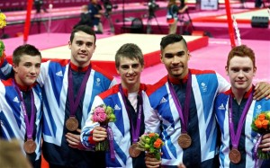
Sports played in Hungary (3)
This is the mens gymnastics team in 2012 at the olympics.
Hungarys gymnastics team in 1966.

Slide 9
Population and Tourism
Around 9.87 million people live in Hungary.
Hungary is popular for its tourists and attracts around 10.2 million tourists.
Unfortunately Hungarys population is decreasing and the majority lives in Budapest.

Slide 10
Food
It is a symbol of the country and can be traced to the 9th century.

Slide 11
Language
Hungarian is the official language of Hungary and one of the 24 official languages of the European Union. Outside Hungary it is also spoken by communities of Hungarian people in neighbouring countries—especially in Romania, Slovakia, Serbia and Ukraine.
Now I am going to show you some words in Hungarian.

Slide 12
Words in Hungarian
Hi: Szia
How are you: Hogyan szeretnél még kipróbálni
Hungary: Magyrosag
Thank you: köszönöm
Your welcome: szívesen

