Slide 1
By Susie

Slide 2
Contents
Population
Language
Flag
Cities
National food
Festivals
Important people
Map
Famous landmarks
EU
And a quiz
Currency

Slide 3
Population
The population of Estonia is almost 1.4 million the real population is 1.3 million also known as 1,315,819.

Slide 4
Language
The official language for Estonia is Estonian here are a few different and common words in Estonian.

Slide 5
vabanda | excuse me
vabandust | sorry
pole viga | no problem
Can 2 people come up and have a conversation
tere | hi, hello
tervist | hello
tere hommikust | good morning
tere päevast | good afternoon
tere õhtust | good evening
tere tulemast | welcome
Jah yes
Ei no
palun please; you're welcome
Aitäh thanks
Tänan thank you
tänan väga thank you very much
head aega | goodbye
head ööd | goodnight
nägemist! | bye, see you!
ilusat päeva! | have a nice day!

Slide 6
Flag
blue to represent the sky above the native land. black to symbolize the soil of the homeland and the fate of Estonians and white for purity, hard work and commitment.

Slide 7
Cities
The capital city of Estonia is Tallinn. Officially, there are slightly over 400,000 people living in Tallinn. Tallinn is very busy and is filled with shops.
Parnu is a little town of 50 000 people in southwest.
Tartu is the second largest city in Estonia and the centre of Southern Estonia .

Slide 8
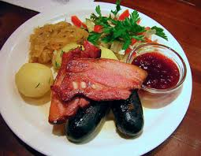
NATIONAL FOOD
The National food of Estonia is Black sausage with oven roasted potatoes, stewed sauerkraut and lingonberry jam. The black sausage is made of fresh pig's blood , smoked bacon ,salt, 2 onions, black pepper and more.

Slide 9
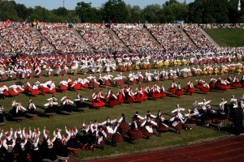
Festivals
Laulupidu Estonia Song and Dance Celebration is in July . the first song celebration took place in 1869 and the first dance celebration took place in 1934. This festival is to thank the peoples ancestors for there history they have made .
The national day 24 February is the day Estonia got independence from Russia.

Slide 10
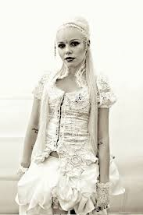
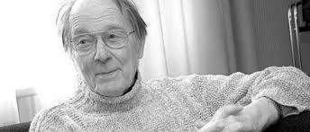
Important people
Jaan Kross is an Estonian writer his work has been made into 20 different languages. He was a poet and he was born on the 19th of February 1920 and he died on the 27th December 2007 he died when he was at the age of 87.
Kerli Kõiv is a famous singer. she was born in Estonia but lives in another country and sings in English not Estonian. She was born on February 7th 1987 she’s age 28. Kerli Kõiv is mostly popular In Estonia

Slide 11
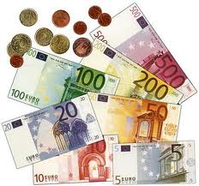
Currency
The currency of Estonia is Estonian kroon's but you may also use euro’s.

Slide 12
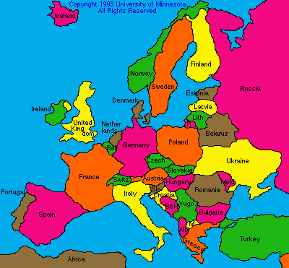
Map
Who can find Estonia

Slide 13
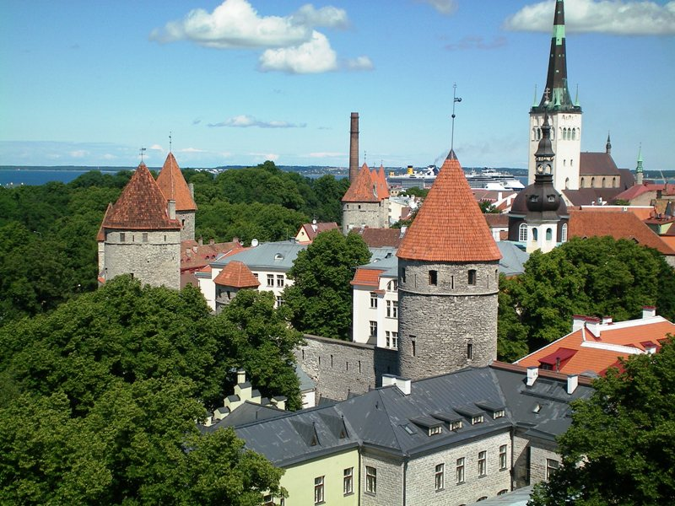
Famous landmarks
This is were the people of Estonia had wars that they have won so people like to come because of all the old cannons and weapons that they used for the war.
Tallinn Old City

Slide 14
EU
Estonia joined the Eu in 2004 along with 7 other places Cyprus, the Czech Republic, Hungary, Latvia, Lithuania, Malta, Poland, Slovakia, and Slovenia.

Slide 15
Some quick facts
Almost 50% of Estonia is covered by forest.
The total size of Estonia is 45,226 squared kilometres.
Estonia has land borders in the other two places with Russia to the east and with Latvia to the south.
Estonia invented a new sport or game which is for kids to swing on monkey bars and try and see who can leap the furthest.

Slide 16
Quiz
Q. What place is on the south to Estonia on the map.
A . Latvia
Q. Where is Parnu
Southwest
East
northwest
Southwest
Q. How do you say hello or hi in Estonian
A. Tere

Slide 17
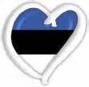
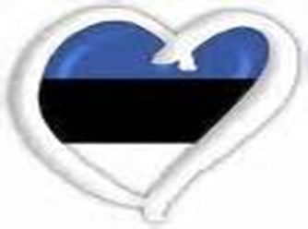

Slide 18
Any questions

