Slide 1
Higher Revision Slides
Dr Stephen - March 2017

Slide 2
Unit 1 : Rates of Reaction Collision Theory
For a chemical reaction to take place, particles must collide with: - Energy greater than or equal to the activation energy.
- The correct collision geometry.

Slide 3
Unit 1 : Rates of Reaction
Factors which increase the rate of reaction are:
Increase Temperature
Increase Concentration
Decrease Particle Size (increase surface area)
Use of a catalyst

Slide 4
Increase in Temperature
For collisions to be successful they need to have sufficient energy. Increasing the temperature increases the energy of the particles, allowing for more successful collisions.

Slide 5
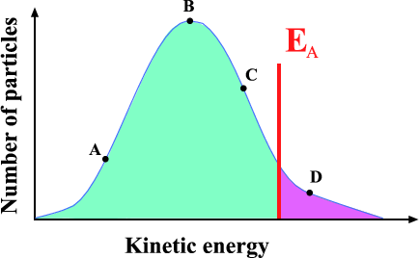
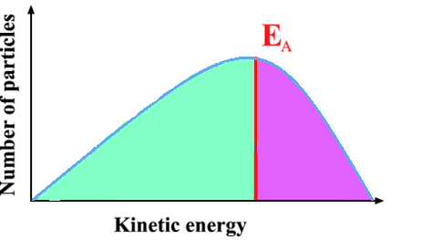
Increase in Temperature
At lower temperatures, few particles have energy greater than E_{A}.
At higher temperatures, the curve shifts to the right. More particles now have sufficient energy for a successful collision

Slide 6
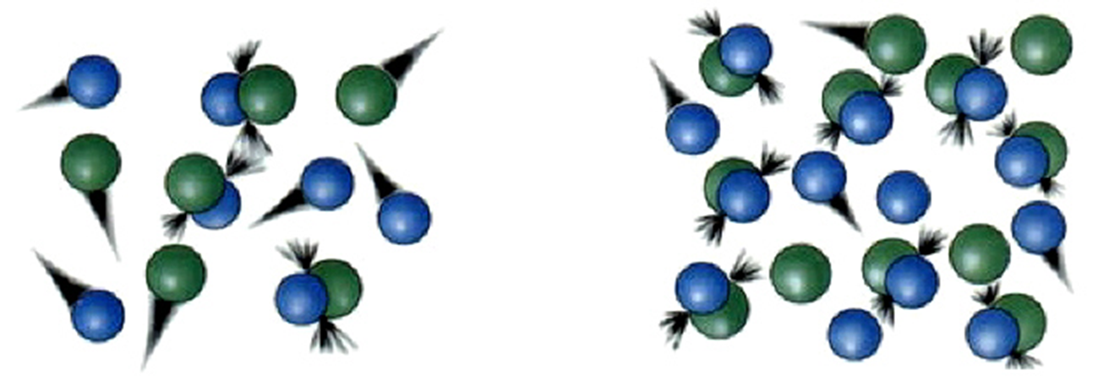
Increase in Concentration
As you increase the number of particles in a given volume, you increase the concentration.
Increasing concentration moves the particles closer together and make it more likely that they will collide.
More collisions = more successful collisions = faster rate of reaction.

Slide 7
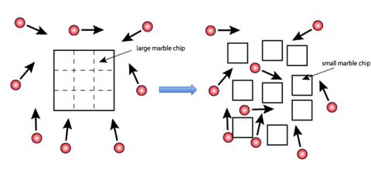
Decrease in Particle Size (increase in surface area)
Chemical reactions happen at the surface. If a particle is broken up into smaller particles, there is more surface available to react on.
The greater the surface area, the greater the number of collisions, the greater the number of successful collisions, the faster the rate.

Slide 8
Reaction Pathway
∆ H = products – reactants.
If ∆ H is negative, the reaction is EXOTHERMIC.
If ∆ H is positive, the reaction is ENDOTHERMIC.
E_{a}
E_{a}
+ΔH
Enthalpy
Enthalpy
-H

Slide 9
Activated Complex
Not all collisions are successful. Particles must have sufficient energy (activation energy, E_{A}) in order to make the ACTIVATED COMPLEX.

Slide 10
Use of a catalyst
Catalysts allow us to LOWER THE ACTIVATION ENERGY of a reaction.
By doing this, catalysts speed up a chemical reaction.
Catalysts are not used up in this process.
Uncatalysed
Catalysed
75 -
60 -
50 -
Reactants
P.E.
25 -
Products
Reaction path

