Slide 1
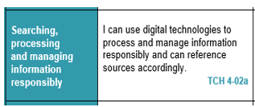
Digital Literacy – Lesson Focus

Slide 2
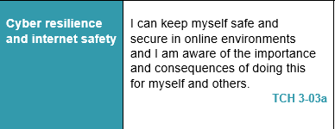
Digital Literacy – Lesson Focus

Slide 3
PUPIL PROJECT
You are now going to create one of the following –
PowerPoint
Poster using word
Physical poster
Your chosen item must be useful for other pupils and contain accurate and detailed information (you may use your notes)
You will have a maximum of 45 minutes to complete this.
You will then get feedback from another pupil identifying at least one thing that is good and two things that can be improved.
You will have 20 minutes to make these changes.
Each product will be presented to the class and the class will VOTE for the best.

Slide 4
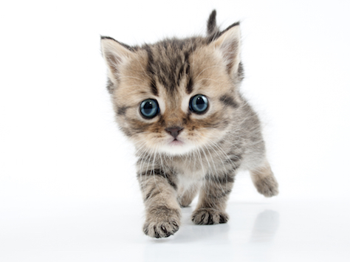
PUPIL VOICE
Last task
Now complete the lesson 5 Pupil voice worksheet

