Slide 1
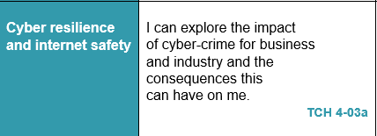
Digital Literacy – Lesson Focus

Slide 2
SAFE DISPOSAL

Slide 3
SAFE DISPOSAL
RESEARCH TASK
Look at each of the suggested websites and create a report at least three paragraphs long outlining the correct way to dispose of devices/computers.
https://www.getsafeonline.org/information-security/computer-and-mobile-disposal/
https://www.wired.com/story/gadget-disposal-safe-secure/
Please note - you will be using this resource later, so please spell-check and take your time to produce high quality work.
Print these notes with your name on it and hand them into the teacher.

