Slide 1
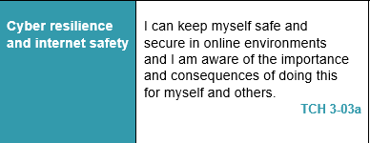
Digital Literacy – Lesson Focus

Slide 2
STRONG PASSWORDS
Strategies

Slide 3
STRONG PASSWORDS
The Importance of Password Security
https://www.youtube.com/watch?v=FdmRgaNn2p0
Avoid Weak Passwords
https://www.youtube.com/watch?v=w0HTnLs3ZSs
Strong Passwords (Stereotypes)
https://www.youtube.com/watch?v=9LxdtaSvQ3I
https://edition.cnn.com/2019/04/22/uk/most-common-passwords-scli-gbr-intl/index.html
3.08 mins
1.35 mins
1.46 mins

Slide 4
PASSWORD MANAGERS
How Do Password Managers Work?
https://www.youtube.com/watch?v=DI72oBhMgWs
Top 5 Best FREE Password Managers
https://www.youtube.com/watch?v=Huq3qj5W3b0
Up to 5.10 mins
5.30 mins

Slide 5
Task 1
Complete Pupil Worksheet - Password Strength Checker using the following websites
https://www.teamviewer.com/en/best-password-security/
https://password.kaspersky.com/
20 minutes
Now complete Pupil Feedback 1 (on the Worksheet 1)

