Slide 1
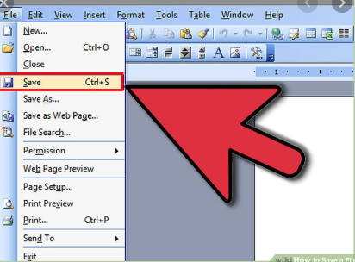
Good Practice/Advice
File Saving Strategies

Slide 2
File Saving Strategies
Numbers
Scenario
Imagine you are working on a Word document and every so often you Save it.
Can you identify any problems this approach might have?
Click to remove
The computer crashes and the file is damaged (which means everything is lost)
You open up another document and it asks you to save and you click on the other file name and overwrite your old work.

Slide 3
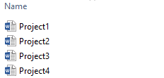
File Saving Strategies
Numbers
Even if you save a file at regular intervals there can be problems.
Numbers Technique
When saving a file use Save As
When saving a file add a number and increase it by one when you use the Save As.
For example

Slide 4
File Saving Strategies
Numbers
Can you identify any benefits of using this approach?
Click to remove
If your file is damaged or if you overwrite the file you have only lost a small amount of work, if saving every 5 minutes then you have lost only 5 minutes worth of work.
Can you identify any disadvantages of using this approach?
Click to remove
It will take up more file space but most of the work you do in school will be using relatively small files, so it shouldn’t be a problem.

Slide 5
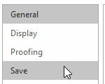
File Saving Strategies
Autosave
Most applications have an Autosave feature. Before you start any work you should make sure it is turned on.
For Microsoft Word
To turn on Autosave
Go to then then
Make sure the checkboxes are set – you can also set the time the application will wait before making a backup
Click to remove

Slide 6
File Saving Strategies
Automatic
By default it will save to the C drive of your computer but you can change this by using the Browse button

Slide 7
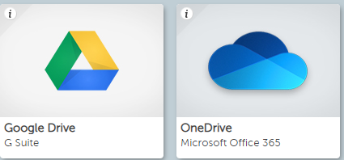
File Saving Strategies
Others
Using Glow, all pupils have Google Drive and One Drive access.
To make a backup you can drag and drop your saved file into the relevant browser window.
There are apps you can download to help with this process but these can only be used with your home Computer/Devices.

Slide 8
Task 1
At the end of our four Cyber Security lessons there will be a pupil project.
20 minutes
SUMMARY NOTES
Think about today’s lesson. Identify what information would be useful to other pupils.
Using the information you think is important, create a Word document with at least two paragraphs – remember to save it with any new techniques you wish to use.
Please note - you will be using this resource later, so please spell-check and take your time to produce high quality work.
Print these notes with your name on it and hand them into the teacher.

