Slide 1
Social Networking

Slide 2
Pupil Voice
Complete
Feedback 8 in the Lesson 3 - Pupil Voice Worksheet
I think …
I think …

Slide 3
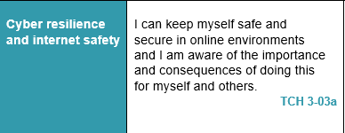
Digital Literacy – Lesson Focus

Slide 4
Security Risks - Social Networking
What is Social Networking?

Slide 5
Video Internet Safety
14.22 mins

Slide 6
Class Discussion on Contents of Video
I think this …
5-10 mins
I think this …
We think this …

Slide 7
Security Risks - Social Networking
Dangers you can face while social networking are:
Stalking
Identity theft
Catfishing
1. Stalking: - People often post detailed and specific information on Facebook including phone numbers, addresses and social plans. In doing so you can be more easily stalked by strangers or even acquaintances.

Slide 8
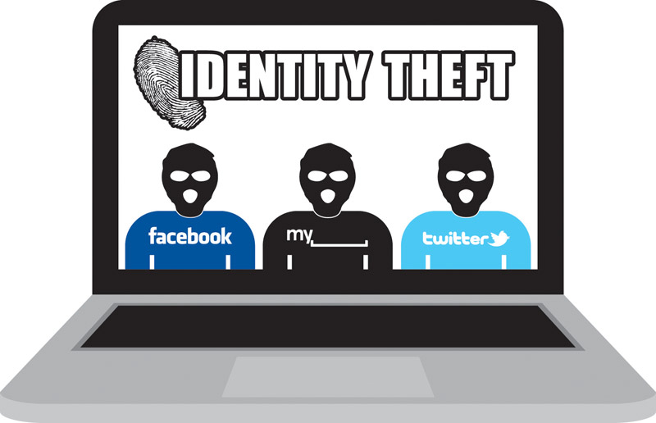
Security Risks - Social Networking
2. Identity Theft:-
Information posted on Social Media that can be used by Identity thieves include :-
Full name,
Names of your family members
Phone number
Birthday
Address
Relationship status
Passport-style profile photos
Place of employment
Identity thieves use this information to replicate your online presence and potentially for criminal purposes.

Slide 9
Security Risks - Catfishing
3. Catfishing:- Occurs when a user creates a false or highly
exaggerated profile for the purposes of conducting a
relationship online. Some profiles are created to exact revenge,
blackmail or cause embarrassment.

Slide 10
Security Precautions - Anti Catfishing Tips
1. Inability to contact the other party "in person" they will not
Use Skype or SnapChat, they will not or cannot meet you in public despite the seriousness of your relationship.
2. Google search by image in order to determine whether the
photos you've received are legitimate and authentic.
3. Details of their personal life consistently change or their life
story seems unbelievable or outlandish.
If the relationship becomes too intense, they may develop a life
threatening illness, or face another threat to their "life" that could terminate the relationship. Your best resource is your instinct for the truth, and to keep track of variations in their stories.

Slide 11
Security Precautions – Top tips for safer social networking
If you use social networks always think about who can see the things you post and what they reveal about you.
Know who your friends are
Share with care
Use privacy settings
Know how to report
Know how to get help

Slide 12
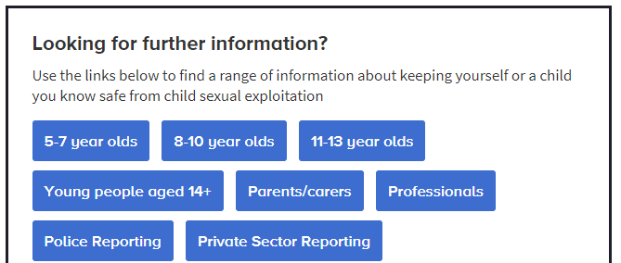
How to report Abuse ?
Pupil Task : Explore the content of the website:- Children Exploitation and Online Protection
https://www.ceop.police.uk/safety-centre/
Select the link appropriate for your age
10 mins
Notes:
Let the pupils visit the web site so they can become familiar with it

Slide 13
Personal Risks - Who will target you on Social Network sites
In 2013 a organized crime gang used a scam where they befriended and tricked victims into making explicit webcam recordings and then blackmailing them.
The gang would get acquainted with victims by setting up online accounts with social networking sites, whilst posing as attractive American women.
After a successful exchange of online chat conversations, they invite and entice their would-be victims to use video calls and this would be recorded, unknown to the victim.

Slide 14
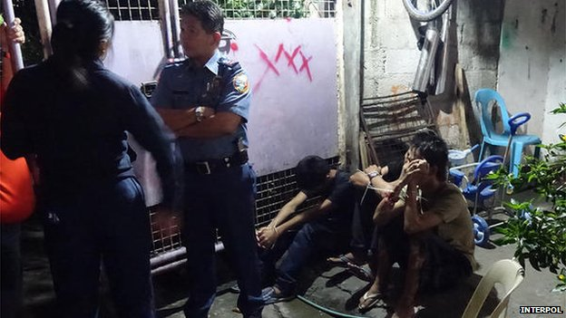
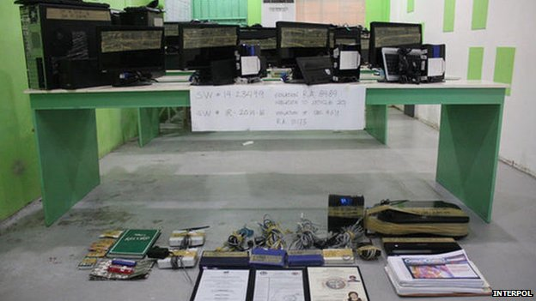
Personal Risks - Who will target you on Social Network sites
The gang that carried out these attacks where from Philippines. They targeted young people all over the world including US, Hong Kong, Singapore, Australia and Scotland.
Organized crime gangs are targeting social networking sites as they can make more money through identity theft and blackmail than selling drugs.
Police arrested 58 members of the gang. Video Link
10.00 mins
Notes:
You need to scroll down past the article and pictures to click on the video link.

Slide 15
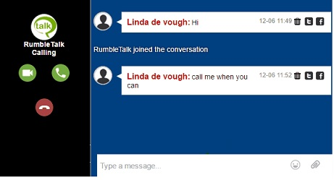
Personal Risks - Chat-rooms
What is a chat-room?
Chat-rooms are used to share information via text with a group of other users.
have conversations with multiple people at the same.
usually connected via a shared interest. e.g. Football team or computer game.

Slide 16
Personal Risks - Dangers of Chat-rooms
Dangers you may face while using chat-rooms are :
Grooming
Bullying
If you want to use a chat-room make sure it has a moderator – someone who makes sure the chat is relevant and that the environment is safe for all users.

Slide 17
Personal Risks -Cyberbullying
Cyberbullying takes place on social websites or through mobile phones.
It can happen 24 hours a day, seven days a week causing the victim to feel trapped and unable to escape.
Children may be bullied by someone they know or someone using a fake account to remain anonymous.

Slide 18
Personal Risks - Cyberbullying
Cyberbullying is a growing problem on social networking sites.
One social networking site has admitted that allowing users to stay anonymous can cause "problems and issues".
The site's been linked to several teen suicides in the UK and abroad and has also been criticised for not taking cyber-bullying seriously.
In one case bullies made an account pretending to be a user’s mum and posted, 'Oh go kill yourself, I'll buy the pills for you to do it'.

Slide 19
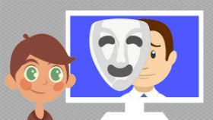
Personal Risks - Grooming
What is Grooming?
Grooming is when an adult uses social networking websites to get to know a young person and gain their trust.
The adult will eventually try to meet the young person to carry out some type of illegal activity often of a sexual nature.

Slide 20
Personal Precautions - Anti-grooming tips
Know who your friends are.
Share with care.
Use privacy settings.
Know how to report.
Know how to get help.
Only join chat-rooms with a moderator.

Slide 21
Pupil Voice
Complete
Feedback 9, 10, 11 and 12 in the Lesson 3 - Pupil Voice Worksheet
I think …
I think …

Slide 22
Task 1 – share your knowledge
Create a Poster (Word or physical) that will warn people of the dangers of Social Media.
When you have finished ask at least two people to give you feedback on two good things and two things that can be improved.
If required, update your work to reflect the feedback.

