Slide 1
How to Search Smart

Slide 2
Pupil Voice
Complete
Feedback 5 in the Lesson 2 - Pupil Voice Worksheet
I think …
I think …

Slide 3
Digital Literacy – Lesson Focus

Slide 4
Digital Literacy – Lesson Focus

Slide 5
Learning Objectives
Learning Objectives
Understand how search engines work
Understand some tools to “search smarter” – improve our search results by reducing search results and increasing their relevance.
Lesson Outcomes
To explain how a search engine works.
To try out some advanced tools and see how they improve our search results.

Slide 6
Important
Literacy – Key Words
Index | Another name for a database of websites.
Boolean Operators | ‘AND’ ‘OR’ ‘NOT’ logic statements used to improve database searches.
Relevance | How close the information matches what you were looking for.

Slide 7
Question
When you go to a Search Engine such as Google and type in your search term what do you think happens on the Google side of things to find the item(s) you are looking for?

Slide 8
How the Google search engine works:
3.14 mins

Slide 9
Summary
Google has a big database (index) containing millions of web addresses
Each web address has a list of words and the number of times they appear in the site.
So when you search the web, you are not actually searching the web. You are searching the google database.
You are finding all the websites which contain the word(s) you have searched for.

Slide 10
Search Results
Results point to 4.93 billion websites

Slide 11
30 Trillion Web Pages Tracked By Google
So we have just seen that there are billions of websites listed on Google’s Database.
Searching for the 1 website we need can be a difficult job.
But there some advanced techniques that we can use….lets learn the tips!

Slide 12
Advanced Search Tips
Using Boolean Operators
You can use Boolean operators…
…(special words and symbols)…
…to drill down and find the information you need.
AND
OR
Quotes
“ ”
Minus Sign

Slide 13
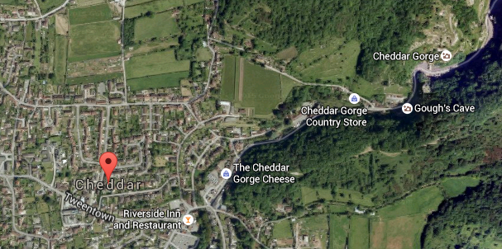
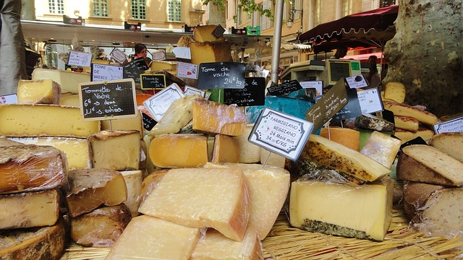
What happens if we type CHEDDAR CHEESE into Google?
?
Do we get what we want?
Or do we get lots of unwanted websites as well?

Slide 14
Normal Google Search
Key Words: Cheddar Cheese
Cheddar
Cheese
Ignores websites that just have the word CHEDDAR
Ignores websites that just have the word CHEESE
Finds websites containing the words CHEDDAR and CHEESE but not necessarily together

Slide 15
Advanced Google Search
Key Words: Cheddar OR Cheese
Cheddar
Cheese
Finds websites that just have the word CHEDDAR
Finds websites that just have the word CHEESE
Finds websites containing the words CHEDDAR and CHEESE but not necessarily together

Slide 16
Advanced Google Search
Key Words: Cheddar -Cheese
Cheddar
Cheese
Finds websites that just have the word CHEDDAR
Ignores websites that just have the word CHEESE
Ignores the sites that have the word CHEDDAR and CHEESE in them

Slide 17
Advanced Google Search
Key Words: “Cheddar Cheese”
Will display the sites that have the phrase CHEDDAR CHEESE.

Slide 18
Task 1
15 minutes
Complete
Lesson-2- Task 1- Searching Smart - Pupil Worksheet

Slide 19
Video Google Advanced Search
6.16 mins

Slide 20
Why do we use Boolean Operators?
Question

Slide 21
Task 2 – share your knowledge
Create a Poster (physical or in Word) that will help people understand how to use Boolean Operators.
When you have finished, ask at least two people to give you feedback on two good things and two things that can be improved. If required, update your work to reflect the feedback.
The teacher will narrow all the submissions down to the best four – the class will then vote for the overall winner.

Slide 22
Pupil Voice
Complete
Feedback 6 and Feedback 7 in the Lesson 2 - Pupil Voice Worksheet
I think …
I think …

