Slide 1
Maidenhill Primary School and Nursery Class
Parent Information Evenings- August 30 and September 1 2022

Slide 2
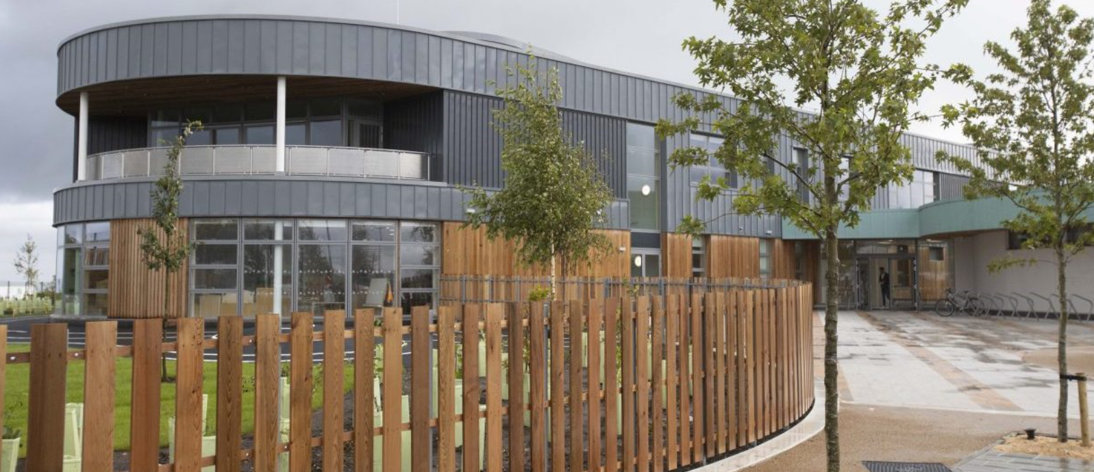
Welcome!
School: 0141 570 7090
schoolmail@maidenhill.e-renfrew.sch.uk

Slide 3
Learning Now and Forever

Slide 4
The story so far……..
2019-2020- The Year of 2 Halves
August 2019- 80 children P1-5
2020-2021- Restrictions, Recovery and Reassurance
August 2020- 160 children P1-7
2021-2022- So Much Promise, So Many Absences
August 2021- 300 children P1-7
2022-2023- ?
August 2022- 380 children P1-7

Slide 5
Where are we now?
Quality Indicator | School Self-Evaluation
Leadership of Change | Very good
Learning, Teaching and Assessment | Good
Ensuring Wellbeing, Equity and Inclusion | Good
Securing Children’s Progress/ Raising Attainment and Achievement | Good

Slide 6
Curriculum for Excellence Levels:
Primary One
Reading | Writing | Talking & Listening | Numeracy & Mathematics
96% | 96% | 100% | 98%
Primary Four
Reading | Writing | Talking & Listening | Numeracy & Mathematics
97% | 97% | 97% | 97%
Primary Seven
Reading | Writing | Talking & Listening | Numeracy & Mathematics
100% | 100% | 100% | 97%

Slide 7
East Renfrewshire Standardised Testing
 | Reading | Numeracy and Mathematics
P3 | 102 | 100
P5 | 100 | 103
P7 | 97 | 102

Slide 8
Improvement Plan Priorities 2022-2023
To improve attainment and achievement through enhanced opportunities for parental and family engagement in children’s learning and development
To ensure excellence in learning, teaching and assessment by building the capacity of our practitioners
To design and implement a curriculum that meets the needs of all learners

Slide 9
How will we know we are successful?
What will we do?
How will we do it?
Parents and families report that they know how best to support their children’s attainment, achievement and wellbeing. Attainment and achievement data continues to improve.
We will improve attainment and achievement through enhanced opportunities for parental engagement in children’s learning and development.
By formulating a clear Parental Engagement Policy and resuming a calendar of parental engagement events.
By enhancing online communication.
By continuing to establish Family Centred Approaches in the school and nursery class.

Slide 10
What will we do?
How will we know we are successful?
How will we do it?
We will ensure excellence in learning, teaching and assessment by building the capacity of our practitioners.
By creating further opportunities for practitioners to reflect on professional standards and pedagogy through dialogue, forums, moderation, data analysis and shared professional learning.
By facilitating opportunities for all practitioners to engage in and share collaborative enquiry.
Practitioners report increased confidence in all areas of learning, teaching and assessment and this is reinforced by whole school self-evaluation data.

Slide 11
How will we do it?
How will we know we are successful?
What will we do?
By forming practitioner working groups to take forward curriculum design in Numeracy and Mathematics, Literacy and Language, Expressive Arts and child-led learning.
By creating a curriculum forum to allow children to contribute to curriculum design.
By embedding the principles of Universal Curriculum Design.
Practitioners report increased confidence in designing a curriculum that meets the needs of all learners. Learners report increased confidence in leading learning at class and whole-school level.
We will design and implement a curriculum that meets the needs of all learners.

