Slide 1
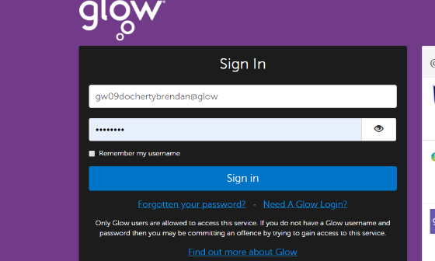
Logging in to Glow
Maidenhill Test
gw20testmaidenhill
Your child has had time to practise logging in to Glow and Google Classroom in school and should remember the process and their password. It is essential that your child is able to remember their password for glow, as they will use these login details to access Glow when in school.
All Glow usernames start with gw and your child has been issued with a card sharing their username information.
If you are unable to find the webpage please use a search engine, such as Google, to search for:
‘Glow sign in RM’.
You can also download the Google Classroom App to a number of tablets/ devices. Your child can log in to the app using their Glow username followed by @er.glow.scot. For example,
gw20testmaidenhill@er.glow.scot
Recovering Glow Passwords
2
1
3
If your child has forgotten their password, please follow the steps above to reset it, or contact the school via schoolmail.
schoolmail@maidenhill.e-renfrew.sch.uk

Slide 2
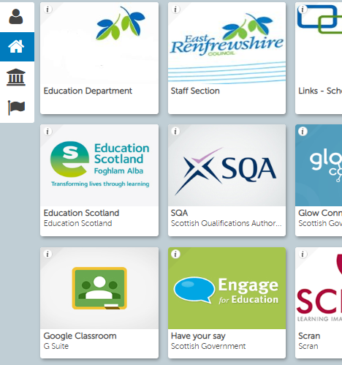
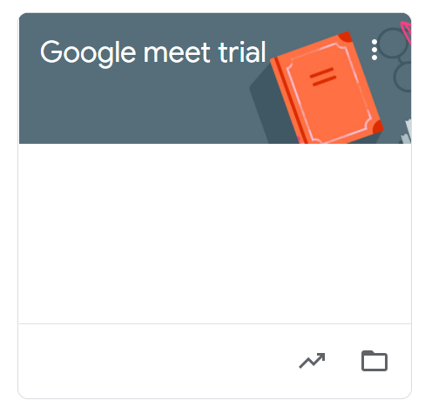
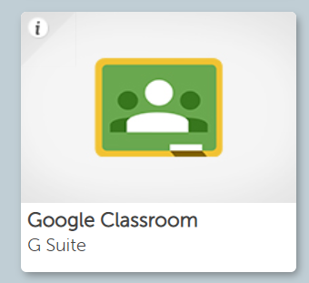
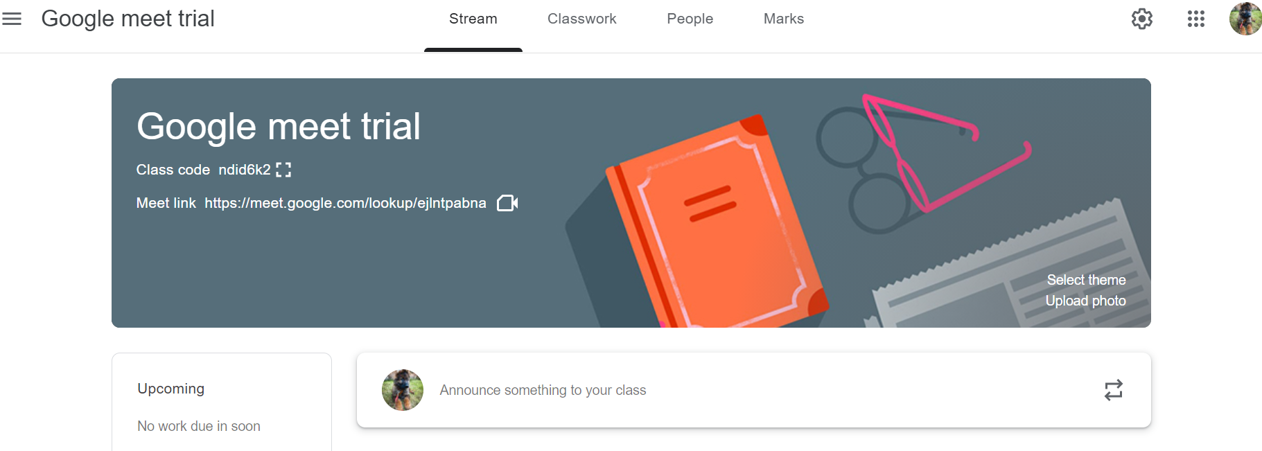
Accessing Google Classroom
The Google Classroom tile can be found on your child’s Launch Pad.
Once your child has clicked on the Google Classroom tab, they will be taken to a page where the classes they are a member of are shown.
When your child clicks in to their class, they will see page that looks similar to this:
The ‘Stream’ tab shows your child the latest updates from their class teacher, including announcements for upcoming meetings.
The ‘Classwork’ tab allows your child to access specific tasks set by their class teacher.

Slide 3
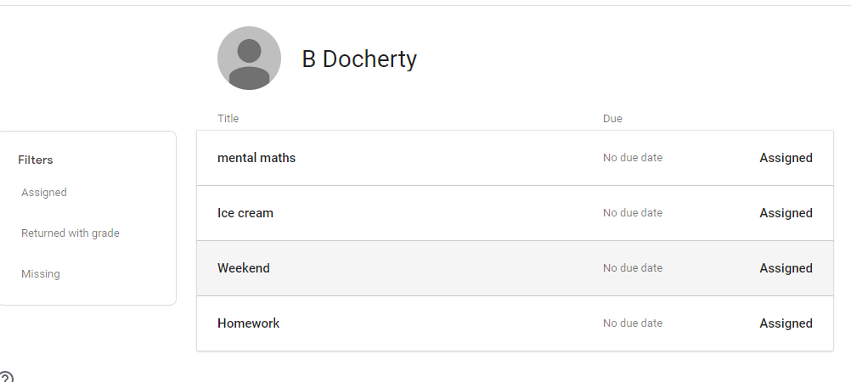
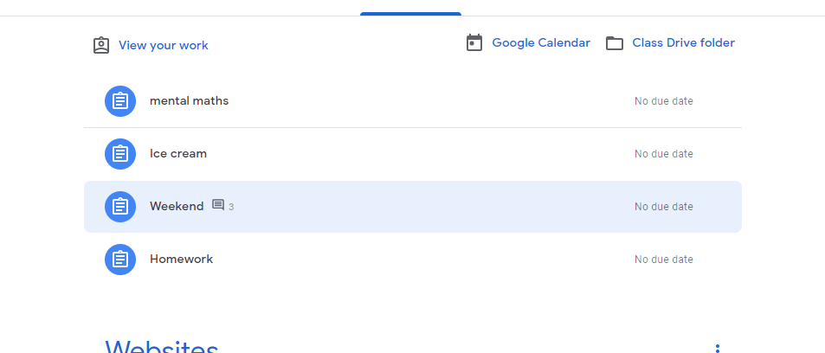
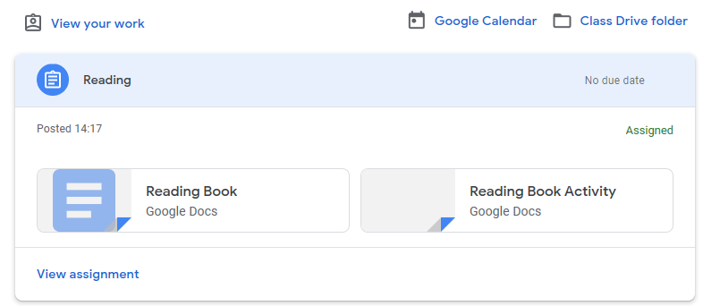
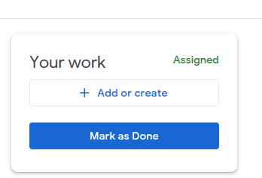
1
Completing Specific Tasks on Google Classroom
Once your child has clicked on ‘View your work’, they will be able to access tasks set by their teacher.
2
They will be able to select any task they have been assigned.
3
When your child clicks on the piece of work, the document will open.
All documents save automatically and your child’s teacher will be able to identify their work.
Your child will be able to open more than one document at a time and can move between activities using the tabs in the task bar.
4
Once your child has completed the assigned task, they can return it to their teacher using either the ‘TURN IN’ or ‘MARK AS DONE’ button on the top right of the document.

Slide 4
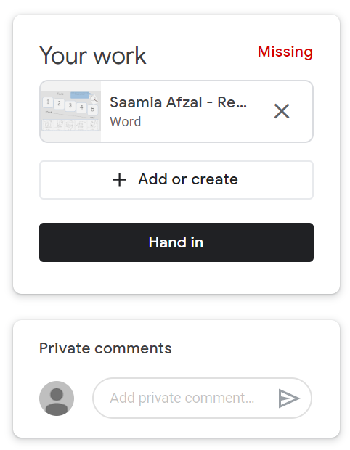
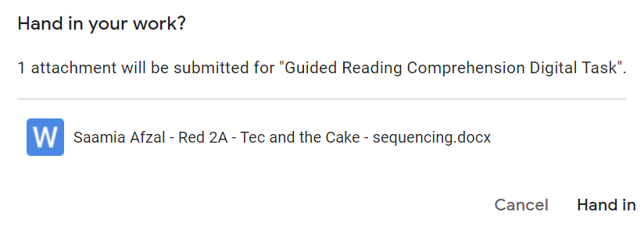
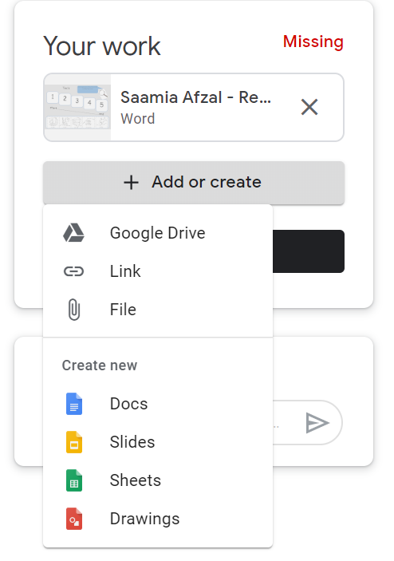
Submitting Online Learning via Google Classroom
2
1
To help us track your child’s online learning experiences, they should ‘Hand in’ all activities they have completed; including practical tasks and online games.
Once your child has engaged with an activity, either online or away from the screen, they should return to the assignment in the Classwork tab and follow the steps above; this will ensure that your child’s teacher can identify any work they have finished.
Sharing Additional Information
Although not necessary, it is possible for your child to upload additional information alongside their completed target. This may be a photograph of a model they have built, a picture they have drawn or work they have completed in a workbook or jotter. This information can be uploaded using the steps below; however, please do note, this is not a requirement for any task set by your child’s teacher.
1
Once you have clicked on ‘File’ you will be able to select an image from your device to upload.
2

Slide 5
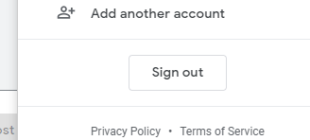
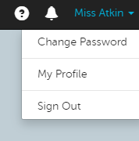
Logging Out of Glow
1
Google
Classroom
Glow
Additional Information
We hope that our school will remain open for the duration of this academic session. However, in the unfortunate event of a school closure, we will use Google Classroom as the platform for remote learning. Further guidance will be released if this does indeed, happen again.

