Slide 1
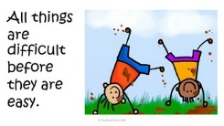
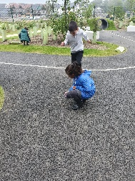
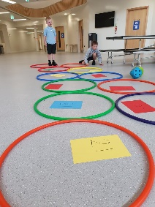
What a fabulous start to P3! We are all so glad to be back learning together in class. We are having a particular focus on Growth Mindset to establish a positive attitude to learning and making mistakes from the very beginning of the school year. We read “The Girl Who Never Makes Mistakes” and “I Can’t Do That Yet.” This helped us come up with some positive statements about our learning.
Primary 3
We have been having a particular focus on outdoor learning this term. We loved making some outdoor equations using loose parts, for example, sticks and stones. Please ensure your child has appropriate outdoor clothing to make their outdoor experience as fun as possible!
Our PE days will be Tuesday, Wednesday and Thursday. This will take place outdoors so warm clothing please! This can be kept in school. So far we have been working on football skills, focusing on passing and dribbling.
We have also been hard at work completing our Maths and Literacy targets too. We have been focusing on asking ‘robot’ (literal) questions from our reading books. In Maths we have been doing some times tables and we have brushing up on our adding/subtracting!
Keep up to date with what we are up to in class on Twitter at @MaidenhillP3

