Slide 1
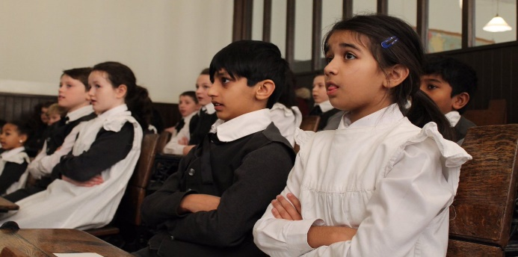
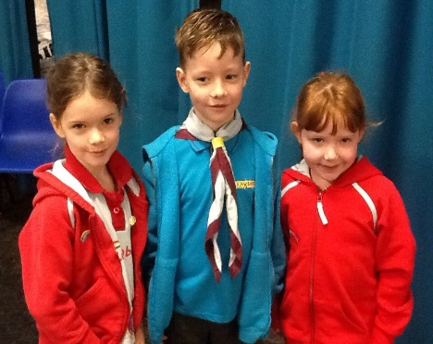
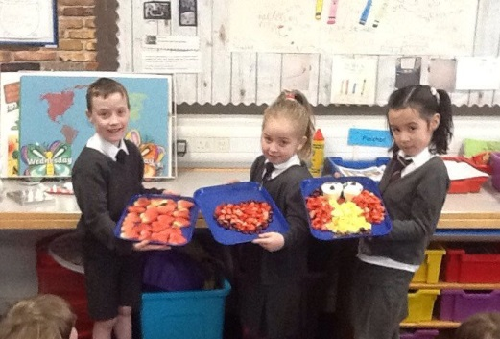
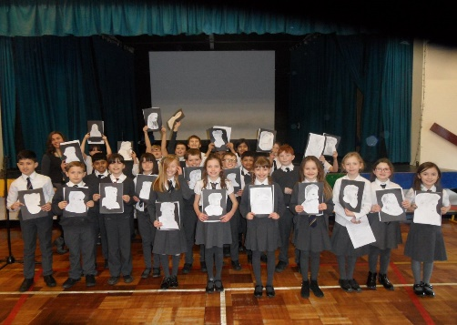
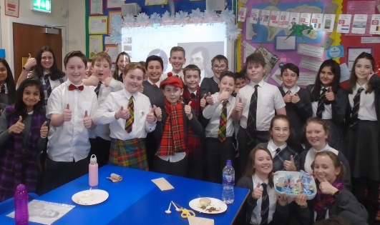
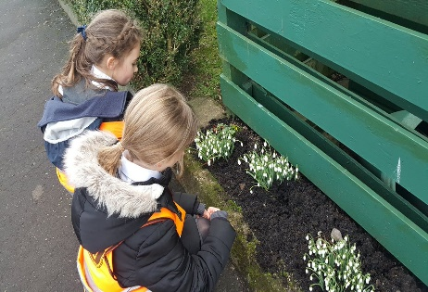
Meet The Teacher
Kirkhill Primary School
Thursday 5 September 2019
Everyone Attaining, Everyone Achieving through Excellent Experiences

Slide 2
Our Revised Vision and Values
At Kirkhill we are #PROUD of our school community. Everyone is encouraged to be creative, strive for excellence and be inspired to attain, achieve and be their best.
At Kirkhill we are #PROUD and empowered to demonstrate our values of;
Perseverance
Resilience and Respect
Optimism
Unity
Diversity
Everyone Attaining, Everyone Achieving through Excellent Experiences

Slide 3
Literacy and English
Phonics – single sounds, songs and actions for each sound
Common words
Rhyme
Focus on letter formation
‘Red counter’ activities in class – independent task
Teacher led task
Everyone Attaining, Everyone Achieving through Excellent Experiences

Slide 4
Numeracy and Mathematics
Number recognition
Ordering and sequencing numbers
Games to reinforce learning
‘Blue counter’ activities in class – independent task
Teacher led task
Everyone Attaining, Everyone Achieving through Excellent Experiences

Slide 5
Health and Wellbeing
PE - Games – Monday
PE - Fitness – Thursday
Mental/Social/Emotional Health – Bounceback/Circle Time activities
Weekly assembly – share achievements
GIRFEC
Everyone Attaining, Everyone Achieving through Excellent Experiences

Slide 6
Other Curricular Areas
Social Studies – child led
Science – The Human Body
Drama – Christmas Nativity Show
Art – Exploring materials, colour, shape
ICT – Learning to use class tablets
RME – Christian stories
Technology – Junk modelling
Everyone Attaining, Everyone Achieving through Excellent Experiences

Slide 7
Homework
Phonics – focus on formation, using actions to rehearse sounds
Reading – CVCs and blending
Numeracy – number songs, number recognition, sequencing and ordering
Homework will be issued through our class blog on a Monday. If you have trouble accessing homework online or would like a paper copy please contact the Office and we can arrange for paper copies to be sent home.
Everyone Attaining, Everyone Achieving through Excellent Experiences

Slide 8
How you can help…
Please remind your child to:-
Please ensure all items of clothing are clearly named
Help foster independence by encouraging your child to dress themselves, fasten and unfasten own buttons, etc.
Please ensure morning snacks are small enough to be eaten within a 15 minute break time
Discuss lunch options with your child if ordering a school lunch
Everyone Attaining, Everyone Achieving through Excellent Experiences

Slide 9
How Will We Keep You Informed?
Sharing our Learning
Twitter @KirkhillPS
Class blogs
Termly overview
Snapshot jotters
Curricular events
Communication
Twitter @KirkhillPS
Friday Bundle
Monthly newsletter
School website
Everyone Attaining, Everyone Achieving through Excellent Experiences

