Slide 1
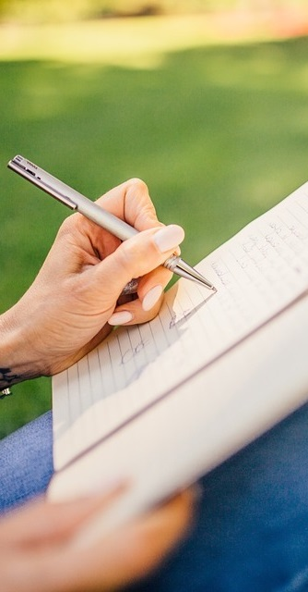
Primary 2b Homework
Week Beginning: Monday 16th March 2020
Outdoor Learning Day
Monday
Curricular Area | Tasks
 | Please complete any three activities on the Maths Homework Grid. Put a dot in the box after you have completed the task.
G | Spelling: Choose an activity from your spelling menu to help you learn your words. I have popped a jotter into homework folders for spelling games ☺ Common words – Mrs, school, more Reading Reading book sent home, please use the back pages to support your child with their reading.
hoo | Could you please ensure that homework folders are returned on a Friday (or last day of school week if it is a holiday weekend). This allows homework to be organised for the next week. Also, please ensure reading books are kept safe in these folders and are returned at the same time on a Friday. Many thanks ☺
Numeracy &
Mathematics
Spelling Words
In homework folders ☺
Literacy
& English
Other/
Reminders
Your education should help you use and develop your talents and abilities.
It should also help you learn to live peacefully, protect the environment and respect other people. (UNCRC: Article 29)

