Slide 1
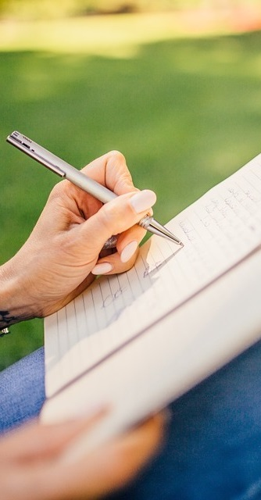
Primary 2b Homework
Week Beginning: Monday 9th March 2020
Curricular Area | Tasks
 | Please complete any three activities on the Maths Homework Grid. Put a dot in the box after you have completed the task.
 | Spelling: Choose an activity from your spelling menu to help you learn your words. I have popped a jotter into homework folders for spelling games ☺ Common words – time, life, line Reading Reading book sent home, please use the back pages to support your child with their reading.
 | Thank you to everyone for looking for their plastic folder! I have now made sure everyone has one to keep their homework safe. Many thanks ☺
Outdoor Learning Day
Monday
Numeracy &
Mathematics
Spelling Words
In homework folder ☺
Literacy
& English
Other/
Reminders
Your education should help you use and develop your talents and abilities.
It should also help you learn to live peacefully, protect the environment and respect other people. (UNCRC: Article 29)

