Slide 1
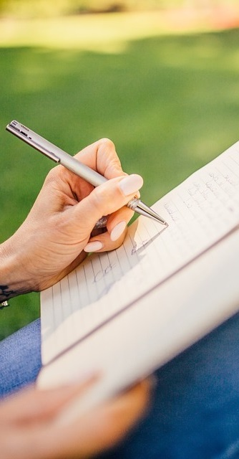
Primary 2b Homework
Week Beginning: Monday 13th January 2020
Curricular Area | Tasks
 | Symmetry Before the Christmas holidays we were learning about Symmetry. Look for shapes and objects around the house or outside that are symmetrical. Use a mirror to find lines of symmetry. Draw some of the shapes you find and add in the line of symmetry.
 | Spelling: Choose an activity from your spelling menu to help you learn your words. Common words – what, many, soon, book Reading Reading book sent home, please use the back pages to support your child with their reading. If you have any additional books from previous weeks at home please send these into school.
 | Just a wee reminder that our Outdoor Learning Day is on a Monday. Outdoor Learning clothing items/wellies can be brought in on this day and will be returned home at the end of the day.
Outdoor Learning Day
Monday
Numeracy &
Mathematics
Spelling Words
ew drew flew chew grew threw blew Chill Challenge knew nephew cashew
Literacy
& English
Other/
Reminders
Your education should help you use and develop your talents and abilities.
It should also help you learn to live peacefully, protect the environment and respect other people. (UNCRC: Article 29)

