Slide 1
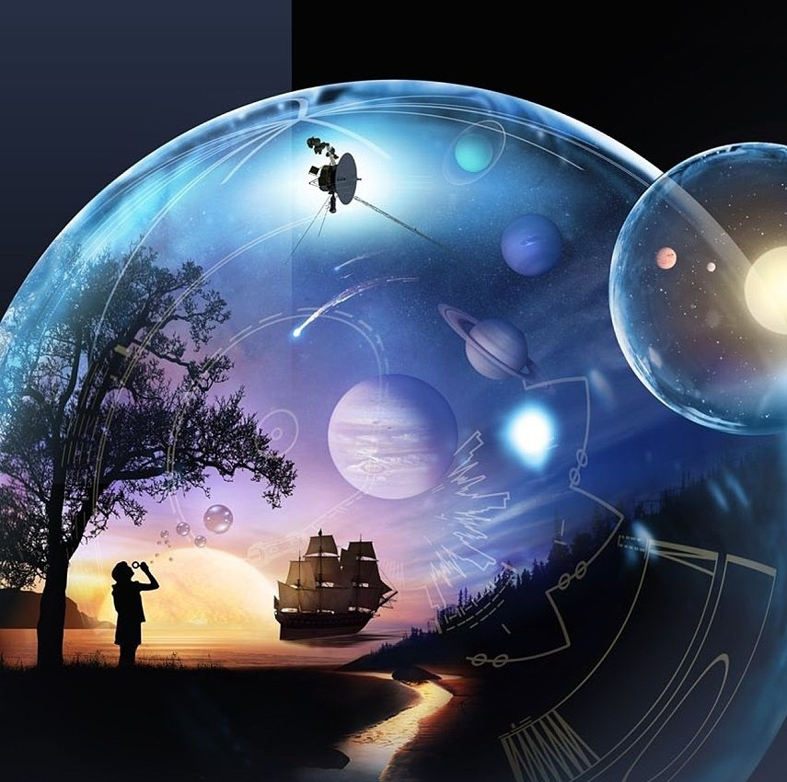
Primary 2b Homework
Week Beginning: Monday 4th November 2019
Curricular Area | Tasks
 | Two week homework – Due in on Friday 15th November Topic – Dinosaurs Over the next two weeks I would like you to complete a mini research project, finding out about our class topic, The Dinosaurs. In class so far we have been learning about the different types of dinosaurs, when they lived on a timeline and learning about fossils. Your mini research project can be about anything to do with our topic and you can choose which way to present your information – a dinosaur fact-file, a poster about fossils or a leaflet with writing and pictures (just some ideas, its completely up to you what you choose to create!) ☺ Reading books will continue to go home.
Your education should help you use and develop your talents and abilities.
It should also help you learn to live peacefully, protect the environment and respect other people. (UNCRC: Article 29)

