Slide 1
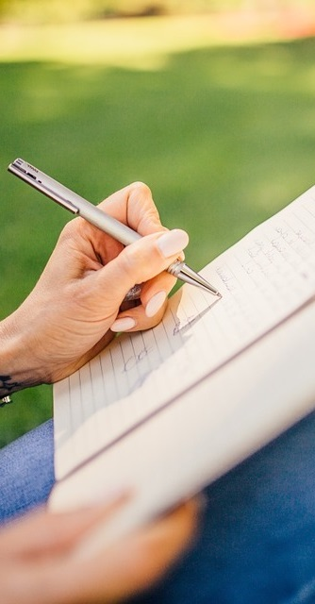
Primary 2b Homework
Week Beginning: Monday 2nd September 2019
Curricular Area | Tasks
 | Please practice your number bonds to 20 to develop fast recall. e.g. 5+4=9, 6+7=13 Here are links to some games: www.topmarks.co.uk/maths-games/hit-the-button www.ictgames.com/saveTheWhale/index.html
 | Spelling: The spelling words this week are a revision from Primary One. sh, ch and th Choose an activity from your spelling menu to help you learn your words.
 | I am looking forward to meeting you on Thursday at Meet the Teacher! Please bring in a painting apron/shirt if you have not already done so.
PE Days
Thursdays Fridays
Numeracy &
Mathematics
Spelling Words
ship sharp dish fresh chop chest chin such thin three with think
Literacy
& English
Other/
Reminders
Your education should help you use and develop your talents and abilities.
It should also help you learn to live peacefully, protect the environment and respect other people. (UNCRC: Article 29)

