Slide 1
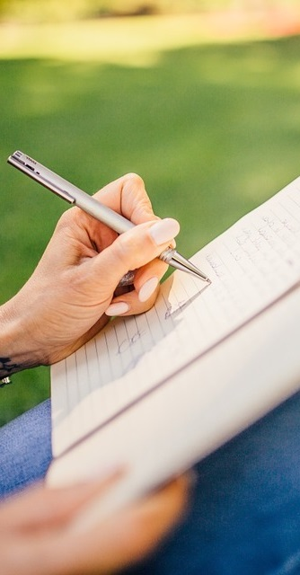
Primary 2a Homework
Week Beginning: Monday 24th February 2020
Curricular Area | Tasks
 | Please complete a different lot of three activities from the Maths Homework Grid. Put a dot in the box after you have completed the task.
 | Spelling: Choose an activity from your spelling menu to help you learn your words. Common words – who, after, hand, right Reading Reading book sent home, please use the back pages to support your child with their reading. If you have any additional books from previous weeks at home please send these into school.
 | Please ensure if children take their PE kit home for any reason that it comes back into school. On PE days (Tuesday, Thursday) please ensure if jewellery is worn, your child can remove it. Thanks for your help.
Outdoor Learning Day
Monday
Numeracy &
Mathematics
Spelling Words
high right thigh bright might light Chill Challenge frighten midnight delight
Literacy
& English
Other/
Reminders
Your education should help you use and develop your talents and abilities.
It should also help you learn to live peacefully, protect the environment and respect other people. (UNCRC: Article 29)

