Slide 1
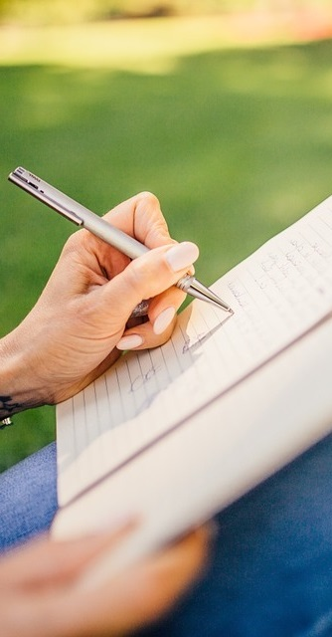
Primary 2a Homework
Week Beginning: Monday 3rd February 2020
Curricular Area | Tasks
 | Money – Some ideas for you to try. Putting the coins/notes in order of value. Totalling amounts of money. Calculating change from 10p, 20p, 30p, 50p and then a £1. Play ‘shops’ using real money. Real life context – Go shopping and use money yourself to buy items.
 | Spelling: Choose an activity from your spelling menu to help you learn your words. Common words – how, where, now, too Reading Reading book sent home, please use the back pages to support your child with their reading. If you have any additional books from previous weeks at home please send these into school.
 | This homework is up until Friday 14th February 2020. Our Indoor PE slot has changed and will now be a Tuesday. Please could you send in a wet weather activity for your child if you have not already done so. An activity book, colouring book or a pad of paper for them to draw on is fine.
Outdoor Learning Day
Monday
Numeracy &
Mathematics
Spelling Words
ow brown growl now crown allow Chill Challenge powder howling flower
Literacy
& English
Other/
Reminders
Your education should help you use and develop your talents and abilities.
It should also help you learn to live peacefully, protect the environment and respect other people. (UNCRC: Article 29)

