Slide 1
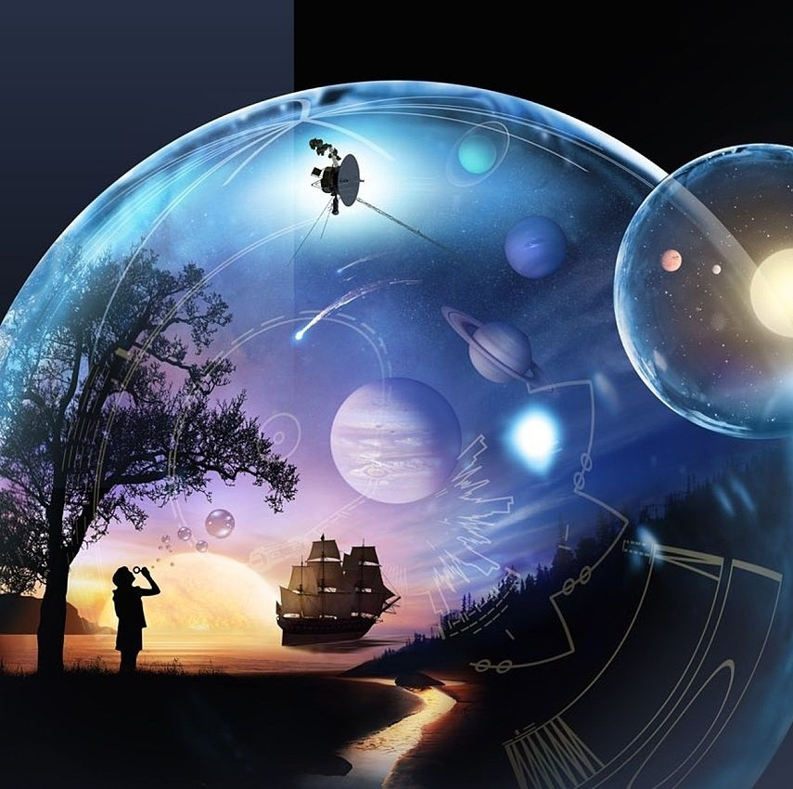
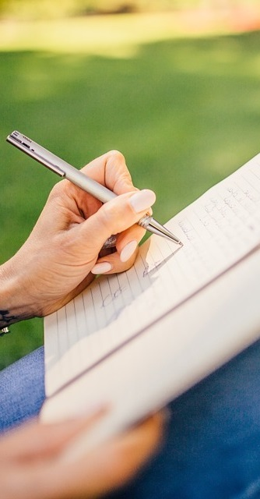
Primary 2a Homework
Week Beginning: Monday 26th August 2019
Curricular Area | Tasks
 | ‘Getting to Know You’: For homework this week, please (if possible) bring in a photo of you with your family or pets. Be prepared to tell us about your family and/or pets. We would also like to learn a little bit more about you. Please prepare a short 1 or 2 minute talk about yourself. You may wish to include: What are your hobbies? Do you go to any clubs? Do you have any special talents? What are your favourite subjects in school? Who are your close friends? Reminders: Please bring in a PE Kit if you haven’t already done so: blogs.glowscotland.org.uk/er/Kirkhill/preparing-for-school/uniform Please provide your child with a labelled painting apron (or an old shirt/t-shirt) for use within the class. Homework will in future be posted on our Class Blog on a Monday: blogs.glowscotland.org.uk/er/kirkhill25a
PE Days
Thursdays Fridays
Numeracy &
Mathematics
Class Blog
blogs.glowscotland.org.uk/er/kirkhill25a See here for updates from our class!
Literacy
& English
Other/
Reminders
Your education should help you use and develop your talents and abilities.
It should also help you learn to live peacefully, protect the environment and respect other people. (UNCRC: Article 29)

