Slide 1
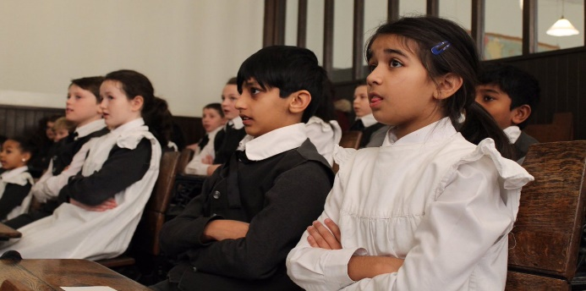
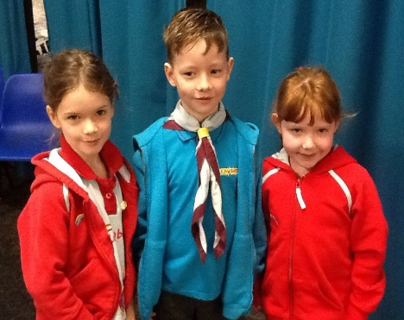
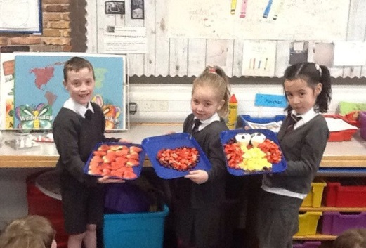
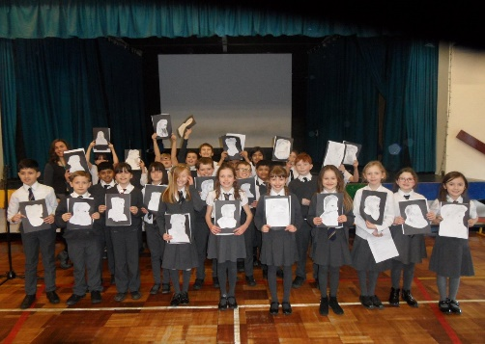
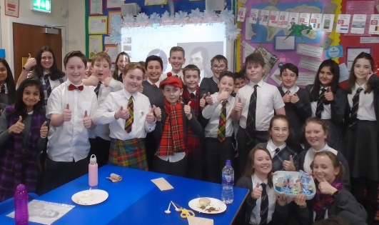
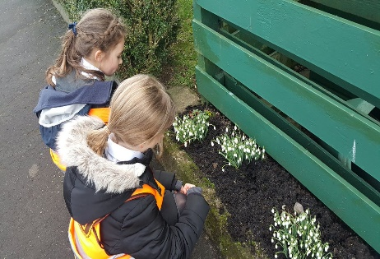
Meet The Teacher
Kirkhill Primary School
Thursday 5 September 2019
Everyone Attaining, Everyone Achieving through Excellent Experiences

Slide 2
Our Revised Vision and Values
At Kirkhill we are #PROUD of our school community. Everyone is encouraged to be creative, strive for excellence and be inspired to attain, achieve and be their best.
At Kirkhill we are #PROUD and empowered to demonstrate our values of;
Perseverance
Resilience and Respect
Optimism
Unity
Diversity
Everyone Attaining, Everyone Achieving through Excellent Experiences

Slide 3
Literacy and English
Spelling – daily. Assessment on Friday
Handwriting
Grammar - weekly
Big Writing – Thurs P3b1, Wed P3b2
Talking and listening - Ongoing
Everyone Attaining, Everyone Achieving through Excellent Experiences

Slide 4
Numeracy and Mathematics
Interactive Oral Mental Mathematics
Introducing the Lesson
Direct Interactive Teaching
The Plenary Session
Games to reinforce learning
Online resources such as Education City
Everyone Attaining, Everyone Achieving through Excellent Experiences

Slide 5
Health and Wellbeing
PE - Games – Monday (outdoor)
PE - Fitness – Wednesday (indoor)
Mental/Social/Emotional Health – Bounceback/Mindfulness
Weekly assembly – share achievements
GIRFEC
Everyone Attaining, Everyone Achieving through Excellent Experiences

Slide 6
Other Curricular Areas
Social Studies – Plastic Warriors
Science – Food Chains
Art – IDL/Topic related
ICT - Graphics
RME – Places of Worship
Technology – Craft Design – Topic Related
Everyone Attaining, Everyone Achieving through Excellent Experiences

Slide 7
Homework
Spelling - Weekly (issued on an Monday for Friday)
Reading - Weekly
Mental Maths - Weekly (Monday to Thursday)
Other Research/Curricular Area – Roughly Twice a Term
Everyone Attaining, Everyone Achieving through Excellent Experiences

Slide 8
How you can help…
Please remind your child to:-
Prepare all homework to a high standard and ask an adult to check and sign homework
Undertake reading homework with an adult
Ensure they bring PE kit on correct days
Put homework into school bag
Return letters on time
Ensure they have all equipment e.g. pencils/reading glasses etc.
Ensure they have a full water bottle on arrival each morning
Everyone Attaining, Everyone Achieving through Excellent Experiences

Slide 9
How Will We Keep You Informed?
Sharing our Learning
Twitter @KirkhillPS
Class blogs
Termly overview
Snapshot jotters
Curricular events
Communication
Twitter @KirkhillPS
Friday Bundle
Monthly newsletter
School website
Everyone Attaining, Everyone Achieving through Excellent Experiences

