Slide 1
The presentation can only be copied or altered for non-commercial personal or educational use.
© Citizenship Foundation Charity Reg No 801360 Author: M. Heath www.gogivers.org

Slide 2
Using Go-Givers lessons
This PowerPoint is designed to inform, and to support critical thinking and discussion.
Go-Givers PowerPoints can be used in their entirety OR content can be saved and edited.
In order for the links and animation to work, always show the PowerPoints in ‘slide show’ view.
The green dot in the bottom right hand corner of the slide indicates when the slide animation is complete.
More information about using PowerPoint can be found here
The LEARNING ACTIVITIES are an essential and integral part of this lesson. They are linked at the end of this PowerPoint.

Slide 3
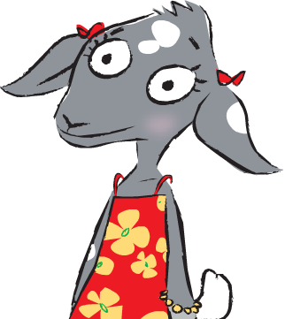
In this lesson we will learn about how we can help to make our community a caring community.

Slide 4
Caring for our Community

Slide 5
What kind of community would you like to belong to?

Slide 6
A
Caring

Slide 7
How do people show that they care?

Slide 8
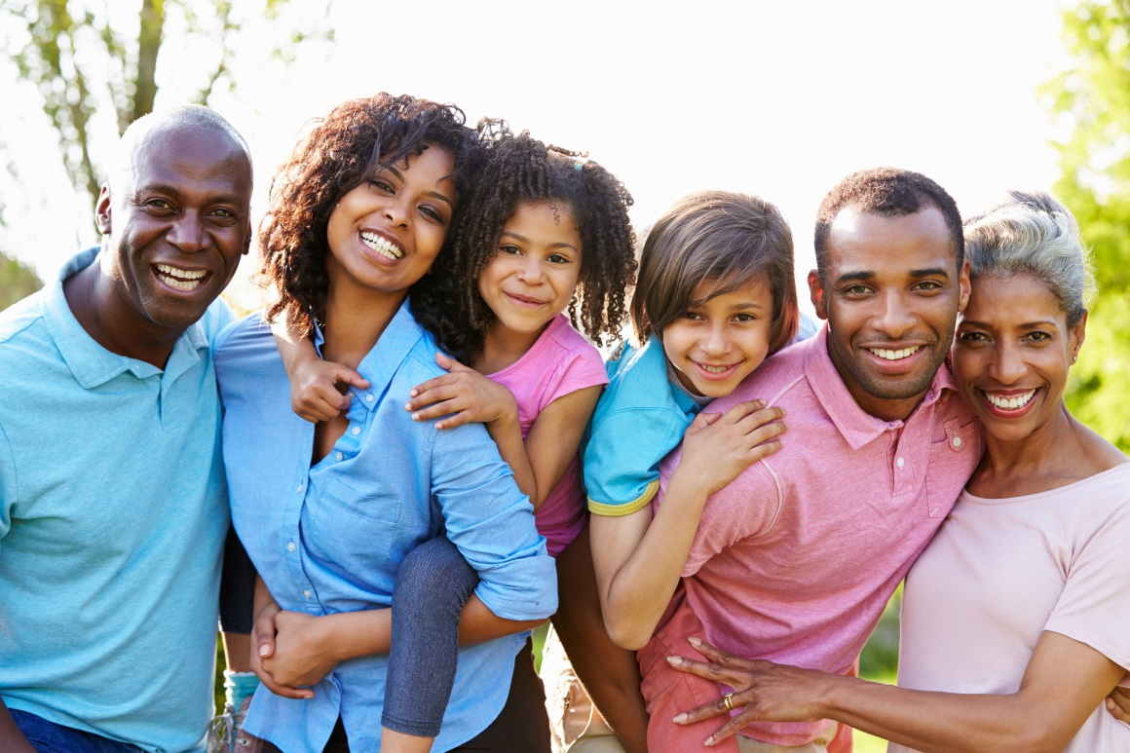
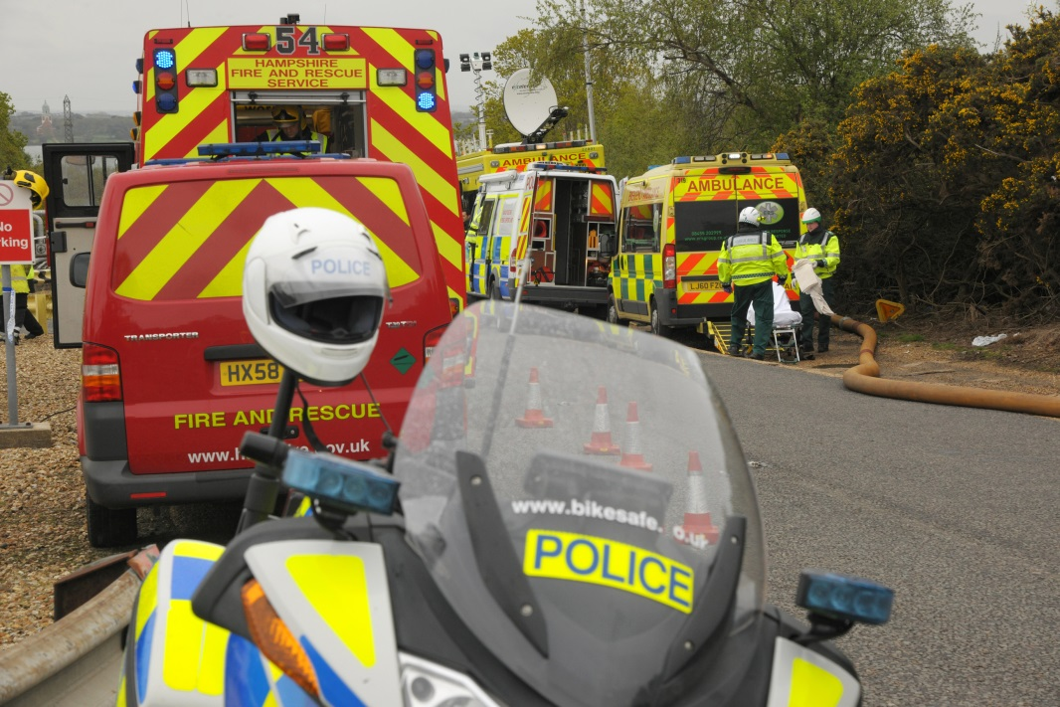
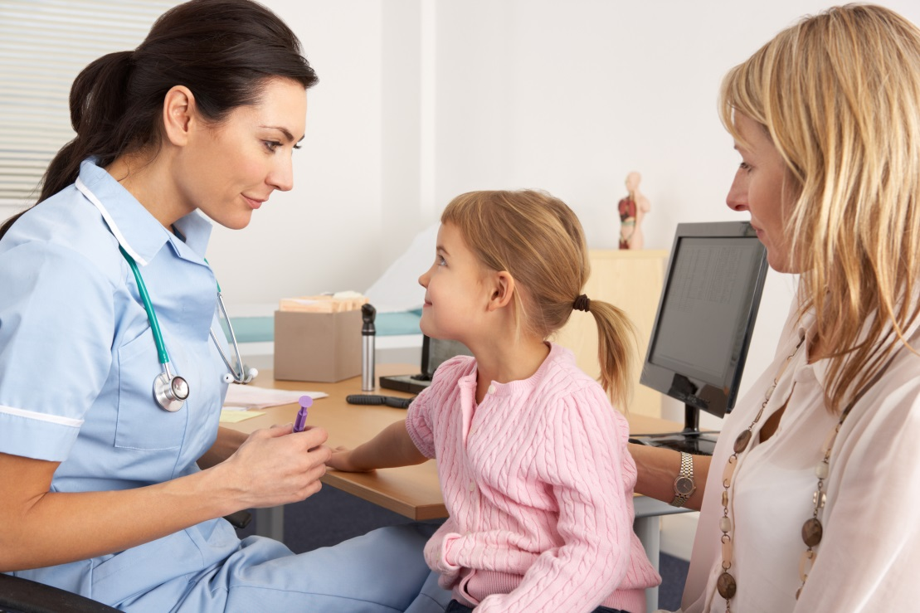
Who cares for you in your community?

Slide 9
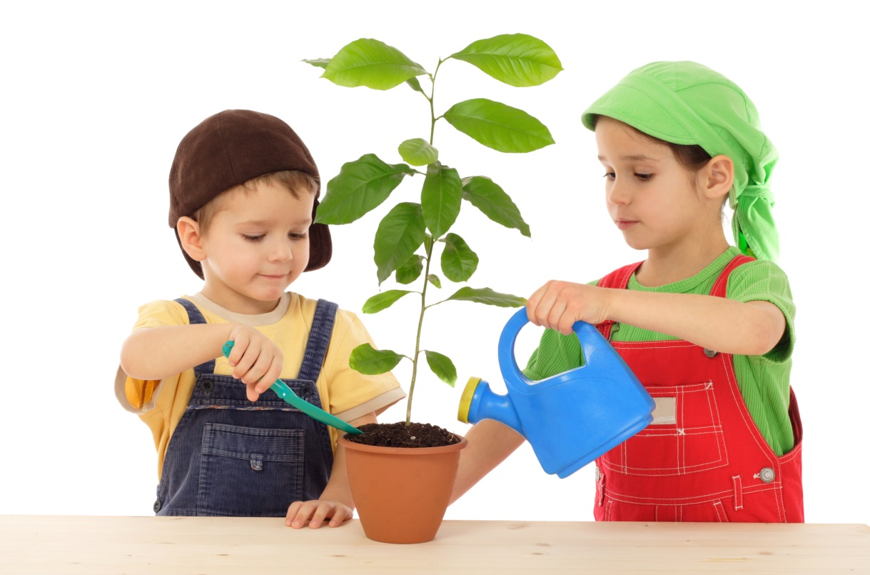
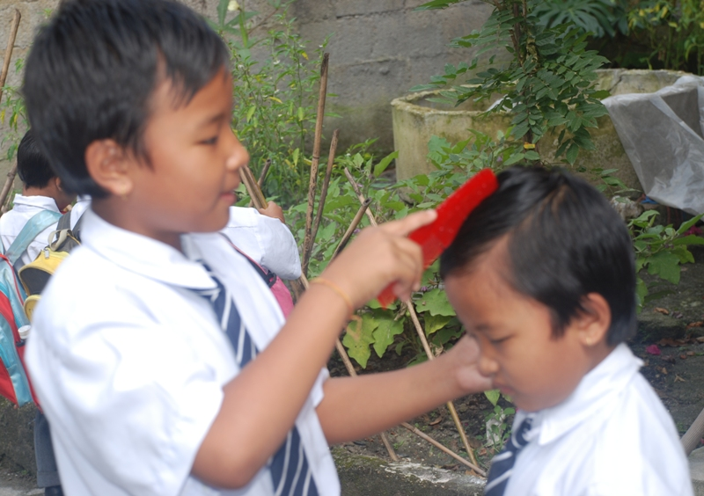
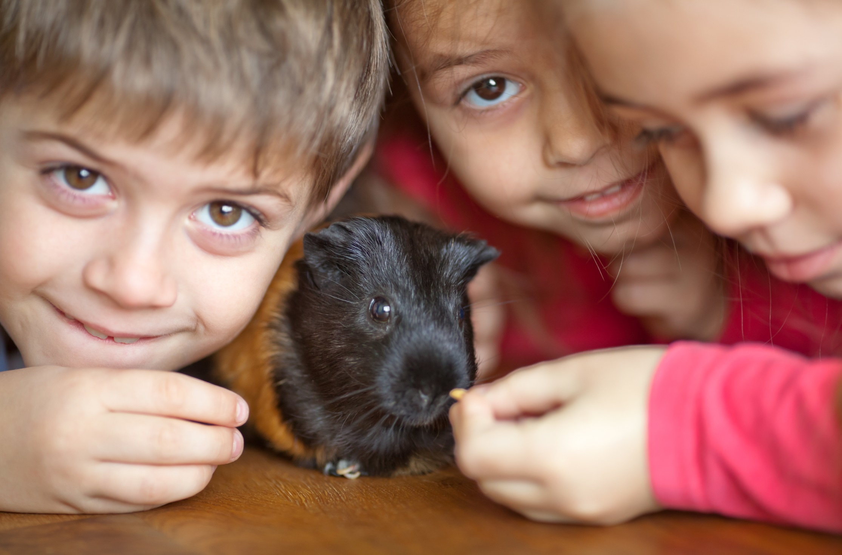
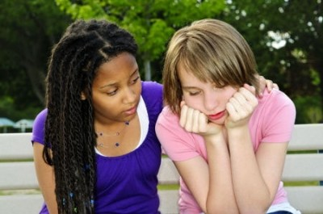
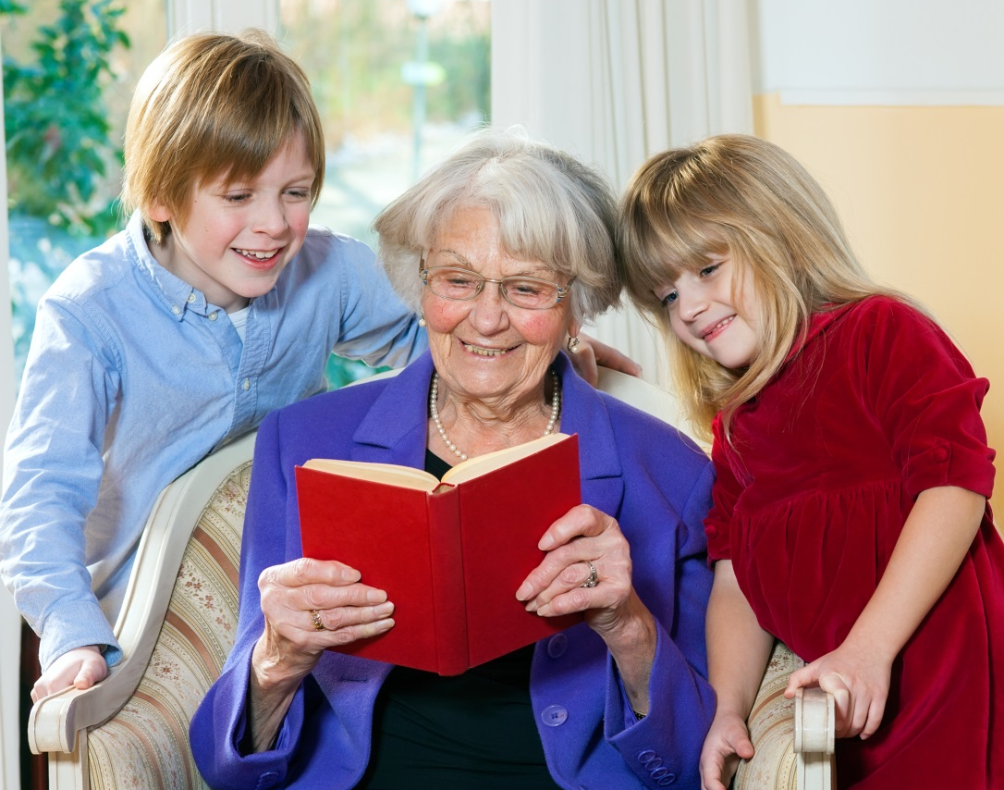
Who or what do YOU care for?

Slide 10
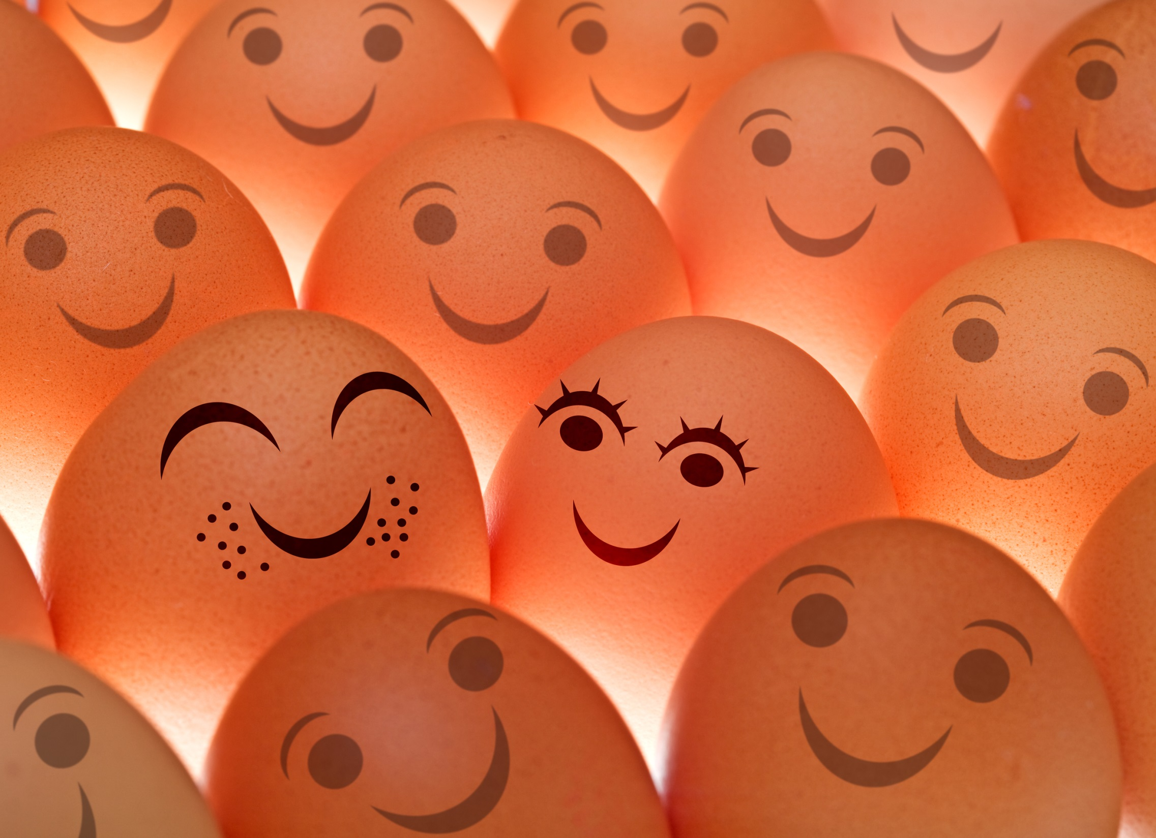
Should you care about people in your community who are not friends or family?
Why?

Slide 11
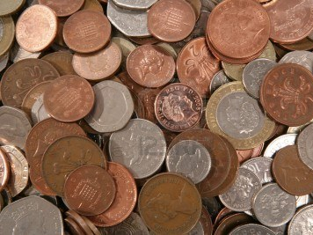
People sometimes set up charities to collect money and care for other people who are in need.
Have you ever given any of your pocket money to a charity?

Slide 12
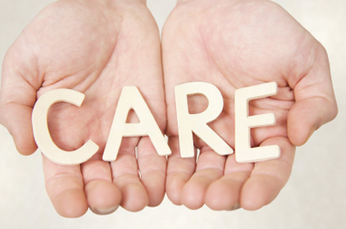
What could you do to make your community more caring?

Slide 13
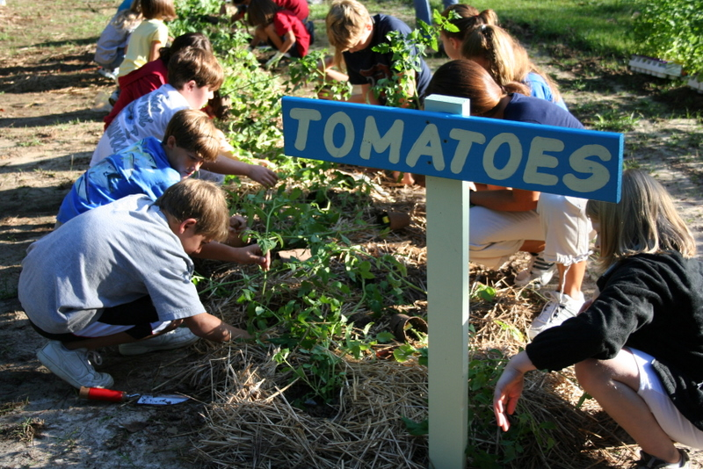
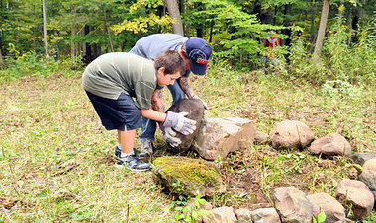
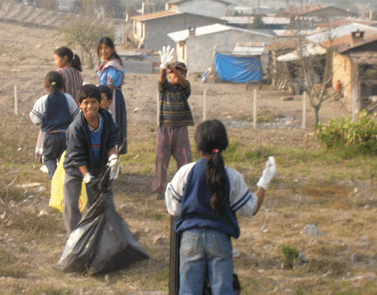
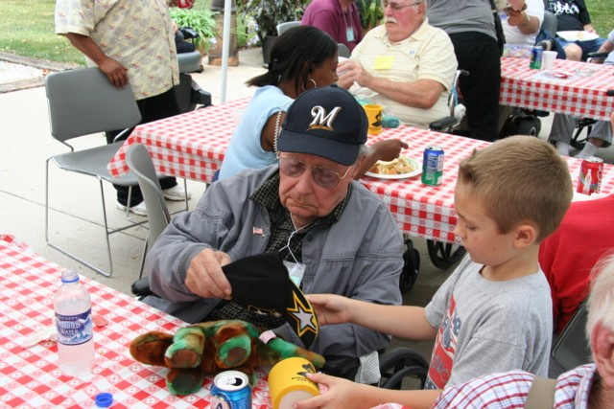
Giving money isn’t the only way of caring for others…
Can you think of any other ways that children can help care for their community?

Slide 14
Activities to complete this lesson include:
Community Survey
Philo the Philanthropist

