Slide 1
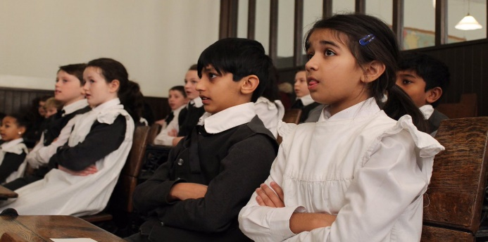
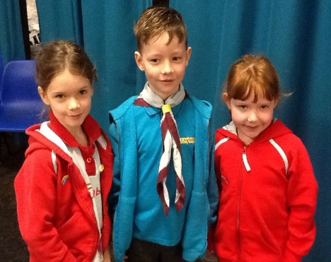
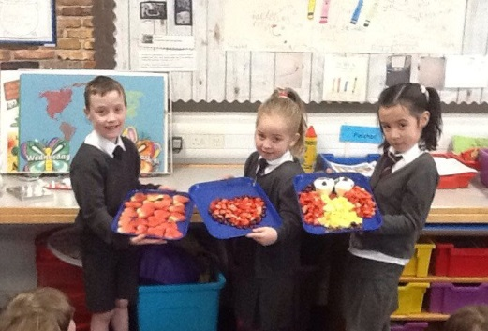
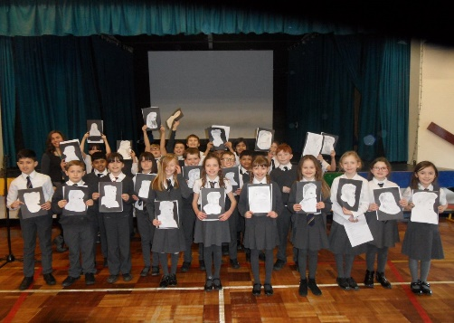
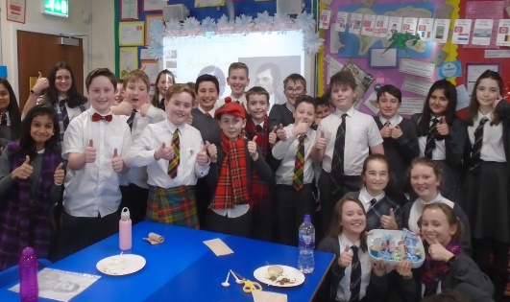
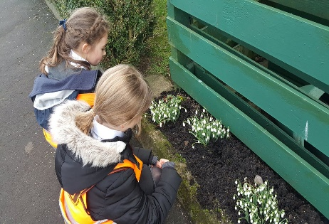
Meet The Teacher
Kirkhill Primary School
Thursday 5 September 2019
Everyone Attaining, Everyone Achieving through Excellent Experiences

Slide 2
Our Revised Vision and Values
At Kirkhill we are #PROUD of our school community. Everyone is encouraged to be creative, strive for excellence and be inspired to attain, achieve and be their best.
At Kirkhill we are #PROUD and empowered to demonstrate our values of;
Perseverance
Resilience and Respect
Optimism
Unity
Diversity
Everyone Attaining, Everyone Achieving through Excellent Experiences

Slide 3
Literacy and English
Spelling – Discussed on Monday assessment on Friday
Handwriting –Monday
Grammar - Tuesday
Big Writing – Wednesday
Reading - Friday
Everyone Attaining, Everyone Achieving through Excellent Experiences

Slide 4
Numeracy and Mathematics
Interactive Oral Mental Mathematics i.e. loop cards, bingo, etc.
Introducing the Lesson
Direct Interactive Teaching
The Plenary Session
Games to reinforce learning
Online resources such as Education City
Everyone Attaining, Everyone Achieving through Excellent Experiences

Slide 5
Health and Wellbeing
PE - Games – Striking and Fielding Games - Thursday
PE - Fitness – Wednesday
Mental/Social/Emotional Health – Wednesday
Bounceback/Mindfulness
Weekly assembly – share achievements
GIRFEC
Everyone Attaining, Everyone Achieving through Excellent Experiences

Slide 6
Other Curricular Areas
Social Studies – Charlie and the Chocolate Factory and enterprise.
Science – Body Systems
Drama – Charlie and Chocolate Factory based
Art – Line drawing skills
ICT - Internet Safety/E- Portfolios
RME – Christianity and Stories from other religions
Technology – Craft Design
Outdoor Learning – Tuesday afternoon
Everyone Attaining, Everyone Achieving through Excellent Experiences

Slide 7
Homework
Spelling - Weekly (issued on an Monday for Friday)
Mental Maths - Weekly (Monday to Thursday)
Literacy Task – sometimes in addition to spelling
Other Research/Curricular Area – Roughly Twice a Term
We hope that homework will be as interactive as possible, please work with your children at home on this.
Everyone Attaining, Everyone Achieving through Excellent Experiences

Slide 8
How you can help…
Please remind your child to:-
Prepare all homework to a high standard and ask an adult to help complete and oversee homework
Undertake reading homework with an adult
Ensure have what they need in their PE kit
Put homework into school bag
Return letters on time
Ensure they have all equipment e.g. pencils/reading glasses etc.
Ensure they have a full water bottle on arrival each morning
Everyone Attaining, Everyone Achieving through Excellent Experiences

Slide 9
How Will We Keep You Informed?
Sharing our Learning
Twitter @KirkhillPS
Class blogs
Termly overview
Snapshot jotters
Curricular events
Communication
Twitter @KirkhillPS
Friday Bundle
Monthly newsletter
School website
Everyone Attaining, Everyone Achieving through Excellent Experiences

