Slide 1
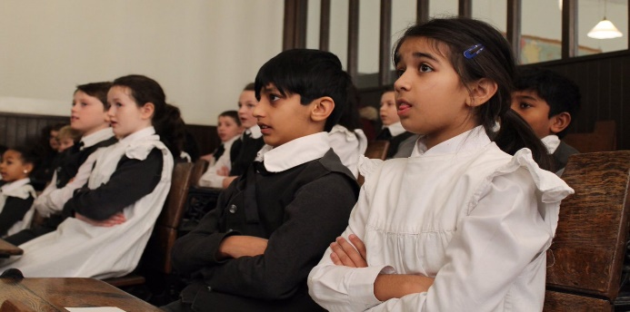
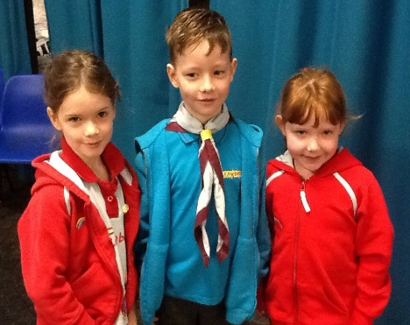
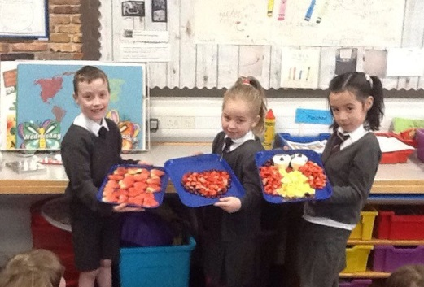
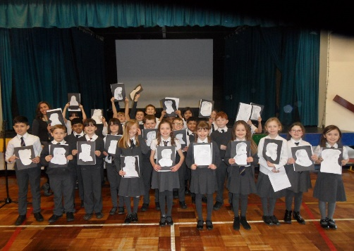
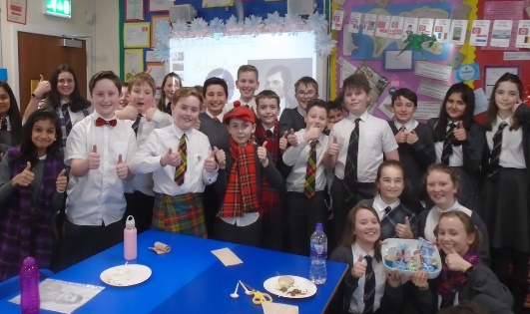
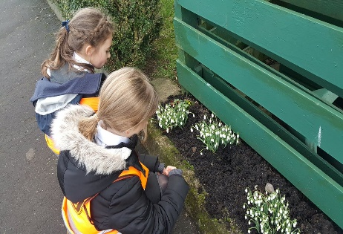
Meet The Teacher
Kirkhill Primary School
Thursday 5 September 2019
Everyone Attaining, Everyone Achieving through Excellent Experiences

Slide 2
Our Revised Vision and Values
At Kirkhill we are #PROUD of our school community. Everyone is encouraged to be creative, strive for excellence and be inspired to attain, achieve and be their best.
At Kirkhill we are #PROUD and empowered to demonstrate our values of;
Perseverance
Resilience and Respect
Optimism
Unity
Diversity
Everyone Attaining, Everyone Achieving through Excellent Experiences

Slide 3
Literacy and English
Spelling – Chilli Challenge. Children choose their own level for each rule. Assessment on Friday.
Handwriting and Dictionary Skills
Knowledge about Language (KAL)/ Grammar
Writing – Personal, Imaginative, Functional.
Talking and listening
Everyone Attaining, Everyone Achieving through Excellent Experiences

Slide 4
Numeracy and Mathematics
Interactive Oral Mental Mathematics
Introducing the Lesson
Direct Interactive Teaching
The Plenary Session
Games to reinforce learning
Online resources such as Education City
Everyone Attaining, Everyone Achieving through Excellent Experiences

Slide 5
Health and Wellbeing
PE - Wednesday – outside in playground – Striking and Fielding
PE - Thursday - inside
Mental/Social/Emotional Health – Bounceback/Mindfulness
Weekly assembly – share achievements
GIRFEC
Everyone Attaining, Everyone Achieving through Excellent Experiences

Slide 6
Other Curricular Areas
Science – Body Systems, Separating Mixtures and Autumn Topic
Drama – Scenes from Charlie and the Chocolate Factory
Art - Observational drawing and 3D Crafts
ICT – GLOW, Power Points, Teams.
RME – Biblical Stories, Different Forms of Worship and Artefacts
Technology – Craft Design, Food Technology
Everyone Attaining, Everyone Achieving through Excellent Experiences

Slide 7
Homework – Please look on P5b GLOW Blog
Spelling - Weekly Chilli Challenge – 5 given words then come up with 5 extra words from the spelling rule(issued on an Monday for Friday) Complete active spelling activities from the Spelling Menu.
Mental Maths or Written Maths- Weekly (Monday to Thursday)
Other Research/Curricular Area
Homework will be issued through our class blog on a Monday. If you have trouble accessing homework online please contact the Office and we can arrange for paper copies to be sent home.
Everyone Attaining, Everyone Achieving through Excellent Experiences

Slide 8
How you can help…
Please remind your child to:-
Complete all homework to a high standard and ask an adult to check it
Ensure they return their PE kit to school after being at a club
the previous day and also after holidays
Put any written homework into school bag
Return letters on time
Ensure they have all equipment e.g. pencils/rubber/reading glasses etc.
Ensure they have a full water bottle on arrival each morning
Everyone Attaining, Everyone Achieving through Excellent Experiences

Slide 9
How Will We Keep You Informed?
Sharing our Learning
Twitter @KirkhillPS
Class blogs
Termly overview
Snapshot jotters
Curricular events
Communication
Twitter @KirkhillPS
Friday Bundle
Monthly newsletter
School website
Everyone Attaining, Everyone Achieving through Excellent Experiences

