Slide 1
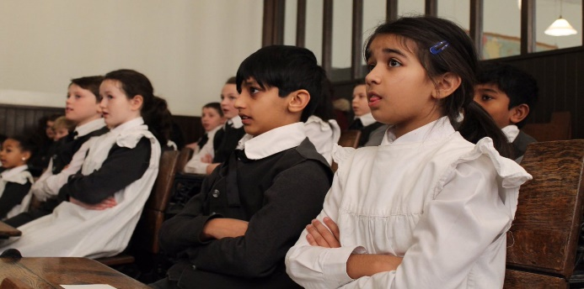
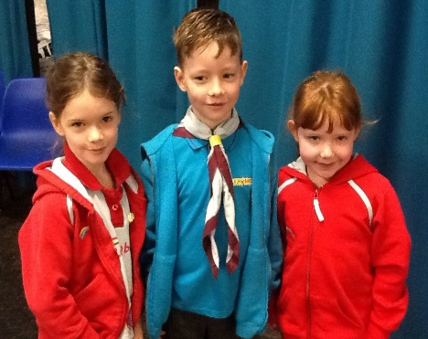
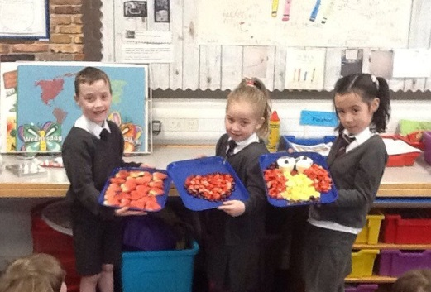
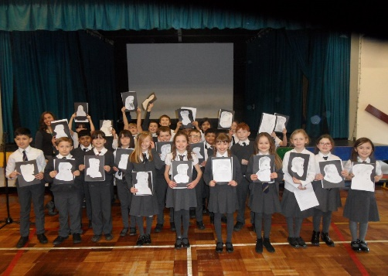
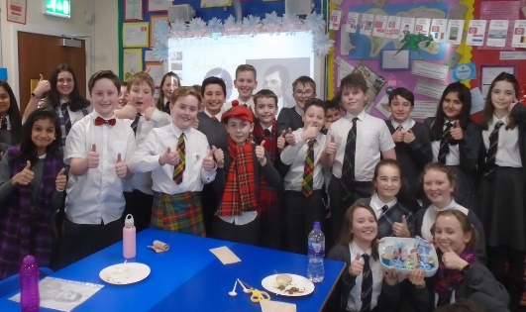
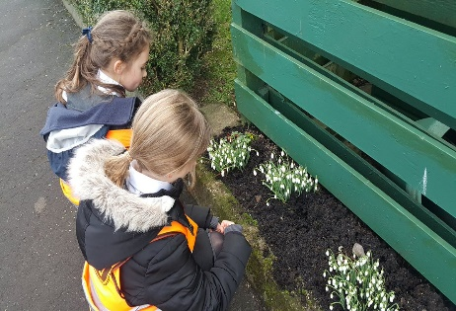
Meet The Teacher
Kirkhill Primary School
Thursday 5 September 2019
Everyone Attaining, Everyone Achieving through Excellent Experiences

Slide 2
Our Revised Vision and Values
At Kirkhill we are @PROUD of our school community. Everyone is encouraged to be creative, strive for excellence and be inspired to attain, achieve and be their best.
At Kirkhill we are @PROUD and empowered to demonstrate our values of;
Perseverance
Resilience and Respect
Optimism
Unity
Diversity
Everyone Attaining, Everyone Achieving through Excellent Experiences

Slide 3
Literacy and English
Spelling – daily. Assessment on Friday
Grammar-Tuesday
Writing – Wednesday
Handwriting –All the time
Reading and Comprehension-Monday and Thursday
Use of online resources such as Read Theory
Everyone Attaining, Everyone Achieving through Excellent Experiences

Slide 4
Numeracy and Mathematics
Mental Maths-
Mathematical Thinking Challenges
Countdown
Around the world
Challenge cards
Everyone Attaining, Everyone Achieving through Excellent Experiences

Slide 5
Health and Wellbeing
PE - Possession Games – Tuesday
PE - Fitness – Thursday
PE – Fit for Fifteen– Monday, Wednesday and Friday
Mental/Social/Emotional Health
Bounceback/Mindfulness
Growth Mindset
Internet Safety
Peer Pressure
Sexual Health and Relationships
Weekly assembly – share achievements
Everyone Attaining, Everyone Achieving through Excellent Experiences

Slide 6
Other Curricular Areas
Social Studies – World War II
Science – Buoyancy and Micro-Organisms
Drama – Topic related
Art – Topic related
ICT – Microsoft teams, Blogs
RME – Judaism
Technology – Computing Science
Everyone Attaining, Everyone Achieving through Excellent Experiences

Slide 7
Homework
Literacy - Weekly (issued on an Monday for Friday)
Numeracy- Weekly
Other Research/Curricular Area – Weekly
Please check Class Blog
If you have trouble accessing homework online or would like a paper copy please contact the Office and we can arrange for paper copies to be sent home.
Everyone Attaining, Everyone Achieving through Excellent Experiences

Slide 8
Dates For Your Diary
Term 1
Lord Provost Debate- Monday 9th December 2019
Term 2
P7 Show- Monday 30th March 2020
Term 3
P7 Residential Trip Lockerbie Manor- 15thJune 2020
MCHS Induction Days 11/12th June 2020
P7 leavers Service/Dance- Thursday 25th June 2020
Everyone Attaining, Everyone Achieving through Excellent Experiences

Slide 9
How you can help…
Please remind your child to:-
Prepare all homework to a high standard and ask an adult to check and sign homework
Ensure they bring PE kit on correct days
Put homework into school bag
Return letters on time
Ensure they have all equipment e.g. pencils/reading glasses etc.
Ensure they have a full water bottle on arrival each morning
Everyone Attaining, Everyone Achieving through Excellent Experiences

Slide 10
How Will We Keep You Informed?
Sharing our Learning
Twitter @KirkhillPS
Class blogs
Termly overview
Snapshot jotters
Curricular events
Communication
Twitter @KirkhillPS
Friday Bundle
Monthly newsletter
School website
Everyone Attaining, Everyone Achieving through Excellent Experiences

