Slide 1
St. Joseph’s Primary
Supporting our Pupils
Karen Wynne In service
October 2022

Slide 2
St. Joseph’s Primary
Supporting our Pupils
Supporting our Staff
In-Service day 2
October 2022
Today’s focus is on the development of the support resource for staff and the new curricular resource
No personal questions will be asked
No reflection on personal experiences
Time will be given to review new material specific to your stage

Slide 3
St. Joseph’s Primary
Why the need for a Community Approach to Supporting
Bereavement, Loss and Grief?

Slide 4
St. Joseph’s Primary
Supporting our Pupils
CONTEXT
Response from Psychological Service - meeting a demand
Partnership with PPWH 2015 (approx)
Establishment of ERC Strategy Group

Slide 5
St. Joseph’s Primary
A Community Approach to Supporting Bereavement, Loss and Grief

Slide 7
St. Joseph’s Primary
https://blogs.glowscotland.org.uk/er/public/healthierminds/uploads/sites/18270/2022/04/07082751/When-a-Suicide-Happens-Supporting-Young-People-Families-and-Staff.pdf

Slide 8
St. Joseph’s Primary
Supporting our Pupils

Slide 9
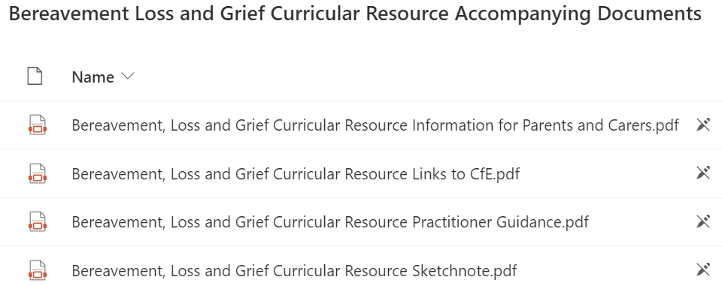
St. Joseph’s Primary
Supporting our Pupils
Bereavement Loss and Grief Curricular Resource Accompanying Documents
5
Key
documents

Slide 10
St. Joseph’s Primary
Supporting our Pupils
Bereavement, Loss and Grief Curricular Resource Practitioner Guidance.pdf

Slide 11
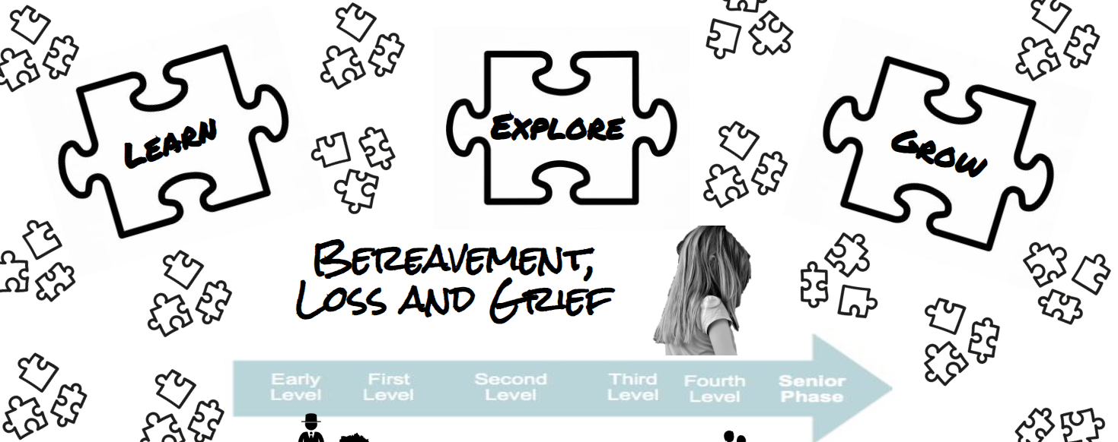
St. Joseph’s Primary
Supporting our Pupils

Slide 12
St. Joseph’s Primary
Supporting our Pupils
Bereavement, Loss and Grief Curricular Resource Links to CfE.pdf

Slide 13
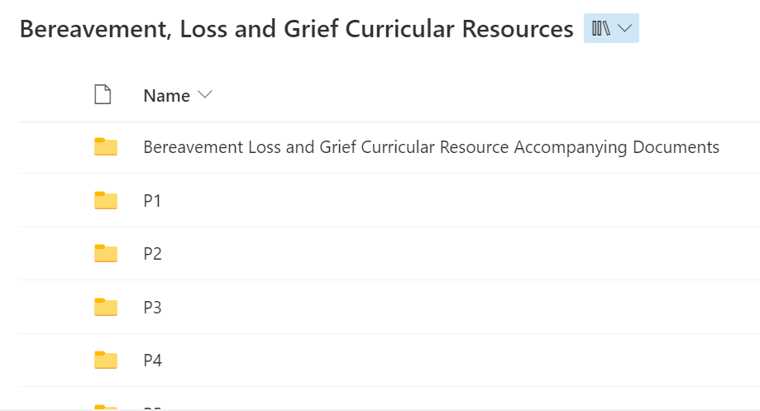
St. Joseph’s Primary
Supporting our Pupils
Bereavement, Loss and Grief |
https://glowscotland.sharepoint.com/sites/EastRenfrewshireCouncil/StaffSection/Bereavement%20Loss%20and%20Grief%20Curricular%20Resources/Forms/AllItems.aspx

Slide 14
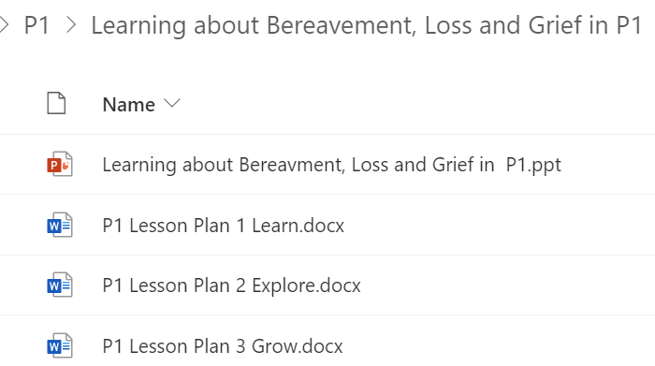
St. Joseph’s Primary
Supporting our Pupils
Bereavement, Loss and Grief |
Every stage has 3 lessons and an accompanying powerpoint.
Every stage follows the same structure:
LEARN
EXPLORE
GROW
https://glowscotland.sharepoint.com/sites/EastRenfrewshireCouncil/StaffSection/Bereavement%20Loss%20and%20Grief%20Curricular%20Resources/Forms/AllItems.aspx

Slide 15
St. Joseph’s Primary
Supporting our Pupils
What happens now?
BLG Pupil questionnaires will be printed off and distributed by office
BLG Parent info leaflet being emailed home 31st Oct with Mass info
3 BLG lessons delivered in Nov (annually) - natural RE link
The Catholic Church invites us during the entire month of November, the Month of the Holy Souls, to pray for the departed. On 1 November, the church begins the Month of the Holy Souls by celebrating the Solemnity of All Saints — a celebration of our common vocation to holiness, and a recognition of that holiness in the deceased who have already entered into the communion of saints. On 2 November, All Souls Day, and throughout the month of November, the church asks us to pray for those who have died and ask God to welcome them into his embrace.

Slide 16
St. Joseph’s Primary
Supporting our Pupils
Task (30 mins)
The key documents are saved into GSuite:
BEREAVEMENT, LOSS & GRIEF
Add material for your stage to this central class folder (Ppt, lessons, etc)
Review lesson content with stage partner(s)
Return for feedback, comment, questions

Slide 17
St. Joseph’s Primary
Supporting our Pupils
COMMENTS:
QUESTIONS:

Slide 18
St. Joseph’s Primary
Supporting our Pupils
What happened next?..................

Slide 19
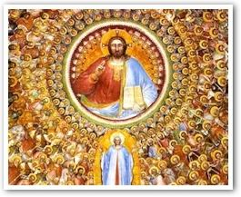
St. Joseph’s Primary
Supporting our Pupils
Dear Parents/ Carers
A reminder that tomorrow (01 Nov) is a Holy Day of Obligation: the Feast of All Saints. All pupils will attend Mass: P5-7 in St Joseph’s Church / P1-4 in school.
In the Catholic Church, November is a month in which we have a focus on remembering those who have died and our Religious Education and PSHE lessons during this month link to this theme.
Please see the attachment for further information from the ERC Bereavement, Loss and Grief Team, of which Mrs Wynne (DHT) is a member.

Slide 20
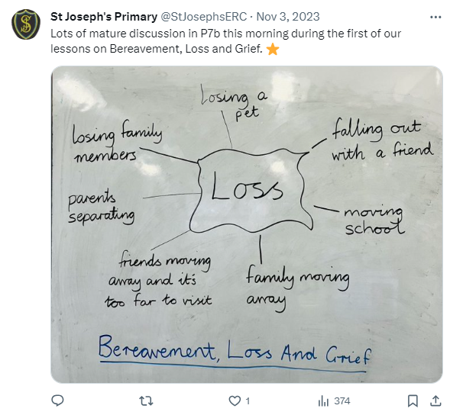
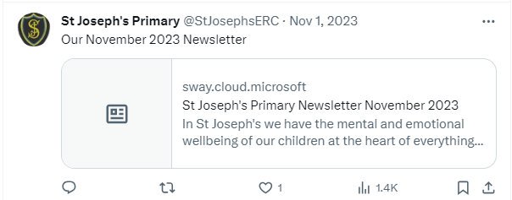
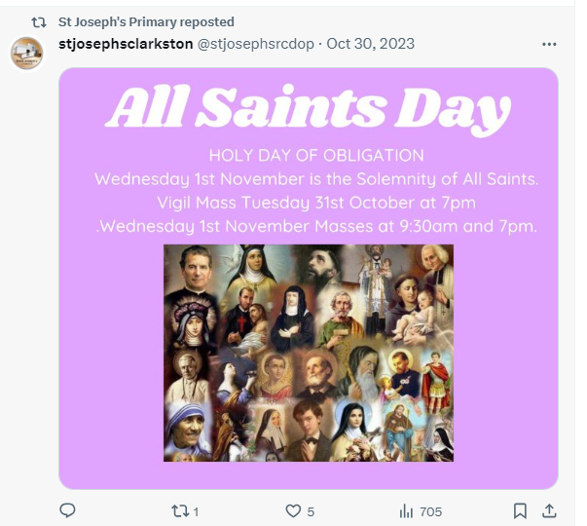
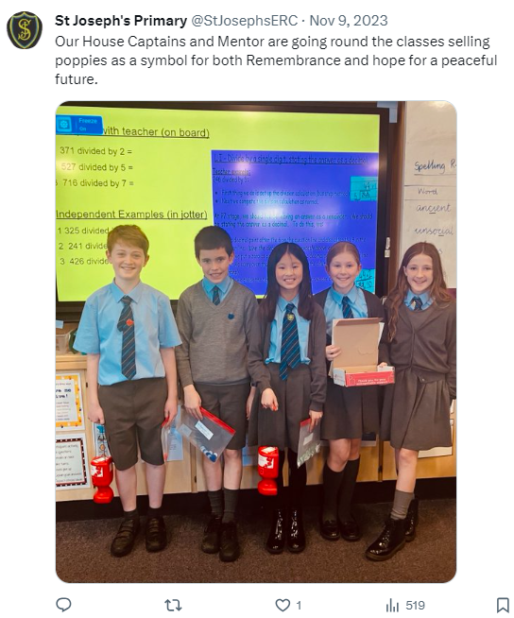
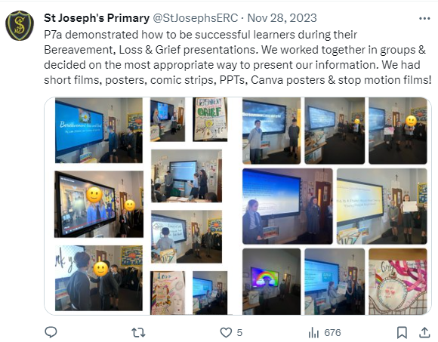
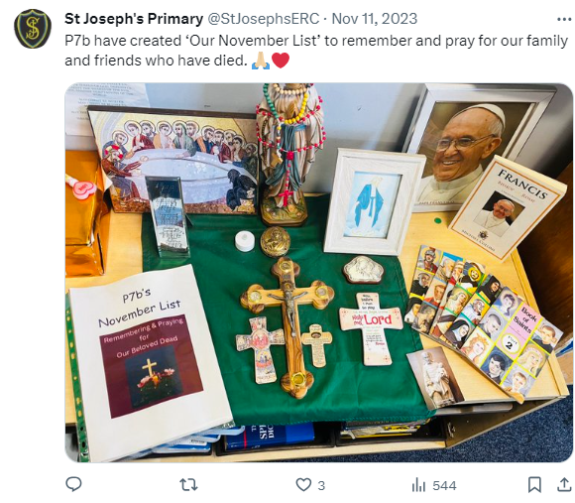
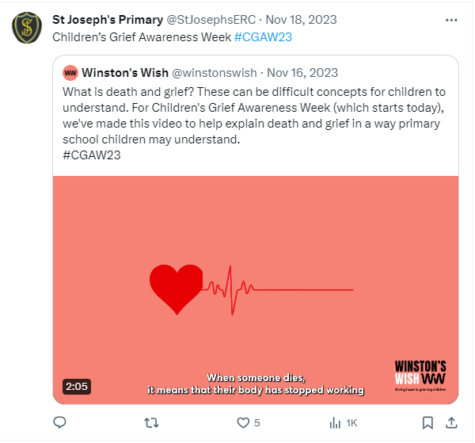
November

Slide 21
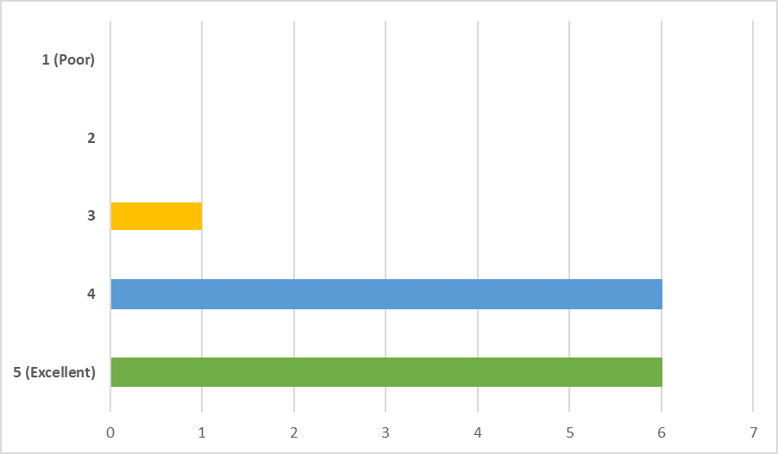
Teachers’ overall rating of the lessons

Slide 22
St. Joseph’s Primary
Staff Questionnaire Dec 23
Overall, the survey responses were very positive, and highlighted a range of strengths with the content of the lessons and their supporting resources.
The suggestions for adaptations/improvements were minimal.
The suggestions were that some younger children may have found the materials challenging, and that some of the activities (though enjoyable) did not link as closely to the theme of the lesson compared to other activities.
Overall, teachers felt the lessons were age and stage appropriate; that they felt confident delivering the lessons; and that the lessons dealt with the topic of loss sensitively.
Whilst children were not included in the survey, feedback indicates that the majority were engaged in the lessons and benefited from exploring the topic of death/loss in a safe and supportive environment.

Slide 23
St. Joseph’s Primary
Staff Questionnaire Dec 23
Theme 1: Supported children to understand death and grief in a safe environment.
· All children could relate to the topics and were able to discuss/share personal experiences when appropriate. They felt confident enough to volunteer personal experiences and were encouraged when others agreed or had experienced something similar.
· The lessons allowed difficult topics to be discussed and created a safe environment for open conversations with children.
· A very positive message reinforcing that everyone deals with grief in different ways.
Theme 2: The materials were helpful and provided appropriate explanations of death.
· For younger children, I feel using short clips from animated films to help children understand death and loss was a useful starting point. It helped children to think and open up about their own experiences.
· Resources were well pitched.

Slide 24
St. Joseph’s Primary
Staff Questionnaire Dec 23
Theme 3: The lessons were age and stage appropriate.
· The explanations and wording were child friendly and understood by all in the class
· child friendly, grief was explained in a very accessible way
· Child friendly but the infants found it challenging.
Theme 4: The lessons created opportunities for discussions and self-directed learning.
· Created opportunities to have mature class discussions, children were a support to one another, learners realised grief if a process, the group project in P7 allowed children to conduct their own research and make sense of the grief journey themselves.
· The class as a whole had excellent discussions and this developed into smaller group discussions.
· They encouraged lots of valuable discussion and conversation around the topics.

Slide 25
St. Joseph’s Primary
Staff Questionnaire Dec 23
Theme 5: Detailed lesson plans were helpful
· Having the lesson plans so detailed helped to deliver the lessons efficiently, correctly and gave me more confidence in my ability to talk to the children about such a sensitive subject.
· Good to have clear guidance on areas covered at the stage and see how it would progress next year.
Theme 6: Clear structure to the lessons
· Good structure which was consistent throughout the set of lessons

