Slide 1

Emotionally Based School Absence
Chris Atherton
Angela Merrylees
Session Three: Outcome Focused Planning
3

Slide 2


Framework
Included, Engaged and Involved –Part 1 :A positive Approach to the Promotion and Management of Attendance in Scottish Schools
September 2020
June 2019

Slide 3

https://blogs.glowscotland.org.uk/er/healthierminds/emotionally-based-school-absenteeism/

Slide 4

Session Three
GIRFEC and Wellbeing Planning
Planning expectations
Elements of an approach to planning
Graded exposure and individualised planning
3

Slide 6
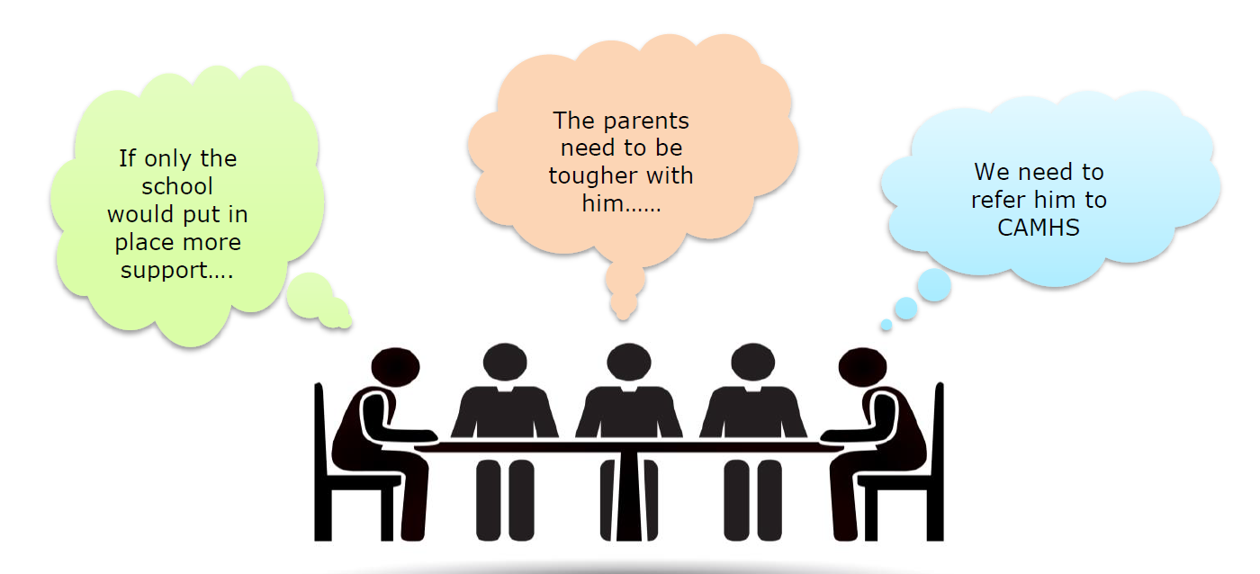
A

Slide 7
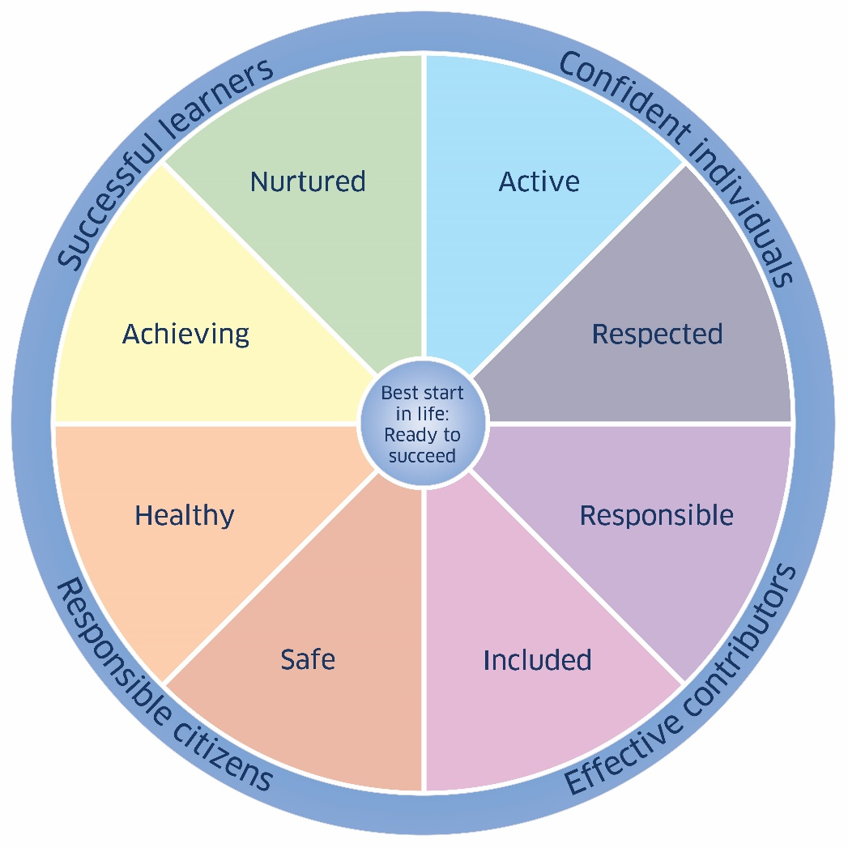
Our planning process
GIRFEC Planning
Child’s Wellbeing Plan (Education)
Individualised support = additional support need that requires an agreed plan across school and home
https://blogs.glowscotland.org.uk/er/meetinglearnerneeds/
C

Slide 8
What to Expect – Challenges!
Implementing the plan can be difficult and is to be anticipated.
Maintaining a solution-focussed stance will allow for small successes to be recognised and other options to emerge should there be bumps in the road at any point. (There absolutely will be!)
Views may differ as to what is a priority, so practitioners need to be ready for negotiation and collaboration with the young person and their family.
Each situation will be different and will require a tailored response. This is part of the challenge with EBSA, as every young person requires something a little bit different and a big bit customised.
As a practitioner, being resilient and persistent is key at this stage.

Slide 9
Elements of a plan: some advice, not a road map
Direct telephone contact between parent/carers and pastoral school staff (sooner rather than later: remember the two week threshold);
A return to school at the earliest opportunity, even a visit to the front door to get started;
Early home visits to discuss the child or young person’s reluctance to attend;
Early assessment, agreed outcomes and reviews;
All parties to keep focus on actions of review until next review period: work to the plan;
Frequent review meetings (for some this will be daily or weekly in the early stages);
Transition planning with colleagues;
Individualised SMART outcomes, agreed with adults and the child or young person (CWP: Education);

Slide 10
Elements of a plan: some advice, not a road map
Individualised planning e.g. customised timetable; school visits, base time; late starts, early finishes, safe place for support e.g. sensory room; key adults identified, time out cards etc.);
Ensure all staff working with the child or young person know about their needs AND strategies to support them, including the part they play in making it a success;
Identified member of staff to check-in with and turn to for support if the anxiety of school becomes too much (connection).
Encouraging consistent engagement in school life, minimising factors that pull the young person away from their learning, and developing the child or young person’s resilience.

Slide 11
What are the goals?
Successful outcomes are underpinned where children and young people feel listened to and understood, and where they are supported to:
  develop their ambition, aspiration and motivation;
  increase their confidence, self-esteem, self-efficacy, and value in themselves;
  develop feelings of safety, security and a sense of belonging within the school;
  have positive experiences where they can succeed;
  develop positive relationships with peers and / or staff;
  understand the relationship between their thoughts, feelings and behaviour;
  work in partnership with their family, the school and external professionals;
  develop a sense of direction and purpose in their education, with a clear end goal in sight, such as training or employment in a preferred area.
  (West Sussex council (adapted), 2021)

Slide 12
You have more influence than you might think…
Practitioners have the most control and influence over the child or young person’s school experience.
The school experience often needs to be adapted to become a better fit for individuals who are vulnerable to EBSA, one that promotes their strengths and resilience factors and minimises the risks.
Successful outcomes are more likely where practitioners:
  are empowered to be adaptable and flexible;
  are solution focussed;
  plan to reduce EBSA gradually over time;
  promote individual attendance and engagement on the basis of pupil voice, their interests and strengths;
  recognise small achievements and progress along the way;
  identify some ‘quick wins’ that give the young person a sense of progress and achievement;
  seek to improve the child or young person’s whole school connectedness, looking specifically at their relationships and appropriate curricular experiences.
  (O’Hagan, Bond & Hebron, 2022).

Slide 13
Individualised Supports
Graded exposure to the building, staff, and timetable;
Soft start to the day, particularly on a Monday and Friday – find a hook – something they might enjoy coming in for that will reward their transition into the building;
Customised timetables for days/weeks and terms;
Daily check-in with a member of the school team;
Daily celebrations, however small, that acknowledge any success;
A 1-2-1 session (daily / weekly) to discuss and review the plan for re-engagement with school and any other worries the young person may have;

Slide 14
Individualised Supports
Walk & talk: getting alongside the young person either inside or outside the school building can be much more helpful than sitting in a formal environment or across a desk;
Strategies for moving to a safe space, if needed;
Robust transition planning and interventions;
Adult contacts for the child or young person when they are in the building (especially at transitions);
Individualised or group work to support emotional and mental wellbeing;
Ongoing, regular communication with parents / carers.

Slide 15
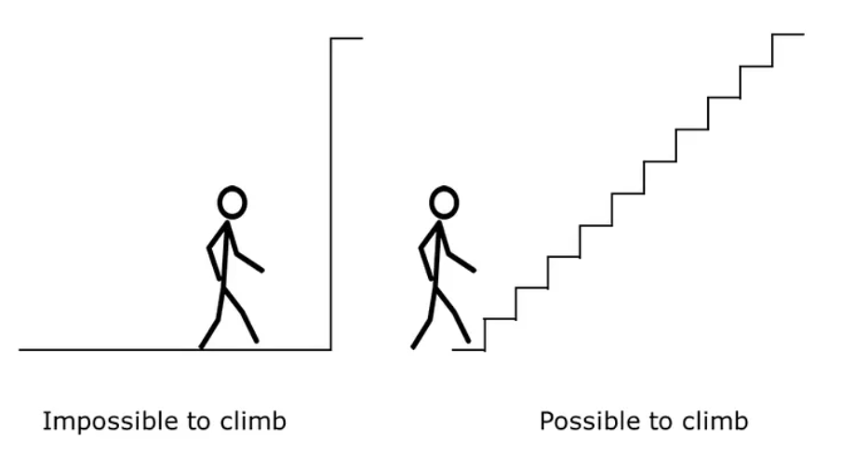
Graded Exposure
Joseph Wolpe (1957)
Gradual move towards the task which is the hardest
Plan and rank actions in terms of difficulty (in consultation with the young person)
Smallest of small steps where necessary
Partnership with family and team around the young person

Slide 16
Start with short visits to the school during quiet times, even if it's after school. Agree an exact amount of time for being in the school building (anything from 5 minutes to 60 minutes).
Visit the school every weekday for a short time. Organise an enjoyable activity or preferred type of work that can be done in a safe, welcoming space.
Gradually increase the amount of time spent in school during these visits.
Gradually introduce more experiences (e.g. bringing friends or teachers to the young person, introducing morning break).
Take a similar approach with the classroom or individual subjects, starting with preferred / most important ones (again anything from 5 minutes to a full period).
Attend class / subject for the same amount of time ach day.
Increase time spent in class.
Step by step, work towards a robust differentiated timetable.
Stable attendance pattern and full timetable.

Slide 17
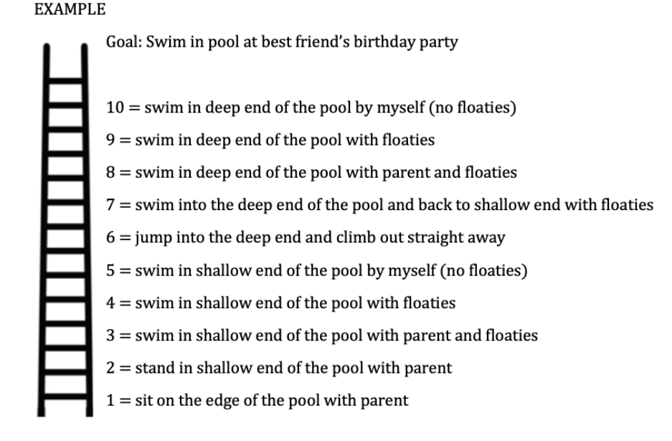
C

Slide 18
 |  | Targets: | Tick
Week 1: | 8th-11th June | Get up and ready for school by 9am each morning.
 |  | Drive to school with family members then come back home if you want to.
 |  | Log on to Google Classroom and check work for 1 subject per day.
 | Any other achievements
Week 2: | 14th – 18th June | Continue to get up and ready for school by 9am each morning.
 |  | Continue to drive to school with family members then come back home if you want to.
 |  | If at home, continue to Google Classroom and check work for 1 subject per day.
 |  | Travel in the car to the school on one day to collect some work from Mr Smith, from the car park.
 | Any other achievements
Week 3: | 21st - 25th June | Continue to get up and ready for school by 9am each morning.
 |  | Continue to drive to school with family members then come back home if you want to.
 |  | If at home, continue to Google Classroom and check work for 1 subject per day.
 |  | Travel in the car to the school on one day to collect some work from Mr Smith, from the car park.
 |  | Write a list of school achievements over the past year and email it to Mr Smith.
 | Any other achievements
A

Slide 19
Individualised Supports
One Key Adult - Someone that they identifies as having a good relationship with
Daily brief check in every day for five-ten minutes
Enhanced check in 1 or 2 periods a week (individual or group)
Project Work: focussing on relationships, weekly targets and solutions to any worries they may be having and emotional literacy work within the context of their ASD.
C

Slide 20
Individualised Supports
Work around CBT approaches: labelling emotions; challenging negative self talk; developing their awareness of calming strategies (proactive and responsive); restorative conversations around challenges they are experiencing; keeping a diary of her energy levels (what is draining, what is enriching their resilience); general self care around exercise and sleep etc.
Some key resources for any practitioner identified to work with them on this include ‘Been There Done That Try This’ (by Tony Attwood et al), ‘Exploring Depression and Beating the Blues’ (Tony Attwood), and our own Healthier Minds Resources online.

Slide 21
Individualised Supports
Planned sensory breaks - needed for decompression time in a nurturing, welcoming space.
Responsive sensory breaks – identify one or two areas they can go to for time out, and if they are not available – a plan for who they can speak to.
Quiet spaces to meet their needs with key friends at break and lunchtime, avoiding busier environments like the lunch hall, forum area.
Class seating options - discuss with them as it may be that some classes are less problematic than others depending on their subject preferences.
Triggers - relationship with specific teachers, general noise and activity level, and number of pupils.
Some pupils prefer to sit at the back and with a bit more physical space if possible so they don't feel under the microscope. They may use ear buds or ear defenders if these are more subtle and they can't really be seen as easily by their peers.
C

Slide 22
Individualised Supports
Project work around their special interests (preferably tied to an award).
Leadership role – e.g. helping out in the department that they like the most, community work experience tied to their interests or ASD advocacy work with other young people with ASD.
Outdoor learning experiences - many ASD pupils thrive when they are out-with the school environment, so that may give them a lift (less overwhelming from a sensory viewpoint).
‘Thera-pet’ – young people get the chance to take turns to walk the dog outside – this isn’t for everyone…

Slide 23
Planning for a return to school/class
Emotional Support: Regulation and Resilience
Partnership with Parents & Carers
Communication with School Staff: who NEEDS to know and when
Follow Up and Follow Through: on what has to happen and when
Support and Challenge
Pupil Agency and Voice
C

Slide 24

Be optimistic, especially if the child makes it one day and not the next
Bumps in the road are normal: reassure yourself and others
Every day is a new day
Try one small change at a time, especially if planned and documented for all to see
Keep going
Maintain flexibility and a solution focused approach
C

Slide 25
So far…
Reviewed terms used to describe Emotional Based School Absence
Considered the impact of the language we use to frame the issue
Touched upon (because the complexity cannot be underestimated) motivating factors and their contribution to ESBA
Explored motivating factors through case study
Discussed the importance of early intervention
Introduced the starting point for information gathering through Functional and Ecological assessment information
Reviewed some key aspects of planning which fit with CWP (Education: approach
Discussed examples based on graded exposure
A

Slide 26
Thank you for taking the time to join us. If you have any questions before we next meet on 6th of March please feel free to get in touch.
Next Peer Coaching Session: 27th February 2023
Angela.Merrylees@eastrenfrewshire.gov.uk
07788 496 711
A

