Slide 1
ASD Peer session 2

Slide 2
Pupil Perceptions

Slide 3
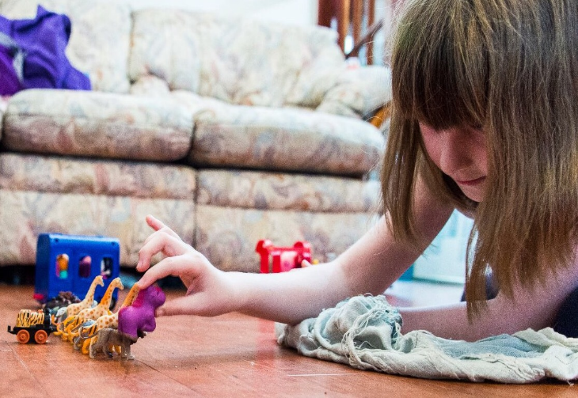
Pupil Perceptions A Day In Mainstream School For My Autistic Daughter Sept 13, 2017 by miriamgwynne
written with her full consent and approval to help others see how challenging mainstream can be
Morning preparation
I wake up and come downstairs
and try not to think about school
too much. I get my iPad or toys and
set them up just how I like it. I know I need to get dressed and eat but until things are ‘right’ I can’t think about those things.
I need to do one thing at a time so please leave me alone. Let me do it my way. Constantly asking me questions is so stressful as is nagging me about time. By the time we need to leave I am already stressed and anxious.

Slide 4
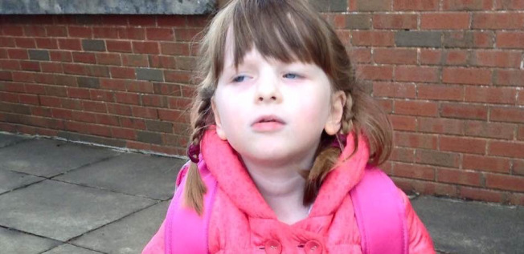
In the playground
I am scanning.
This is so hard to see who I need to see when everyone is dressed the same and moving around.
The noise, the unpredictable movements, the bags on the ground…that’s a lot to take in for me.
I only want to find my best friend and the longer it takes to find her the more I get worried.
What if she is off sick?
What if she has an
appointment today?

Slide 5
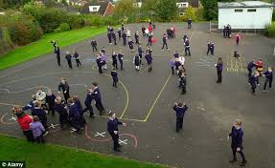
The bell
Bells panic me.
They mean I have to move somewhere quickly and I sometimes get stressed.
Bells mean pressure and children running and they might push me over.
I stand in my line and face forwards making sure I don’t look at anyone.
The teachers shout about not talking and standing straight but I am doing those already and not sure what I should be doing differently.
I turn to see if everyone else is doing what I am doing and now my class is pulled up
for me facing the wrong way!
I feel to blame. I feel so anxious.
I feel different.

Slide 6
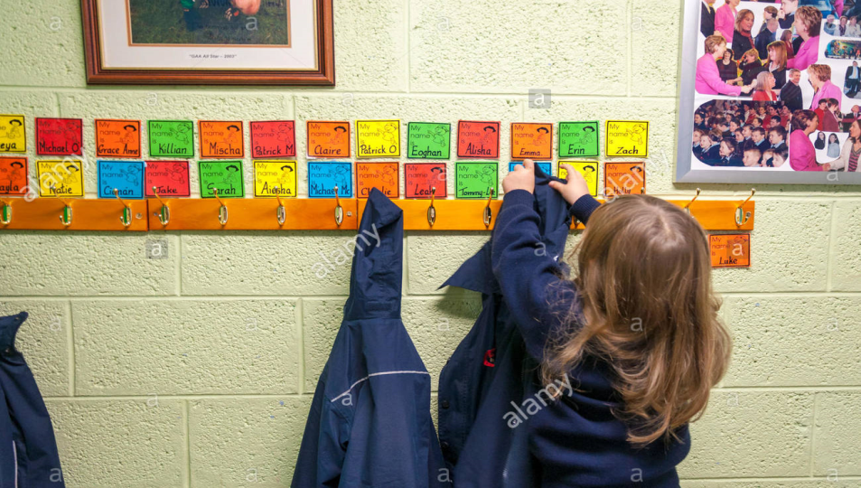
Getting to class
I have to remember to put my bag one place, my packed lunch somewhere else and then hang my coat on the right peg.
It can be confusing to remember all that while others are talking and moving all around me and the lights are so bright inside.
Sometimes I wait until most of the others are in the class but then I worry I will get shouted at for taking too long! Sometimes I forget I have my school bag as it is on my back and I can’t see it!
How can everyone else
do this so quickly and easily
and I can’t?

Slide 7
Class
I listen so much.
In fact I listen so hard to everything that sometimes I can’t do my work because I need to stop and listen to everything the teacher says in case she is talking to me.
I want to write neat because I don’t want a row but then they say I need to work faster and I can’t do fast and neat.
It is hard to concentrate with others so close to me.
They move about and talk and
turn pages and it is so
distracting sometimes.
The walls have so much stuff
on them,
I can hear the tap dripping and
I can hear people walking about.

Slide 8
I am scared to talk in case I get in trouble.
Sometimes I just can’t do the work.
Yesterday they wanted us to do a senses poem about fireworks.
They told me to imagine being at a bonfire with fireworks but how can you do that if you have never been to a bonfire before? I haven’t.
They told me to write about what I would touch but you are not allowed to touch fireworks so I can’t write anything.
They told me to write what I can smell but all I can smell right now is disgusting school
dinners and I can’t even spell that.
I just leave that one too.
Then the teacher gets me in
trouble for not doing the task.
I want to cry. The tears won’t come out.

Slide 9
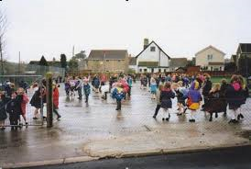
Playtime
I don’t understand this bit.
You play with toys so why call it
playtime when there are no toys?
Just call it ‘talk time’ or
‘stand in the playground time’ instead.
I take my own toys out. Then it rains and we have to come inside and I can’t play with my toys and it is so confusing for me. I don’t like changing things.
I get cold at playtime because it is hard to fasten my coat and if I take my time the people tell me to hurry up and go outside so I just can’t fasten it up now.
I have one area I like to stand and play with my one friend. We play the same game every day. We like it that way.
I want to play with others but I can’t because I don’t understand what they are playing. They don’t have toys. I can’t work out made up games like that.

Slide 10
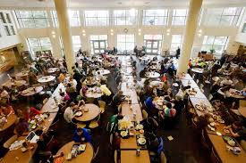
Lunchtime
Lunchtime is horrible.
We have a short time for everyone in the whole school to eat and they want us all to line up and take turns and sit at huge tables with other children I don’t know.
I just want to sit down and get time to eat and not have to hear chatter and smell what everyone else has that I don’t like.
It is far too noisy and busy and
yet no-one will open my
yoghurt or peel my banana.
I feel lost and confused
and just want out of there.

Slide 11
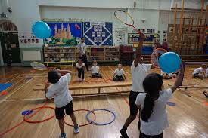
P.E I hate PE so much.
I never know what we are going to do.
Sometimes we do balls and sometimes running and sometimes sports.
I hate it all. I know I can’t do it and people laugh.
How can I catch a ball when there is so much else going on in the same hall at the same time?
I can’t focus.
I am so cold. My legs don’t like not having trousers on. My arms miss my cardigan so much.
I once fell and hurt myself in PE so I don’t run now because running is dangerous plus they
said at assembly to not run in school
so I don’t run.
Then they tell me to run and I want to
ask ‘but you said not to run in school’
but my voice won’t work.
I want to cry. The tears won’t come.

Slide 12
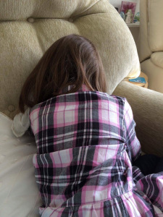
I do like school.
I like learning and I like doing work.
I like having a desk and I really want to be star of the week.
I like the other children though I don’t know if they like me.
Mum, I want to tell you about things that have bothered me like being told to work quicker or not eating.
I am tired from it all and
now I feel safe.
I want to cry. This time the tears will
come so please let them.

Slide 13
What resonates most with you?
What could you do to support this child?
https://www.youtube.com/watch?v=3UHN-rdLfh4

Slide 14
Central Coherence
Ability to see ‘the big picture’, to understand context and to use context to draw meaning.
Autistic learners tend to focus on the detail rather than the whole picture which can mean
What you might see:
Avoid making choices
Seem to understand everything you say yet miss the point
Focus on ‘irrelevant’ details
Read fluently but don’t always pick up the meaning
Rote learn maths but struggle as it gets more complicated.
https://www.youtube.com/watch?v=U8XS2nzF0hA

Slide 15
What have you seen in your practice that would fit with this?
How could you do things differently or support someone in this area?

Slide 16
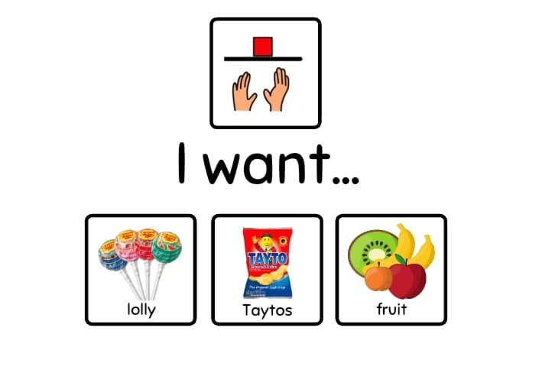
What can you do to support Central Coherence:
Support choices (forced alternatives or visual prompts)
Identify the main idea in new
information
Make learning intentions explicit
and rehearse the main idea of the
lesson

Slide 17
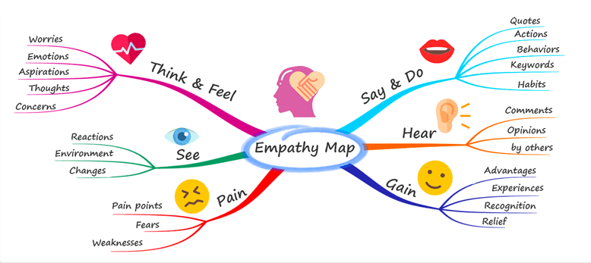
Make links explicit (why are we doing this)
Mindmaps can help to illustrate
connections between ideas
Forewarn of changes and events
Rehearse and practice for new or
different events
Use Social Stories.

Slide 18
Executive function
Help us to regulate, control and manage our thoughts and actions.
What you might see:
Find it hard to start or stop activities
Struggle with interruptions
Have difficulty sequencing tasks e.g dressing, organising their schoolbag, following through the steps in a maths problem
Be reluctant to try new things
Be impulsive and regret these actions later
Inconsistency in learning: managing one day but not the next.
https://www.youtube.com/watch?v=REo3fzja5xs

Slide 19
What have you seen in your practice that would fit with this?
How could you do things differently or support someone in this area?

Slide 20
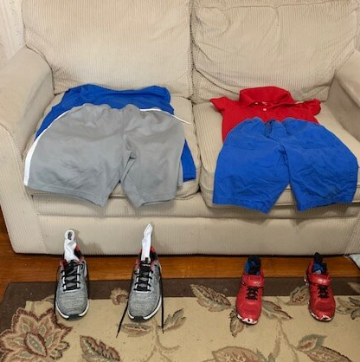
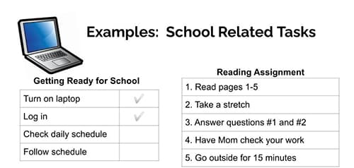
What we can do to support Executive Function
Be attentive to support needs at the start of a task and at transitions
Give instructions in the order things are to happen
Break down tasks into clear steps-visual supports are helpful (e.g. pictures of what needs to go in schoolbag)
Chunk tasks

Slide 21
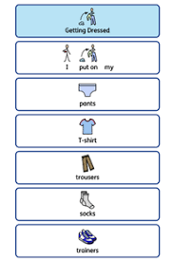
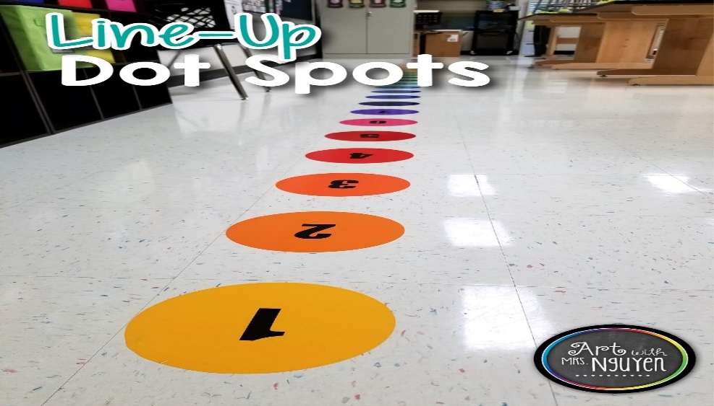
Sequence activities and routines
Ensure materials for tasks are well organised-label where class materials go
Page layout for work may need to be pre-set for the learner
Give thinking time
Support understanding of time by using visuals, e.g. photos
Use timers
Use ‘line up feet’, ‘a ‘rope with knots to hold while we line up’ or numbers at different work stations.

Slide 22
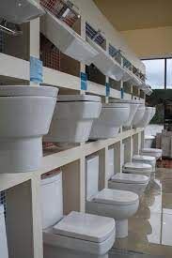
Context Blindness
Difficulty seeing and understanding the context
What you might see
Perform well in tests (e.g. of social skills or emotion recognition), but not in real life
Not use seemingly obvious contextual information (e.g. knowing that toilets in a bathroom showroom are not real toilets and should not be used!)
Think in an ‘over literal’ or ‘concrete’ way
Be overly formal or over familiar
Be overwhelmed by new people or places
Overshare of personal information
Find it difficult to process ambiguity (e.g. when someone says one thing but means another)
Find it hard to see things from the perspective of others
Have difficulty adapting rules to changing social contexts – might ‘police’ others or just behave unexpectedly.
https://www.youtube.com/watch?v=eEP_QJnN1bU

Slide 23
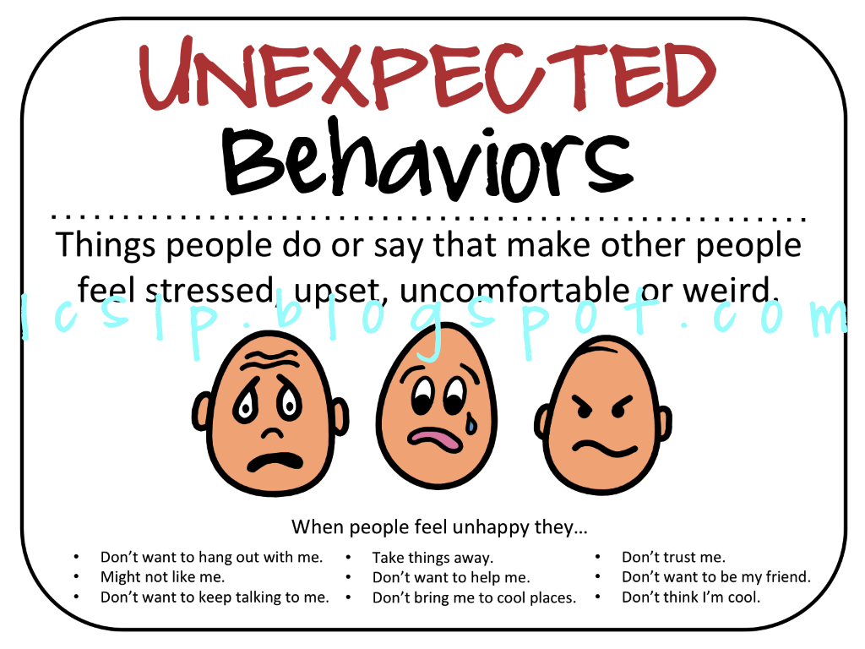
What we can do to support Context Blindness:
Teach about expected and unexpected actions and thoughts
Use Social Stories and reference the social context
Teach emotion vocabulary within natural social experiences
Use social skills approaches which focus on teaching sensitivity to context (e.g. Social Thinking, PEERS programme)

Slide 24
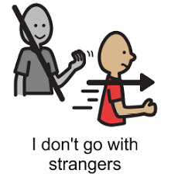
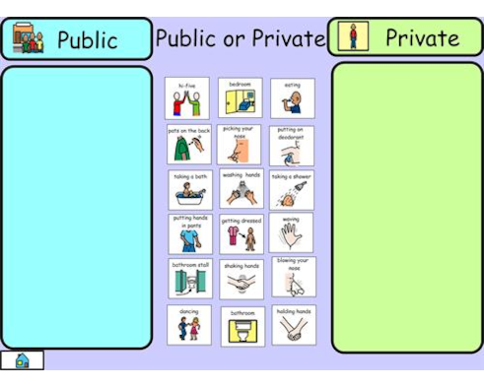
Use timetables and increase predictability (reduce need for processing in the moment)
Practice and prepare for unfamiliar situations
Teach and refer to ‘public’ and ‘private’ (places, behaviours, etc.)
Explicitly teach implicit rules (e.g. which urinal to use)
Teach about personal safety, relevant to current need and developmental stage
Teach how to stay safe online.

Slide 25
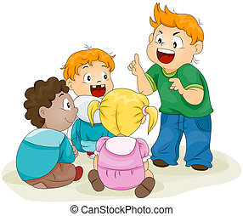
Theory of Mind (ToM),
An awareness that other people have thoughts, feelings, beliefs, perspectives and experiences which are different to their own and they realise that these explain people’s responses and actions.
They might:
Try to tell other people what to do
Think they are the teacher or attempt to ‘police’ others
Seem ‘cheeky’ or selfish
Push to the front of the line (not thinking about others)
They might not:
Follow class instructions. E.g. ‘Everyone take out your textbook’
Know you are talking to them unless you use their name
Seek approval (what you think is not registering for them). https://www.youtube.com/watch?v=YGSj2zY2OEM

Slide 26
What we can do to support TOM
Cue the child by name and teach the meaning of ‘everyone’
Create a predictable environment (where there’s less ‘in the moment’ working out to do)
Use visual prompts to support words
Exaggerate emotional responses
Tell the child what you are thinking

Slide 27
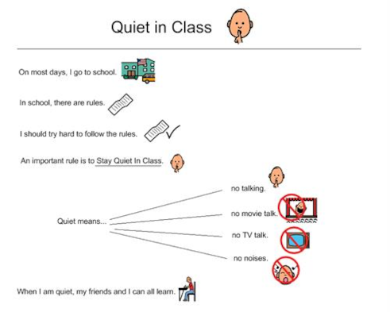
Find out what motivates the learner and join them in their interests
Avoid using restorative conflict resolution with autistic learners
Teach ‘Inside Thoughts and Outside Thoughts’
Social Stories and Social Thinking can be useful in supporting ToM.

Slide 28
