Slide 1
Autism: Inclusive Practice
Peer Support Session One

Slide 2
The focus of these sessions: - to reflect on previous presentation - to consider the practicalities in your context. - to share how you have successfully supported pupils with ASD - Hopefully consider the different strategies to support key themes

Slide 3
Keep things visual
How visual and predictable is your learning environment and school?

Slide 4
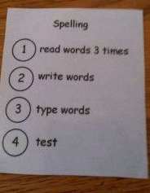
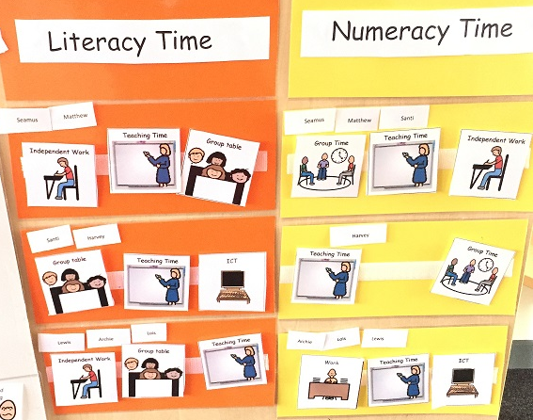
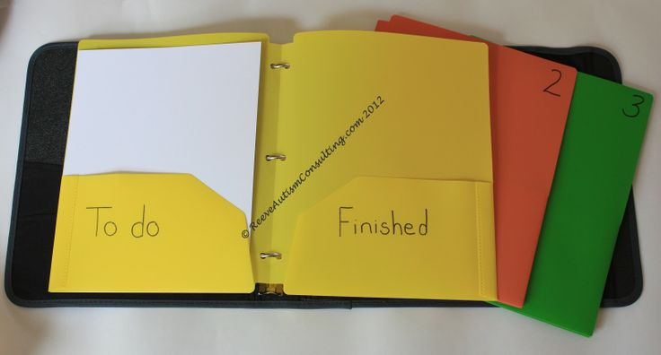
Keep things visual
Here are some examples that you could use….

Slide 5
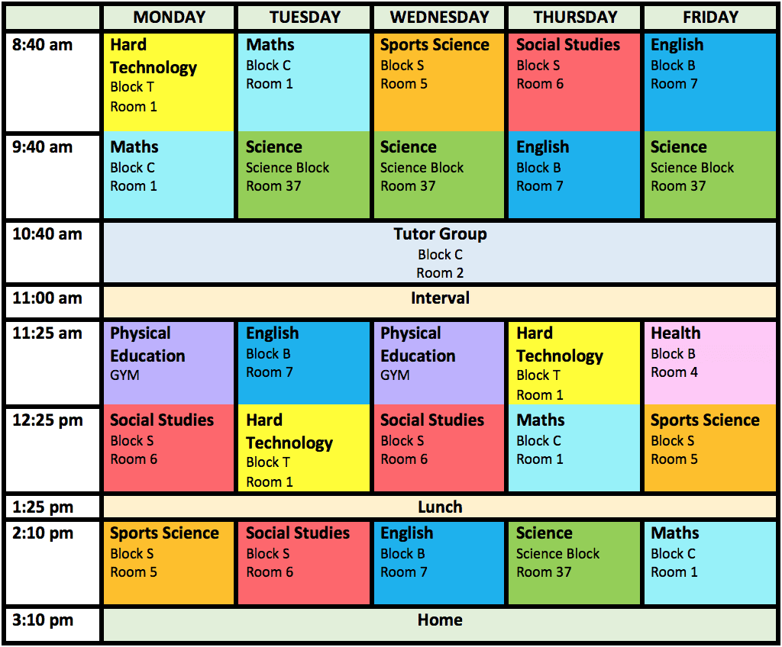
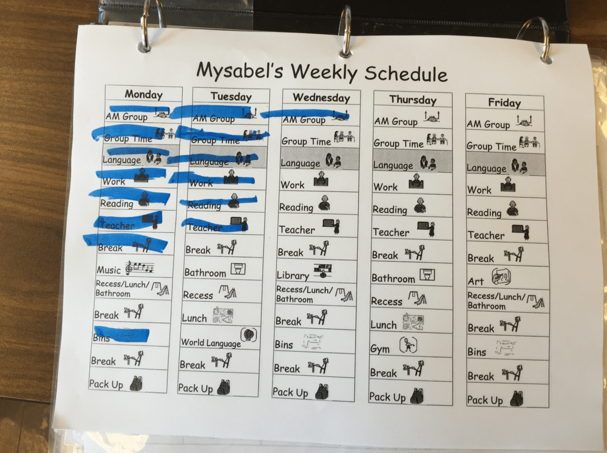

Slide 6
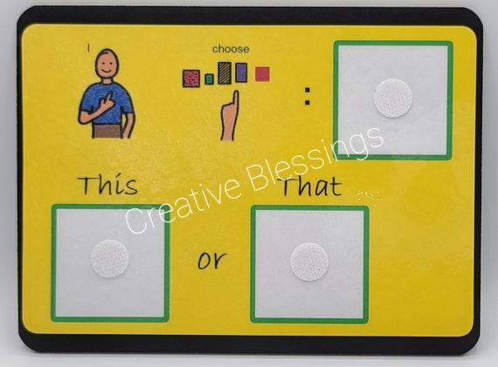
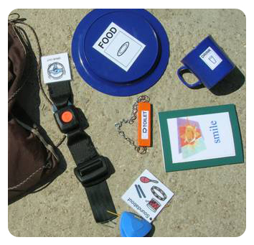

Slide 7
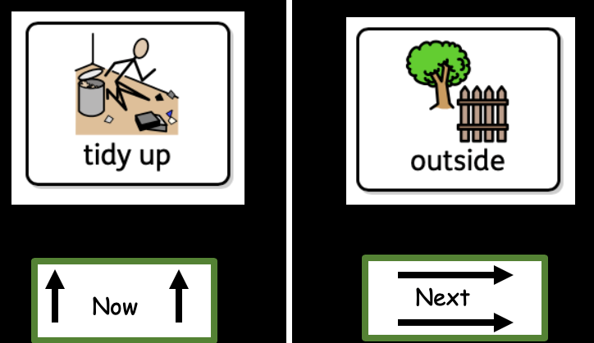
what will happen next (because they cannot guess)
Don’t presume that as they aren’t using visuals that don’t need it.

Slide 9
Enhance the structure
How predictable is your learning environment?
How do you share the plan for the day / week?

Slide 10
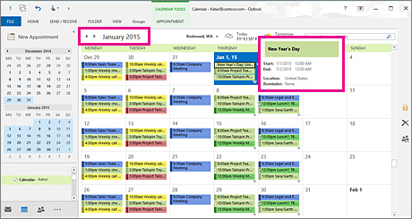
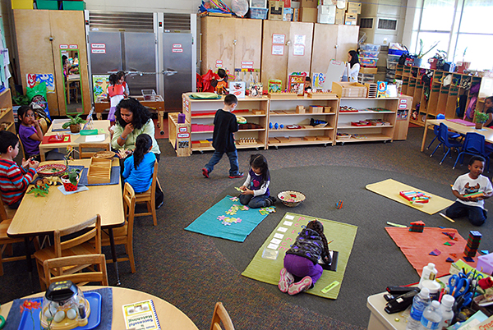
Enhance the structure Here are some examples….

Slide 11
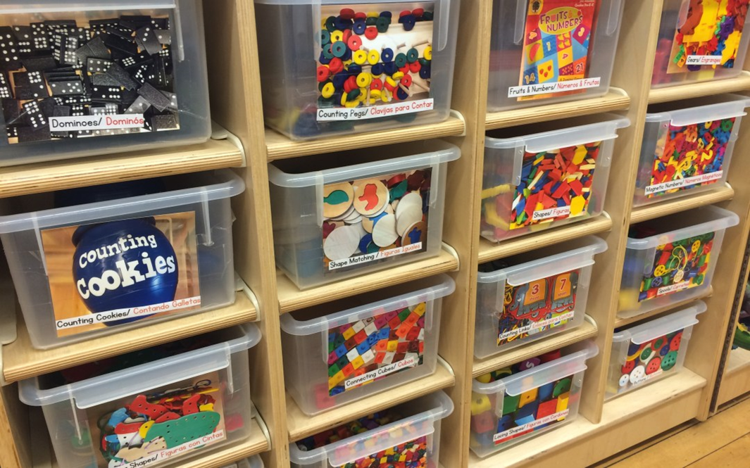
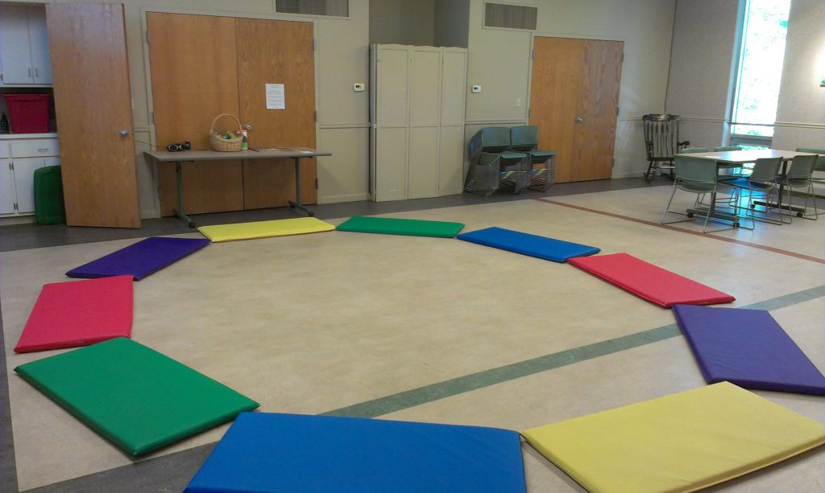
Labelling the environment
Clearly defined areas.

Slide 12
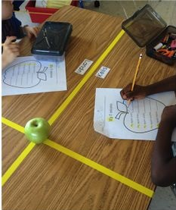
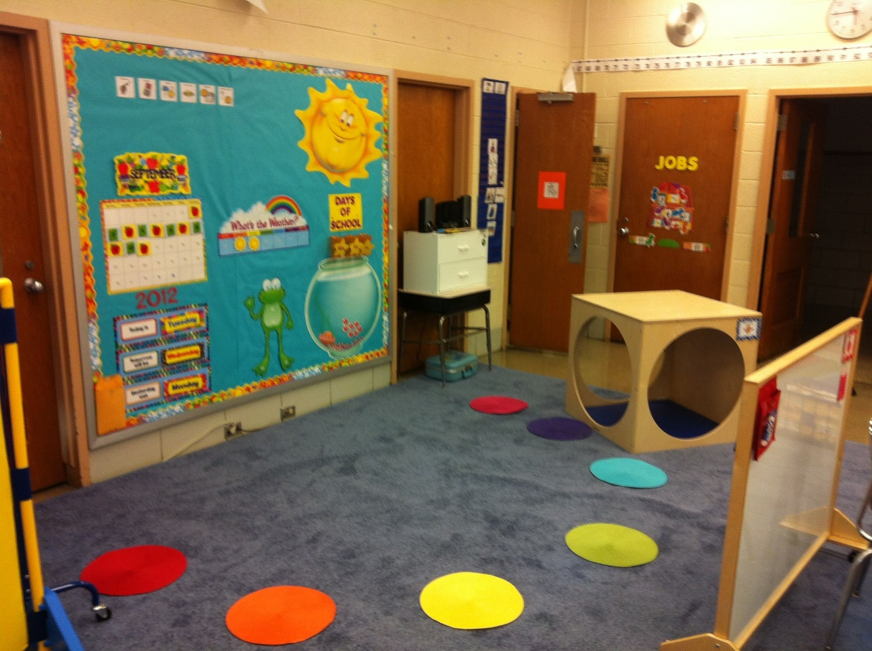
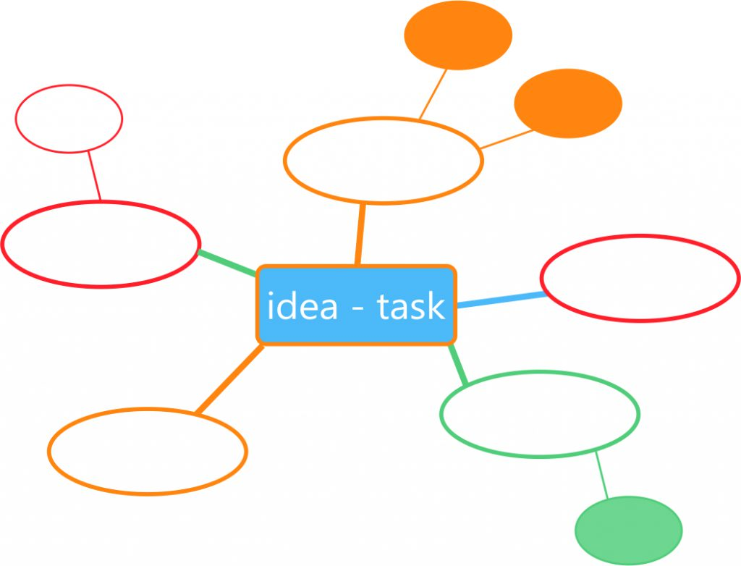
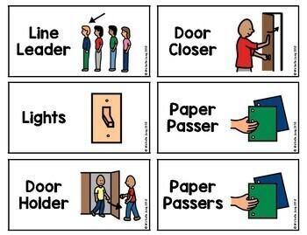
Plan for ‘surprise’ / change in a planned way
Build in flexibly in a planned way - don’t always do maths before lunch

Slide 13
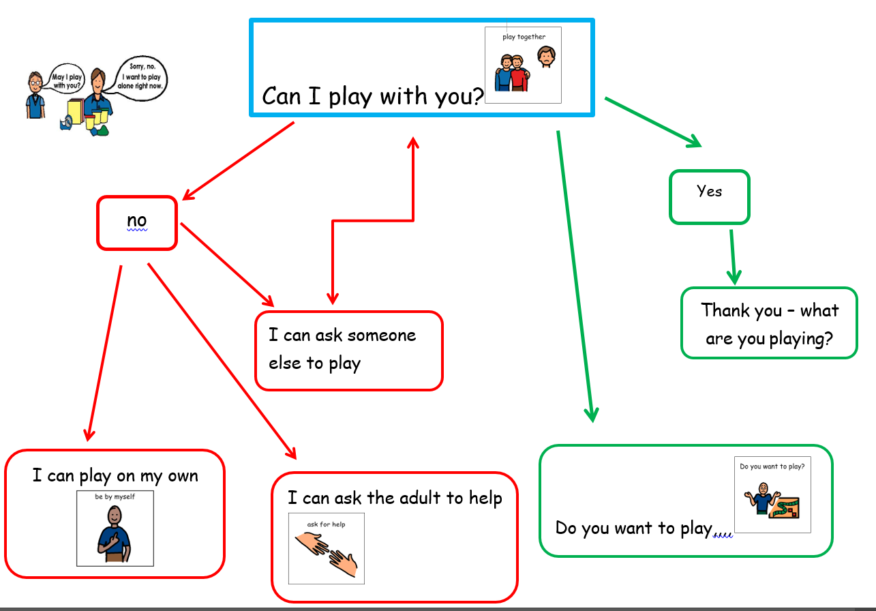

Slide 14
Language
Have you consider how clear and concise your spoken language is?

Slide 15
Language
Things to consider….
Be as accurate and as specific as you can be –
sit nicely? What does this mean??
Use of idimiosm
Teach pupils to ask for clarification when people use language they don’t know

Slide 16
Don’t repeat as will start the process again.
Use the person’s name, to cue them in
Reduce your language
Teach them how to initiate conversations
Using eye contact can be uncomfortable

Slide 17
Support change and tell why
How do you share changes with your pupils including staff absence - what could you do differently?

Slide 18
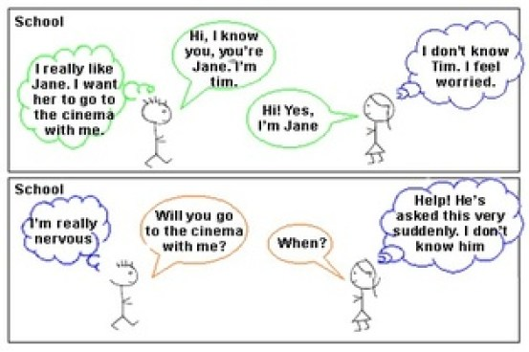
Support change and tell why Comic strips
Here’s some ideas…
https://sparkingspeech.com/2020/06/27/understanding-the-unwritten-rules-comic-strip-conversations/

Slide 19
Social stories
https://blogs.glowscotland.org.uk/er/autismadvisors/wp-admin/post.php?post=154&action=edit
https://www.autism.org.uk/advice-and-guidance/topics/communication/communication-tools/social-stories-and-comic-strip-coversations
https://www.autism.org.uk/advice-and-guidance/professional-practice/social-stories

Slide 20
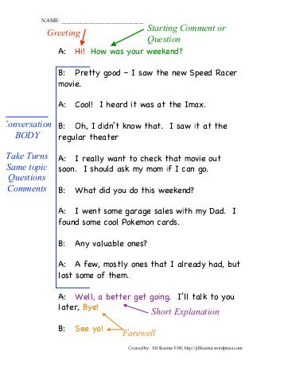
Scripts.

Slide 21
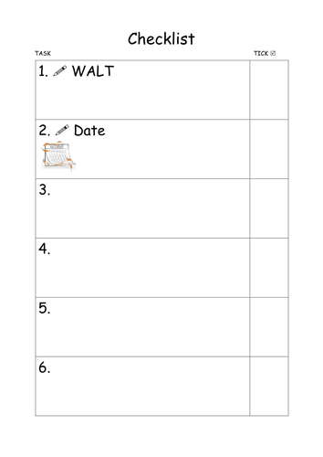
Some times anxiety is caused by rules which make no sense!
Why do we have to do assembly?
Why do I have to shake the vicar’s hand?
Why do I have to sing?
what you are supposed to be doing (because the teacher failed to give you sufficient instructions)

Slide 22
Flexible expectations Make it easier How is this achieved in your setting?

Slide 23
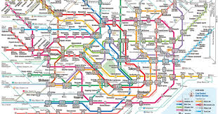
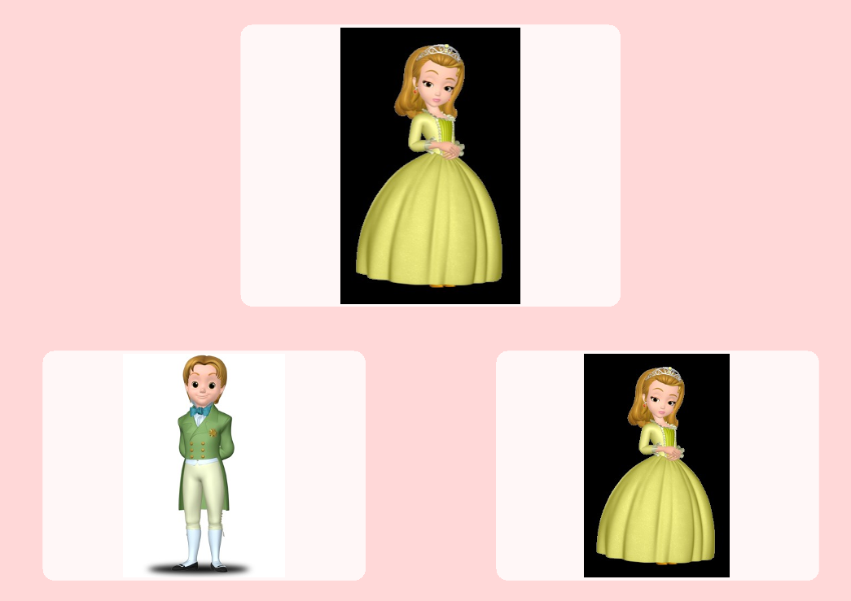
Flexible expectations Make it easier
How have you used special interests in the past?
How could you use them?
Allocating time to
talk about interests

Slide 25
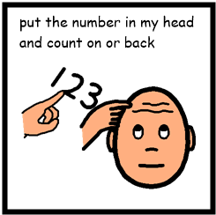
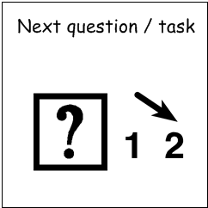
Don’t presume able to transfer skills – often generalised.
Fear of making mistakes – need for perfection
Getting 100% - change view that getting 15/20 is what you are working towards
Not attempting with the fear of making a mistake
Highlight own mistakes
Backward chaining
Teach the last step first
Cant cope with others breaking rules
good ignoring.
Its okay - its not your job
Teach them how – don’t presume they know how
even if they have done it before
Consider what is being asked of them in the task. Break it down into achievable tasks

