Slide 1
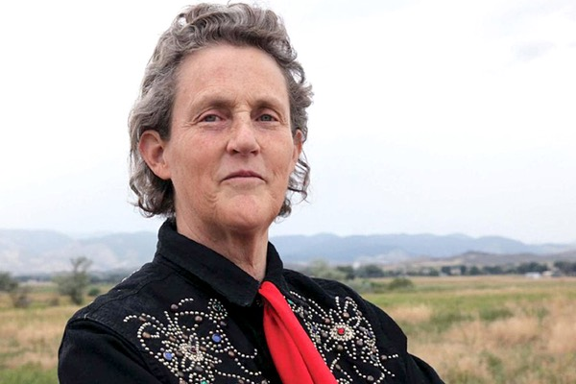
“What would happen if the autism gene was eliminated from the gene pool? You would have a bunch of people standing around in a cave, chatting and socializing and not getting anything done.” “The most interesting people you’ll find are ones that don’t fit into your average cardboard box. They’ll make what they need, they’ll make their own boxes.” “Rigid academic and social expectations could wind up stifling a mind that, while it might struggle to conjugate a verb, could one day take us to distant stars.”
Dr Temple Grandin

Slide 2
Autism: Inclusive Practice
East Renfrewshire Educational Psychology Service

Slide 3
Seminar Leads
Chris Atherton
Christine McGovern
Yvonne Hutchison
Jennifer Lerpiniere
Annie McGauley
Seminar One: Tuesday 8th November
Seminar Two: Tuesday 6th December
Seminar Three: Tuesday 24th January
Sector Specific Seminar Four: Tuesday 21st of March
All Seminars 3.45-4.45pm
Microsoft Teams

Slide 4
Peer Support Facilitators from Carlibar Communication Service
Rebecca MacDonald
Sharon Nelson
Claire Stewart
Donna Marie Weston
Peer Support Session One: Tuesday 22nd November
Peer Support Session Two: Tuesday 13th December
Peer Support Session Three: Tuesday 31st January
All sessions - 3.45-4.45pm

Slide 5
Overview of the Programme
Key Areas:
An Introduction to Autism Spectrum Conditions
Communicating a Positive View of Autism
Differing Presentations of Autism
Cognitive Theories of Autism
Managing Anxiety Driven Controlling Behaviours
Managing Difficult Situations: Low Arousal Approaches and Responding to Distressed Behaviours
Post identification – working with parents and children / young people
Throughout – Practical examples of how to create an inclusive environment for autistic individuals and families

Slide 6
Seminar one

Slide 7
Autism
Lotter 1966 – Presumed prevalence of 0.04%
1/100 in United Kingdom
National Autistic Society
Five fold increase in the 1990s – plateaued by early 2000s (Taylor et al., 2013)
1/68 in United States
Centers (sic) for Disease Control March 2014
More prevalent in males (4:1)***
Est 700,000 in the UK (1.1% of population) (NAS)
Notes:
Francis Happe – Core social and communication problems across a wide spectrum
Two key observations in her work
How hard individuals have to work to accommodate the social conventions and rules of others
How anxious individuals with ASD are.
Dr Bruno Bettelheim
Born in Vienna, Autria-Hungrian
Experienced Nazi concentration camp between 1938 and 1939 before being released during an Amnesty for Hitler’s birthday.
Emigrated to America
Noticed social withdrawal of individuals placed in extreme environments
Psychoanalytics – decided that children must have been in an extreme environment
Experienced mortal fear in response to mother’s unwanting and unloving interaction
Cold refrigerator mother
Dr Bernard Rimland
Twins with Autism
Many examples of only one affected
Contradictes psychoanlaytic theory
Genetical Biological Basis
Dr Nancy Minshew
Clearly a neurological disorder
Brain abnormalities are observable – structural differences
Different regions are not well connected
People experience the world very differently
Dr Matthew Anderson
Genetic Copy Number Variations (eg 15q11-13 duplication of this most common in autistic individuals, deletion of gene causes Angelman Syndrome)

Slide 8
Origins
Leo Kanner (1943)
‘Autistic disturbances of affective contact.’
Observation of 11 patients
Hans Asperger (1944)
‘Autistic Psychopathy in childhood.’
Observation of 4 patients

Slide 9
Clinically Diagnosed
DSM V
Autism Spectrum Disorder
“persistent difficulties with social communication and social interaction”
“restricted and repetitive patterns of behaviours, activities or interests” (this includes sensory behaviour)
present since early childhood, to the extent that these “limit and impair everyday functioning”
Source: NAS

Slide 10
DSM V
Social Communication Disorder
Presence of persistent social communication and social interaction difficulties
Absence of restricted, repetitive patterns of behaviour

Slide 11
Problems with a clinical approach
Within-person deficit model
It’s not a mental disorder, it’s a neurological difference
It’s not a homogenous group - every autism profile is unique
Yes, some have learning differences, some are non verbal, some have learning disabilities, but most do not.
Is there really such a thing as neuro-typical?
Reverse the logic of this definition – do non-autistic people find social communication and interaction all that easy? Are their behaviours, activities and interests really all that varied?

Slide 12
So if Autism isn’t quite that, what is it?
“a difference in a person’s cognitive state”
“a condition of extremes”
Predominant Neuro-Type (PNT)
Autistic Neuro-Type (ANT)
Luke Beardon

Slide 13
Key Issue – Bias
Many children and young people in your school will have neuro-developmental differences that influence how they function in a social world that is shaped, for the most part, by people without such differences.

Slide 14
For example
Autistic people’s experience is seldom (if ever) kept in mind when, for example, school buildings, restaurants and shops are designed.
The experiences of autistic people were not, historically, understood or taken into account when school systems were developing into how they look today.
It is only over the last twenty years or so that our knowledge and understanding of the differing needs and requirements of autistic people has truly begun to influence mainstream practice.
Even so, the generally good baseline knowledge, understanding and experience of practitioners is not always shared by the wider population.

Slide 15
Strategies are worthless without awareness and understanding
An inclusive, neurodiversity aware school will find that autistic children and young people are more likely to attend and engage in their learning.
Whole school commitment is critical, as the anxiety that this population of children and young people can experience is often routed in:
their social communication experiences
their relationships with peers and staff
the inconsistencies they experience with respect to rules and expectations (which may not even be noticed by others)
multiple transitions
sensory and environmental triggers
not being properly understood

Slide 16
Result
The social world of non-autistic people becomes extremely difficult for the autistic person to navigate
The social world isn’t a safe place…fear, anxiety, stress => cognitive rigidity
A system for navigating the social world is not effective / consistent enough
Less options to choose from – most effective is to sabotage = I AM BACK IN CONTROL

Slide 17
Temple Grandin
“Fear is the main emotion in autism”

Slide 18
The Human Brain
http://www.bbc.co.uk/news/health-40488545

Slide 19
Temple Grandin

Slide 20
What Patterns Might I See in those with Autism?

Slide 21
Visualizer (Tony Attwood)
More classic ASD profile
Strong perceptual reasoning skills
Interest lies in a world with pictures / patterns and logic
Language skills may develop more slowly – sometimes incompletely, or not at all
Verbal reasoning skills appear weaker / used less often
Less attuned to auditory processing activities – words and meaning disappear
Preference for ‘show me don’t tell me’
Limited use of emotional vocabulary
Notes:
Some autistic people will benefit from strong visual and perceptual reasoning skills, and enjoy learning and activities that involve pictures, patterns and logic. However you may find that their spoken language develops slowly or incompletely, that they are less likely to understand creative or idiomatic language, and that their verbal reasoning skills are not as strong as most others for their age and stage. They may also have differences in how they process auditory information, so spoken words and their meaning might disappear quite quickly, or they may not follow that instructions apply to them as individuals. They may also have a limited emotional vocabulary. This type of profile is perhaps more familiar as it is aligned to a historically narrower understanding of an autistic profile.

Slide 22
Verbalizer (Tony Attwood)
Strong verbal reasoning skills
Interest in the written word / vocabulary / information
World of emotional literacy - thoughts and feelings
Processing time needed for linguistic, cognitive and social activities
‘If I wait, I'll forget’ – ends up interrupting
Yet – hates being interrupted!
Ask three before me (friends / peers) - doesn't work
Delay in response to an act, reaction might come hours or days later.
Need time to identify internal emotions
Be prepared for a delay in response! Don’t ask again – that resets the process…
Notes:
Some autistic people will present quite differently to this, for example, they may have very strong verbal reasoning skills, an interest in vocabulary and the written word, be immersed in the world of emotional literacy, highly attuned to their internal thoughts and feelings, but perhaps require processing time and time out from linguistic, cognitive and social activities. Some autistic people experience delayed effects in response to an act or experience, with their reaction coming hours or days later. Some need more time to identify their internal emotions.

Slide 23
With such a varying profile of need and experience, autistic people need to be understood individually.
Plans need to be tailored specifically in partnership with them to ensure they meet their needs and offer them the right learning experience.
Let’s look at some key areas…

Slide 24
Social Communication and Interaction
Some Indicators and Differences

Slide 25
Language and Communication
Pragmatic
Literal
Semantic
Notes:
Semantic – the meaning of language
Pragmatic – the functional use of language – how it is used in context.
Literal – not deviating from the exact meaning of language (non figurative / idiomatic / euphemistic)

Slide 26
Some Common Indicators and Differences (In some autistic people)
Delay / lack of speech development (age and stage)
Lack of response to other’s speech (including own name)
Stereotyped and repetitive use of language
Pronoun reversal (saying ‘you’ for ‘I’)
Idiosyncratic use of words – describing and not naming, own statements
Literal interpretation of language
Differing ways of initiating or sustaining conversation including (e.g more direct, no small talk, less turn taking, abrupt beginning and end)
Differences in speech e.g. pitch, stress, intonation and in the use of or understanding of voice prosody
Semantic / conceptual differences

Slide 27
Indicators and Differences (In some autistic people)
Differences in understanding or use of non-verbal communication – facial expression, gesture
Lower drive or motivation to develop and sustain friendships, understanding the social elements of friendships (as PNTs would view them!)
Seemingly inappropriate comments and actions (for the context)
Lower tolerance for close proximity, or the opposite!
Seemingly less attuned to recognise or respond to other people’s feelings
May seem to assume other people know their thoughts, experiences and feelings.

Slide 28
http://www.bing.com/videos/search?q=sheldon+cooper+sarcasm+sign&view=detail&mid=025EEDB81834BB35070B025EEDB81834BB35070B&FORM=VIRE&adlt=strict
http://www.bing.com/videos/search?q=friendship+algorithm&adlt=strict&view=detail&mid=9E8D1FE6E107A918DB609E8D1FE6E107A918DB60&FORM=VRDGAR

Slide 29
Passions, Preferences, Focus
Some Indicators and Differences

Slide 30
http://www.bing.com/videos/search?q=fun+with+flags&adlt=strict&view=detail&mid=F69398E6F236F697EE36F69398E6F236F697EE36&FORM=VRDGAR
http://www.bing.com/videos/search?q=sheldon+cooper+routine&adlt=strict&view=detail&mid=B080132947EB01F04E93B080132947EB01F04E93&FORM=VRDGAR

Slide 31
Indicators and Differences
Play and writing often based on re-enacting scripts / films / stories from or centred around a preferred interest
May need more support and direction to make choices between activities and in unstructured times
Passions and interests may become all encompassing, may not be shared by peers of a similar age (less problematic when you get older!)
Hates rules to be broken
Changes to routines / expectations causes anxiety
Three dimensional thinking – differences in ability to see alternative perspectives

Slide 32
Common Triggers and Challenges
Think about the fixed v growth mindset
Fear of making a mistake / need for perfection - If I don't try, I don't make a mistake. Mistakes prove you are stupid.
In some, this can be seen misconstrued as intellectual arrogance or narcissism – could be a barrier to developing positive relationships.

Slide 33
Common Triggers and Challenges
Point out errors of others as they have broken the rules
Self perception as an adult (don’t differentiate)
Need / desire to do things my way - predictability
Last to know and seek help if on the wrong track
Anxiety increases cognitive rigidity

Slide 34
Features of Effective Support

Slide 35
What Can I Do?
Keep things visual: Either pictorial, written down or using videos, Visual prompts are helpful to gain and direct attention, to support comprehension and enhance learning experiences. Make visual cue cards available for support around daily social communication if required.
Enhanced the structure: Weekly timetables, daily schedules and learning activities broken down into shorter, more manageable steps will often help. Clear timescales, start and finish activities on time, give a chance to complete work at another time for closure.
Break the problems down: Explore the use of social stories for specific experiences that they find challenging. Consider a time-out card or strategy, and a plan for where to go that is safe and appropriate, if things are getting tough for any reason.

Slide 36
What Can I Do?
Time to process: Begin by using their name. Allow at least 10 seconds for a response before checking - understood the question / expectation / instruction. As them to repeat back in their own words.
Make it easier: Keep language simple, concise and consistent to avoid overload, and supplement with visuals where possible. Break the tasks down into more manageable steps
Slowly forward: A de-sensitisation or gradual exposure plan (e.g. building on short amounts of time in non-preferred situations (e.g. classes, subjects, areas of the building, transition points, with particular peers or staff) rewarding and recognising very small steps and appropriate use of contingency / safety plans
Make it logical: If the young person relates to it, use probability, maths, likelihood and logic wherever possible. Numbers are consistent, language and people are often not.

Slide 37
Teach Them How!
How and when to start
When its ok to interrupt
What turn taking looks like
Remaining on topic
Follow up questions
Personal space
Facial expressions and non-verbal communication
When and how to end politely
Appropriate voice volume and tone awareness for different contexts.
Model appropriate social use of language e.g. sentence openers and responses to familiar types of questions.
Encourage clarification questions - for phrases or use of words that seem atypical.
This skills will help to develop their social confidence and ability to develop peer relationships

Slide 38
What Can I Do?
Support change: Enhance support for transitions where necessary e.g. meeting and greeting, change of person, place, expectation, environment
When will it happen, what should they expect, what is expected of them, how long it will last, and what will happen after? What can they do to help manage the change? Time to process that change is coming, e.g. “in five minutes the bell will go…”
Provide clearly defined breaks between structured activities, and choices to manage unstructured times
Tell them why: Explain the reasons behind decisions and changes that affect them. E.g. school values, rules and boundaries
Explore the logic behind them
Special interests (Passions): Capitalise on their interests and strengths - tap into what they are passionate about, then tailor their curricular experiences around these. You can also make the links between your subject area and theirs explicit.

Slide 39
What Can I Do?
Make them feel useful and capable: “I’d find it so helpful if you could…” Give them the chance to showcase their strengths, talents and interests
Have restorative discussions: Especially when things haven’t worked out, and use visuals to support questioning (e.g. What happened? Who was affected? How did it make you feel? What needs to happen now?) and visual prompts for responses (e.g. “it was too loud…”, “I felt angry…”
Make sure you’re clear: Consider how your language and phrasing could have been misinterpreted and check that you have been understood as you intended to be.
Be as accurate and concrete as you can.
Teach them the meaning of unusual phrases and encourage them to ask for clarification
People are very often loose and inaccurate with the language they use and rely on people getting the ‘jist’ of what they mean – often relying heavily on context or prior discussion / knowledge. This is often fundamental to communication errors between autistic and non-autistic people.

Slide 40
What Can I Do?
Highlight your own mistakes and recovery: Model how to cope with the frustration, and talk through how to recover.
Selected choices: These give them the feeling of being in some control, which can reduce feelings of anxiety (e.g. “Do you want to start the phased return during period one or period two?”
Flexible expectations: Choose your battles: is your aim and need worth risking a breakdown in your relationship or an emotionally distressing experience for the young person? This is not the same as letting them do what they like. Boundaries are clearly important, but where possible avoid them becoming power battles. E.g. “Because I’m telling you… because I said so”
Backward learning: If they are stuck, refusing or struggling, try backward learning – you or someone else helps them with 90% of the task, they finish the last 10% so experience closure (and build from there)

Slide 41
What Can I Do?
Indirect praise: For example talk to a pupil or member of staff about something good the child has done while they are in earshot – may be more easily accepted than directly praising them.
Explicitly teach for each context: Emotional regulation, and desirable social behaviours often need to be taught directly and specifically around all potentially triggering situations.
Some children and young people will not be able to flexibly transfer their coping strategies across different situations.
This can sometimes be seen unhelpfully by others as evidence that they are ‘picking and choosing’ or ‘manipulating’ situations to their own end.
Teach the behaviours and language you want to see, rather than focussing on the behaviour or language you want them to stop using.
Depersonalise the situation: Use rules to your advantage, e.g. “I have a dress code for work, because those are the rules of the system.”

Slide 42
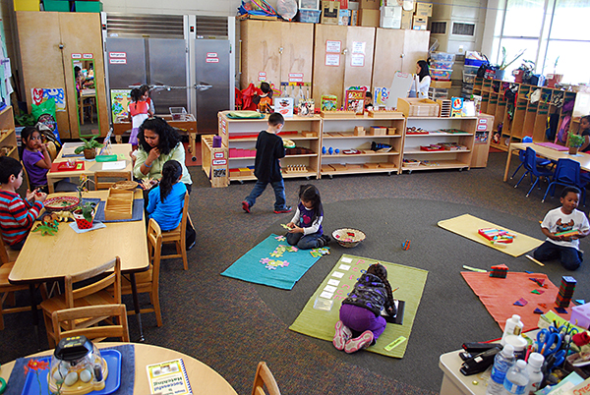
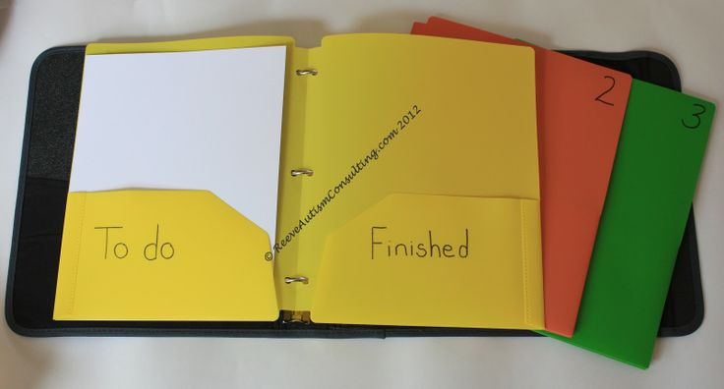
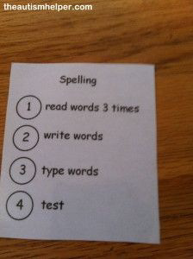
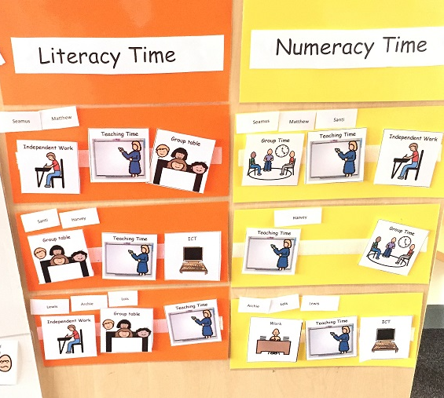
Autism Specific Considerations (That can help just about anyone)
Keep things visual
Enhanced the structure
Break the problems down
Time to process
Make it easier
Teach them how
Support change
Tell them why
Notes:
Keep things visual – layout of building / classroom = designated areas. Labelling environment, schedules
Enhanced the structure – structure of the classroom, predictability of the day / week.
Break the problems down – size of the problem – whether it is something within your control. What do you know. What can you do
Consider what is being asked of them in the task. Break it down into achievable tasks
Time to process – additional time – don’t repeat as will start the process again.
Make it easier – consider winning the war not the battle – can you compromise. Consider your reasons. Do you need to sit to listen?
Teach them how – don’t presume they know how. Talk through the steps – how have we learnt certain things? Reasons why have to do things which often don’t make any sense eg lining up in the supermarket. Having to make small talk
Support change – change – the unknow making it predictable including why? Why do I need to go to High school. Social stories to reinforce. Scripts. Comic strips
Tell them why – why do I need to keep on my seatbelt – what will happen if I don’t. written information as well as spoken. Written to reinforce.

Slide 43
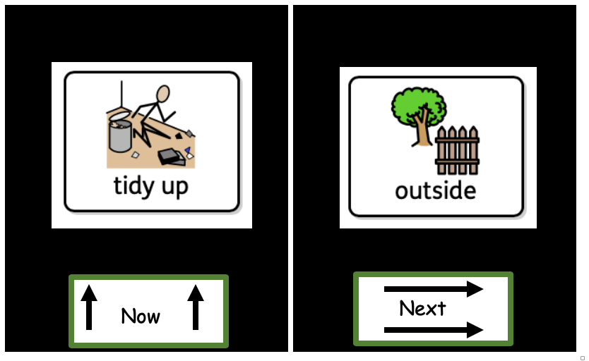
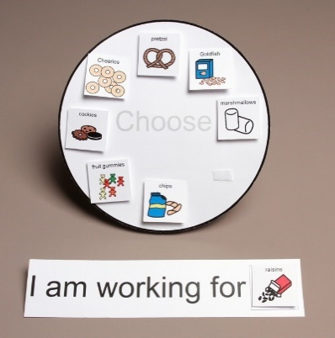
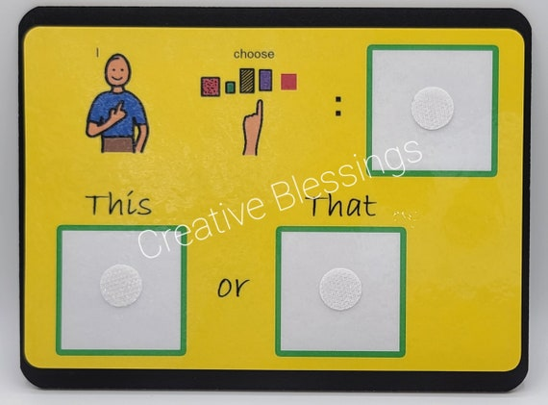
Autism Specific Considerations (That can help just about anyone)
Special interests
Make them feel useful and capable
Have restorative discussions
Highlight your own mistakes and recovery
Selected choices
Flexible expectations
Backward learning
Indirect praise
Notes:
Special interests – not an obsession. Use as motivators, contexts for learning, method to share learning – using character as 3rd person to share information
Make them feel useful and capable – give them responsibility. Sharing the purpose of things
Have restorative discussions – make use of visuals to explore what has happened. What happened before. Make use of options and not presume able to recall. Coloured semantics.
Highlight your own mistakes and recovery – talk through what you have done. Normalise making mistakes and opportunities for learning. Accept that we don’t have to be perfect although many individuals feel that they do
Selected choices – allow them to feel in control and present options – order of the tasks, options on what can work for
Flexible expectations – consider what is the focus that trying to achieve, sitting with the class or listening
Backward learning – learn the last part of a routine first and gradullay increase
Indirect praise – many unable to accept praise and not wanting to be the centre of attention. Either direct praise to everyone or indirect – thumbs up, away from others. Low self esteem and will forcus on the negative

Slide 44
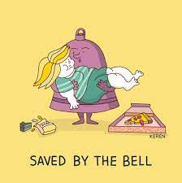
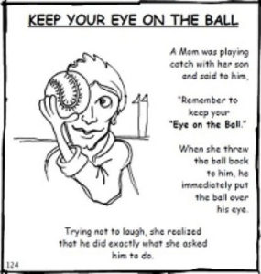
Autism Specific Considerations (That can help just about anyone)
Make sure you’re clear:
Consider how your language and phrasing could have been misinterpreted and check that you have been understood as you intended to be. Be as accurate and concrete as you can.
Teach them the meaning of unusual phrases and encourage them to ask for clarification when people use language they don’t understand. E.g. “They are off to play football in the bus” doesn’t mean they are playing football inside the bus.
People are very often loose and inaccurate with the language they use and rely on people getting the ‘jist’ of what they mean – often relying heavily on context or prior discussion / knowledge.
This is often fundamental to communication errors between autistic and non-autistic people.
Notes:
Make sure you’re clear: Language
check that you have been understood
Be as accurate
concrete as you can – sit nicely?
unusual phrases
ask for clarification when people use language they don’t understand. E.g. “They are off to play football in the bus” doesn’t mean they are playing football inside the bus.
You know what I mean? Do you?
Rely on context
Recall of prior discussion / knowledge.
This is often fundamental to communication errors between autistic and non-autistic people.

Slide 45
Autism Specific Considerations (That can help just about anyone)
Slowly forward
Make it logical
Explicitly teach for each context
Depersonalise the situation:
Use rules to your advantage, e.g. “I have a dress code for work, because those are the rules of the system.”
Notes:
Slowly forward – celebrate the successes
Don’t presume able to transfer skills – often generalised.
Don’t presume that as they aren’t using visuals that don’t need it.
Don’t presume because they go home every night they know that it will happen every night
Make it logical – meaningful. For what reason. Present each step
Explicitly teach for each context
Depersonalise the situation:
Use rules to your advantage, e.g. “I have a dress code for work, because those are the rules of the system.”

Slide 46
"I’ve come to a frightening conclusion that I am the decisive element in the classroom. It’s my personal approach that creates the climate. It’s my daily mood that makes the weather. As a teacher, I possess a tremendous power to make a child’s life miserable or joyous. I can be a tool of torture or an instrument of inspiration. I can humiliate or heal. It is my response that decides whether a crisis will be escalated or de-escalated and a child humanized or dehumanized. (H. Ginott)
Notes:
I am part of the environment
I am able to make changes.
My behaviour needs to be consistent and predictable
My presentation, understanding of the individual, ability to make changes = makes the difference.
I have a lasting impact on that child future both positive and negatively.
I can support a situation to be defused, supported or esculated.

Slide 47
Summary
Anxiety and fear can be very dominant emotions for autistic people.
Many of the challenges that autistic people encounter arise within the rules, parameters and constraints of a neuro-typically dominant social world.
School systems generally reflect this dominance, resulting in higher risk for neuro-atypical people to experience higher levels of stress.
For some autistic people, this would have been underlined by lockdown during the pandemic, where these daily stressors were suddenly removed.
We know that some children, young people and families have found some aspects of the return to full time education difficult.
However for others, the structure, routine, predictability, engagement, and separation of home and school contexts, as well as reconnection with key adults and peers, has been very welcome. It really depends on the individual and their experience.

Slide 48
Summary
Autistic people usually exhibit differences in how they communicate and interact socially.
They may have strong interests or passions about specific activities or interest, and may enjoy routinized, repetitive experiences.
Autistic people often experience the sensory world differently, and can be either hyper or hypo-sensitive.
Many young autistic people will identify sensory triggers like the school bell, the canteen, and large, busy spaces, as quite triggering and difficult to cope with. This can be evident at major transitions such as entering or exiting the school building, break, lunch time, and transitions between classes.
Their preferred topics of conversation or their general social communication style may make it more difficult for them to establish friendships they can feel secure and calm in.

Slide 49
Be Aware
the content of what you say carries more weight than all other elements of your communication (e.g. your speech prosody, volume, intonation, pitch, and non-verbal communication)
the issue of communication breakdown between neuro-typical and neuro-diverse individuals is one of a double empathy problem, it’s not the individual with ASC that has sole ownership of the problem
a person with ASC will often have a base level of anxiety that is much higher than most neurotypically developing people, meaning they are more vulnerable to emotional lability and shame if they have regular emotionally draining responses

Slide 50
Next Time
Cognitive Theories of Autism
Sensory and Perceptual Differences

