Slide 1
Supporting Children with Anxiety
East Renfrewshire Educational Psychology Service/Healthier Minds Service
May 12th, 2022

Slide 2
Introductions
Kirstie Rees | Depute Principal Educational Psychologist
Jennifer Wilson | Depute Headteacher
Angela Merrylees | Principal Teacher, Healthier Minds Service
Paula Queen | Assistant Educational Psychologist
Hannah Sissons | Assistant Educational Psychologist

Slide 3
https://blogs.glowscotland.org.uk/er/healthierminds/
https://blogs.glowscotland.org.uk/er/healthierminds/
Parents’ Guide

Slide 4
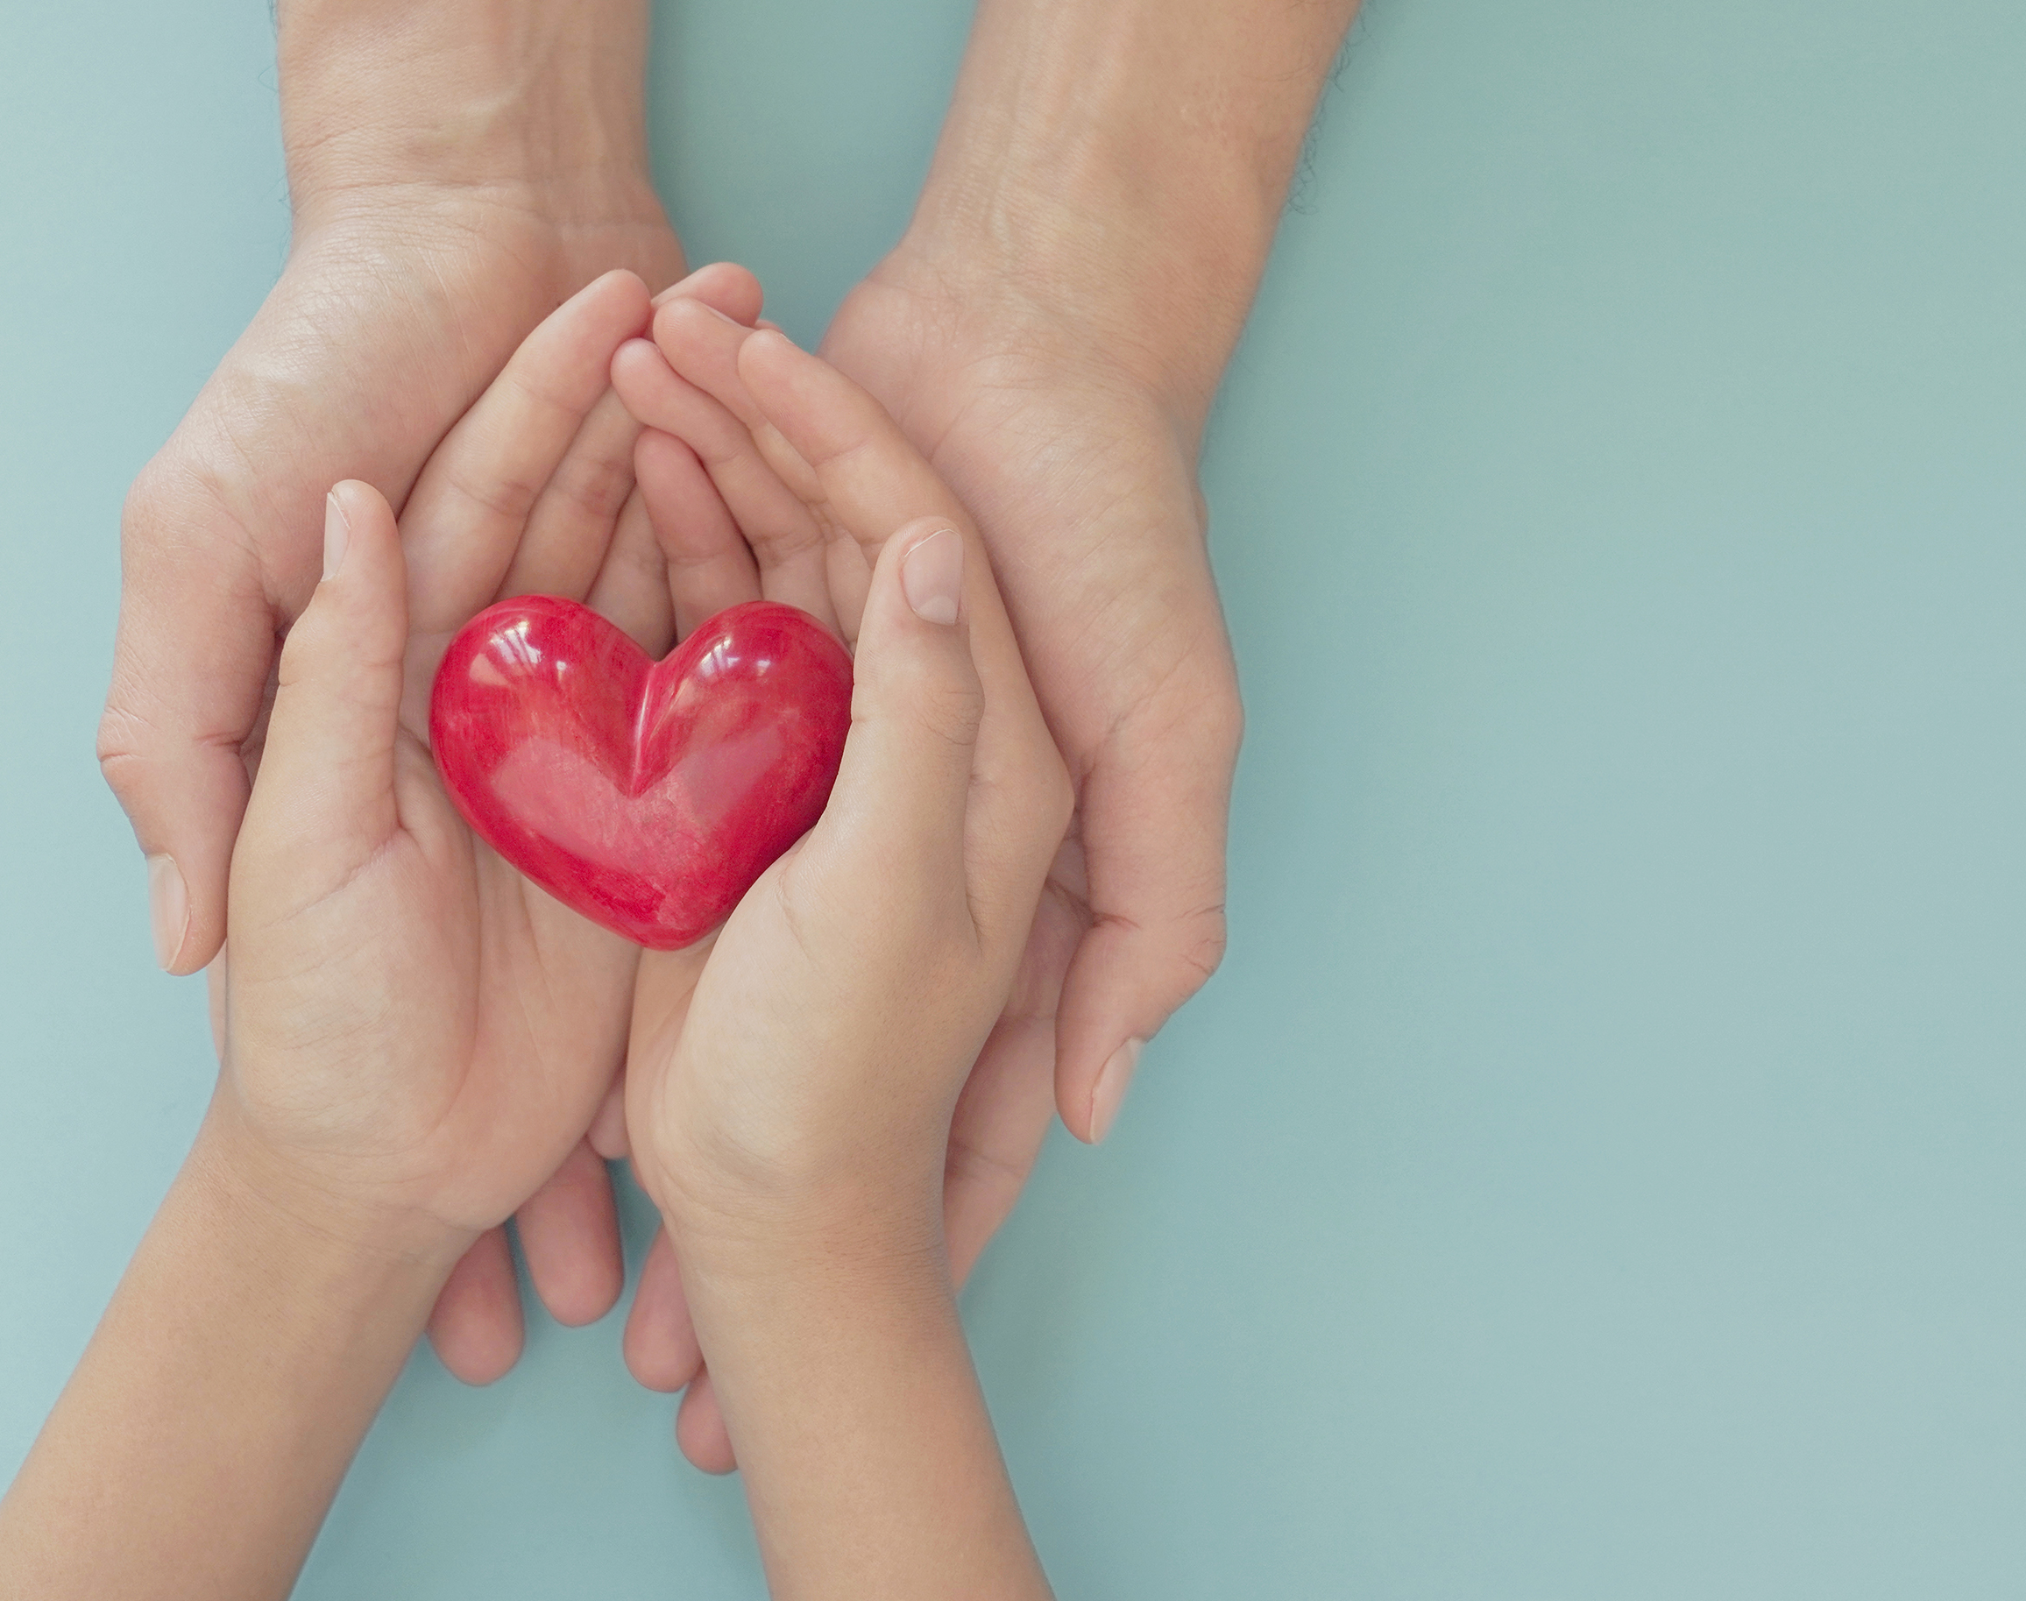
Aims of the Session To understand mental health and wellbeing To understand why children feel anxiety and stress To recognise what makes your child stressed To identify how your own child responds to stress To work out how you can help them to develop coping strategies and RESILENCE

Slide 5
Being a child today can be tough Covid Social Media But we learn from the hard stuff….

Slide 6
We all feel a range of feelings all the time This is NORMAL
What’s wrong with you?
What’s happened to you?
The Mental Health and Wellbeing Continuum

Slide 7
What is stress?
A small amount of stress is a good thing
Amygdala – detects stress
Fight/flight/freeze stress response

Slide 8
Our Stress Response
Fight:
- Hitting, kicking, arguing, shouting
Flight
- Running away, hiding, being quiet
Freeze
- Restless, trying to make others happy, being stuck on danger
Collapse
- Sleepy, shallow breathing, feeling cold/shivery

Slide 9
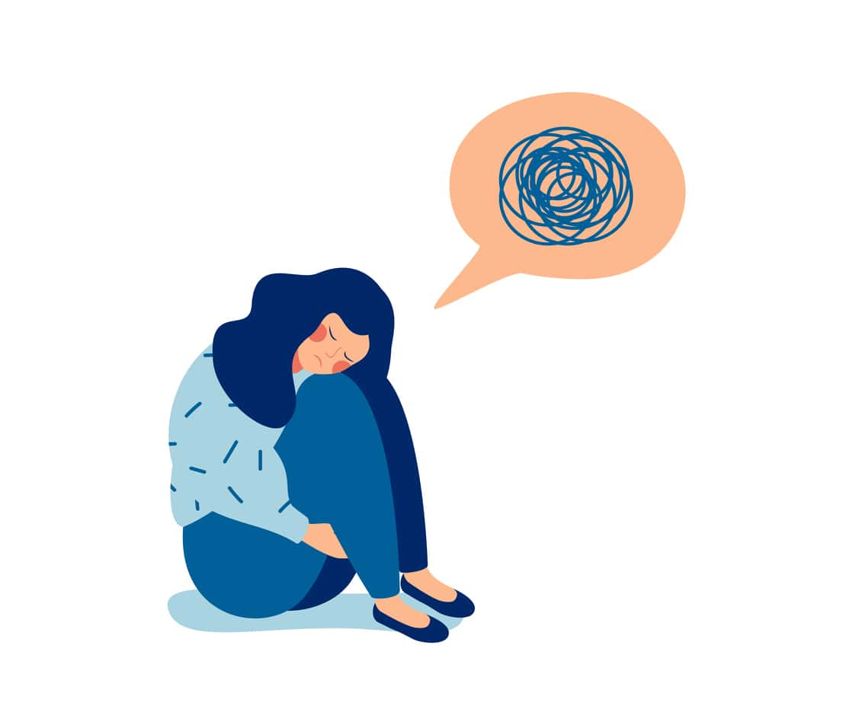
Anxiety in children and young people
Stress can lead to anxiety
Anxiety can look similar to stress:
Asking for reassurance repeatedly
Complaining of headaches and tummy aches
Not wanting to be away from their parents/carers
Crying a lot or changes in mood

Slide 10
What causes your child stress..?
Falling out with friends
School
Social Media
Problems with family members
Losing someone close to them
Transitions and Change
Divorce in our family

Slide 11
Where do they feel it..?
Sore head…
Tight shoulders..
Increased heart rate
Knot in stomach
Feel sick
Feel sick
Clammy hands

Slide 12
So, how can you support your child? Balance structure with nurture
Relationships
Routine (eating, sleeping, exercise)
Motivators
Plan for Transitions
Children still need containment, as well as to learn independence skills

Slide 13
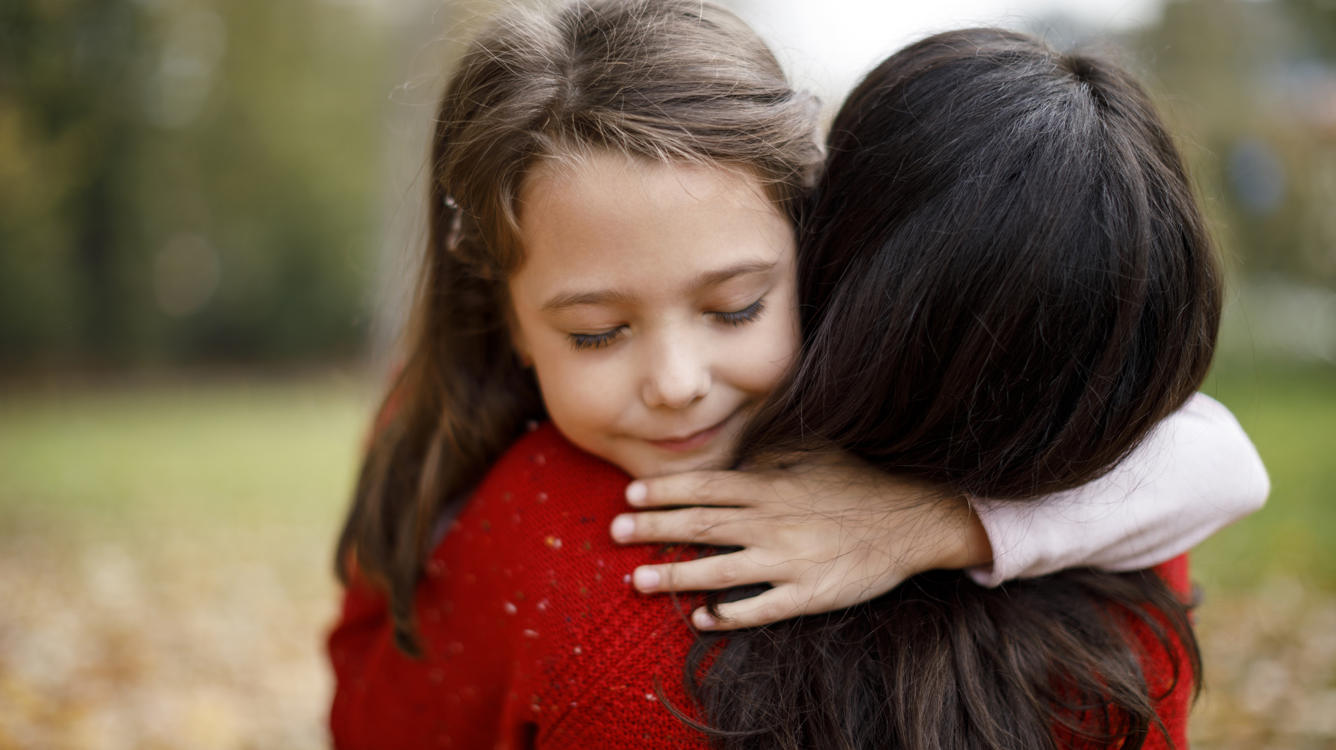
Get alongside your child

Slide 14
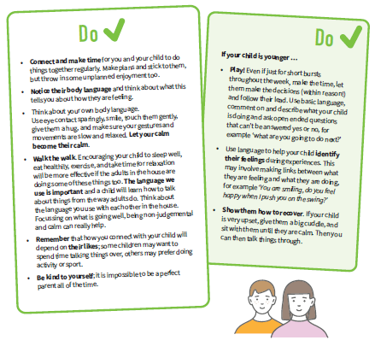
Listen, Talk and Connect

Slide 15
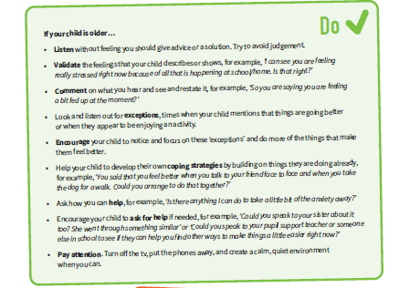
Listen, Talk and Connect

Slide 16
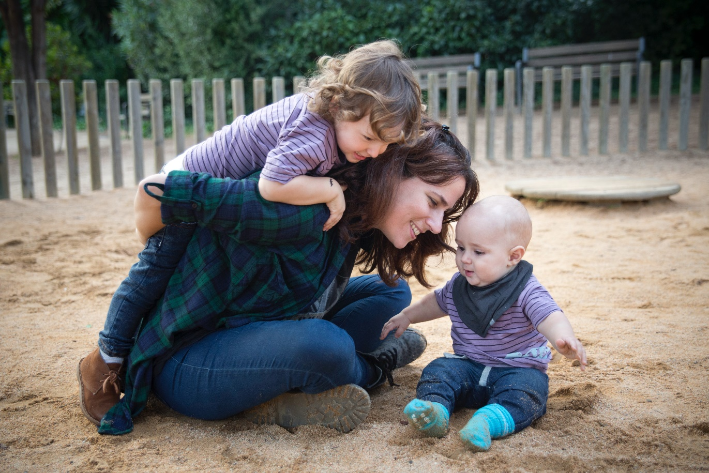
Physical Activities and Relaxation

Slide 17
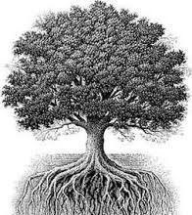
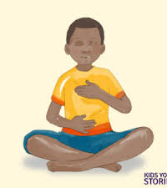
grounding breathing

Slide 18
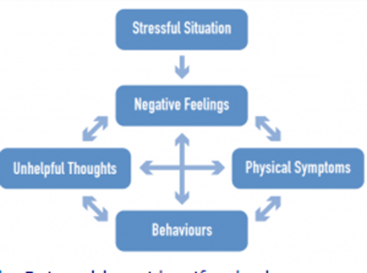
Understanding the Link between: Thoughts, Feelings and Behaviours

Slide 19
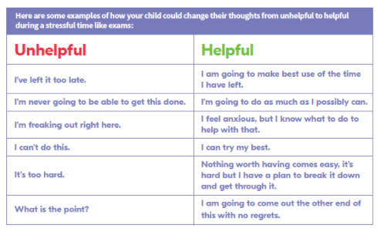
Changing negative thoughts

Slide 20
A Staged Approach
Avoid avoidance….

Slide 21
Resilience…. Remember, we we learn from the hard stuff….

Slide 22
https://blogs.glowscotland.org.uk/er/healthierminds/
https://blogs.glowscotland.org.uk/er/healthierminds/

