Slide 1
The Impact of Coronavirus
COPING IN UNCERTAIN TIMES
Nick Smiley and Kirstie Rees
East Renfrewshire Educational Psychology Service

Slide 2
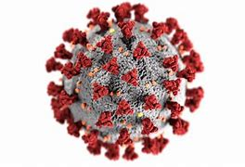
Covid-19 How does it make us feel? How does it affect our behaviour? What helps us to cope?

Slide 3
Living through a Pandemic
Bored
Frustrated
Grieving
Happy
Anxious
Unfocused
Angry
Creative
Exhausted
Calm
Guilty
Out of control
Relaxed
Overwhelmed
Unmotivated
Confused

Slide 4
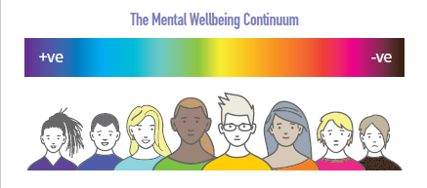
We all respond differently to difficulties
depending upon the size,
our sense of control
and who and what is there to help us

Slide 5
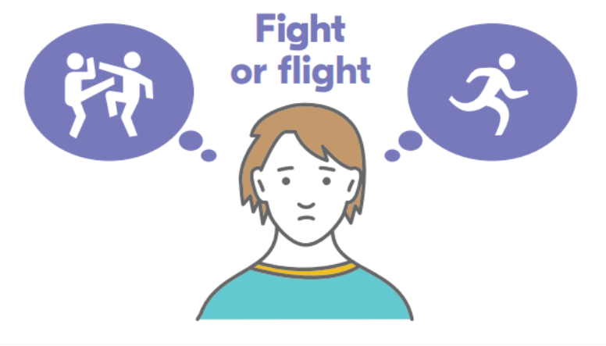
So how does our brain react? Fight, Flight or Freeze

Slide 6
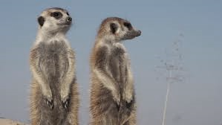

Slide 7
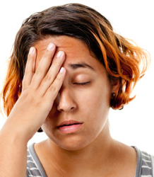
How is the pandemic affecting our children and teenager’s behaviour?
Images from: Parenting Through Middle School: Top 4 Picks for Raising Tweens (yourteenmag.com)
Expectations | TeenSpeak
Notes:
We might feel calm one minute, and then overwhelmed the next.
We might just feel numb and want to retreat
We might feel more stressed and alert – ‘hypervigilant’ – like a meerkat in a zoo standing up and looking out to check what’s going to happen next
We might feel a bit sick
We might feel angry and small things may make us want to just lose it
It might bring back lots of other feelings that remind us of other stressful times and times when we experienced loss or difficult change
And it might make the stress we were feeling even harder to manage
And we might feel all of these things in any one day
It can be a real a rollercoaster ride.

Slide 8
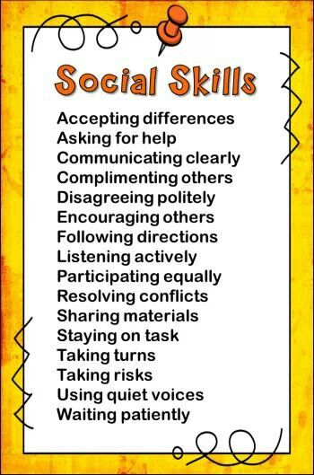
Social Skills
Social Skills

Slide 9
The Teenage Brain
Self-interest
Independence
Brain development
Peer groups
Risk taking
Mood changes
Sensitivity

Slide 10
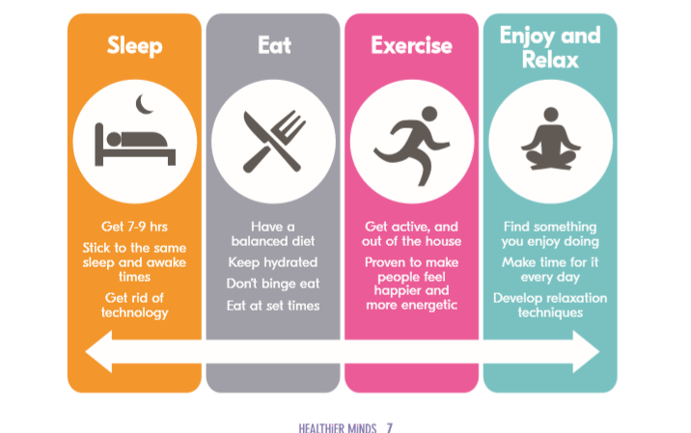
The Basics…

Slide 11
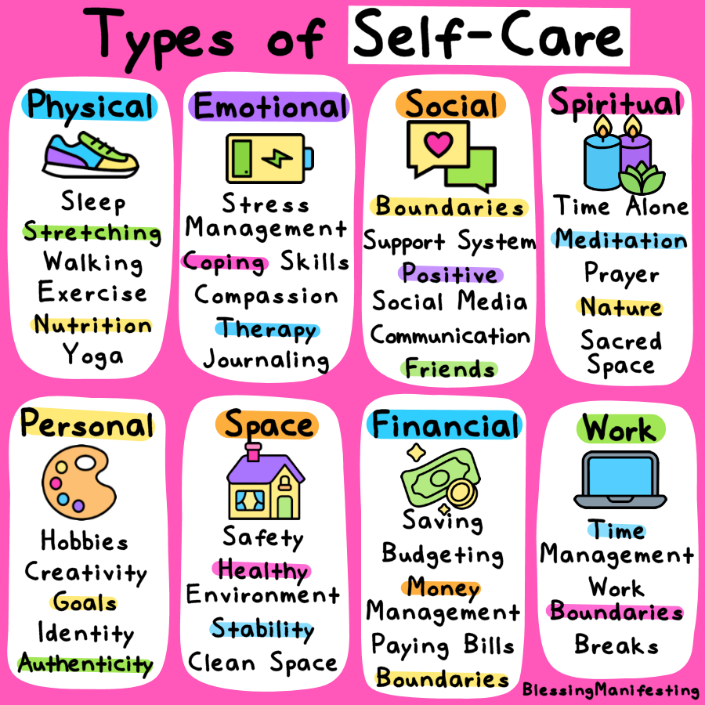
Notes:
For parents – fit your own life jacket 1st!
We are all struggling at the moment and it's ok for our children to know that we are not ok. We need to promote a culture where talking about our feelings is not just acceptable but good and that starts with us - talking, sharing, showing emotion and crucially how we manage big feelings and what coping strategies we use.

Slide 12
Control what you can control

Slide 13
Develop your own coping toolbox
Physical Tools | Talking Tools
Relaxation exercises | Talking to a close friend
Mindfulness exercises | Changing your thinking

Slide 14
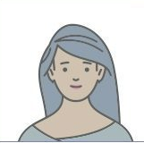
Your ‘Inner Circle’..
Who always makes you feel better, no matter what…?

Slide 15
Try to tackle your thinking

Slide 16
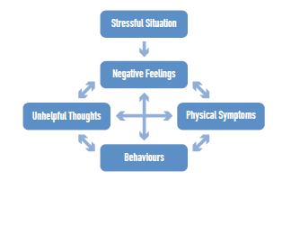
Listen to your body- know your triggers

Slide 17
Be kind to yourself
Selfcompassion.org.

Slide 18
This won’t last forever….

Slide 19
https://blogs.glowscotland.org.uk/er/healthierminds/
https://blogs.glowscotland.org.uk/er/healthierminds/additional-support-needs/relaxation-strategies/

