Slide 1
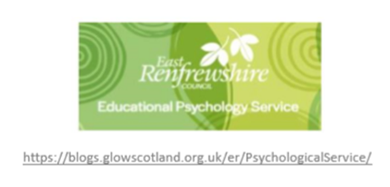
The Impact of Covid 19 HELPING OUR CHILDREN TO THRIVE IN UNCERTAIN TIMES
Ainsley McGoldrick, Katherine Fraser and Partners
East Renfrewshire Educational Psychology Service

Slide 2
Uncertainty
Lack of control
Loss
Health fears
Notes:
Impact of covid

Slide 3
This is Covid 19
Anxious
Struggling to focus
Angry
Overwhelmed
Physically unwell
Fatigued
Antisocial
Guilty
Absolutely fine!

Slide 4
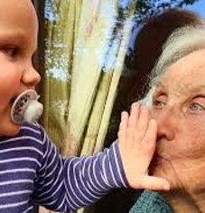
What Covid 19 means for children
Closed ELCs and schools
Loss of contact with extended family and friends
Reduced opportunities for clubs, soft plays, activities, organised groups
A different way to play
Closure of libraries, museums, community centres, travel restrictions
Understanding new rules
Parents juggling roles
Parent wellbeing

Slide 5
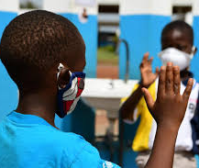
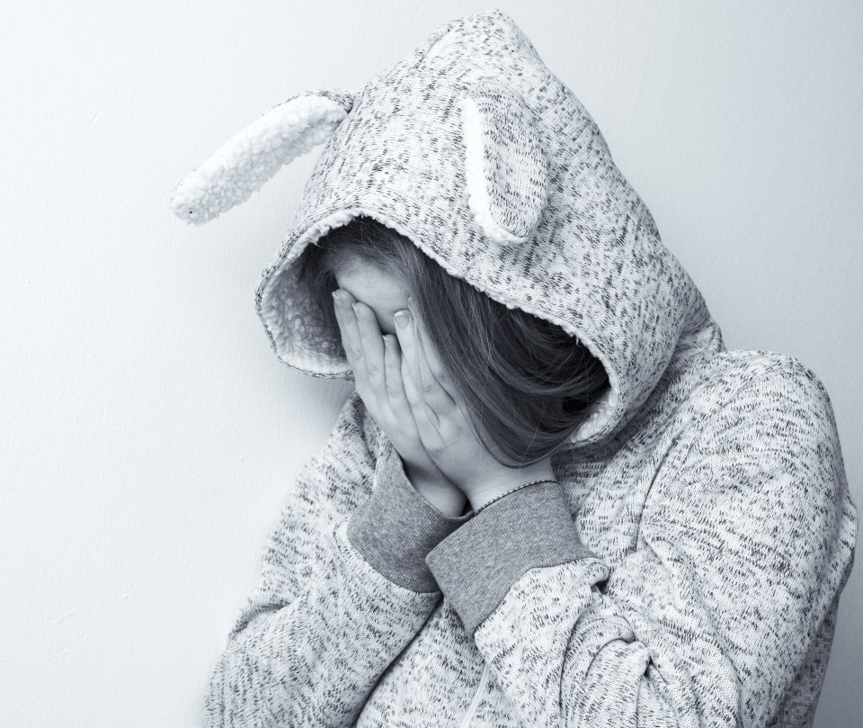
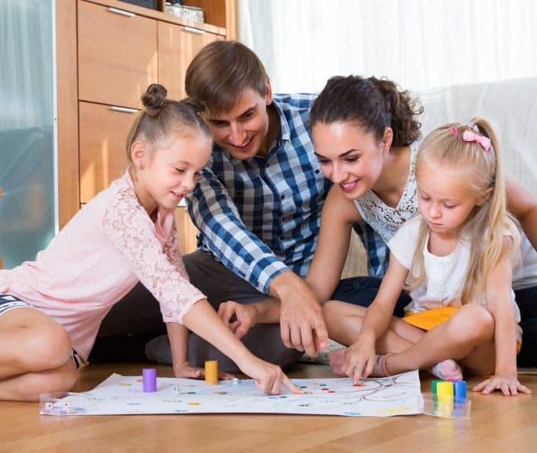
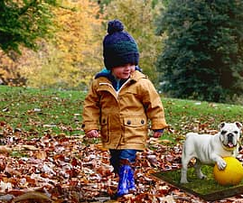
Notes:
Very mixed picture:
Improved family relationships
Improvement in children’s play skills and imaginative play
Increase in outdoor play
Feedback from the parents - coped well and adjusted well
Gained valuable lessons during lockdown
But Scottish research indicating negative impact on
Sleep
Mood
Behaviour
Physical activity
Diet
Concentration
Amount of screen time
Mental wellbeing
Contact with family and friends – most children have missed family and playing with friends
Parent emotional wellbeing

Slide 6
Anxiety, distress, sadness can be more difficult to spot in younger children
Notes:
When we experience threats or a crisis, our brain is pre-programmed to act in a certain way. When cavemen saw a wild animal their brain would flip into survival mode, react to the threat and return to normal. And this still happens to our brains today but obviously the threats are different and they seem to last a bit longer giving our brains and bodies less time to return to recover.
The front part of our brain – the part which controls our thinking, planning and organising - shuts down so we can't think rationally, plan or organise our thoughts instead the bit of our brain that helps us survive is turned on and we react instinctively you will have heard the phrase fight, flight, freeze
Stress hormones are released into our bloody that make our body ready to react.
As adults we learn over time certain strategies to mitigate this to a certain extent but children haven't necessarily learned the skills to understand this process, communicate their feelings effectively and find strategies which help regulate their brains and bodies so what we see are some of the behaviours you see here. You may also notice a change in appetite, being more clingy - looking for more reassurance or physical contact, regression in skills such as toileting
Balance – all of these behaviours are a normal part of development. It's also important to remember that children need to experience a wide range of emotions including ones that are more difficult to manage. As parents our job is not to protect them from these feelings but to be there for them when they do and help them to see it's a temporary feeling and there are things they can do to help it to pass.
If you are noticing a marked change in your child's behaviour or these behaviours become the norm and you are seeing them more and more frequently it is possibly an indicator that they are struggling with managing some strong emotions such as anxiety, sadness and anger.

Slide 7
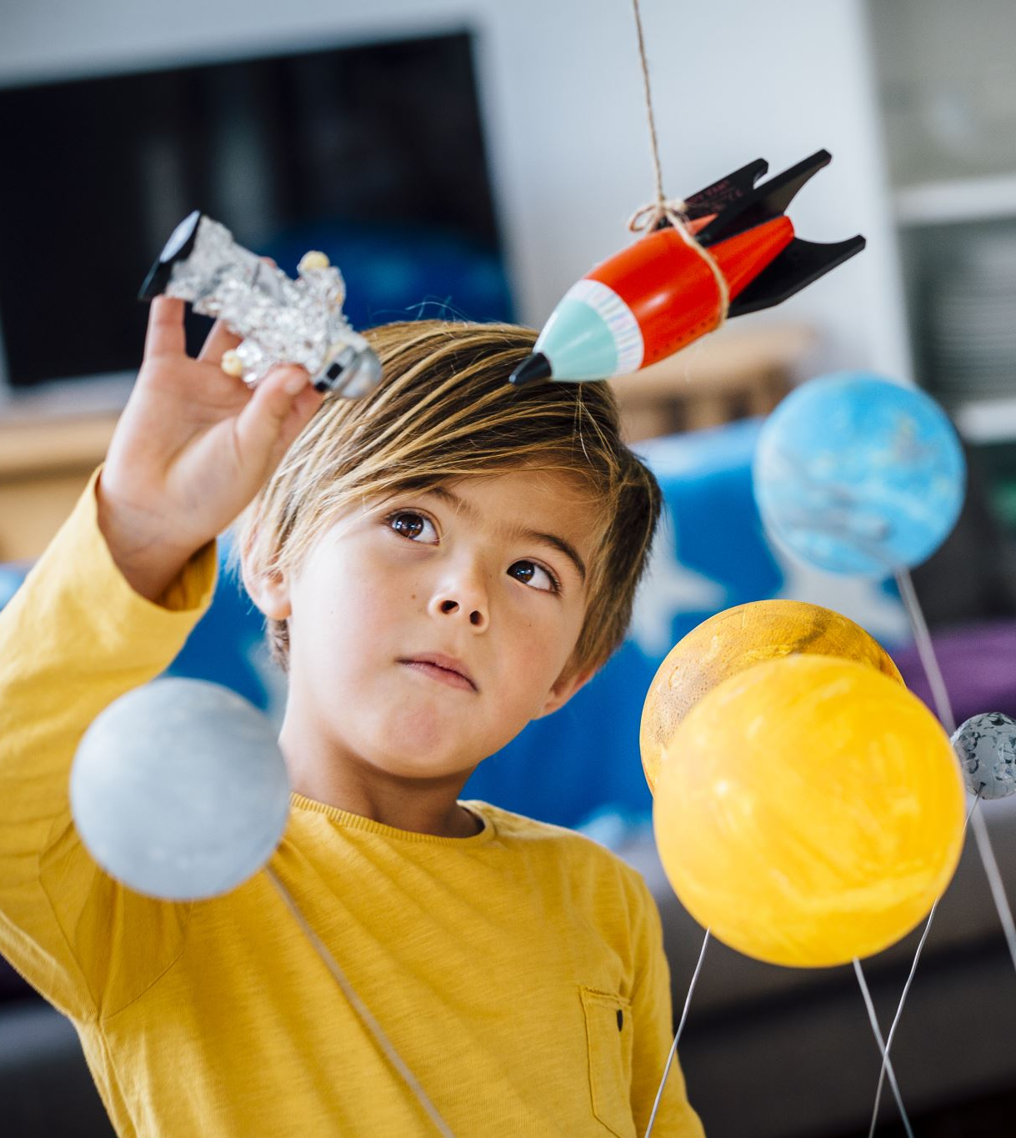
Connection
Play
Regulation
Movement
Notes:
Most important period for brain growth
Keep it simple – consider key themes
Connection – relationships at the heart of healthy development
Play - essential for social, emotional, cognitive and physical development. It is a natural tool for children to develop resilience as they learn to cooperate, overcome challenges, and negotiate with others
Regulation – we need to learn ways to cope when we face challenges
Movement – close relationship between activity levels and mental health

Slide 8
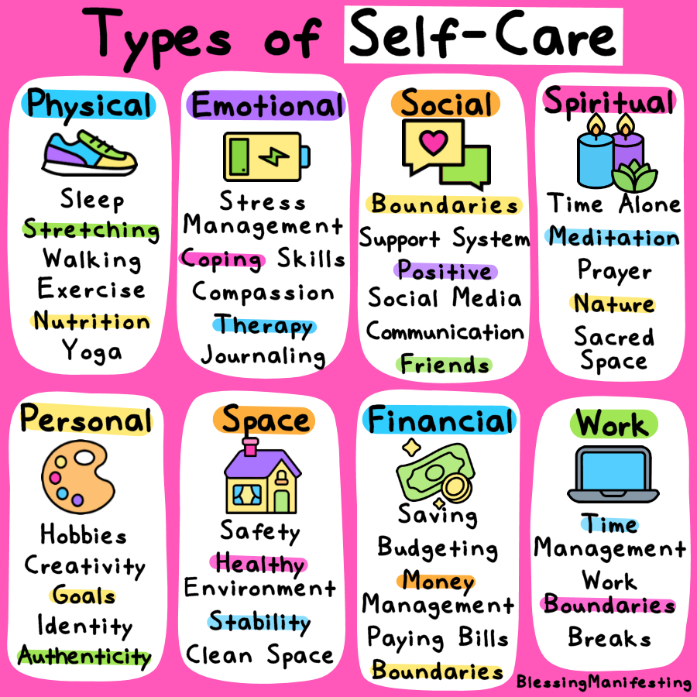
Notes:
For parents – fit your own life jacket 1st!
We are all struggling at the moment and it's ok for our children to know that we are not ok. We need to promote a culture where talking about our feelings is not just acceptable but good and that starts with us - talking, sharing, showing emotion and crucially how we manage big feelings and what coping strategies we use.

Slide 9
Strategies to support young children
Connection
Regulation
Physical and mental movement
Notes:
You’ll want to feel that you’re fixing things and taking away stressful feelings from your children. However what they are feeling and experiencing is normal; many of the behaviours or expressions of emotions are the brain and bodies natural response to stress.
Rather than trying to ‘fix’ the feelings, you can support your children by helping to develop their coping skills and ultimately being that safe nurturing base for them.
How we can do this and why certain strategies work, it comes back to connection, regulation and physical/mental movement.

Slide 10
Connection
Important for mental health
Feeling close to and valued by others is a core human need
Feeling happier and more secure
Notes:
Social relationships support mental health in many ways. They help provide us with purpose and meaning. Feeling close to and valued by other people is a fundamental human need.
When we feel connected to others we feel happier, more secure, and more resilient to challenges. This is why encouraging connection with your child or children can be a beneficial way to support them.

Slide 11
Connection
Contact with others
Acts of kindness
Gratitude lists
Reflecting on happy memories
Encourage talking about worries
Play!
Notes:
Doing something each day that encourages contact with people- write a post-card, smile at someone, make eye contact, greet others.
Encourage acts of kindness throughout the week- being kind to others makes us feel good.
Gratitude lists/positive highlights encourages us to focus on the good parts of the day- re-focussing the brain away from worries.
Talking about feelings/worries from a young age is helpful- modelling language, empowering, normalises worry/sadness.

Slide 12
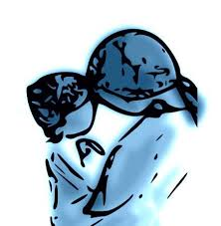
Self-regulation (and co-regulation)
Manging thoughts, feelings and actions
Responding rather than reacting
Important skill for life that we learn from infancy
Notes:
What is self-regulation and why is it important?
Self-regulation is the ability for us to manage our thoughts, feelings, and actions. It helps us to remain calm and alert, and supports the capacity to “respond”, rather than “react” in the face of our many strong emotions and stressors in life and the environment. For example, self-regulation helps a child to calm herself or himself, or to solve a problem without giving up.
We don't just acquire this skill, we have to learn it. When babies are born, they have little ability to self-regulate; however, from infancy, parents and other primary caregivers help children learn through a process called co-regulation By using their voice, movements, affects, gestures, and intonations, parents and primary caregivers can help infants and young children know that they are “felt with” and “attuned to.” This helps babies and children become calmer and regulate. When babies grow up with co-regulation during moments of stress, such as when they are struggling with strong feelings, they begin to internalize and conceptualize strategies for self-regulation and self-soothing.

Slide 13
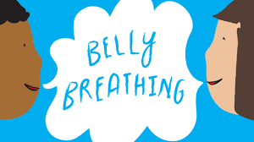
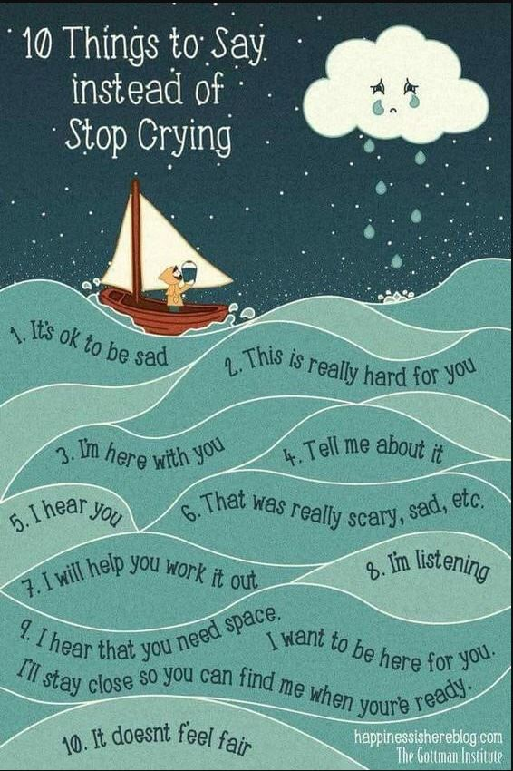
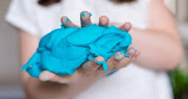
Regulation strategies
Empathising and modelling language
Breathing and relaxation exercises
Sensory activities​
Notes:
Empathising and modelling language is a key way that you can co-regulate your child and help them learn to self-regulate. Having big emotions but not knowing what they are or how to deal with them can be hard, so modelling language and feeling it with your child can help them feel understood, and gives them the language to use next time. Using ‘I wonder’ is a really nice phrase to use, as you’re not telling them how to feel but rather exploring with them. ‘I wonder if you feel sad…’
Deep breathing and relaxation exercises- taking control back and being present. When we feel anxious or stressed part of that is our body being in control of us and going into fight flight or freeze mode, so encouraging awareness and deep breathes has a physical impact on calming children’s bodies down, lowering their heart rate etc. Lots of suggestions on healthier minds page, bubble breathing, breathing buddy. Building that into their routine.
Sensory activities- can be a good way to calm and settle children in a way that doesn’t rely on language. We all have certain activities or preferences that help us feel more settled- e.g. going for a run, getting a massage, playing music, tapping our feet. It’s the same for children, except they don’t yet know what helps them to feel good. Exploring activities such as playdoh or squishy toys, guessing games like what’s in the bag that relies on touch.

Slide 14
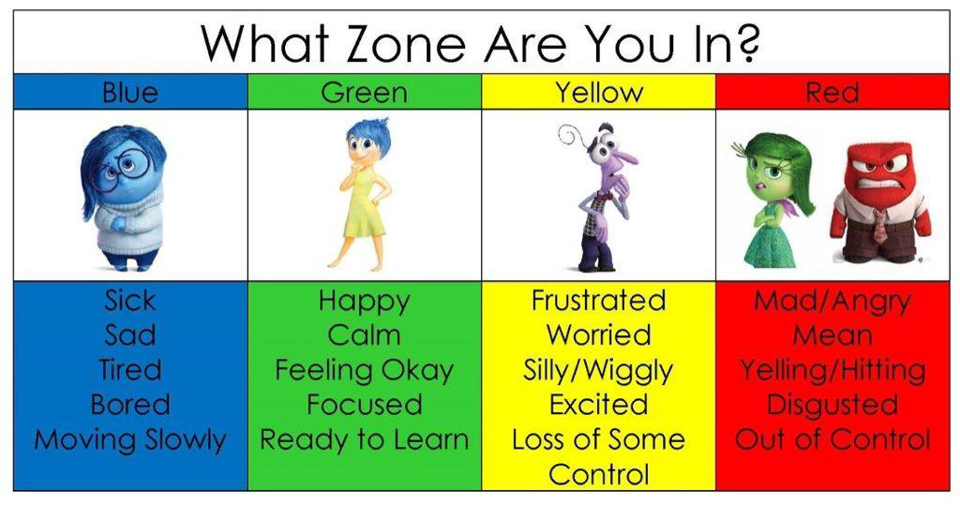
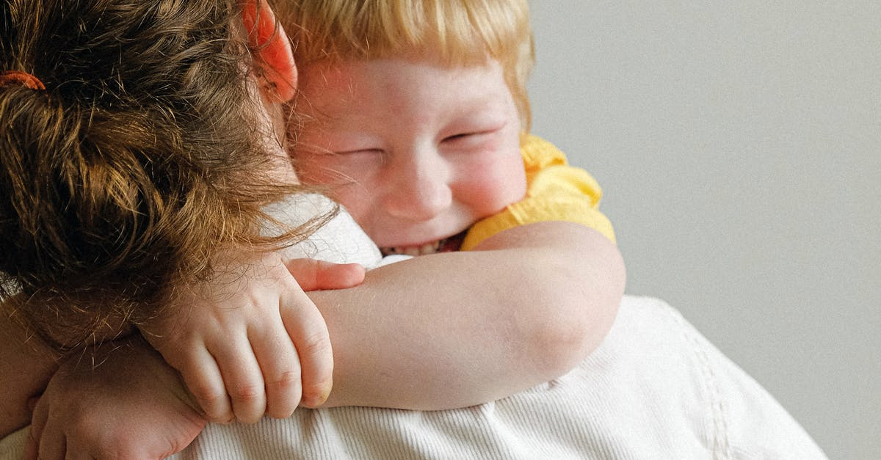
Feelings check-in
Identifying strategies with your child
Connection and co-regulation
Notes:
Feelings check in- encouraging talking about feelings/emotions, and how it feels in their body.
Making your child aware of the strategies that help them, creating a tool kit box. Making sure they have the chance to talk, draw or play out their feelings, as this helps them to process and learn from them.
Hugs!

Slide 15
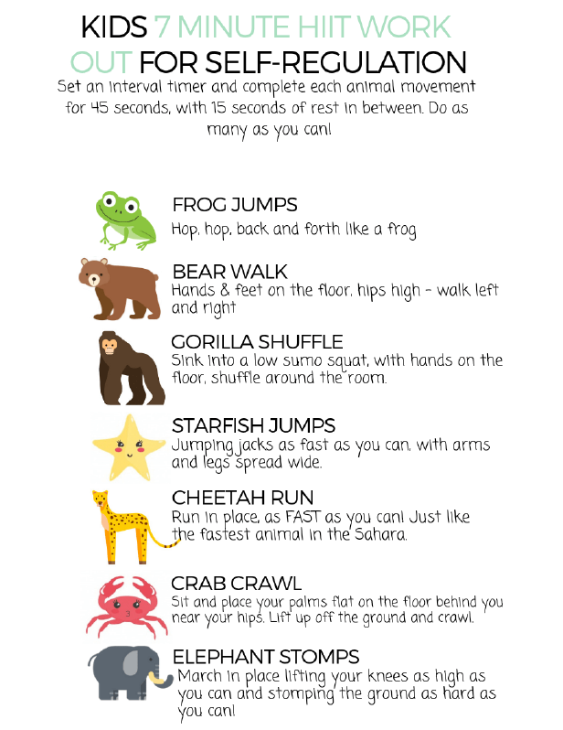
Physical and mental movement
Provides brain breaks
Exercise increases happy hormones (and reduces stress)
Increased vitamin D and fresh air!
Play and exploration is important for development (and fun!)
Notes:
Movement and exercise (particularly being outdoors) gives your children time to relax, reflect and ultimately take a brain break from their work and being on the screen.
Physiologically we know that movement increases the release of endorphins and reduces cortisol, so overall it makes children feel happier and energised.
Getting outdoors, especially at this time of year, can be struggle, but there are huge benefits to getting some time outside. Sunlight is the best natural source for our bodies to produce vitamin D, which releases serotonin, which consequently helps regulate emotions and mood, which is ultimately linked to happiness!
Any sort of movement or exercise- walking, dancing, running, HIIT, yoga.
Most importantly is having lots of opportunities to play. Play has such a crucial role in child development; they learn so much about themselves and how to interact in the world through play, as well as having fun and getting enjoyment.

Slide 16
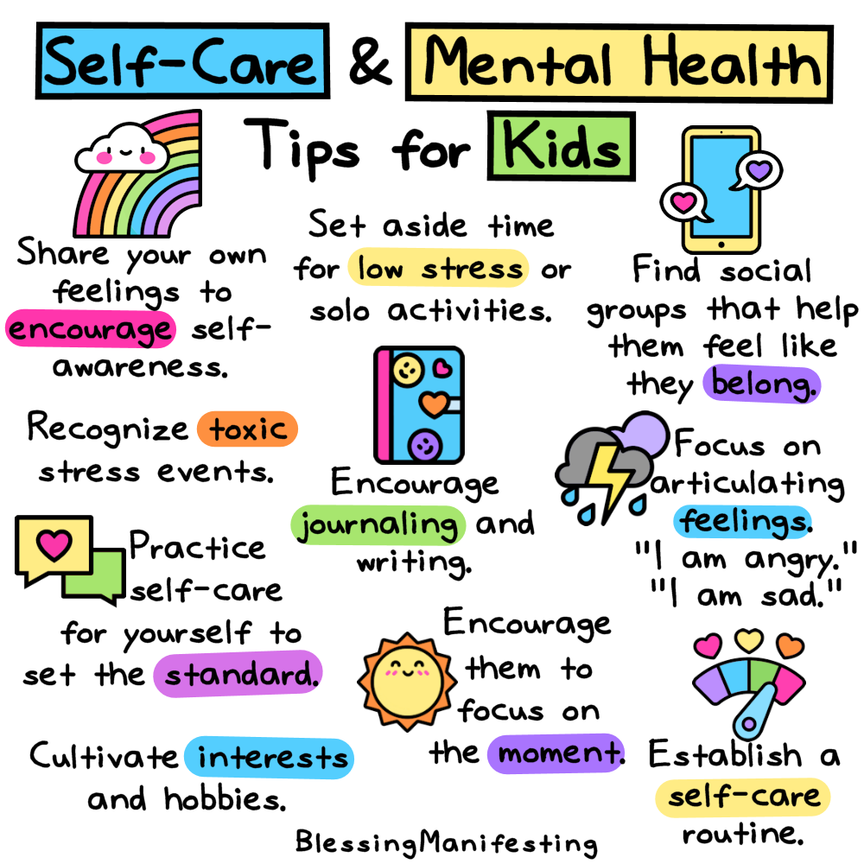

Slide 17
https://blogs.glowscotland.org.uk/er/healthierminds/

