Slide 1
The Impact of Covid 19 SUPPORTING OUR CHILDREN IN UNCERTAIN TIMES For parents of children with additional support needs
Jennifer Speck, Nick Smiley and Partners
East Renfrewshire Educational Psychology Service

Slide 2
This is Covid 19 for all of us…
Physically unwell
Fatigued
Antisocial
Guilty
Difficulty sleeping
Absolutely fine!
Anxious
Struggling to focus
Angry
Overwhelmed
Fearful
Lonely/Isolated
Notes:
None of us could have predicted, this time last year, just what lay ahead of us. And it’s probably just as well. The emotional rollercoaster we have all been on over the past year has been like nothing we have ever experienced before. Everything about the Covid 19 situation is an emotional rollercoaster from anxiety and fear, to anger. We are up and down in how we think, feel and what we do…a lot!! And it’s exhausting….trying to navigate these ups and downs has been incredibly difficult for pretty much all of us. Everyone’s experience of Covid 19 will have been unique but I am sure lots of you will be familiar with most of the what’s highlighted in this slide, although maybe the last one, ‘absolutely fine’ has been increasingly elusive the longer this has gone on – hopefully, you have all had some times when you’ve felt ‘I’m ok’.

Slide 3
What does Covid-19 mean for children with ASN?
Uncertainty
Disruption to normal routines
Lack of control
Loss
No/reduced support network
Isolation
Limited access to resources and services
Closure of wider community environments
Health fears
Challenges of online learning
In other words….HIGHLY STRESSFUL!
Notes:
We know that this has been a difficult time for everyone and every family has had to make big changes to everyday life to cope with the stress and challenges of coronavirus. But we know that children and young people with additional support needs and their parents are likely to have found it particularly challenging. If your child has additional support needs, being away from your support network and normal routines like school might be even harder for them. Knowing how to support them during this time has been hard, and you may have some questions about what all of this will mean for them now and when they return to school, if they haven’t already done so.
Loss of contact with extended family and friends. They may find it difficult to interact with friends via virtual platforms and have therefore become more isolated.
Reduced opportunities for clubs, soft plays, activities, organised groups
Closure of libraries, museums, community centres, travel restrictions
Lots of parents have become all too aware of how children and young people are exhibiting signs of stress. Signs of stress will vary for every child. Some children may verbalise their worries, others may withdraw into themselves, others may engage in challenging behaviours. Some children and young people, particularly those who are older, may be able to self-manage their stress, but this is much more difficult for children with additional support needs .

Slide 4
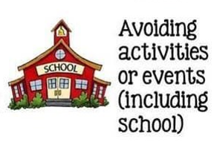
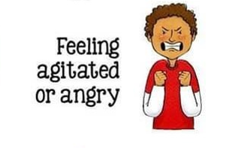
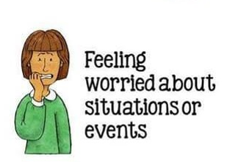
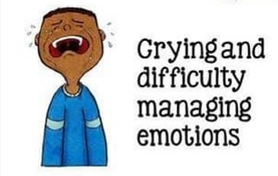
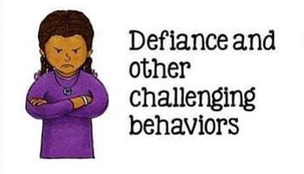
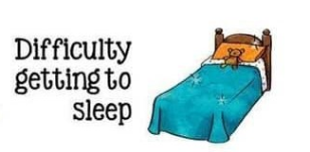
Notes:
At times of unpredictability or when things are uncertain, individuals may experience increased anxiety, reduced ability to focus attention and to communicate with others. When your world is very chaotic and confusing, there is a lot of uncertainty which leads to anxiety. Children with additional support needs often require a very concrete, literal and predictable world to feel secure. It may not be possible for family members to explain in a way they will understand, why their daily routines have changed, why they can and can’t do some things as expected. They may find it difficult or be unable to communicate their needs verbally or to make sense of what they are feeling and because of learning and health needs, they may lack the opportunity to take control over their environment
When we experience threats or a crisis, our brain is pre-programmed to act in a certain way. When cavemen saw a wild animal their brain would flip into survival mode, react to the threat and return to normal. And this still happens to our brains today but obviously the threats are different and they seem to last a bit longer giving our brains and bodies less time to recover.
The front part of our brain – the part which controls our thinking, planning and organising – shuts down so we can't think rationally, plan or organise our thoughts instead the bit of our brain that helps us survive is turned on and we react instinctively – you will have heard the phrase fight, flight, freeze
Stress hormones are released into our bloody that make our body ready to react.
As adults we learn over time certain strategies to mitigate this to a certain extent but children haven't necessarily learned the skills to understand this process, communicate their feelings effectively and find strategies which help regulate their brains and bodies. For children and young people with additional support needs, the world can be a more difficult place to navigate. During the Covid pandemic when children and young people with additional support needs may struggle to make sense of what is happening and to cope with the continual change and uncertainty, and the lack of access to supports and activities that they previously enjoyed, we have seen the impact in many ways…..
What we see are some of the behaviours you see here. It’s helpful to know that many children and young people go back to behaviours from an earlier stage of development when they are going through loss and change so if this happens it is not unusual.

Slide 5
For some, Covid has meant reduced anxiety and concern
Notes:
Feeling BETTER?
For some children the stress of being ready for school on time, travelling to school, sitting in the classroom and being with other children causes lots of anxiety. You might have had a happier child at home since lockdown was introduced. There is no right way for your child to respond to the challenges we’re all facing. The most important thing you can do for your child is to provide the love, care and security they need.
Aspects of being at home that autistic learners have enjoyed…
Reduced sensory processing demands
More options for movement
Learning chunked down
More opportunity to have time doing activities which are personally motivating
Fewer social demands
More able to predict and control their environment
What does this mean for the return to school?

Slide 6
What can we do??
Notes:
It feels like everywhere you look just now (social media, TV…) people are giving advice about things you can do to cope with these times…exercise, eat healthily, take a bath, talk together as a family…
But these things likely feel IMPOSSIBLE right now….
Time to sit and problem solve or think about what you might be able to do might seem completely unrealistic. You might be struggling to do the basics like brushing your teeth, never mind creating a visual schedule. But hopefully some of what we talk about over the next few slides will help. There are, unfortunately, no quick fixes, but hopefully this will give you some ideas of things that might help…even just a little bit. There’s not a one size fits all but the ideas may suit some families some of the time and might be helpful to you.

Slide 7
Creating a sense of safety
Information – we may have to use actions rather than words to make the ‘here and now’ feel safe and calm
Predictability
Expect stress
Visuals
Listen
Notes:
One of the first things we want to do is to try and create a sense of safety for children in what may seem like a very uncertain and scary world at the moment.
Some children and young people with additional support needs may find it difficult or be unable to communicate their needs verbally or to make sense of what they are feeling. To help deal with insecurity and anxiety, we have to try and decrease the uncertainty in their lives. So the first step we want to take is to try and create a sense of safety for children.
One of the ways in which we can do this is by giving them information (obviously in a appropriate way for their needs). Information can help children to understand and, as a result, can therefore reduce anxiety. The most important thing is to be clear and concise. The reality is that news channels don’t present information in a way that’s easy for children to understand and this can feel scary and overwhelming for a child to listen to. For children with additional support needs or with a very literal understanding of the world it can be even more frightening. But children do have questions and a desire to understand why their world looks and feels so different.
Children with ASD will often take your words literally and like things to be in black and white. Try to think of simple, clear answers, rather than talking about what might happen. Your child may have questions for you that you don’t have an answer for. Just be honest and tell them you don’t know. If it is not possible to explain, using words, in a way that they will understand, use your own actions instead to make the here and now feel safe and calm.
The past YEAR has been incredibly difficult and we know that maintaining routines has probably been incredibly difficult to manage….however, moving towards recovery, one of the key things we can do is re-establish routines. Knowing what is going to happen, and when, is generally reassuring and calming. As adults we like to know what is going to happen, and children like this too. A consistent routine lets everyone be secure about the plans for the day. It is often useful to involve children in creating this routine, so that they feel part of the plan, rather than the plan being imposed on them. Establishing and maintaining clear, dependable, reliable routines will help your child to feel that they can trust the world and the people around them to be predictable. Don’t worry if the routine isn’t perfect – Remember, this isn’t a normal situation. If you find that planning and sticking to the routine is causing more stress, friction or conflict, then it’s OK to be more ‘free-flow’.
Expect stress – This is an uncertain and unpredictable situation, stress and anxiety are normal. Normalising the experience is likely to reduce anxiety for some children. Reassure children that lots of adults and other children are in the same situation.
A visual schedule uses pictures and symbols to demonstrate what activities will occur and in what order. Pictures are easier for many children to understand than spoken words. When feeling anxious it can be difficult to take in and hold onto any verbal information so having things presented in a simple visual format can also help to relieve this anxiety. You’ll find information and resources on using visuals on the healthier minds website.
And finally, listen to your child - Be aware that they might not find it easy to understand or explain their thoughts or actions, particularly if they have language difficulties. Be responsive when they do express themselves, so that they feel you listened and believed them. Remember that what they tell you is ‘their truth’ and it reflects their perspective. Commenting can sometimes be a more effective way to talking to children rather than direct questioning that puts them on the spot– so, for example, say ‘when I was your age, I didn’t like …’. or ‘sometimes changes like not going to school can be hard.

Slide 8
Behaviour that challenges
All behaviour is communicating something
For children with ASN, it is likely to be much harder for them to express what’s going on internally
Learning to read behaviours allows you to figure out what the child needs
Not all behaviours need to be attended to – sometimes the best response is no response at all
Notes:
The changes and sacrifices we have had to make lately may have resulted in children and young people displaying some behaviours that can be challenging.
Children and young people with additional support needs, some of whom struggle to use language, may use different ways of communicating when something is wrong. This is when we might start to see behaviours which can be challenging to deal with. Sometimes it’s easy to identify what has led to the behaviour, other times it can feel like it came out of the blue. But it’s important to remember that all behaviour is communication and happens for a reason.
Is your child looking for attention?? E.g. Is hitting, or grabbing a way to get social attention?
Are they behaving in this way to get something tangible, such as food, TV or toys?
Or are they trying to avoid or escape something they don’t like- like an activity or a noisy room?
Priority in short term is not to stop challenging behaviour but to UNDERSTAND it – this will then likely have a knock on effect in reducing the challenging behaviour but this shouldn’t be the initial focus. Information on Healthier Minds that explains how you might explore this.
Other tips include trying to keep calm, which we know is usually far easier said than done. But to help your child keep calm its important that the adults around them keep calm. Children will notice if we are nervous or anxious and may begin to worry. Choice can also be crucial – children may feel out of control and it is important to feel a sense of control when things seem uncontrollable…so include choice to help them feel more in control = but just be aware that, for some children, too much choice can be overwhelming.

Slide 9
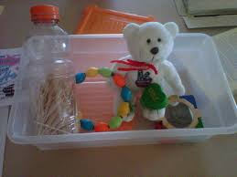
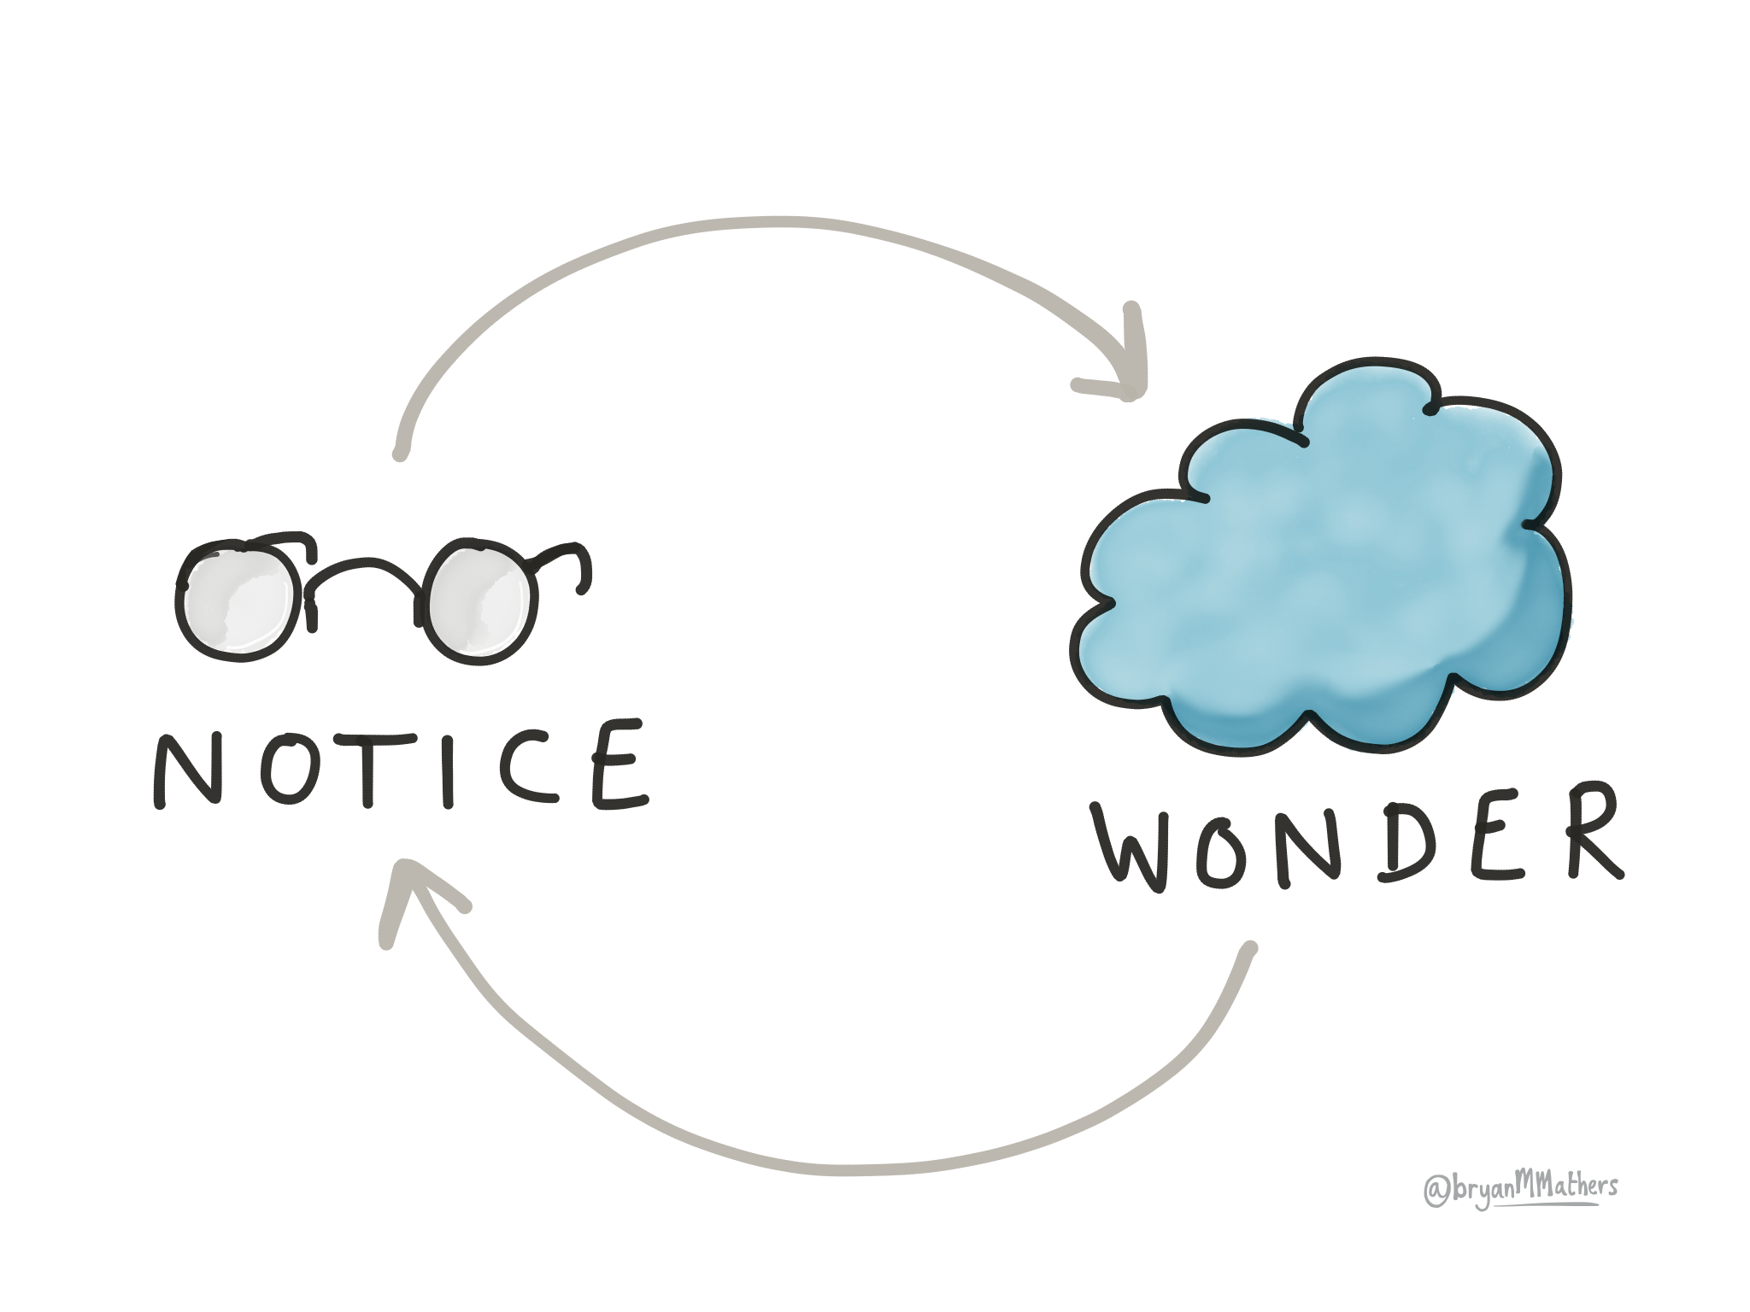
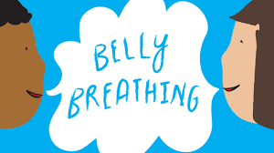
Self-regulation (and co-regulation)
Create safe space
Self soothe box
Empathising and modelling language
Breathing and relaxation exercises
Sensory activities​
Notes:
Next, we want to talk about self-regulation. Self-regulation is our ability to manage our thoughts, feelings, and actions. It helps us to remain calm and alert, and supports the capacity to “respond”, rather than “react” in the face of our many strong emotions and stressors in life and the environment. Self-regulation helps a child to calm herself or himself, or to solve a problem without giving up.
As a result of the situation we have found ourselves in over the past year, we may have all needed some extra support to regulate and this is likely to be the case for children with additional support needs. Some of these suggestions might help them to do so.
A Safe Space is a place in your home where your child can choose to go when they are starting to feel overwhelmed or need time and space to regulate themselves. It could be a pop up tent, a cloth over a table, a corner of the room with cushions or a bean bag...When your child chooses to go to their Safe Space, it is important to give them time and space. Ideally they should choose to come back out whenever they feel ready.
You might also help them to create a self-soothe box that contains things that might help them to calm and feel more relaxed. Anything that can help them to distract and soothe in times of stress.
Empathising and modelling language is a key way that you can co-regulate your child and help them learn to self-regulate. Having big emotions but not knowing what they are or how to deal with them can be hard, so modelling language and feeling it with your child can help them feel understood, and gives them the language to use next time. Using ‘I wonder’ is a really nice phrase to use, as you’re not telling them how to feel but rather exploring with them. ‘I wonder if you feel sad…’
They might also benefit from some breathing and relaxation exercises - When we feel anxious or stressed part of that is our body being in control of us and going into fight flight or freeze mode, so encouraging awareness and deep breaths has a physical impact on calming children’s bodies down, lowering their heart rate and things. Lots of suggestions on healthier minds page.
And finally, sensory activities- can be a good way to calm and settle children in a way that doesn’t rely on language. Sensory activities can be particularly important for children with additional support needs as they can often be under or over reactive to sensory input. Think about opportunities to engage them in sensory play, exploring touch, taste, sound, sight…For children, sensory play can often be very calming and can help them to work through difficult emotions like anxiety and frustration. Working with materials that require pressure and manipulation, such as play dough, can help children release physical energy or tension – and other materials can trigger positive feelings like joy or excitement. Sensory activities also provide great opportunities for communication, both verbally and non-verbally – whether they describe what they are feeling, squeal in delight at a new sensation, or share a moment of surprise.

Slide 10
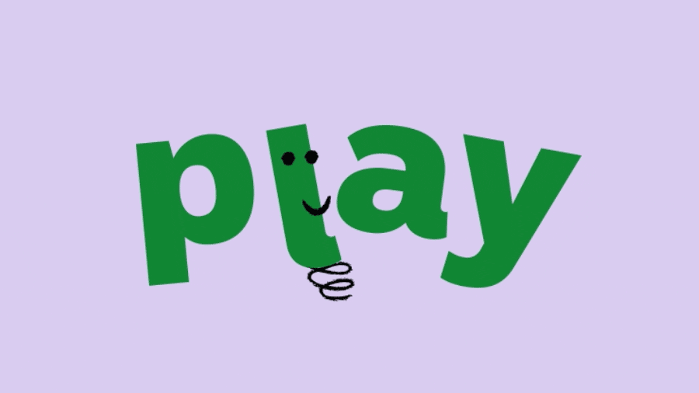
Play their way
Find what motivates
Insert image from HM – sensory activities??
Consider movement opportunities
Notes:
As we’ve discussed, your child might be behaving differently because they’re feeling anxious about things changing. Activities and play can help to give them the space and time to express their feelings. While some young children may benefit most from short activities for just a few minutes, an older child with autism might find activities they can get really absorbed in for a long time more helpful. The important thing is to play their way. Notice what they enjoy and provide more of this type of play. It’s about finding what really motivates them. We all need motivation or ‘drive’ to start and keep going with activities and routines. This is not as a reward for tolerating something you find unpleasant, but about doing something just because you like it. Often, the process of the activity and not the outcome that matters, for example the stirring of cake mix might be more motivating than eating the cake once it is baked.
Providing predictable and engaging movement opportunities can help a child to retain a calm and regulated state and to avoid getting to a point where they are bored, frustrated or distressed. In fact, many children with ASN may rely on physical movement to regulate. Physical activity is also very important for emotional wellbeing. Physiologically we know that movement increases the release of endorphins and reduces cortisol, so overall it makes children feel happier and energised. The greater the anxiety the more important the physical exercise.

Slide 11
Transition back to school
Anxiety
about separating from family
about going back to school
Validate their feelings
Set the tone
What has worked before?
Countdowns
Use visuals and social stories
If they are struggling, explore the reasons why
Notes:
Some children may already be back at school whereas others have yet to make that transition. Children who are heading back to school may be anxious about being separated from their families after months of being together. Even children who were really settled at school before the pandemic are finding it stressful to be separated now.
The return to school is probably something that many parents are feeling worried about and we know that, the reality is, it might be challenging for some children with additional support needs to make the transition back to school. Although some of them may have found home learning difficult, they actually may also have become used to being at home where they feel safe. They may feel anxious and distressed at the thought of returning to the social and sensory world of school.
It’s important to try and stay calm and positive and to validate their feelings. If your child is telling you that they’re worried or having those negative feelings, you want to validate those feelings and let them have some space to express them. But it’s important that you don’t feed it too much and that you also help them think of things they can do about it.
Adults need to set the tone - If you lead with your own anxiety, this is only going to fuel anxiety. Try to act calm, even if you’re not feeling it inside!! Try not to ask leading questions (“Are you nervous about going to school tomorrow?”), which can indicate to your child that there really is something to worry about.
Creating as much predictability for them as possible is really important. As we’ve talked about, anxiety can be linked to the unknown. Children with ASD require a very concrete, literal and predictable world to feel secure. Preparing them for what to expect, as much as you can, will be helpful.
Think about things that have helped your child stay calm before and try to build these into the day. What worked when the schools went back in August?
If your child understands visuals and social stories consider using them to explain what going back to school might look like.
There can be many reasons that children say they do not want to go to school. It can be helpful to think about what those reasons might be. If your child can communicate verbally or through signs, it could be helpful to ask questions to try and understand the reasons why. They might be worried about seeing peers again, be worried about the work being too hard, about missing parents or siblings… It is important to understand and acknowledge that these are real worries, but that we also think about ways we can support children to return to school. And that we talk about the good things about returning to school too!

Slide 12
Notes:
It can be difficult to juggle the needs of everyone in your home. But you also need to TRY and find SOME) time for yourself.
You probably notice that when you are stressed you don’t act in ways you normally do! So, if you are stressed, it can make it really difficult to care for someone who is also stressed.
Self-care is key to calming ourselves so we have the resources (brain power!) to care and support others. But we recognise that for self-care to be effective it needs to be sustainable and practical. Which is not always easy.
One of the biggest pieces of advice is to BE YOUR OWN BEST FRIEND If your best friend came to you upset and struggling what would you say to them? Write this down... pin it in a place you regularly look. Make this how you speak to yourself when you are struggling.
You all want to do the best for your children but sometimes this can put you under lots of unnecessary pressure. Parent guilt has been made worse during the periods of Covid-19 lockdown thanks to constant streams of social media posts of other people ‘winning’ at parenthood. Just remember that these people are presenting their ‘best selves’ not their ‘real selves’. Avoid comparison with others.
Most of all, give yourself a break and be kind - you’re doing your best in an incredibly difficult time.

Slide 13
It will take time
This is not permanent
You know your child best
Notes:
Remember:
The opposite of anxiety in many ways is trust and where individuals lose trust that people and environments around them will be suitably predictable and desirable it can take time to rebuild that trust. We may need to wait and be persistent with strategies identified and applied.
Remember that this is not permanent. It will pass.
No two children are the same and children with Additional Support Needs are no different. You know your child best. You know what they find challenging, what they struggle with the most, what they enjoy and what makes them smile. You will have developed your own ways of helping them. Families have shown resilience beyond what we could have imagined over the past year and you may well have other strategies that already work well for you.
.

Slide 14
https://blogs.glowscotland.org.uk/er/healthierminds/

