Slide 1
Supporting Young People through Exams
East Renfrewshire Educational Psychology Service
March 28th, 2022

Slide 2
Introductions
Kirstie Rees | Depute Principal Educational Psychologist
Jennifer Lerpiniere | Educational Psychologist in Training
Angela Merrylees | Principal Teacher, Healthier Minds Service
Roseann Cartledge | Principal Teacher, Mearns Castle High School
Spencer Gooch | Principal Teacher, Mearns Castle High School
Paula Queen | Assistant Educational Psychologist
Kirsty Frost | Assistant Educational Psychologist

Slide 3
Aim and Structure of Session To discuss the experiences and emotions of young people To explore strategies to reduce anxiety levels To discuss how you can best support your child throughout this time Q and A Panel
https://blogs.glowscotland.org.uk/er/healthierminds/

Slide 4
The Teenage Brain 1. Novelty Seeking and risk taking 2. Social engagement and Independence 3. Increased emotional intensity 5. Creative exploration 6. Bigger picture thinking 7. Move towards interdependence Daniel Siegel; Sarah-Jayne Blakemore; Nicola Morgan
‘

Slide 5
The Impact of Covid
Decreased risk taking
Lack of control and choice
Lack of opportunity to be with peers
Loss of sense of belonging and identity
Online learning/increased social media (30% of teenagers felt stressed by online learning Pieh ei al; 2021)

Slide 6
The World Today
This Photo by Unknown Author is licensed under CC BY-SA-NC

Slide 7
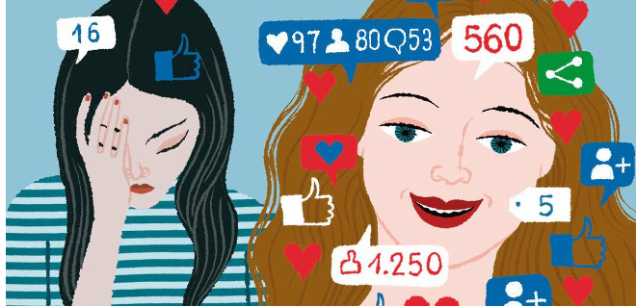
Young peoples’ brains can’t cope with how many people we can compare ourselves to

Slide 8
So, doing exams right now is difficult ….. The Teenage Brain Covid Social Media Normalise young peoples’ responses Validate how they are feeling Individualise how we support them

Slide 9
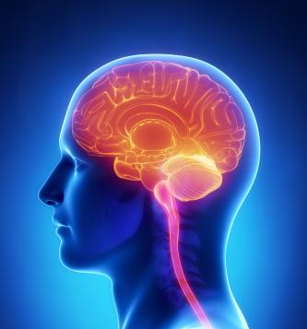
What about Stress? What is even is Stress…?
A normal response to stress – freeze/fight/flight
It has evolved to help us to survive
It can be helpful, when we have the right amount –
So it’s important to find out what amount young people need, and what amount overwhelms them
https://www.youtube.com/watch?v=kv6HkipQcfA
This Photo by Unknown Author is licensed under CC BY-SA

Slide 10
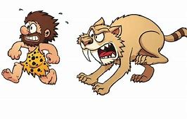
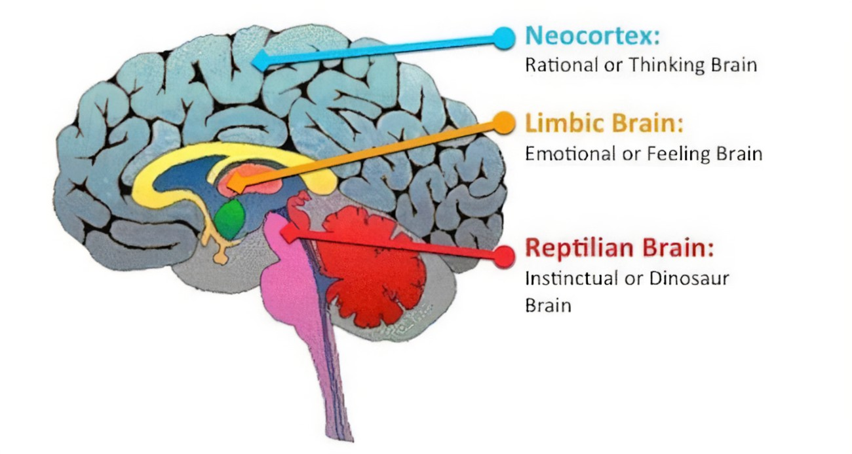
How the brain has developed over time….
https://youtu.be/kv6HkipQcfA

Slide 11
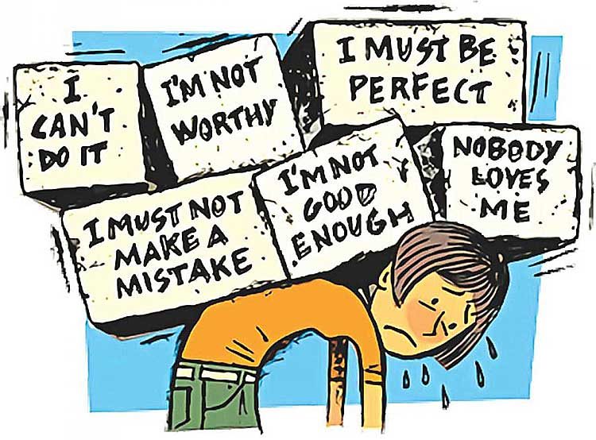
Impact of Stress
Working memory
Self-esteem and self-belief
Negative thinking
Exam performance

Slide 12
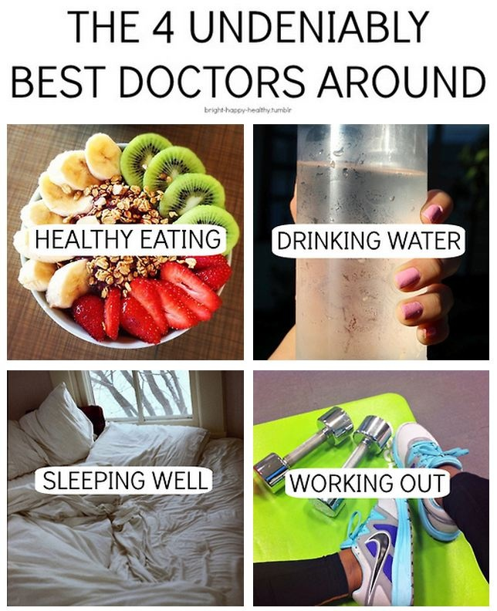
We know these help … Sleeping Good nutrition Exercise Socialising

Slide 13
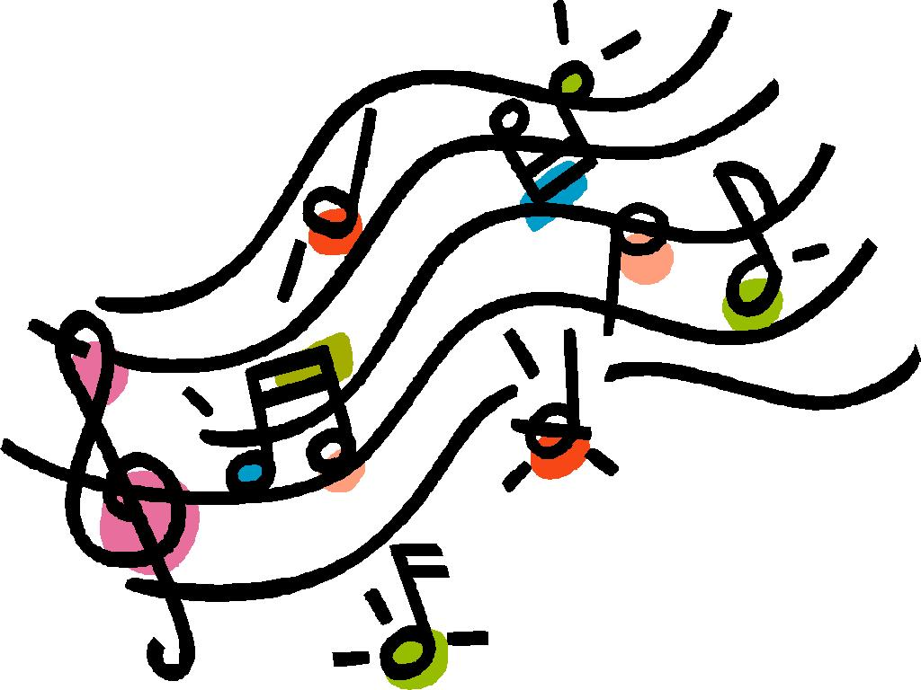
Helping young people cope
Relaxation
Support
Pets
Music
Hobbies
Talk to your child
Allow some time with friends

Slide 14
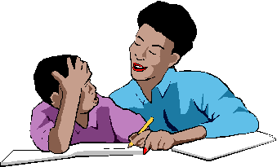
Helping young people study
Encouragement
Establish a study routine
How long can your child concentrate?
Music while studying?
Help children understand concepts
Different methods of studying
Help to prioritise and monitor revision
Online resources e.g. BBC Bitesize / E-sgoil / SQA

Slide 15
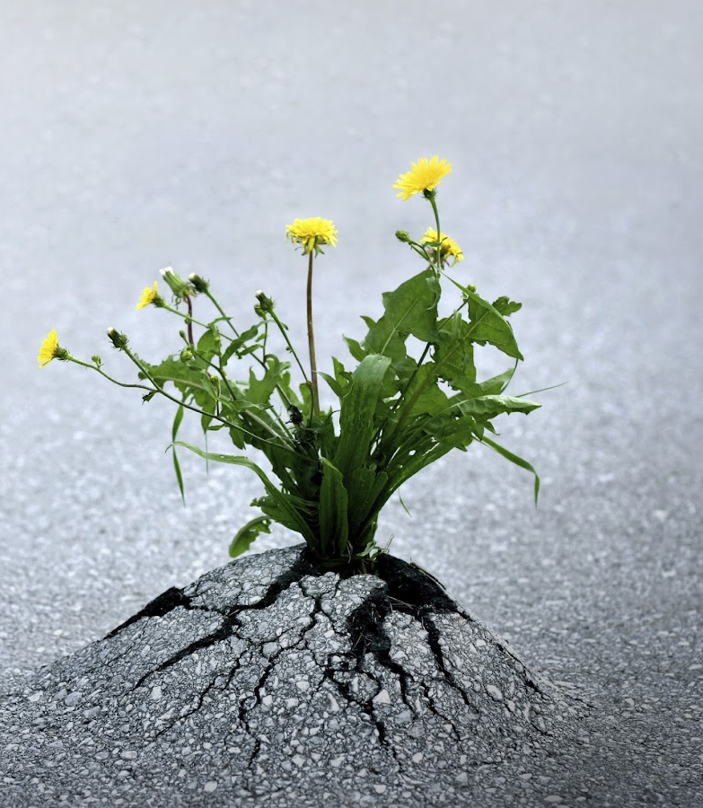
Resilience…. We learn from the hard stuff….

Slide 16
Q and A Since lockdown my child has been struggling with their mental health, she is becoming increasingly anxious around exams and keeps bursting into tears. I can see that she is overwhelmed. How can I help my child with her anxiety and exam stress when she is feeling overwhelmed? Roseann Cartledge

Slide 17
Q and A
I have one child who wants to study all hours of the day and not take breaks or see others, and I have another child that doesn’t see the point in studying at all. How can I support the balance between their studying and their mental wellbeing?
Angela Merrylees

Slide 18
Q and A What can I do as a parent to help my child during this time? I don’t know anything about any of their subjects. Spencer Gooch

Slide 19
Q and A How can I encourage and motivate my child to study when they find this difficult to do? Paula Queen

Slide 20
Q and A Panel Are there any strategies to help my child feel calm before and after exams? Angela Merrylees

Slide 21
https://blogs.glowscotland.org.uk/er/healthierminds/

