Slide 1
Eating Problems and Eating Disorders Information and Guidance for Young People, Families and Professionals

Slide 2
Background
Child Protection Committee
Increased referrals to our services
Multi-agency Working Group

Slide 3
* Insert Parent’s video here
Notes:
https://www.youtube.com/watch?v=cLx3Z0o9Qng

Slide 4
The UK's eating disorder charity Ending the pain and suffering caused by eating disorders
Notes:
Overview of the most common types of ED & how to spot the signs
Overview of the support we provide people

Slide 5
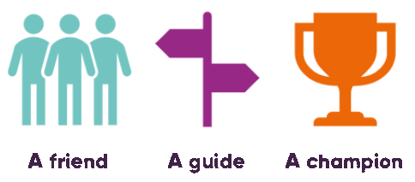
Who are Beat?
The UK's eating disorder charity
Our mission is to end the pain and suffering caused by eating disorders
Notes:
Beat is the UK’s eating disorder charity.
Beat is the UK’s eating disorder charity.
Our mission is to end the pain and suffering caused by eating disorders
In the UK its estimated that there are 1.25 million people suffering from an eating disorder.
ED’s are Serious MH illnesses
Anorexia is a serious condition it has the highest mortality rate of any mental health illness
Bulimia can also be life-threatening
And at Beat we are a Friend a Guide and a Champion for anyone affected by eating disorders; friends, family, professionals or those suffering.

Slide 6
Types of eating disorders
Binge Eating Disorder
Bulimia Nervosa
Anorexia Nervosa
Other Specified Feeding or Eating Disorder (OSFED)
Avoidant/restrictive food intake disorder (ARFID)
A number of other eating and feeding problems exist and include orthorexia, rumination disorder, and pica.
Notes:
There are several different types of eating disorders, the more common ones you may have heard of : Anorexia, Bulimia, Binge eating disorder and then there’s also Other Specified Feeding or Eating Disorder, Avoidant / restrictive food intake disorder and several other eating and feeding problems.
Today I’m going to take you through the three most common, however there is information about all types on our website.

Slide 7
Signs, what to look for
Notes:
“What are the signs of an eating disorder, how can you spot one”?
The short answer is you cant.
Eating disorders are a mental health illness and are not always visible. Indeed in most cases someone with an eating disorder will look perfectly ‘normal’.
So, when we speak about spotting signs, we really mean looking out for changes in Behaviours, instead of physical symptoms.
Behaviours changes that might affect someone with an eating disorder include:
Social isolation
Avoiding eating around others
Difficulty concentrating
Tiredness
Irritability
Low confidence and self-esteem
Anxiety
Obsessive and/or rigid behaviour
Perfectionism and setting unreasonably high personal standards
Self-harm
At Beat we know the sooner someone gets help the better their chances at making a full recovery. And to help us increase awareness of eating disorder symptoms that are more noticeable we came up with our TIP’s Campaign;
This poster takes the 6 most common ‘signs’ of an eating disorder and turns this in to things to potently look out for. If you notice any changes in, or erratic behaviours, alongside noticing any of these 6 singes on a regular basis in a friend, family member or indeed yourself we would suggest you contact our Helpline for more information advice and support.
7

Slide 8
More information: beateatingdisorders.org.uk/types

Slide 9
What Beat do
“
It's helpful to hear someone's voice and be able to hear the holes in my own arguments
”
Support
Helplines
Freephone Helpline365 days a year
Mon-Fri: 9am-8pm and Weekends & Bank Holiday: 4-8pm
Helpline: 0808 801 0677
One to One Web Chat
Talk one-to-one to one of our advisers using our secure instant messaging service
Notes:
What Beat are doing
At Beat we have a number of different service to help fulfil our vision of ending the pain and suffering caused buy eating disorders.
Direct Support services
Helplines – Adults, Studentline, Youthline 9am – 8pm Mon-Fri 4pm-8pm Weekends & Bank Holidays
One to One Web Chat - Talk one-to-one to one of our advisers using our secure instant messaging service

Slide 10
What Beat do
“
Many thanks for your reply and your kind words of support. They mean a lot and I can see that just from my first message you understand how I’m feeling,
Support
”
Email Support
Response within 24hrs
Search for support in local area
Social Media
@BeatEDSupport
Notes:
What Beat are doing
At Beat we have a number of different service to help fulfil our vision of ending the pain and suffering caused buy eating disorders.
Direct Support services
Helpfinder – Post code search for support services in people’s local area
Email Support - response within 24hrs
Answer phone - response within 24hrs
Supportive Twitter & Instagram

Slide 11
What Beat do
Support
Chat Support Groups
The Sanctuary – Daily 5pm – 8pm
Swan (Anorexia Support) – Mondays & Thursday 6:45pm – 8pm
Kingfisher (Bulimia Support) – Wednesdays & Saturdays 6:45pm – 8pm
Nightingale (Binge Eating Disorder Support) –Tuesdays & Fridays 6:45pm – 8pm
Notes:
Online Chat Peer Support Groups – Facilitated and moderated by trained advisors – safe space for people to get support from others who may be in a similar situation
The Sanctuary is an online chat group created specifically in response to coronavirus and the anxieties this could lead to for people with an eating disorder. It is a safe, online space for people with an eating disorder to share concerns and advice on how they are coping with the pandemic. It runs daily from 6pm – 8pm,
The Swan anorexia support group runs on Monday from 6:45pm to 8:00pm
The Kingfisher bulimia support group for anyone suffering with bulimia to share experiences with others in similar situations. runs on Wednesday from 6:45pm to 8:00pm.
Message Boards - Open daily until midnight – Safe space to ask questions and get lots of different perspectives on a problem.

Slide 12
What Beat do
Support for Carers
Telephone – 0808 801 0677
Online
Aivary – Online Chat Group (Sundays 6:45pm)
One-to-One Webchat
Carers Skills Workshops by Zoom
Solace – Online Peer Support by Zoom
Nexus – Weekly coaching support by phone
Message Board
Email / Social Media
Website resources
Notes:
Support for Carers
Telephone
Online
Aivary – Online Chat Group (Tuesdays & Sundays 6:45pm)
One-to-One Webchat
Carers Skills Workshops by Zoom
Solace – Online Peer Support by Zoom – Wales group meets on Monday evenings at 7pm – Sign up on website
Nexus – Weekly coaching support by phone – Nexus is a new telephone support service for parents, siblings, partners, and others caring for a loved one who has an eating disorder. each week with a trained Beat advisor, calls the carer at an agreed time and provides them with a place to talk through what they’re going through and empower them to help their loved one towards positive change - Sign up on website
Message Board
Email / Social Media
Website resources

Slide 13
What Beat do
Support & Training for professionals
Telephone – 0808 801 0677
Email
One to One Web Chat
Training Courses
Coming soon!! Schools training SPOT
beateatingdisorders.org.uk/training-cpd
Notes:
Telephone – 0808 801 0677
Email
One to One Web Chat

Slide 14
Useful links
Worried about a pupil
https://www.beateatingdisorders.org.uk/get-information-and-support/support-someone-else/worried-about-a-pupil/
Link for ordering resources
https://www.beateatingdisorders.org.uk/get-information-and-support/get-help-for-myself/downloads-resources/
Videos
Ambassadors sharing their stories
https://www.youtube.com/watch?v=qzm3c8d8kjU&feature=youtu.be
https://www.youtube.com/watch?v=9-En6RekupM

Slide 15
Thank You!
Emma Broadhurst
National Officer Scotland
e.broadhurst@beateatingdisorders.org.uk
07837 641427
@BeatED_Scotland
beateatingdisorders.org.uk
Notes:
Any questions?

Slide 16
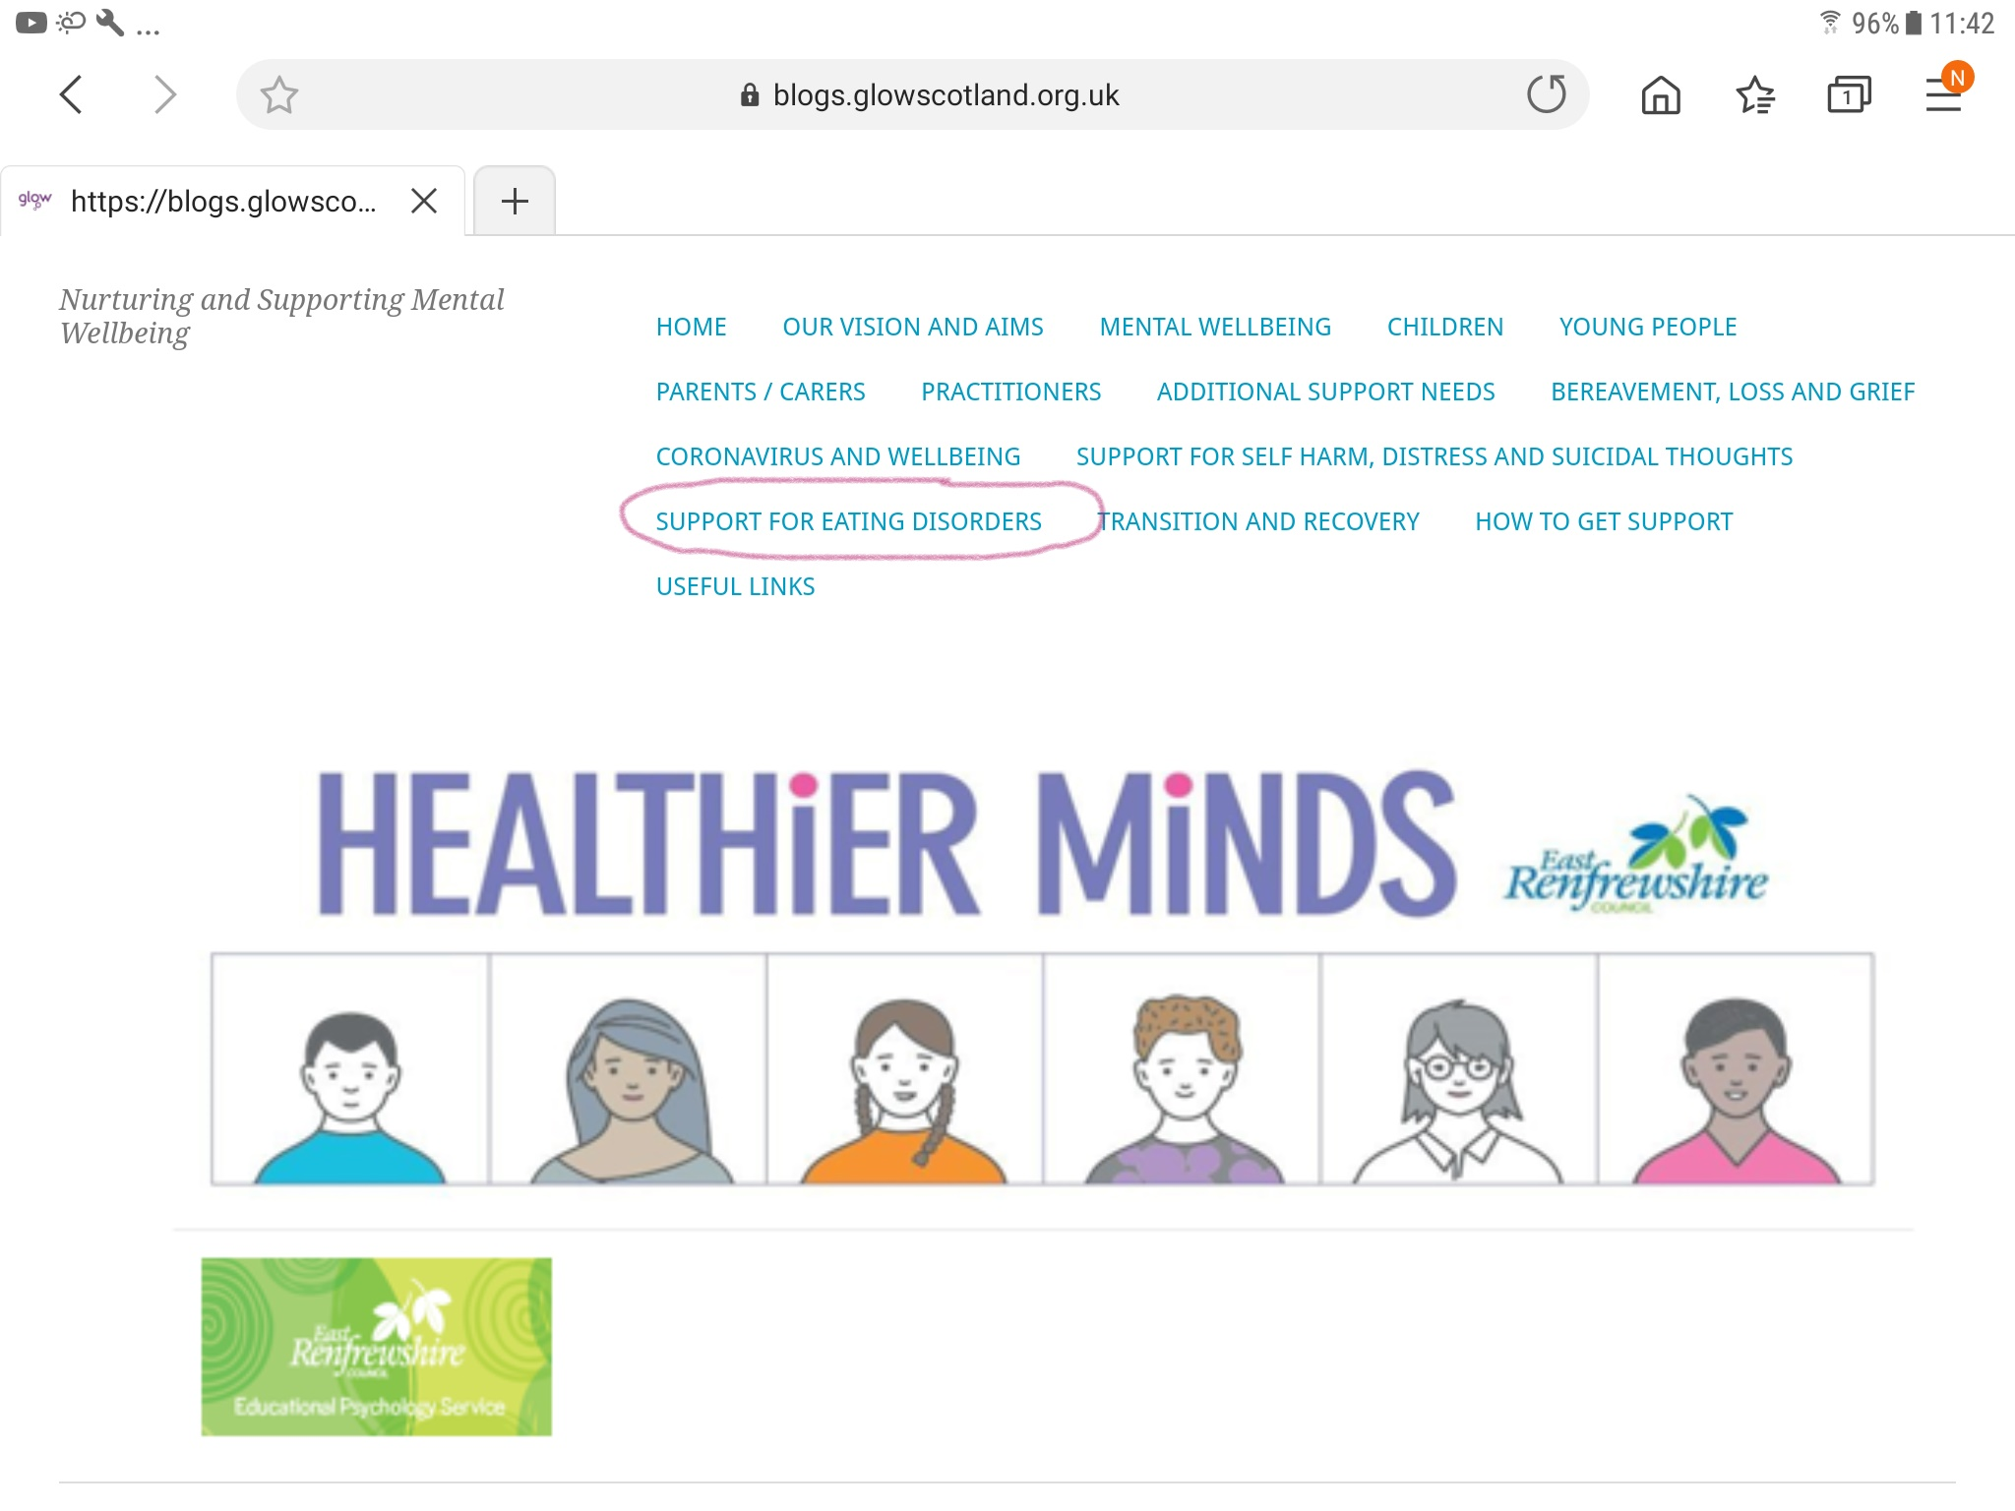
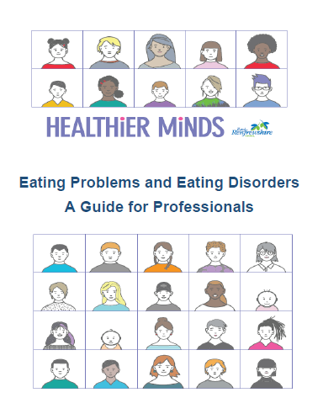
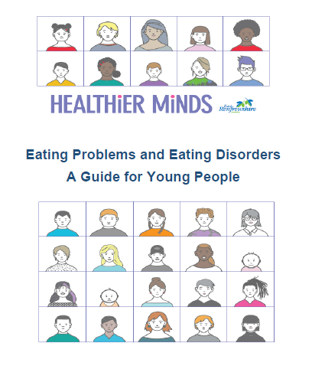
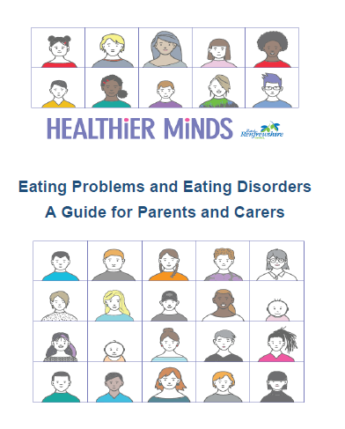
https://blogs.glowscotland.org.uk/er/healthierminds/support-for-eating-disorders/
Notes:
Glow page created with all the resources and information – google Healthier minds east Renfrewshire, click on the online resource and Support for Eating Disorders

Slide 17
Key Aims through the Guidance: What can we all do?
-01-
-02-
-03-
-04-
-05-
Recognise the signs
Build our confidence to talk about eating problems and disorders
Reflect on proactive approaches
Build on how we respond to young people experiencing eating problems and disorders
Know where to get help

Slide 18
Notes:
https://www.youtube.com/watch?v=p-JMFJVdr3c

Slide 19
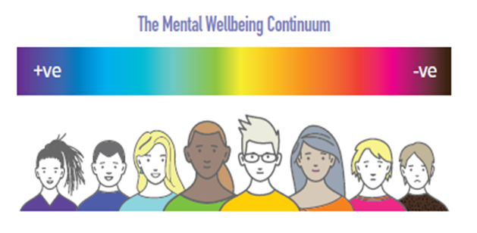
The challenges faced by the young person with eating problems may not be directly related to food, eating or body image but rather reflect strong feelings which they are struggling to manage.
The problematic eating behaviours develop as a way to cope with these feelings of distress, during times of pressure, or to regain a sense of control when they feel out of control of other areas of their life.
Problematic eating behaviours are an indication of poor mental wellbeing and if not addressed could have much longer term implications for mental and physical health.
Early intervention is important for helping someone with an eating problem or disorder to recover.

Slide 20
The challenge of talking about eating problems
Hidden illness creates significant barriers to talking openly about it
Think about who and when
Use caring phrases
Avoid focusing on food and weight - focus on feelings instead
Expect anger, denial, avoidance
Stay calm
Be persistent!
‘I’ve noticed that you’ve been missing lunch recently and I’m worried that you’re not yourself at the moment. Is there anything you would like to talk about?‘
'It sounds like you are having a really hard time, have you been able to speak to your parents about how you have been feeing?’

Slide 21
Practical Strategies
Encourage the young person to seek help
Signpost support organisations
Encourage self care – established or new
Consider media literacy
Work with other professionals and formalise support

Slide 22
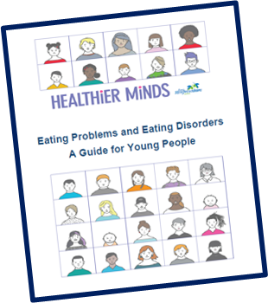
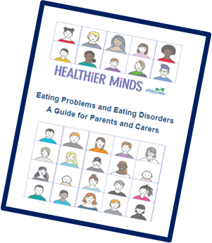
Guide for Young People, Parents and Carers
Films
Introduction to Eating Problems and Eating Disorders
I’m worried I might have an Eating Disorder
I’m worried about my friend
Information and advice for parents and carers
Notes:
The glow page is set out to be accessed by young people, parents and carers but the dowloadable guidance for young people and also for parents and carers are included for those looking for more detailed advice.
You will also find 5 short films incorporating the information available in the guidance.

Slide 23
Notes:
Embed video - worried about a friend https://www.youtube.com/watch?v=xnTEa1IMiQM 1:33

Slide 24
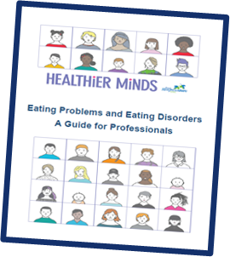
Conversation Starters
Elements of a Whole School Approach
Lesson Plans and Activities
Accessing Support
Supporting Mental Wellbeing
Notes:
For professionals this downloadable guidance contains a range of information related to how a whole school approach can be embedded, how the themes of eating problems and eating disorders can be introduced into lessons, conversation starters, accessing support and supporting mental wellbeing

Slide 25
Online Support

Slide 26
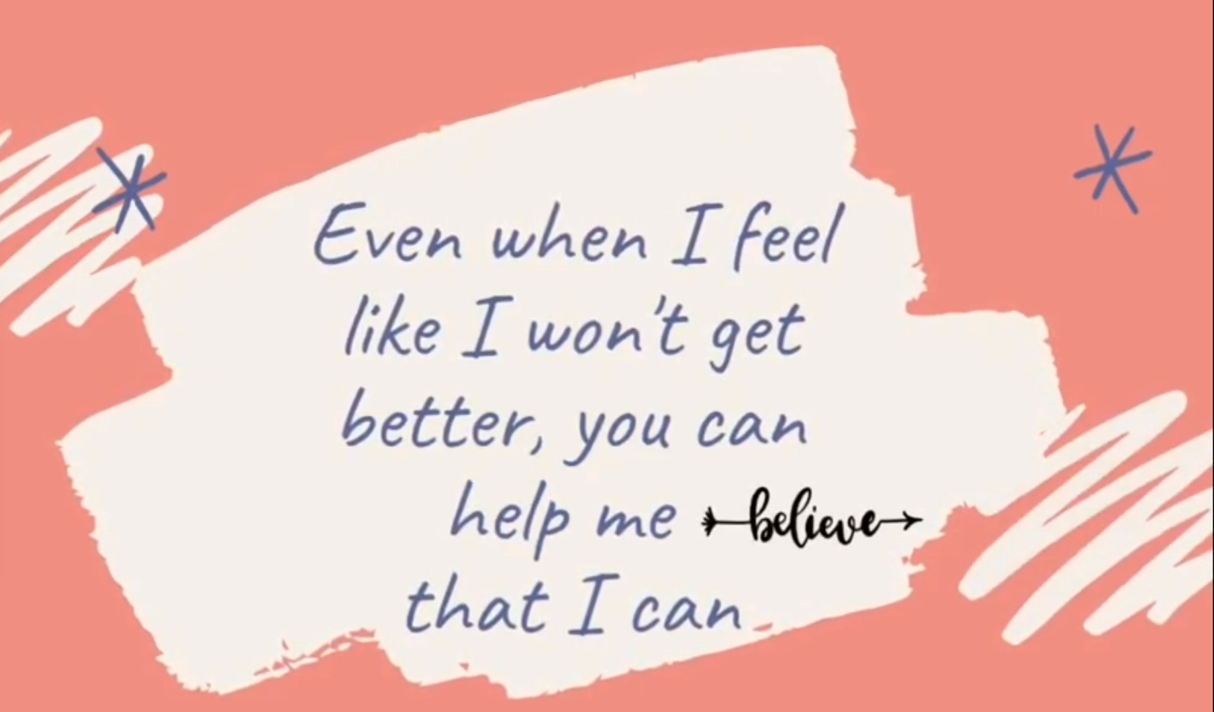
Notes:
https://www.youtube.com/watch?v=cLx3Z0o9Qng

