Slide 1
Emotionally Based School Avoidance
Chris Atherton
Angela Merrylees
Monday 23rd August
A

Slide 2
In the next hour we hope to…
Give an overview of Emotionally Based School Avoidance and it’s many other names
Gather your views on what is happening in your establishment: what works and what is challenging?
Share strategies and support approaches across the group
A

Slide 3
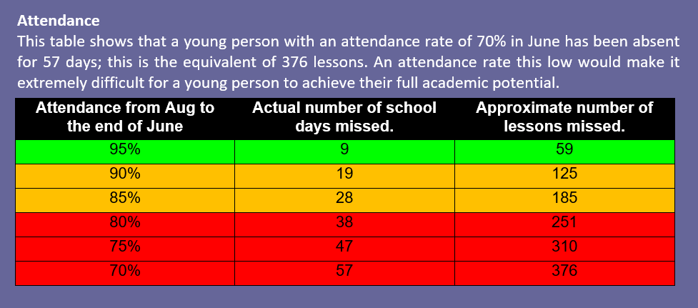

Slide 4
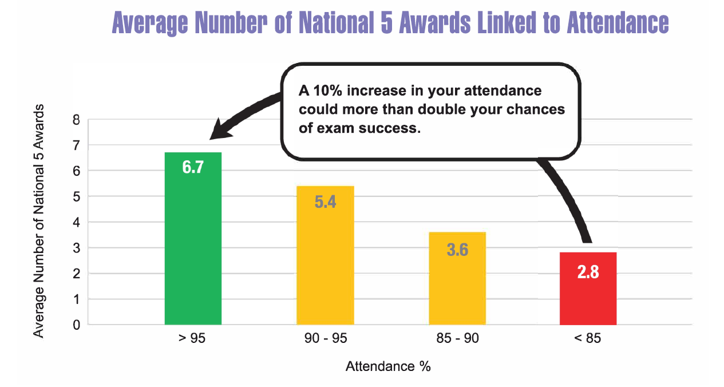

Slide 5
Healthier Minds Data so far
76 (27%) referrals for YP who have school attendance issues/concerns.
37% are 15 y/o
33% have an ASN
38% main reason (code) is anxiety/stress, 17% for low mood (including general, depression and suicide ideation)

Slide 6
School Avoidant Behaviours
School avoidant behaviours are very common in children and young people
Diverse in their presentation
Visible and familiar:
demonstrative behaviours – e.g. separation anxiety
persistent late-coming
leaving the school building
patterns of absence around trigger points (e.g. transitions, specific classes)
Subtle:
regular periods of self-certified absence
any others?

Slide 7
School Avoidant Behaviours
Many of these are addressed by effective parenting strategies
Some through collaboration, between parents / carers and school - effective monitoring and support procedures.
In some cases, these behaviours can develop into severe and prolonged periods of non-attendance that become deeply problematic.

Slide 8
Anxiety Based School Avoidance
Chronic School Absence
Persistent School Absence
School Disengagement
School Refusal
School Refusal Behaviour
School Phobia
School Attendance Problems
Truancy
C
Notes:
The wide range of presenting school avoidant behaviours, coupled with the complex range of factors and conditions that can contribute to these, leads to a lack of consistency in how patterns of problematic non-attendance are defined within the literature and, consequently, how best to approach these from a robust evidence base as a practitioner.

Slide 9
If the list is endless, how do you decide?
C

Slide 10
ESBA: Also known as…
A
Notes:
Despite this, there is widespread recognition that many patterns of problematic non-attendance are driven by a child or young person’s emotional state, giving rise to the terms Emotionally-Based School Avoidance (EBSA).
This terms point to the underlying need, not the surface level behaviour.
Within the construct of EBSA, it is possible to focus on effective prevention and responses.
There are specific tools for assessment and intervention that can help practitioners in their management of this highly complex and challenging area of education

Slide 11
Attendance Matters: A Practitioner’s Guide for Responding to School Avoidant Behaviours in East Renfrewshire (in Draft)
Emotionally Based School Avoidance (EBSA)
“A pattern of school avoidant behaviours indicating that a child or young person is not attending school due to underlying emotional reasons. These reasons can be due to factors within and out-with the school environment.”
C

Slide 12
Risks
Where sustained over a long period of time, EBSA can have a significant and detrimental impact on the child or young person’s:
Learning
Social development
Emotional regulation
EBSA is closely associated with poorer short and long term outcomes, including:
Relationship difficulty
Difficulty mastering emotions in challenging situations
Difficulty sustaining positive destinations such as further education, employment or training
Increased likelihood of poor mental wellbeing
(Kearney and Albano, 2018)

Slide 13
Contributing Factors/Motivating Conditions
ESBA
Child-specific factors
Factors at home
Systemic Factors
Factors at school
C
Notes:
Child Specific Factors (not controllable – but can be influenced)
Factors at home (not controllable – but can be influenced)
Factors at school (more controllable)
Systemic factors (more controllable)

Slide 14
What is currently working well in your establishment to support children and young people with EBSA?
Break Out rooms
Professional Dialogue
Share your thoughts, ideas and questions
C

Slide 15
Break out room discussion points
What are the motivating conditions in your school/setting/context?
What are the challenges in relation to ESBA?
What works well: what strategies, supports or approaches do you feel have had an impact?
C

Slide 16
Motivating Conditions
There are some patterns which are worth considering where children and young people may be more vulnerable. These include children and young people who have:
anxiety
low mood
emotional lability
neurodevelopmental differences such as an autistic spectrum condition, dyslexia, or significant learning needs
experienced significant trauma
responsibilities as young carers
However, each case of school avoidance needs to be assessed in order to identify and address the unique factors that are contributing to the behaviour
Notes:
Every school will have children and young people with needs arising from these factors.
For this reason, the first way to address school avoidant behaviour is by developing an inclusive, relationships-based ethos within the school that staff members and pupils uphold and contribute to.
Where this exists, the school-related risk factors that contribute to school avoidance will be minimised.

Slide 17
Proactive Whole School Characteristics
An inclusive, welcoming environment that nurtures and which celebrates diversity
Commitment to understanding, supporting and addressing the developmental, learning, environmental and psychological factors that contribute to emotionally based school avoidance
Positive, solution focussed interactions between all connected within the school that are characterised by respect, empathy, a non-judgemental stance, and a genuine commitment to both listen and help.

Slide 18
Proactive Whole School Characteristics
An environment where people model and talk about the skills that build resilience, including emotional regulation, impulse control, the ability to reach out when help is needed, to focus on activities that individuals are good at (self-efficacy), to have realistic optimism about the future, and good causal analysis over when things go wrong and how to resolve or recover from them.
Universally high level of staff knowledge, skill and ownership in supporting children and young people with additional support needs
Emotional literacy, resilience and mental wellbeing featuring strongly within curricular experiences.

Slide 19
Proactive Whole School Characteristics
Ensuring that every child and young person has at least one key adult in their school life who demonstrates unconditional positive regard for them even when they are struggling.
High expectations and standards of behaviour, with measured and respectful approaches to supporting those with behaviours that challenge and those who have experienced trauma
Disciplinary management that is relationship driven and characterised by restorative approaches and natural consequences, avoiding punishment and shaming, such as making public examples of young people and egregious demonstration of power and control

Slide 20
Proactive Whole School Characteristics
An expectation that class teachers take the lead in developing relationships with the most vulnerable children and young people – calls for support to include rather than withdraw children and young people from class
Individual school departments each taking ownership for their inclusivity, the level of differentiation they can provide and attendance patterns within their subject, with appropriate support and challenge from the leadership team.

Slide 21
Identification, Assessment and Intervention

Slide 22
Age Related Patterns
Ages 5 – 11
Children will tend to refuse school due to negative affectivity or for attention
Ages 12-17
Young people will tend to refuse school to escape social or evaluative situations and or obtain tangible rewards outside of school
Kearney and Albano (2018)

Slide 23
Early Identification
Early identification, assessment and response is key.
Initial threshold for concern is two weeks
Monitoring and checking in with parents is often best through the very early stages – parental empowerment to address the situation is very important, however adaptations should still be considered early on by the school to alleviate stressors that will undermine the parents' efforts (e.g. being challenged for timekeeping, attending to smaller details like uniform policy compliance, deadlines for homework, upcoming assessments etc.)
Initiating contact and developing a relationship with the parents is critical. Creating an alliance base on honest, empathy and respect will help in times ahead if things get particularly stressful. If the parent is struggling and or feeling judged / blamed, the possibility of ‘splitting’ between home and school is strengthened (parents blame the school, school blame the parents – the stalemate in which everyone loses, especially the young person).

Slide 24
Early Intervention – Guiding principles
Support parents and the child / young person to engage with all relevant appointments with school and multi-agency partners where appropriate
Ensure academic work is made available for completion at home when the child / young person doesn’t make it into school
Support the parents to implement a ‘school day’ within the home (no access to phones / tv. Boredom is an effective strategy in itself. Encourage school preparatory behaviours include morning routines, breaks, lunch and wearing of school uniform, even when home.

Slide 25
Early Intervention – Guiding Principles
Discourage peer contact out with school. If peers are a motivator, making in school attendance the easiest way to feel included can be a strong influence and an effective strategy.
If the young person can link with their peers too easily when they are avoiding school, where is the motivation to attend? (In some circumstances this can lead to isolation if ESBA continues over a longer period of time and needs to be carefully considered e.g. social phobia cases that aren’t necessarily school specific).
Maintain accurate records and monitor attendance patterns, share these with parents, and look for patterns of success and failure in attendance.

Slide 26
Examining the impact of contributing factors
Don’t get trapped - too easy to point to ineffective parenting - even where this is a valid factor, it is very difficult to influence and change, especially when things are entrenched (this doesn’t mean we don’t try to help and support change!)
What are the contributing factors?
What are the dominant factors?

Slide 27
Effective Assessment and Intervention
Developmental – acquiring a good understanding of the young person’s growth and development e.g. their journey with their family, their friends, their experience of educational environments, and any additional support needs arising from developmental or neurodevelopmental differences that they may have (e.g. physical, sensory, social communication, learning differences etc.)
Relational – examining relationships the child / young person has with peers and adults at home and in the school, and also the relationship between parents /carers and key members of school staff
Interactional – acknowledging that factors which can be considered within-child (e.g. anxiety, low mood, social communication differences) only become problematic as a result of the individuals experience of their environment and their interactions within that – e.g. through people, subjects places and rules / expectations.
Functional – developing a more forensic understanding of what is strengthening the school avoidant behaviours and what is weakening the desire to attend school (the push and pull factors)
Targeted – Holistic wellbeing assessment that is ecological and contextual – taking account of home, school and community factors (a robust GIRFEC approach) – that leads to clearly identified plans that minimise risks and maximise opportunities to change the course of the child / young person’s journey.

Slide 28
Contextual Factors
Contextual information guides the scope, pace and length of the intervention
Child-related
Parent-related
Family-related
Peer-related
School-related
Community-related
Kearney and Albano (2018)
Notes:
Child-related variables such as psychopathy and learning problems
Parent-related variables such as poor involvement and supervision
Family-related variables such as conflict or homelessness
Peer-related variables such as bullying or association with deviant peers
School-related variables such as poor school climate or sporadic attendance monitoring
Community-related variables such as disorganised neighbourhoods or economic pull factors

Slide 29
Functional Analysis
What is the problematic behaviour?
What is maintaining the behaviour?
What is the behaviour trying to achieve?
Effective monitoring of attendance and late coming will give insight:
Examine total absences from school, whether authorised and explained or not
Look for patterns –
Parental acquiescence
Family transitions
School based threats
Social isolation
Difficulties with academic work
Kearney and Albano (2018)

Slide 30
Direct Functional Assessment
The School Refusal Assessment Scale (Revised) by Kearney and Albano (2018) supports practitioners to identify which of these four common functions is most dominant:
To avoid school-related objects and situations (stimuli) that provoke negative affectivity (symptoms of dread, anxiety, depression, and somatic complaints)
To escape aversive social and or evaluative situations at school
To receive or pursue attention from significant others outside of school
To pursue tangible rewards outside of school

Slide 31
Other Examples of Direct Assessment
Anxiety (e.g. Spence)
Academic self concept (e.g. Reading self concept scale, Motivation for Reading Questionnaire)
Educational assessment (e.g. WIAT)
Resilience assessment (e.g. Resiliency Scales for Children and Adolescents)

Slide 32
Intervention – Guiding Principles
For plans of reintegration, target areas of the school day that the young person is most willing to attend, focussing on their strengths and areas of interests, their peer relationships, and their relationships with key staff members. Create a clear plan and stick to it.
Outline a clear strategy and timeline of graded exposure / reintegration
Praise and build on the success of small positive steps, make the next step only slightly more challenging
Support parents to encourage and make opportunities for in school attendance every single day, even if it is for the last few minutes of the day or in the building after school is finished. Never minimise any successful step over the threshold of the school building.

Slide 33
 |  | Targets: | Tick
Week 1: | 8th-11th June | Get up and ready for school by 9am each morning.
 |  | Drive to school with family members then come back home if you want to.
 |  | Log on to Google Classroom and check work for 1 subject per day.
 | Any other achievements
Week 2: | 14th – 18th June | Continue to get up and ready for school by 9am each morning.
 |  | Continue to drive to school with family members then come back home if you want to.
 |  | If at home, continue to Google Classroom and check work for 1 subject per day.
 |  | Travel in the car to the school on one day to collect some work from Mr Smith, from the car park.
 | Any other achievements
Week 3: | 21st - 25th June | Continue to get up and ready for school by 9am each morning.
 |  | Continue to drive to school with family members then come back home if you want to.
 |  | If at home, continue to Google Classroom and check work for 1 subject per day.
 |  | Travel in the car to the school on one day to collect some work from Mr Smith, from the car park.
 |  | Write a list of school achievements over the past year and email it to Mr Smith.
 | Any other achievements
A

Slide 34
Intervention – Guiding Principles
Agree clear, natural consequences for attendance and non attendance, making use of the young person’s interests as motivational tools
Encourage school attendance at every point of vulnerability – for example, if the young person is experiencing mild illness or headaches – these can be assessed in school (coming in and being sent home by school staff is better than potentially reinforcing this as a strategy for avoidance). Be transparent with parents about why this should be a collaborative target.
Maintain daily records of success and challenge within the school day when the young person makes it in. Involve them in this as a way to talk over what they have achieved as well as what they need more support or adaptation with. (This level of maintenance is crucial and often overlooked when a child comes in as that is ‘what’s expected’).

Slide 35
Intervention – Guiding Principles
Help the parent to identify their own network of support from family members and friends who may be able to help in different ways (e.g. multiple children getting to school, job related factors that make certain points more difficult, positive role models that the young person admires).
Offer psychoeducational self help resources to support better mental wellbeing (e.g. Healthier Minds)
Develop parent and pupil resources to support what your school is trying to achieve so that they can see the approach is standard practice and evidence based – help people to feel less isolated and less judged through the language that is used.

Slide 36
Intervention – Guiding Principles
Where possible, be solution focussed and try and reduce practical barriers (e.g. temporary transport issues, worries about taking a particular route to school) that present as further obstacles.
Be sure to rule out actual school based threats as a cause of the behaviour (e.g. peer relationship threats or difficulties, social media).

Slide 37
Severe cases
Prolonged non attendance at school, where a young person has been absent for over 1 year, is extremely difficult to unpick and change.
Patterns of behaviour are entrenched
Underlying emotional needs are more difficult to address and support in context
Often very low willingness or capacity to change the dynamics of critical relationship at home
Again, this doesn’t mean we don’t try to support change in these areas
However, by this stage more emphasis needs to be placed on supporting the young person to access their education to achieve and attain as best they can so that they are as ready, as is possible in the circumstances, to access further education, training or employment.

Slide 38
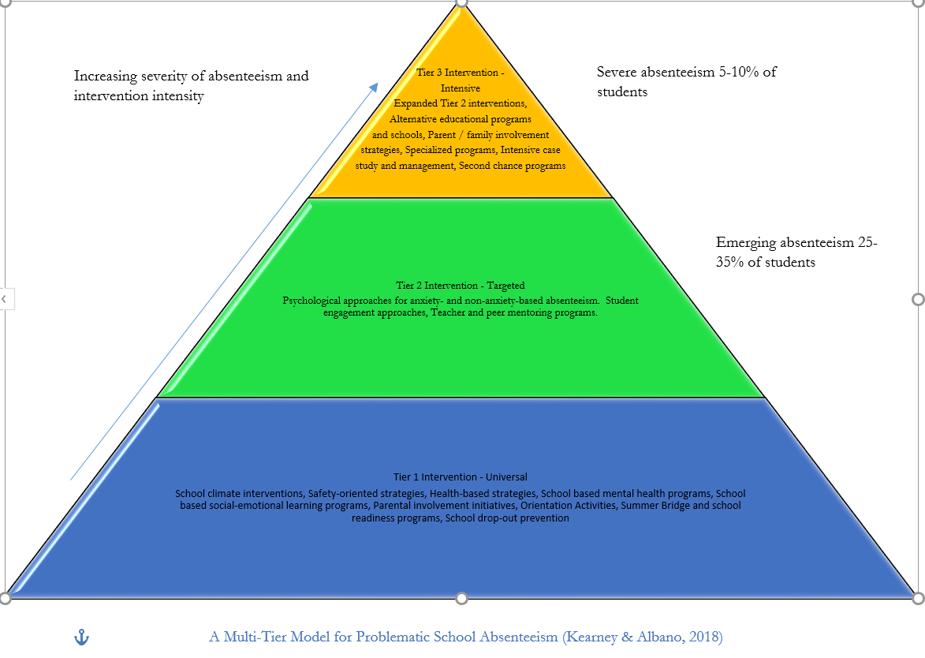
C

Slide 39
In Summary
Early Intervention
Planning – with the child/young person, their family, school staff and partners
Individualised assessment and intervention
Smart Outcomes: Universal, Targeted or Individual
Connectedness and Relationships
Small Steps (sometimes tiny) E.g. Gradual Exposure: treat each success as a win to be developed and progressed.
Flexibility
A

Slide 40
A

Slide 41
A

Slide 42
Chris.Atherton@eastrenfrewshire.gov.uk
Angela.Merrylees@eastrenfrewshire.gov.uk
https://blogs.glowscotland.org.uk/er/PsychologicalService/school-staff/building-resilience/healthier-minds/
https://youtu.be/1s8UxUxga78
A

