Slide 1
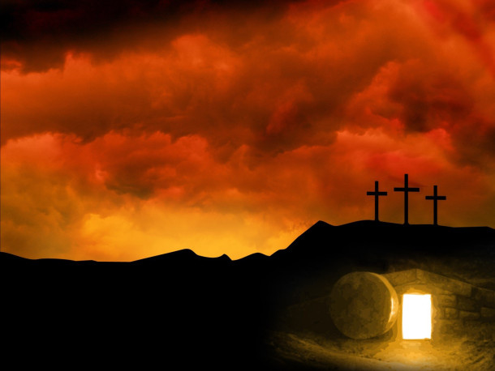
The Easter Story
We are going to learn about the Easter Story.
What do Christians believe happened at Easter?

Slide 2
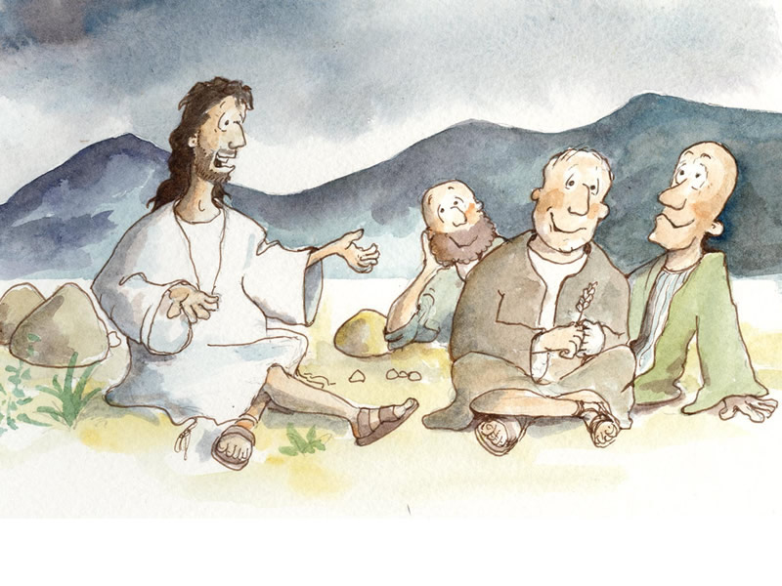
Jesus: The Teacher
Jesus travelled Israel for 3 years.
He taught people about God.
When he came to a town, 100’s of people came to listen to him.
However some people didn’t like him.
This included the Pharisees, the Jewish teachers.
They hated Jesus.
Didn’t like what he was saying.
Made a plan to kill him.
Didn’t stop Jesus preaching about God.

Slide 3
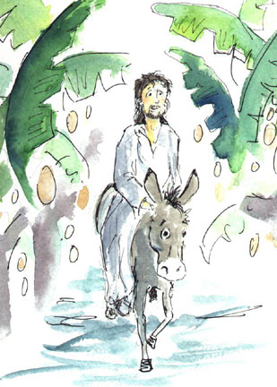
Palm Sunday:
Jesus went to Jerusalem with his disciples.
They went to celebrate Passover.
Passover - celebration of Moses freeing Jews from Egypt.
Jesus rode into Jerusalem on a donkey.
Donkey showed people he was just like them.
People put their coats on the ground for him.
Also broke palm branches off trees.
Waved the branches in front too.
Notes:
Video link attached to image.

Slide 4
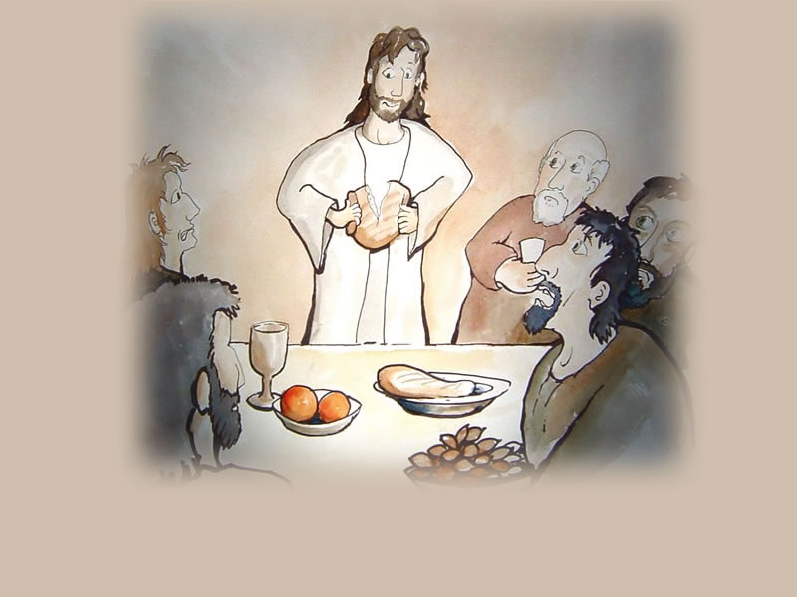
The Last Supper:
Jesus & his disciples gathered for a meal.
It was a Passover meal.
When his disciples arrived, Jesus washed their feet.
Then they shared a meal of bread & wine.
Jesus blessed the bread & wine.
He explained that one of his disciples would betray him.
His disciples didn’t understand.
They all said they wouldn’t do that.
Notes:
Video link attached to image.

Slide 5
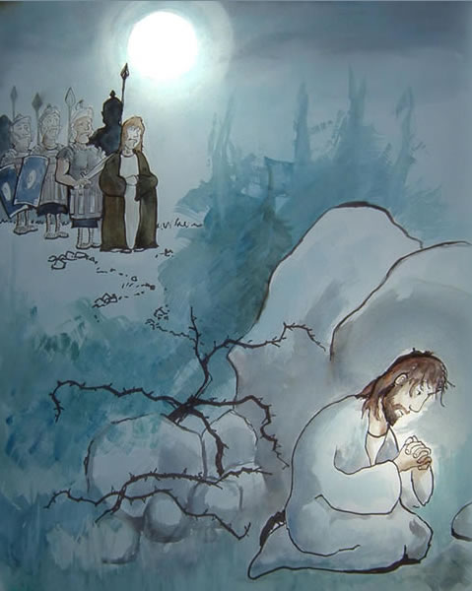
The Garden of Gethsemane:
After the meal, Jesus went to pray.
He went to the Garden of Gethsemane.
Asked the disciples to wait for him.
But they fell asleep.
Prayed to God so that he didn’t have to do what would follow.
Suddenly, Judas arrived.
He was with a group of Roman soldiers.
Judas kissed Jesus on the cheek.
This was a sign to arrest him.

Slide 6
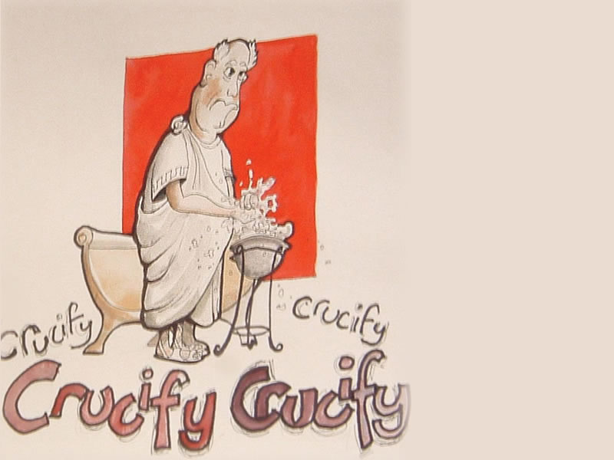
Trial of Jesus:
Taken to Roman governor, Pontius Pilate.
He didn’t think Jesus was guilty.
Wanted to release Jesus.
Was afraid of what the religious leaders would do to him if he released him
Asked the crowd what he should do.
Release Jesus OR Barabbas, a criminal.
They chose Barabbas.
“Crucify him!” the crowd shouted.
Pilate washed his hands & handed him over.

Slide 7
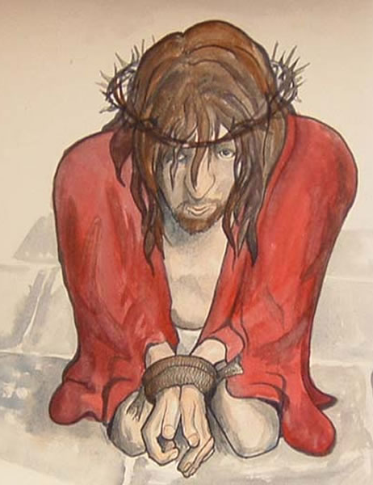
The Crucifixion:
The Romans mocked Jesus.
Put a cloak on him & a crown of thorns.
Laughed at him saying “Hail, King of Jews!”
Whipped Jesus badly.
He was made to carry a wooden cross.
Carried it to through the city to a mountain top.
There they nailed him to the cross.
Placed him between 2 criminals.
Jesus died, & the skies went dark.
Notes:
Video link attached to image.

Slide 8
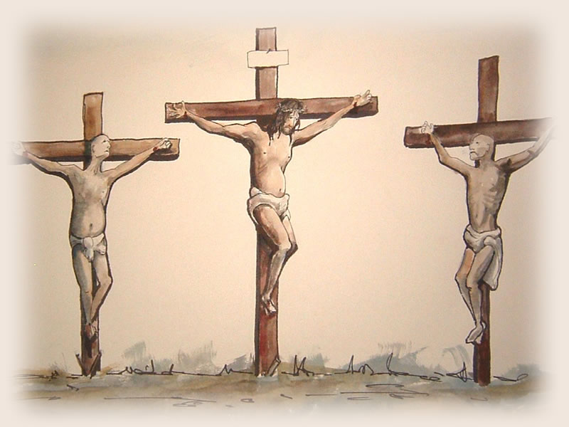
Notes:
Video link attached to image.

Slide 9
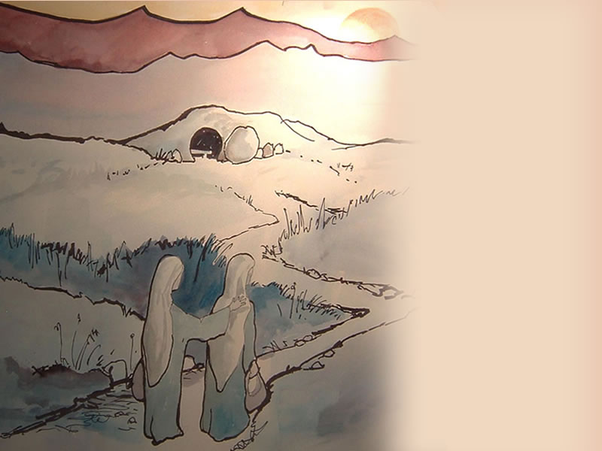
Jesus is buried:
Jesus’ disciples took his body from the cross.
Placed it inside a tomb - a large cave.
Wrapped his body in a white sheet.
Covered the entrance with large, heavy boulder.
They then left the tomb.
They were afraid of being arrested.
Thought the Romans wanted them dead too.

Slide 10
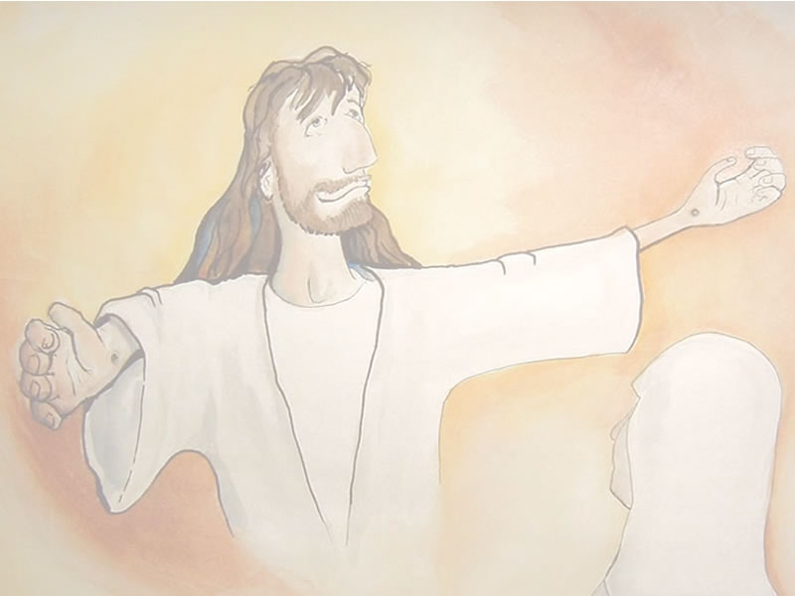
Easter Sunday:
After 3 days, a group of women visited the tomb.
When they arrived, the stone was moved.
The tomb was empty.
Mary Magdalene began to cry.
Behind her a man’s voice said: “Don’t be afraid he was not taken. He has risen.”
The women turned and saw Jesus standing.
They fell to their knees in worship.
Told them to go tell his disciples of his return.
Women ran off to spread the good news.

