Slide 1
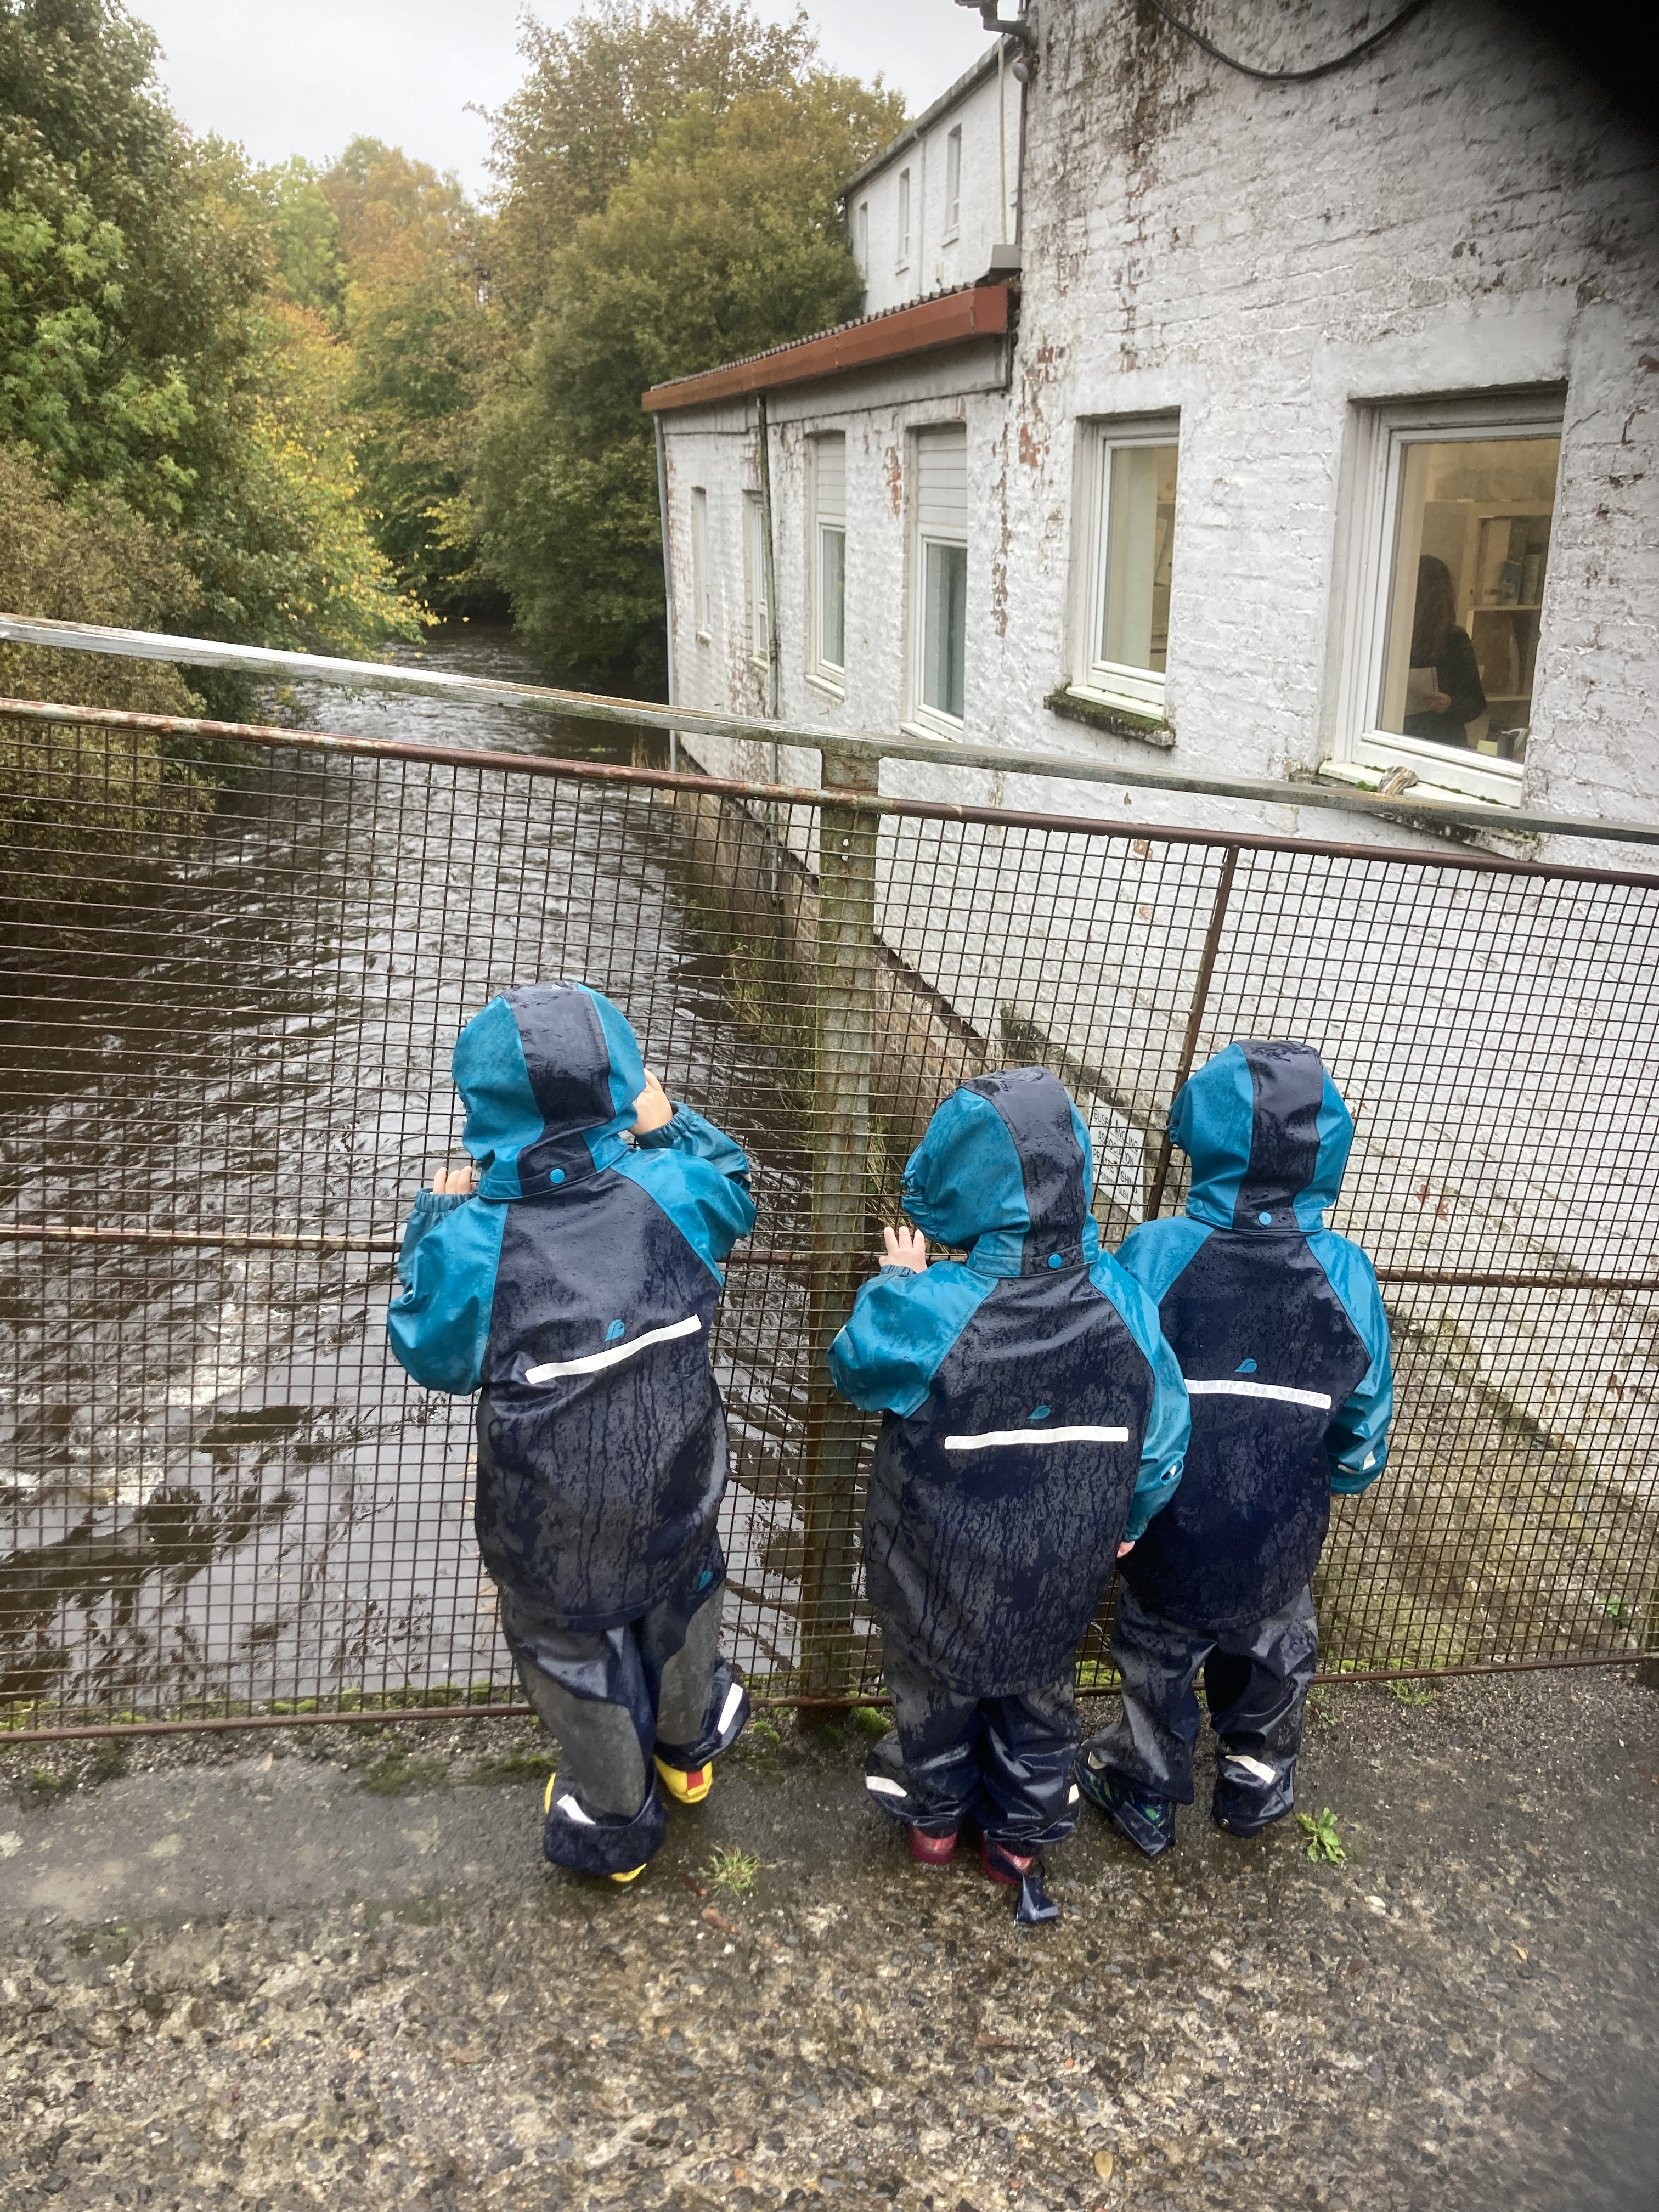
Cart Mill Family Centre
Forest School

Slide 2
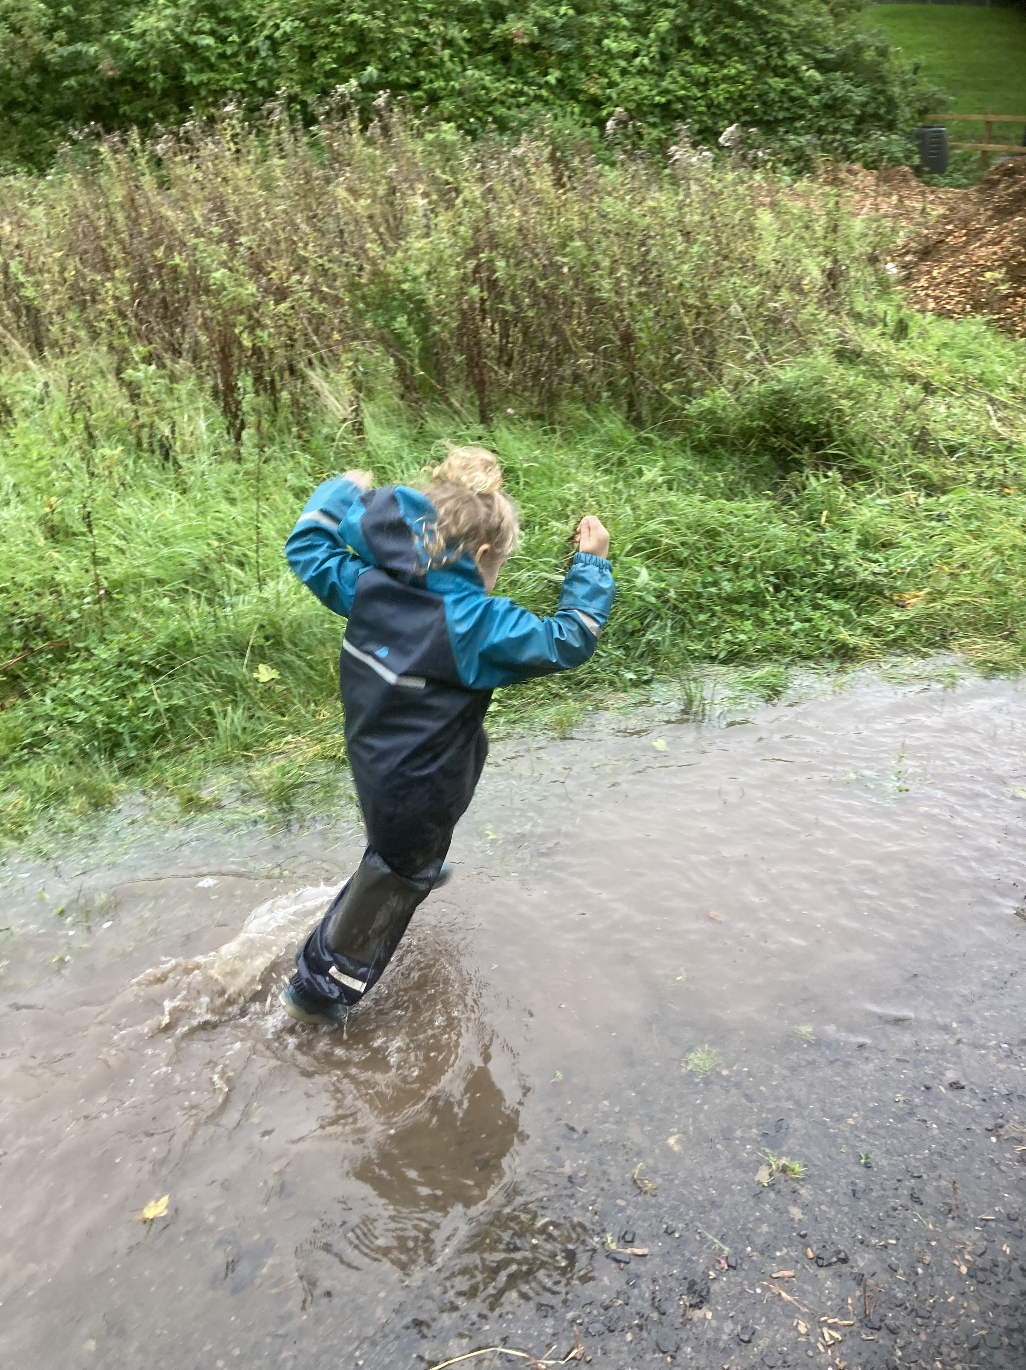
What is Forest School ?
Forest school is a classroom without walls, it is a learning environment with no limits. Forest school is where children can rightfully play and use nature and themselves as their educator, with staff being the assistant in the background.
Forest school is NOT a treat, it is an outdoor learning environment which provides the stimulating environment that is key to children’s development.

Slide 3
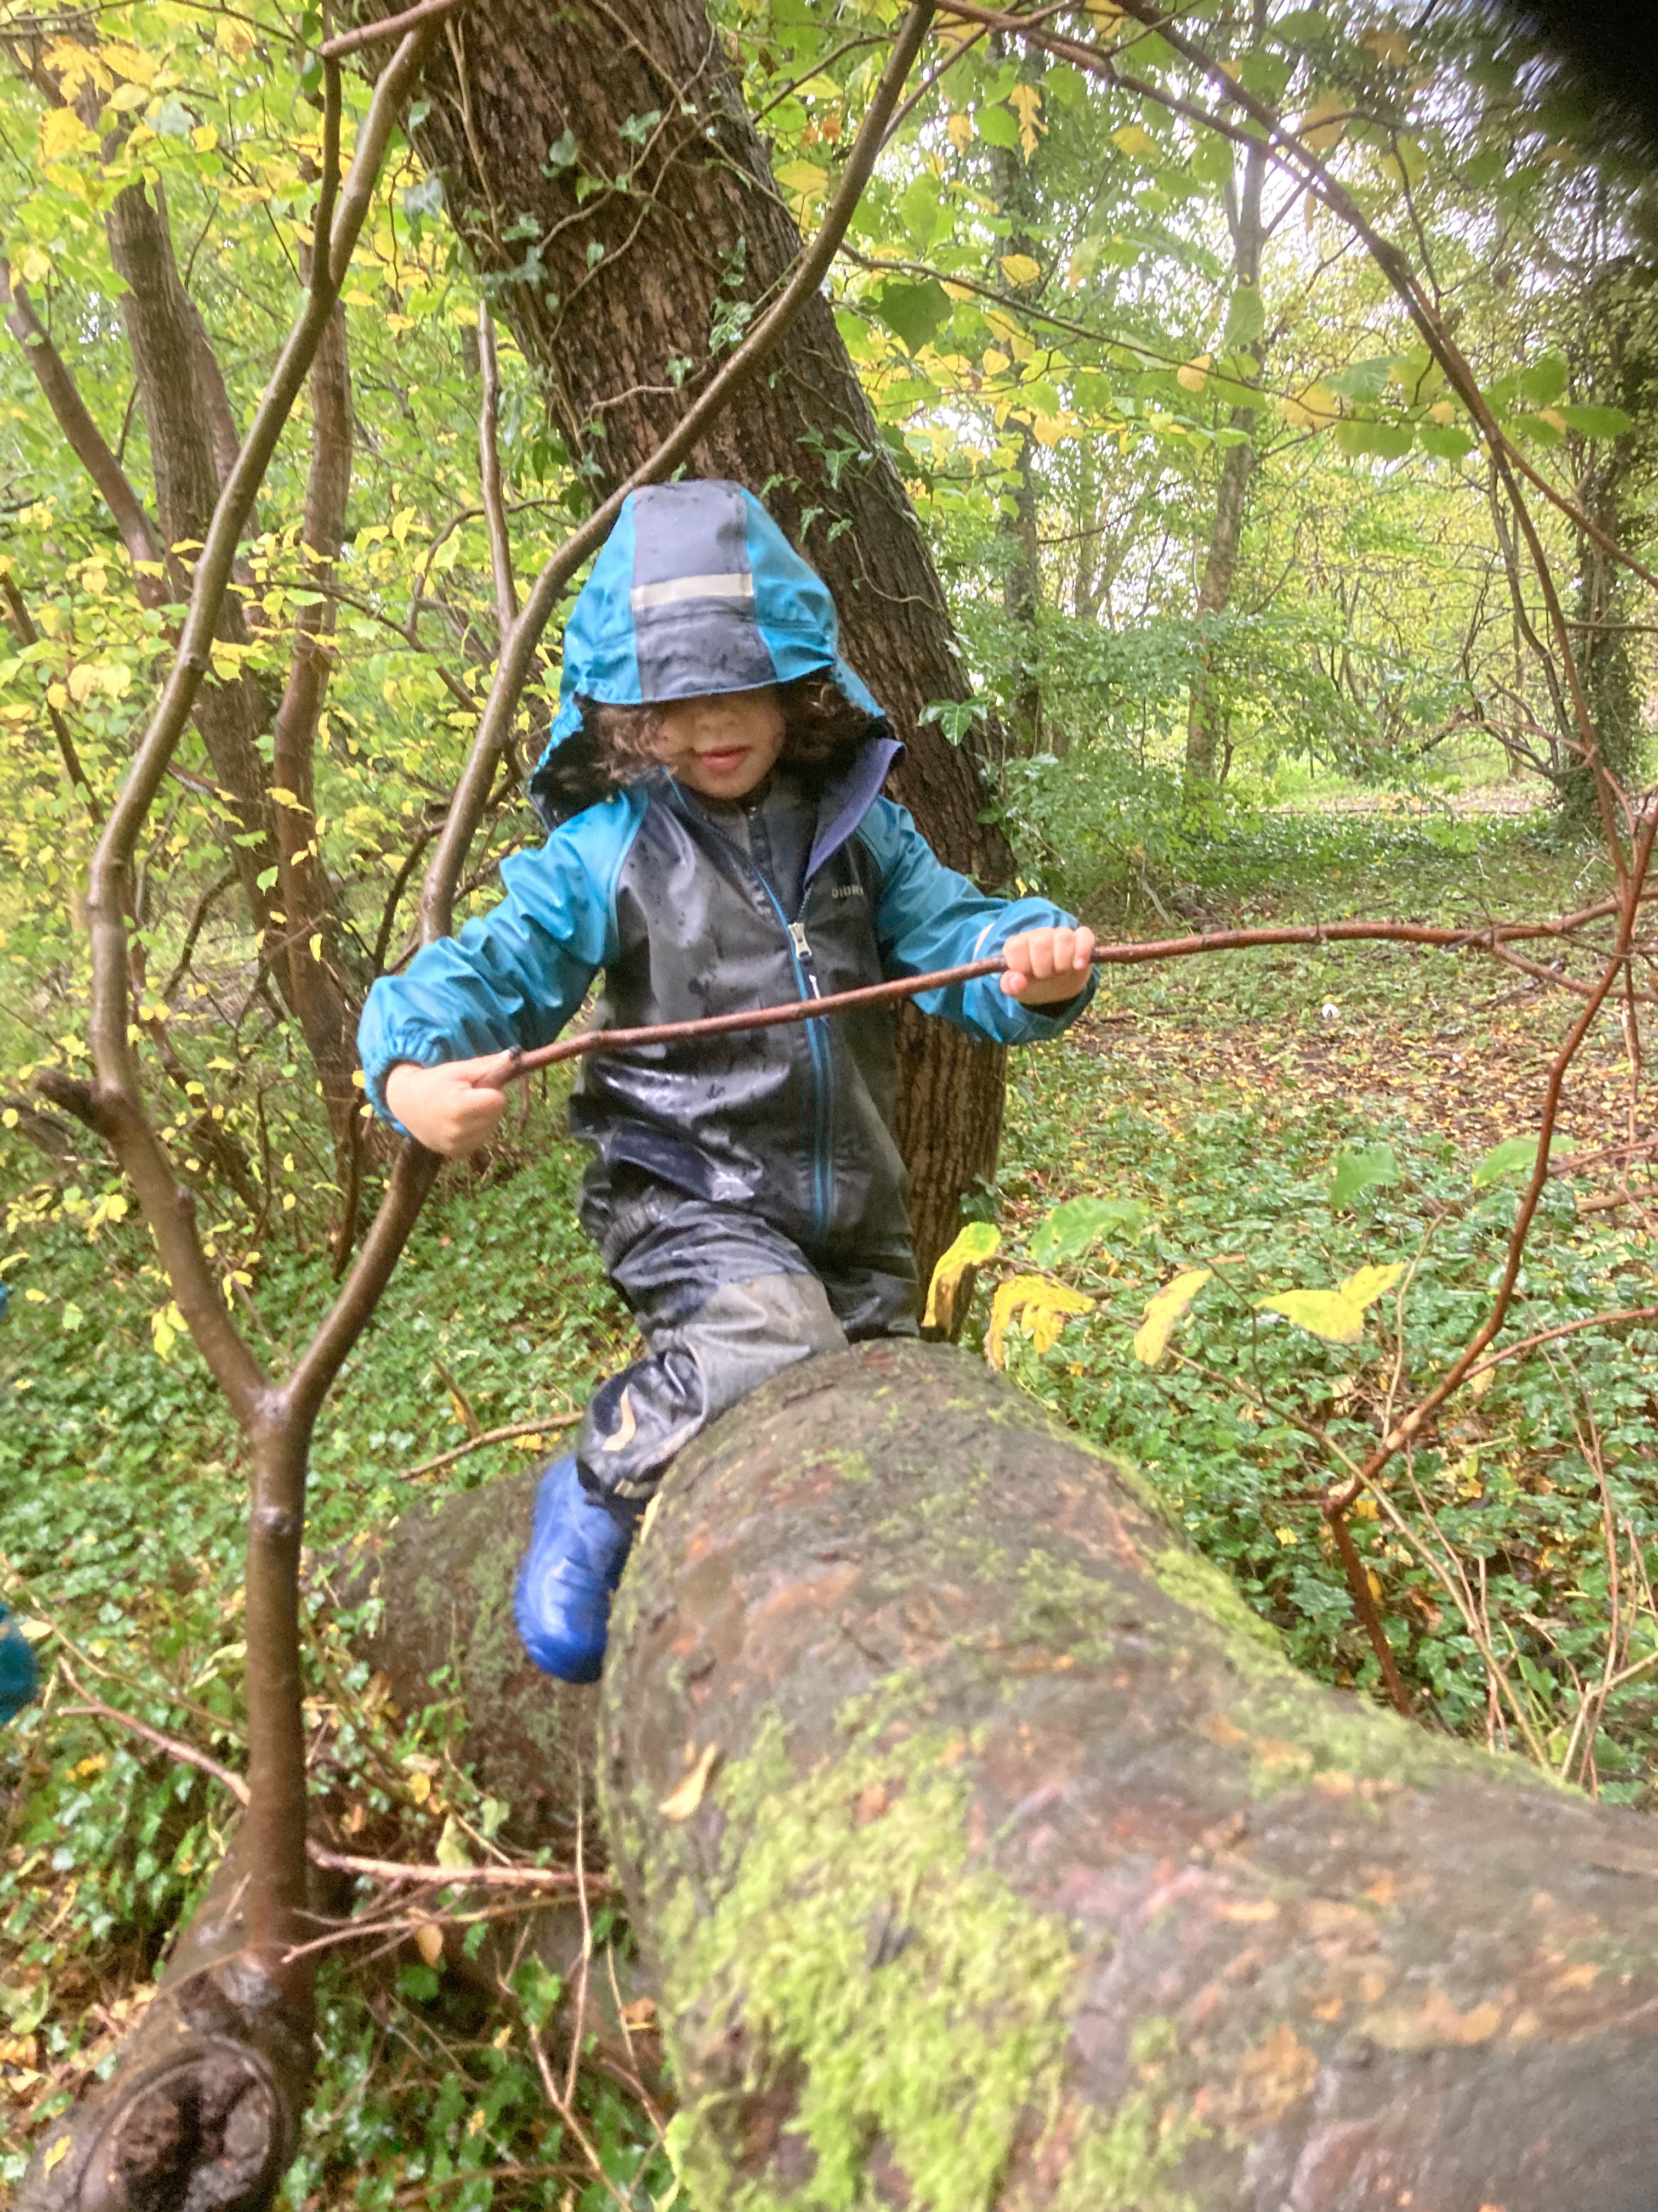
Why do we do Forest School ?
To respond to individual children’s needs.
To nurture individuals self-esteem.
To promote healthy lifestyles.
To encourage independence.
To improve confidence, communication and social skills.
To encourage children to problem solve and take appropriate risks.
To develop an appreciation and respect for the natural environment.
To create memories.
Notes:
1 – some need outdoors more than other.

Slide 4
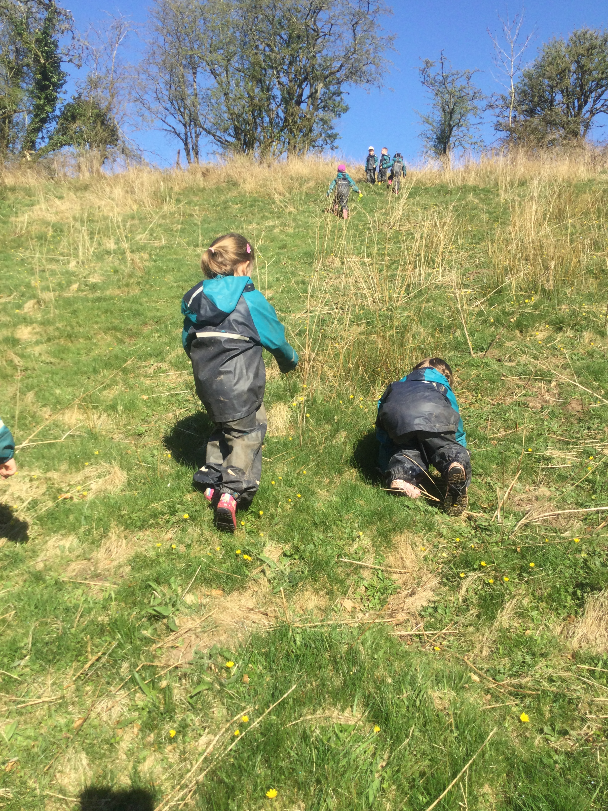
How do we achieve this ?
Through small achievable goals we ensure a child achieves something every time they are at the Forest.
Through encouraging fun and excitement children begin to enjoy a more active and natural way of learning.
Through encouraging children to try and do most things by themselves, i.e. Allowing them time to get dressed into their appropriate equipment.
Through small groups & small ratios children become more confident.
By practitioners stepping back, children are encouraged to communicate with each other, building new relationships and social skills.
Through risk assessing and allowing children to try to achieve anything as long as we have agreed it is safe.
Respecting the area we use. Children don’t want to see it damaged we discuss how to respect the environment.

Slide 5
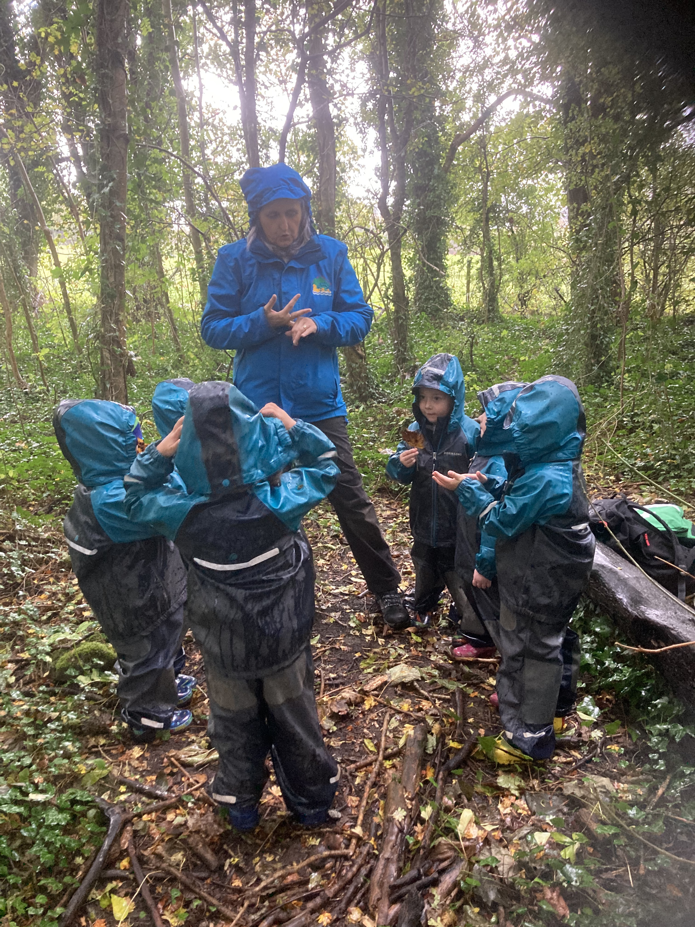
Staff involvement.
We make a plan together.
Take equipment and resources that follow on from the evaluation from the previous week.
Observe and listen to the conversations the children are having.
Assess the safety of the site prior to and during our visits, looking at hazards and risks.
Currently we have two staff, holding level 6 Forest and Outdoor learning award. Namely Val MacLean and Fiona Hannah. Both are qualified first aiders and also holds an emergency outdoors first aid qualification.

Slide 6
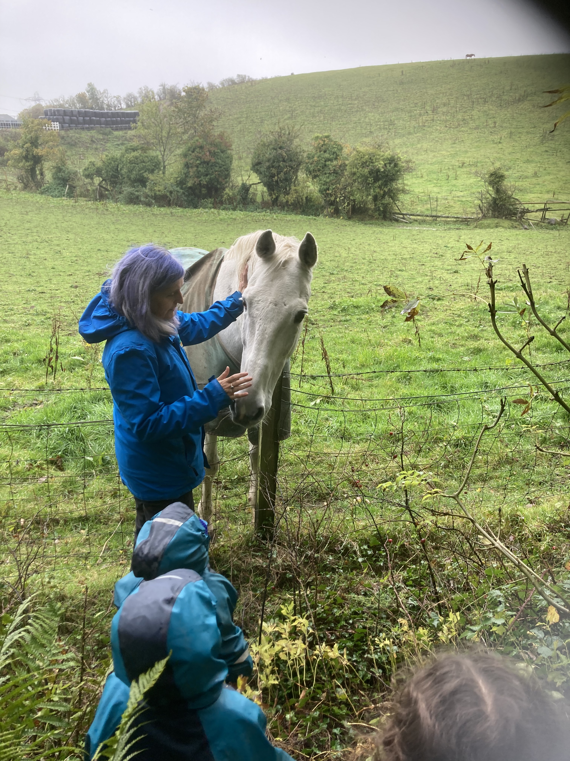
What happens during a Forest School Session?
Week 1: - Children are introduced to the forest, we discuss as a group what is expected of each other.
Week 2: - Children revisit the rules and are then given time to explore.
Week 3: - Children are introduced to ropes.
Week 4: - Children are given the opportunity to explore the use of fires in a forest setting.
Week 5: - Children combine all their skills to have an open play and a cook out

Slide 7
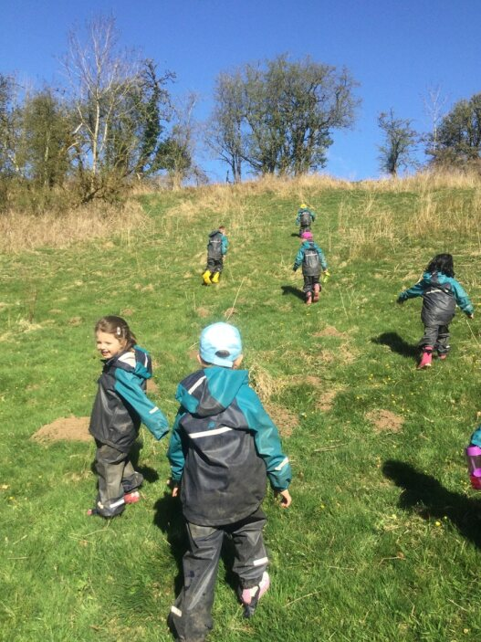
What can you do as a parent ?
Clothing – please dress your child in layers i.e. : joggers or leggings, vest, t-shirt, fleece, thick socks and gloves. Please make sure they have well fitting wellies for the walk! We provide waterproof dungarees and a water and windproof jacket.
Ask your child questions about what they have learned, ask them to risk assess, or visit our blog to see what we have been learning in the forest.
If you are looking for something to do with your child which is free and fun, take them to the forest and allow your child to explore.

Slide 8
Cancellation
Weather Conditions may stop Forest School – extremely cold, high winds and ice.
Staffing

Slide 9
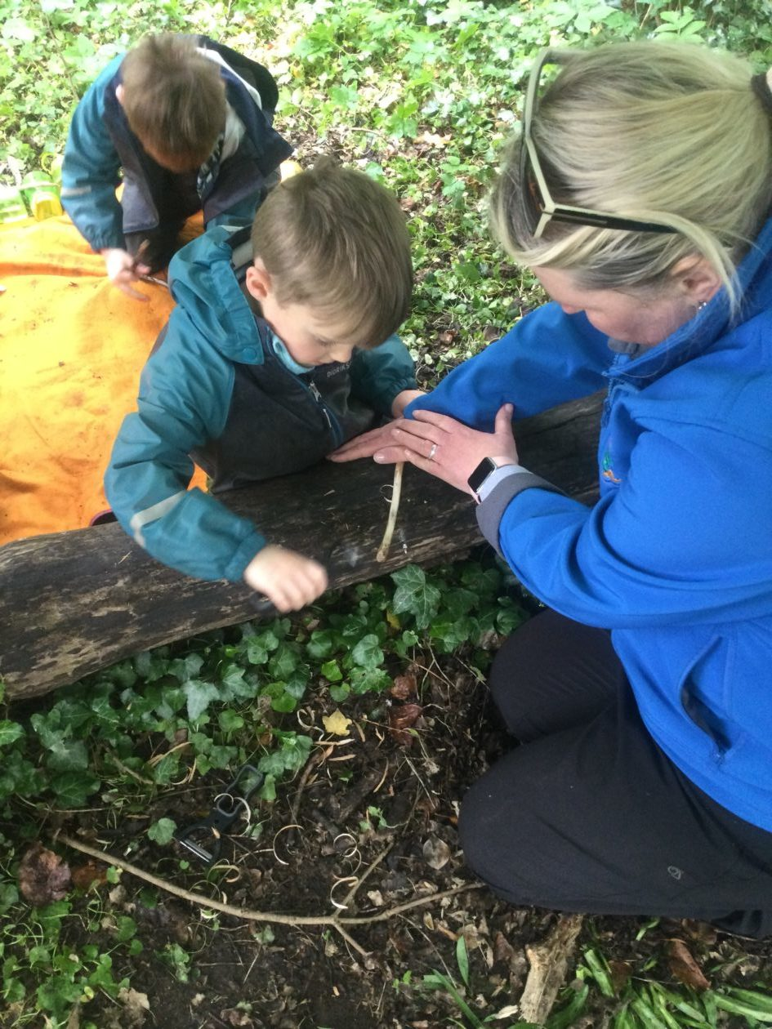
What our children achieve!

