Slide 1
Easter Holiday Maths Challenge
Guide for practitioners

Slide 2
Deputy First Minister’s Maths Challenge
The purpose of this PowerPoint is to provide some activities which link to the Deputy First Minister’s Maths Challenge, involve mathematics and, hopefully, are fun to play.
They are designed to be used more than once, therefore, it would be beneficial if Primary 6 pupils could have the opportunity to familiarise themselves with some of the challenges before they take their booklet home.

Slide 3
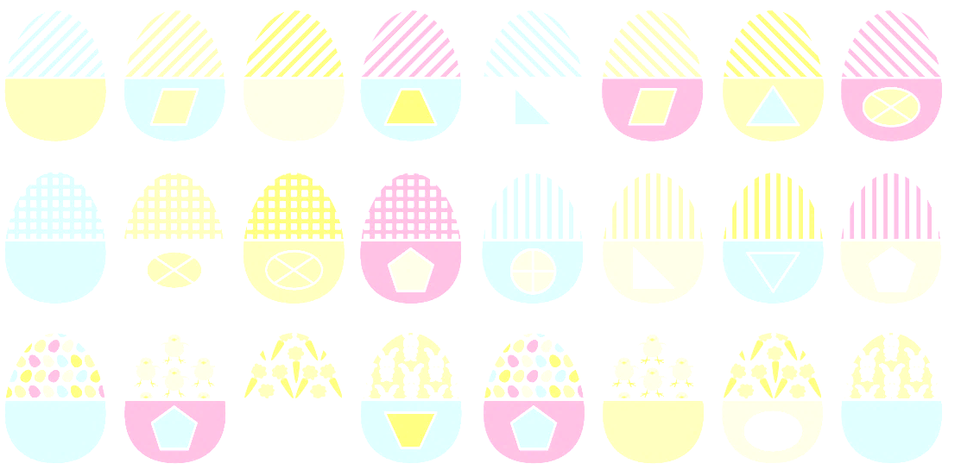
Egg Hunt
The Egg Hunt is designed to be played indoors or outdoors and is able to be played as often as you wish. It is essential that you have permission from an adult that you live with to try these activities outdoors.

Slide 4
Egg Hunt
There are a range of activities you can try with the eggs.
Now, before we begin, let us look at the eggs.

Slide 5
Egg Hunt
No two eggs are exactly the same but have different characteristics which may be similar.
To try: Choose two eggs and think of how they are the same and how they are different.

Slide 6
Egg Hunt
Now choose 3 eggs.
Decide how two of the eggs are similar and what is different on the 3rd egg.
(Perhaps as a game this could give some group points within the class).

Slide 7
Egg Hunt
For example (or eggsample as I like to think ;)
Some eggs have triangles, pentagons, blue shapes, yellow shapes, vertical stripes, right angles and some are symmetrical.

Slide 8
Egg Hunt
This can be repeated using the numbered side of the eggs.
Look at the numbers and see what is similar and what is different.
e.g. look at times tables, doubles, numbers where the digits add to the same total, maybe even prime numbers.
You will have many more ideas of your own. Give it a go.

Slide 9
Egg Hunt
Now try to come up with your own challenges, or sums, to make one of the numbers.
Notes:
This is the strategy – The answer is… what is the question?

Slide 10
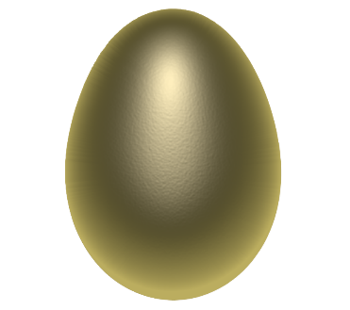
dd ne ut
The main challenge is the game Odd One Out. The eggs can be placed on a table or hidden for players to find. Collect 5 eggs.
Each player, or team, has to see if it is possible to explain how one egg is the Odd One Out. If this is possible then 1 point is given. Put the eggs back and play again. The first to 5 is the winner.
This Photo by Unknown Author is licensed under CC BY

Slide 11
dd ne ut
You can decide if you will use the patterns or the numbers.
This Photo by Unknown Author is licensed under CC BY

Slide 12
Egg Boxes
Using the 24 eggs, group them in sets through a common link – they can be ‘egg boxed’ together.
How many different boxes do you need to put all of the eggs in a box?
An example of one box is on the next slide.

Slide 13
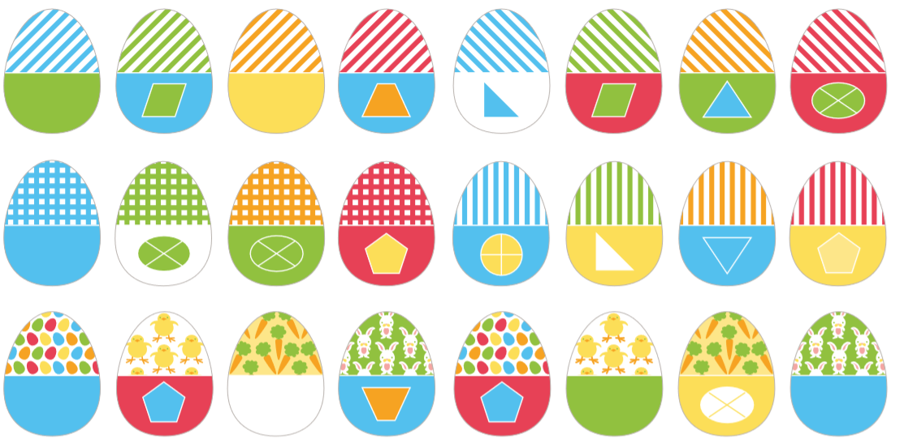
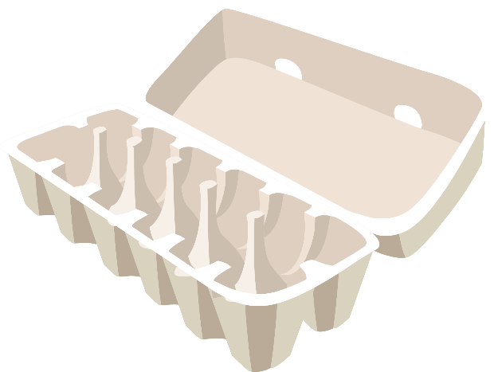
Egg Boxes
These eggs all have a right angle in the shape.

Slide 14
Egg Boxes
Have a go.

Slide 15
Egg Boxes
Multiples of 3. These eggs would go in the ‘egg box’

Slide 16
Egg Boxes
Square numbers (the answer to a smaller number multiplied by itself)
They would go in another ‘egg box’.

Slide 17
Unscrambled Eggs
There are 24 numbers on the eggs. Under each number is a clue to get the next egg you have to find. This can be done in class like cycle cards. Here are some examples.
Notes:
This can be played as cycle cards or one player can lay eggs out in the correct order. (no pun intended) The question on the last egg – will be the number at the top of the first egg.

Slide 18
Unscrambled Eggs
With cycle cards, the question at the bottom leads to the number at the top of the next egg. Then the next clue is read for the egg that will be next; and so on.
The clue at the bottom of the last egg should be the number at the top of the first egg.

Slide 19
Unscrambled Eggs
To play differently, at home, or school, the eggs can be hidden and you ‘hunt’ for the next answer. If you are working together as a group then the task is to get to the end. If you are playing against each other – then 1 point is awarded for each correct egg that is placed next to the previous egg. Remember, to gather everyone together to hear the next clue.

Slide 20
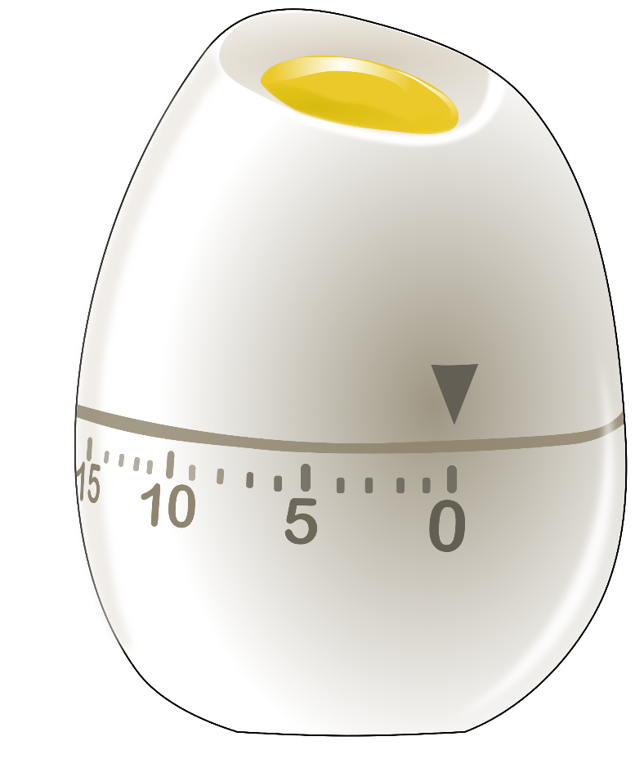
Unscrambled Eggs
If you’ve managed this, how about playing it against the clock? How much faster can you finish each time you play? What is your fastest time?

Slide 21
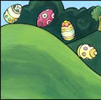
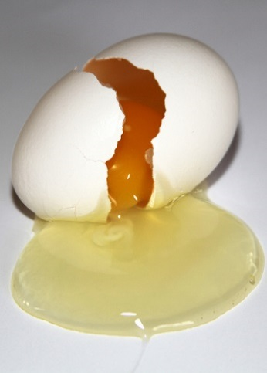
Crack up – Roll down
This game can be played alone or can have people competing against each other. If there is more than one person playing, one person can be the game leader – a little like a game show host. Using a set of the eggs, get the eggs in a pile. Select the egg from the top and display the number. The person whose turn it is has to predict if the next card will be bigger ‘crack up’ or lower ‘roll down’. If the person gets it right, they get to continue. The winner of each round is the person who gets the greatest number of eggs predicted correctly. A bonus point is given for doubles and halves if the player calls out ‘scramble’.
This Photo by Unknown Author is licensed under CC BY-NC-ND
This Photo by Unknown Author is licensed under CC BY
Notes:
Similar to the game show ‘Play Your Cards Right’ – this is an extra (eggstra) and not in the challenges.

Slide 22
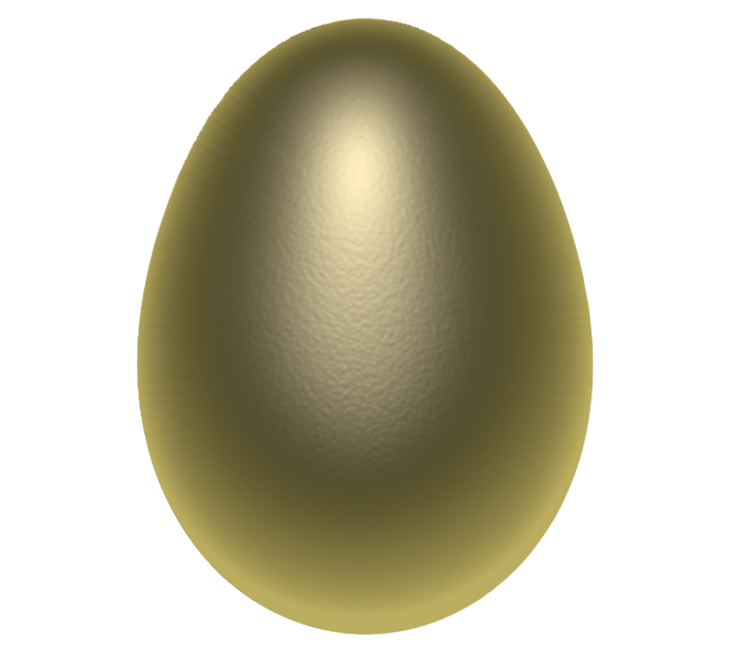
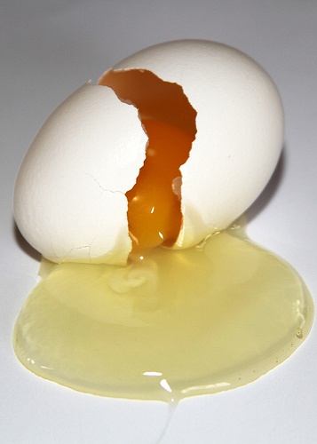
Crack up – Roll down
“17 is quite a low number, a higher number is likely so I’ll say ‘crack up’.”
This Photo by Unknown Author is licensed under CC BY-NC-ND
This Photo by Unknown Author is licensed under CC BY
Notes:
Possible straight forward dialogue.

Slide 23
Crack up – Roll down
“15 of the 24 numbers on the eggs were smaller than 27 so 15/24 eggs are smaller, which simplifies to 5/8 of the eggs. That is more than half so I am going to predict it will be smaller. So I am going to say ‘Roll down’.”
This Photo by Unknown Author is licensed under CC BY-NC-ND
This Photo by Unknown Author is licensed under CC BY
Notes:
More complex reasoning.

Slide 24
The Great Egg Scape
The aim is to have collected, and kept, the most eggs by the end of the game.
After a treasure hunt each player gathers with the eggs they have collected.
Each player should not show the number on the egg to the other players (or the pattern as this may help the other player).
In turns, each player must choose one of their eggs. They then choose a player to challenge.
The task is to come up with a question – the answer to which must match the number on the egg.
If the player chosen answers correctly they win that egg. If they answer incorrectly the egg does not get to ‘Egg Scape’.
Each egg can only be used once in each game. The game is over when all eggs have had the chance to Egg Scape.
This Photo by Unknown Author is licensed under CC BY-NC-ND
This Photo by Unknown Author is licensed under CC BY

Slide 25
The Great Egg Scape
For ‘Egg Sample’:
27 take away 3
24
The answer is correct so the egg gets handed over and
‘Egg Scapes’.
This Photo by Unknown Author is licensed under CC BY-NC-ND
How could we make sure the eggs cannot get away?
This Photo by Unknown Author is licensed under CC BY-NC-ND
This Photo by Unknown Author is licensed under CC BY

Slide 26
The Great Egg Scape
For ‘Egg Sample’:
Find a quarter of 96.
Mmm
If the correct answer cannot be given then the egg cannot ‘Egg Scape’ and you get to keep it.
This Photo by Unknown Author is licensed under CC BY-NC-ND
The harder the question you can come up with – the better. Just make sure the answer is correct.
This Photo by Unknown Author is licensed under CC BY-NC-ND
This Photo by Unknown Author is licensed under CC BY

Slide 27
The rest is up to you
As children, you are the creative minds of the future – you will, no doubt, be able to create other fun activities and games.

