Slide 1
Primary 5b
Friday 11 September
Literacy

Slide 2
???
Literacy!
Literacy?
Literacy?
Literacy!
Literacy!
???
Literacy!

Slide 3
Literacy is being able to:
Read
Write
Talk
Listen

Slide 4
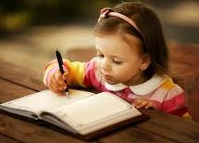

Slide 5
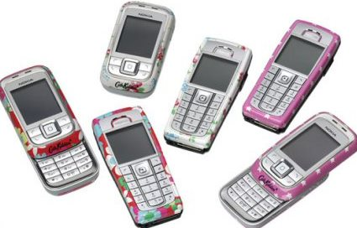
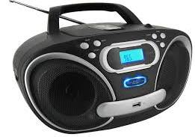
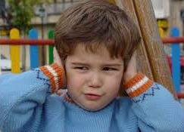
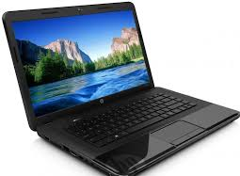
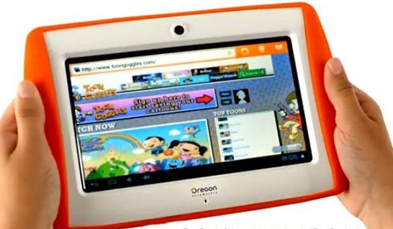
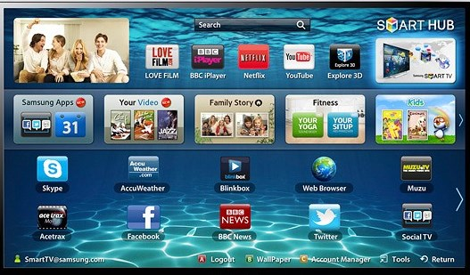

Slide 6
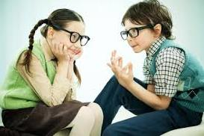

Slide 7
Where do we use literacy?
RME
Science
Social Subjects
Maths
PE
Music

Slide 8
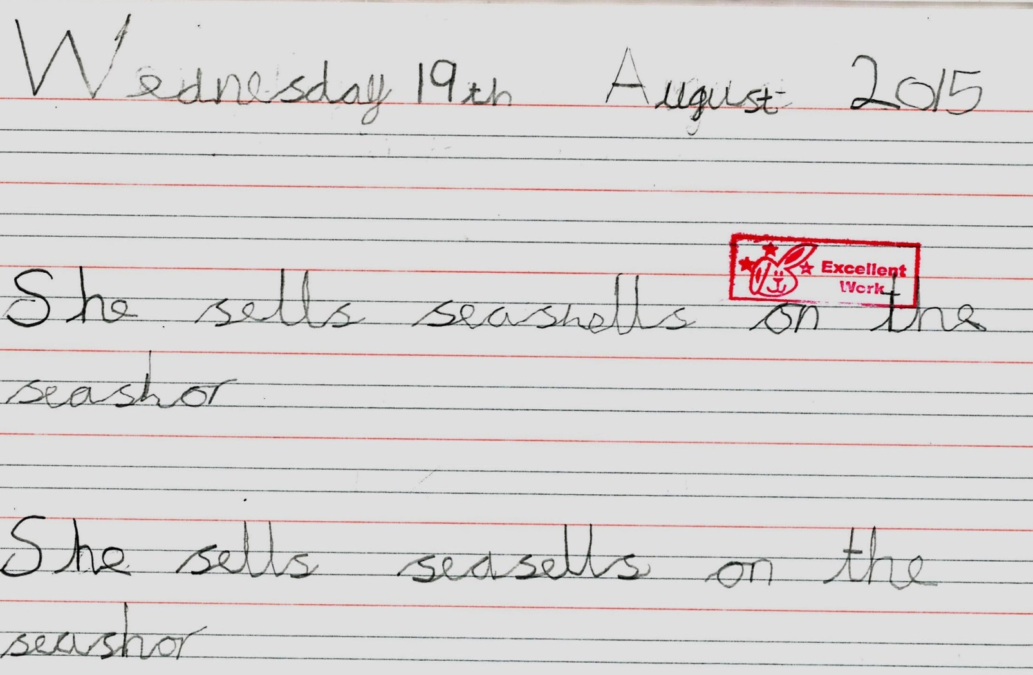
Handwriting by Ryan

Slide 9
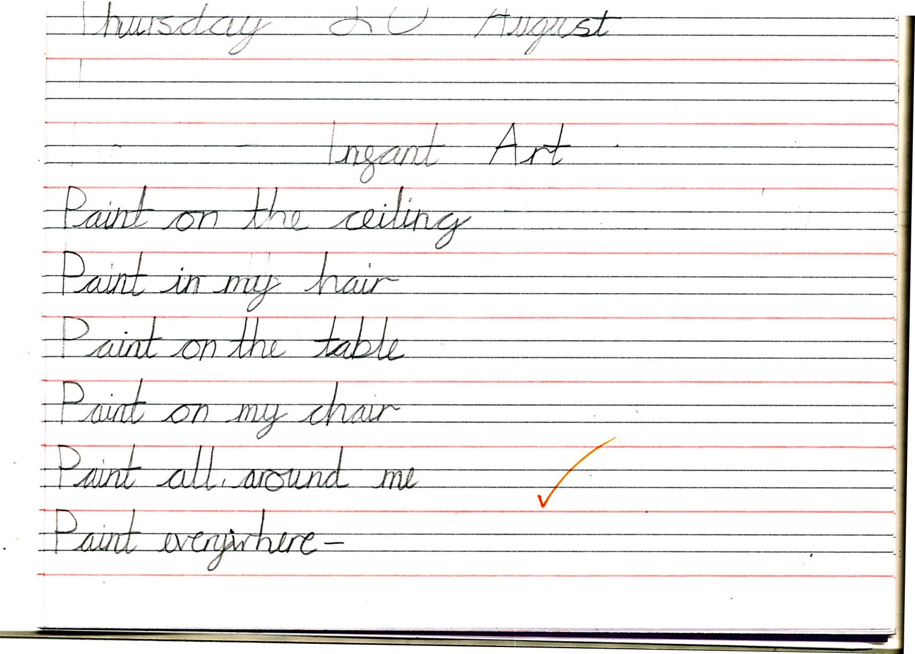
Handwriting/ Poetry Infant Art read by Jessica

Slide 10
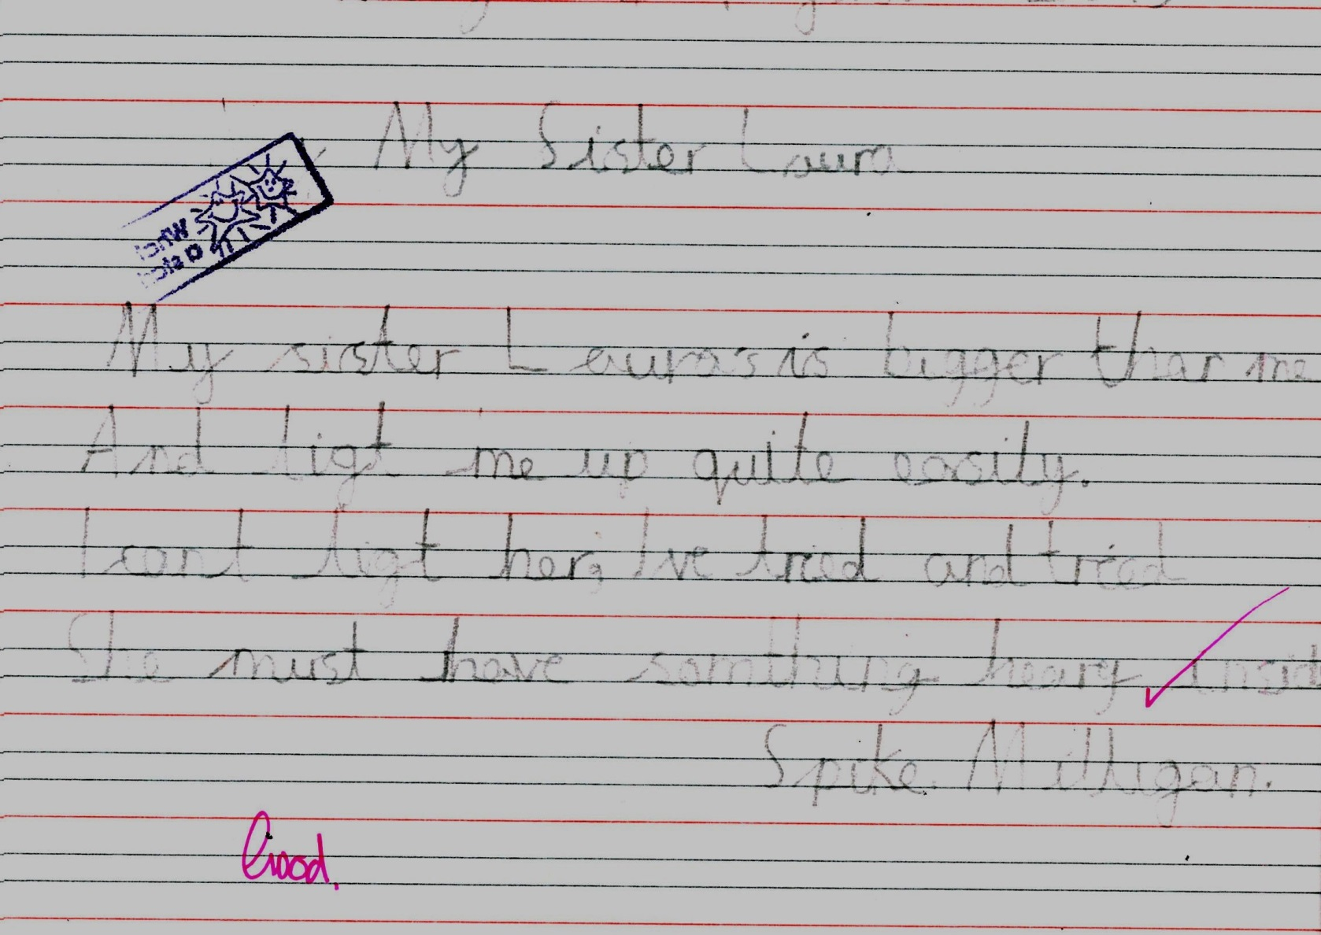
Handwriting/ Poetry My Sister Laura read by Chloe

Slide 11
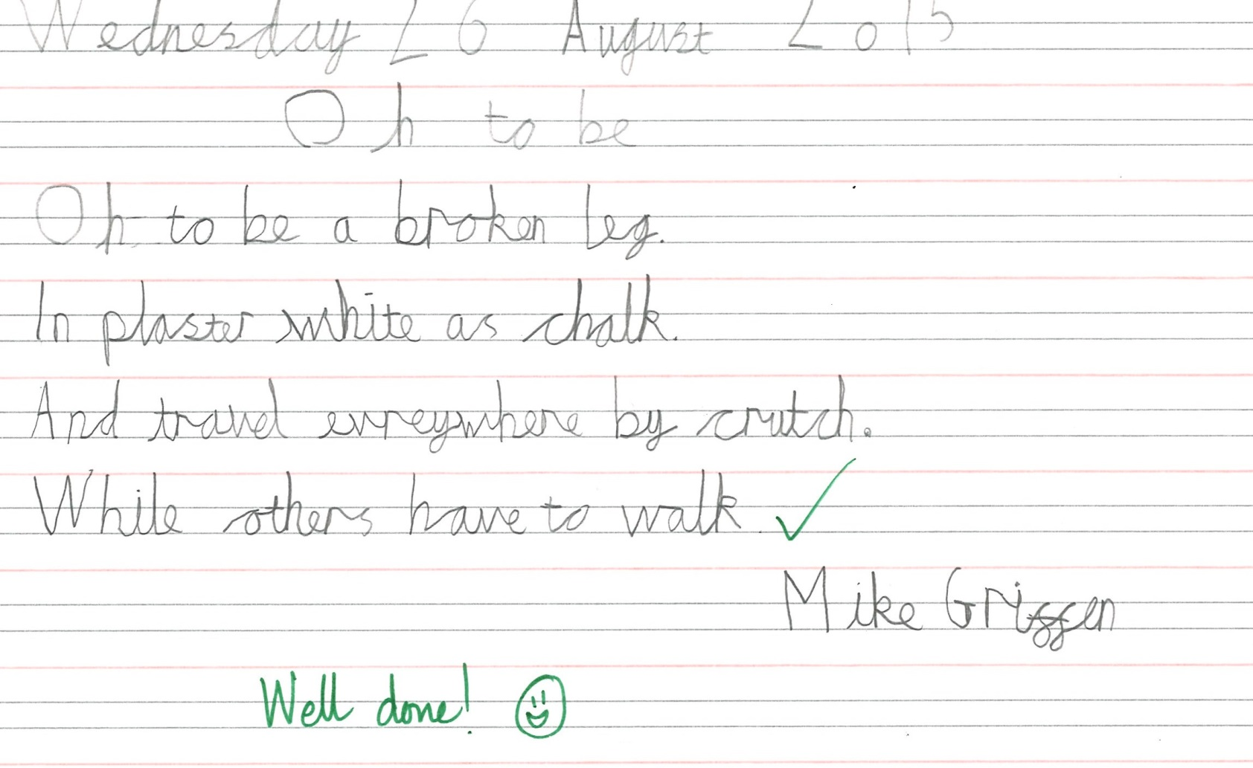
Handwriting/ Poetry Oh to be a Broken Leg read by Aimee

Slide 12
Handwriting/ Poetry The Baby Bat read by Beth

Slide 13
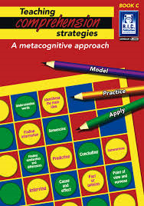

Slide 14
New vocabulary from reading
Proboscis
Nectar
Nourish
Species

Slide 15
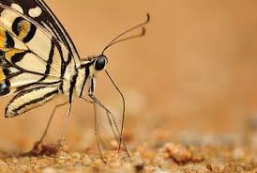
proboscis

Slide 16
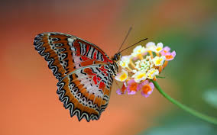
nectar

Slide 17
species

Slide 18
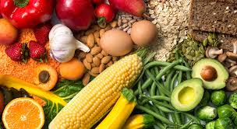
nourish

Slide 19
New vocabulary from RME
Lectern
Pews
Pulpit
Altar
Font

Slide 20
lectern

Slide 21
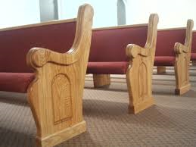
pews

Slide 22
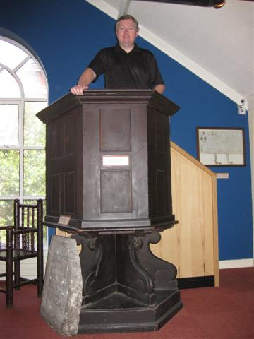
pulpit

Slide 23
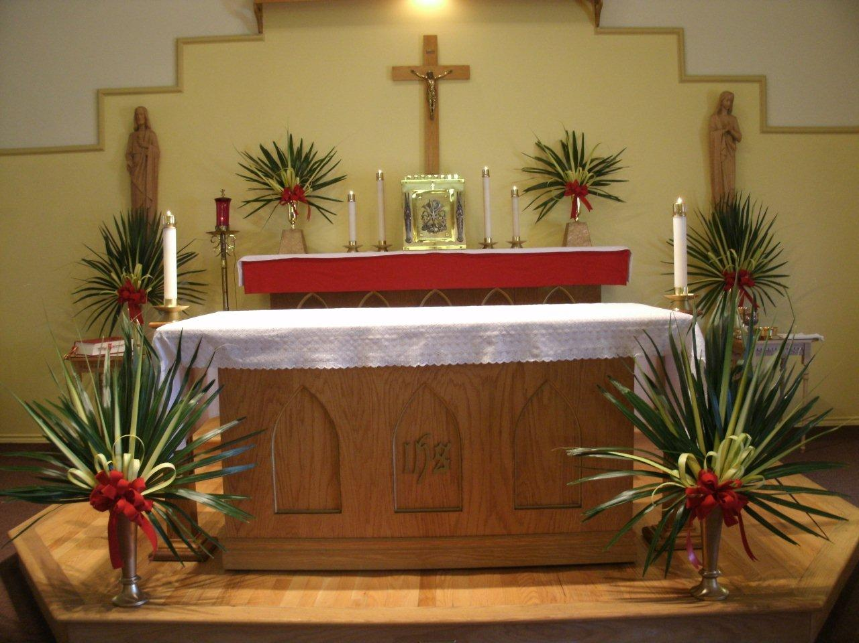
altar

Slide 24
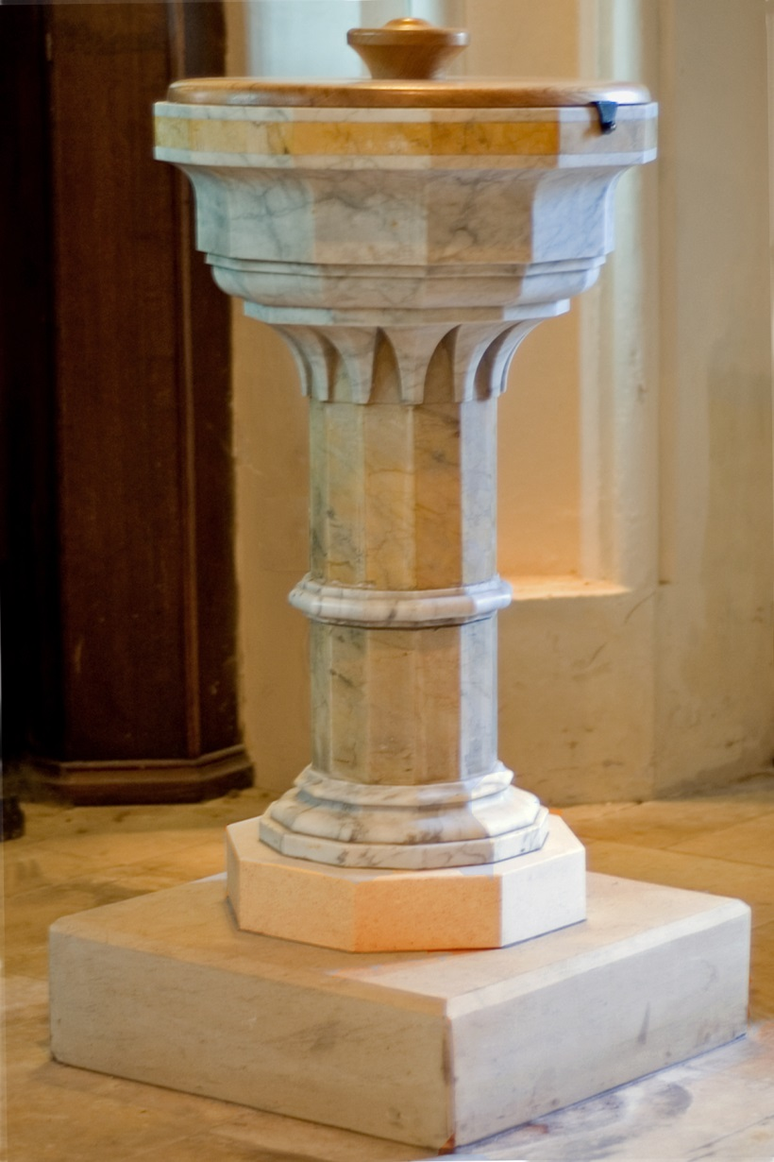
font

Slide 25
The Ink Is Black, The Page Is White
The ink is black, the page is white,
Together we learn to read and write,
To read and write.
And now a child can understand,
This is the law of all the land,
All the land!
The ink is black, the page is white,
Together we learn to read and write,
To read and write

Slide 26
Verse 2
The board is black, the chalk is white,
The words stand out so clear and bright,
So clear and bright.
And now at last we plainly see,
The alphabet of liberty,
Liberty!
The board is black, the chalk is white,
The words stand out so clear and bright,
So clear and bright.

Slide 27
Verse 3
A child is black, a child is white,
The whole world looks upon the sight,
A beautiful sight.
For very well the whole world knows,
This is the way that freedom grows,
Freedom grows!
A child is black, a child is white,
The whole world looks upon the sight,
A beautiful sight.

Slide 28
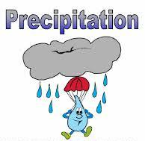

Slide 29
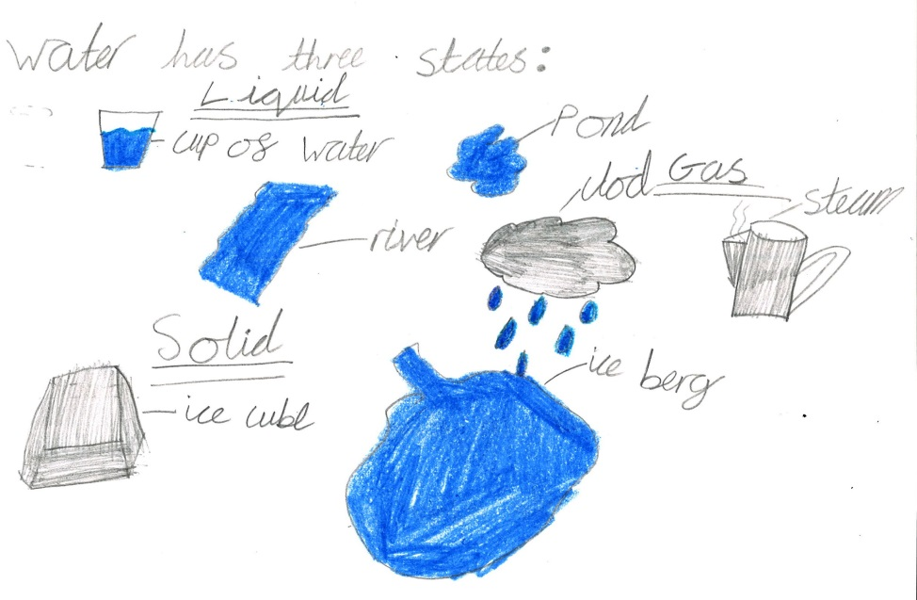
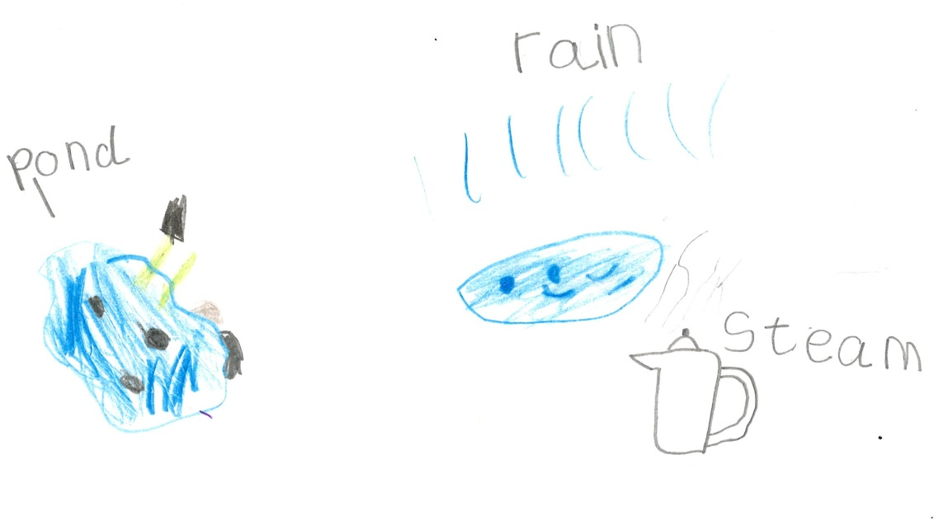
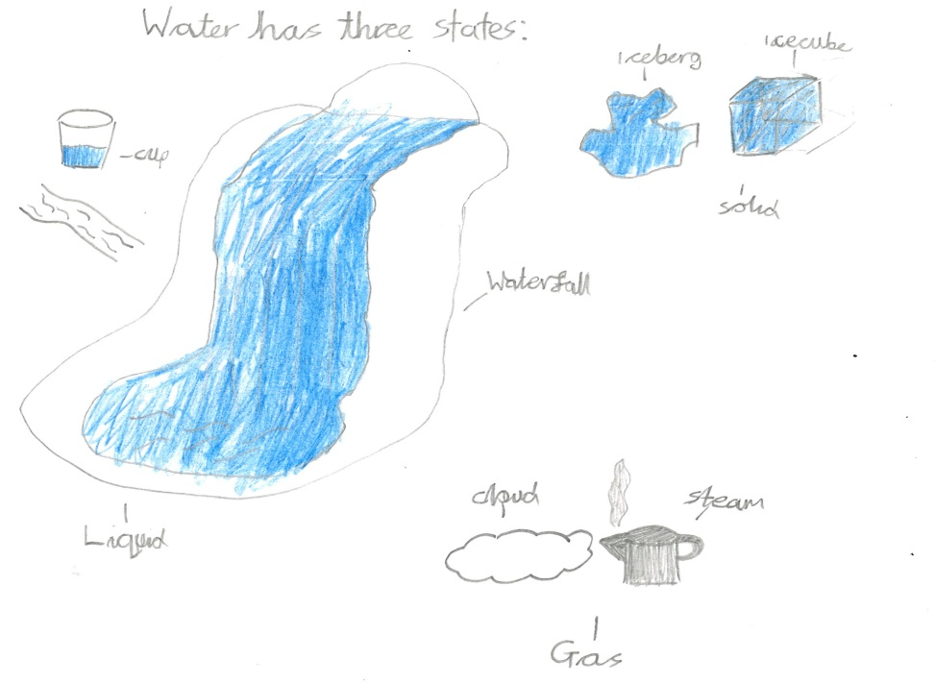
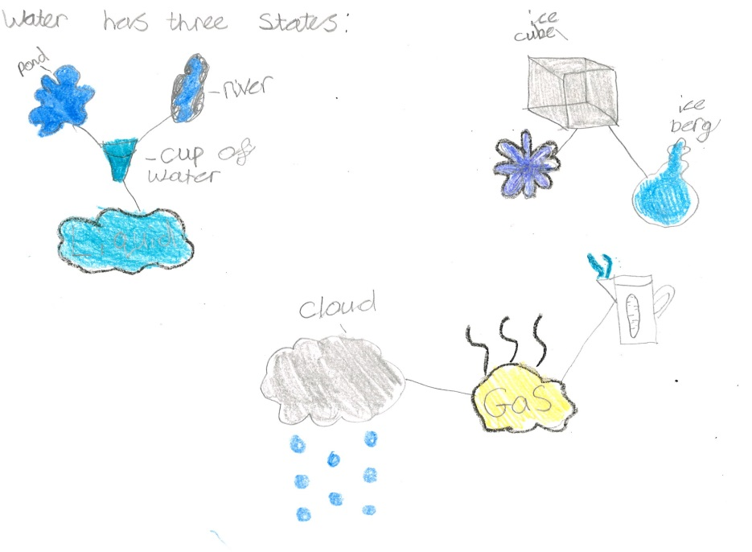
Annotated Diagrams

Slide 30
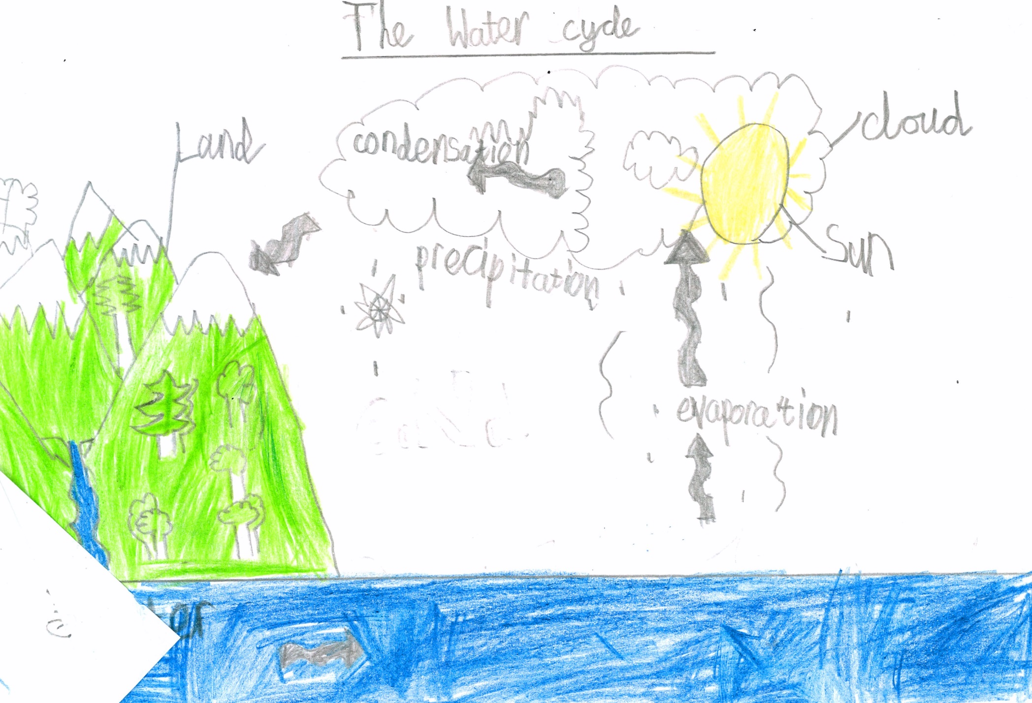

Slide 32
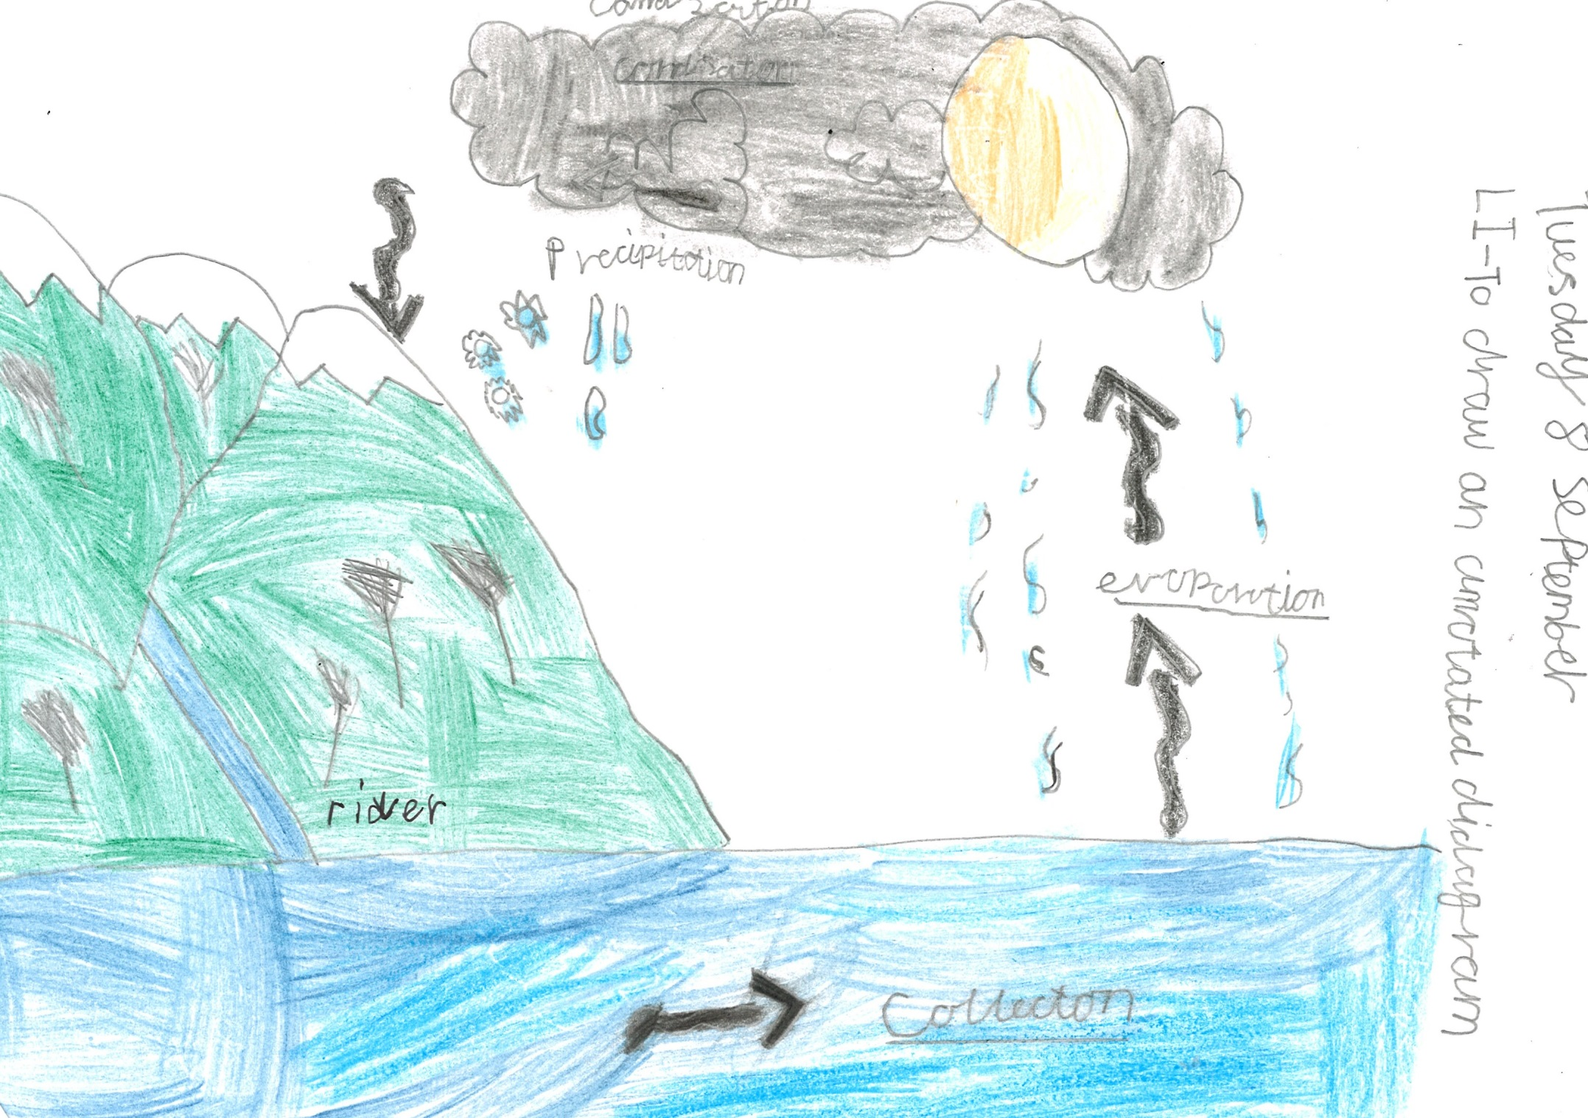

Slide 33
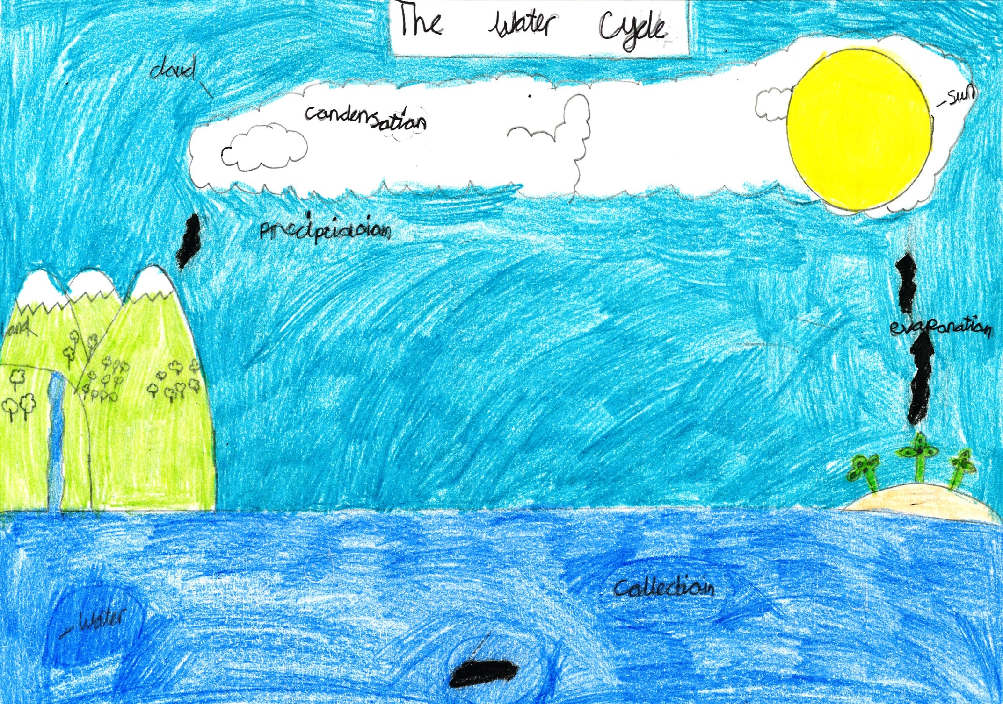

Slide 35
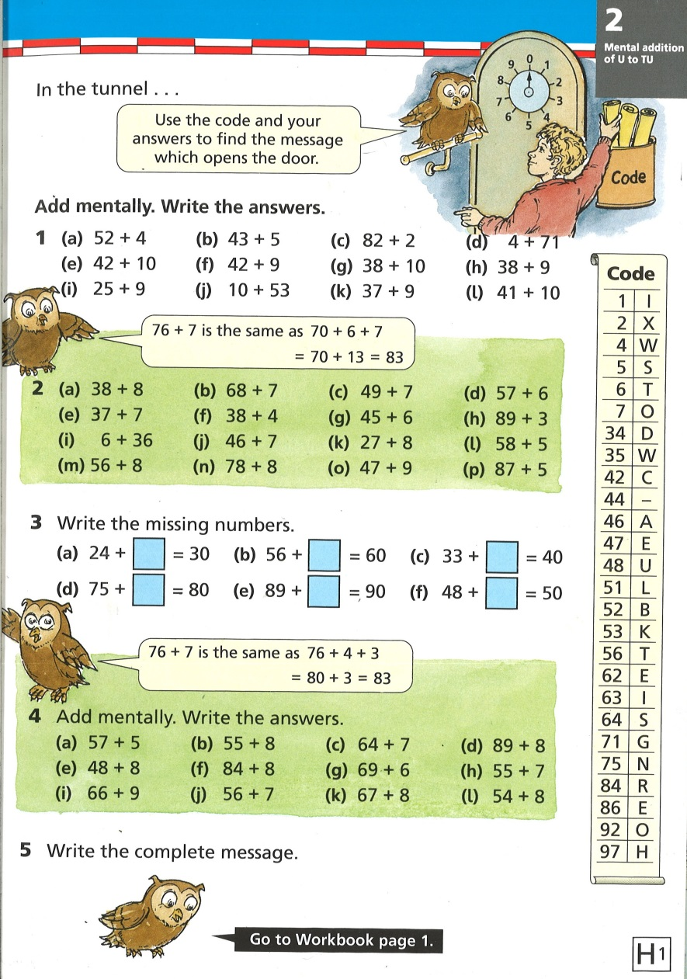
Literacy in Maths

Slide 36
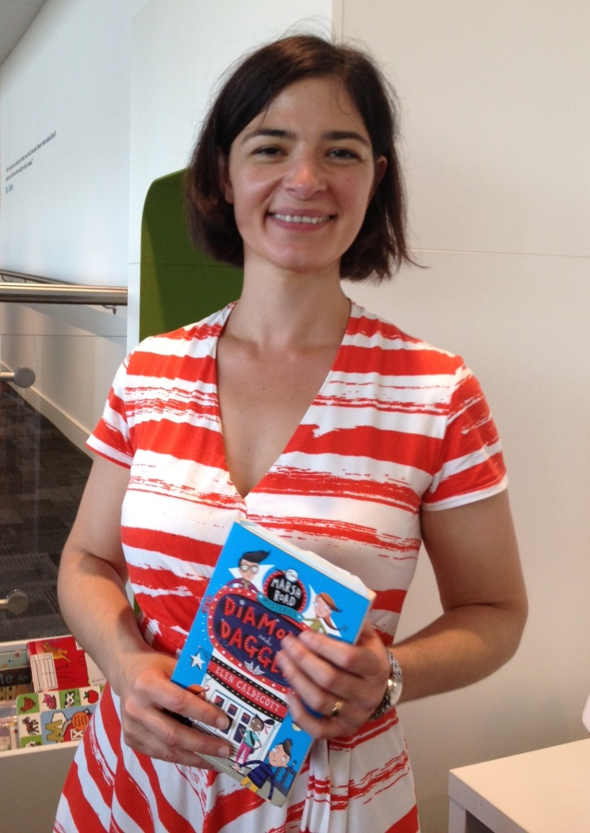
Elen Caldecott

Slide 37
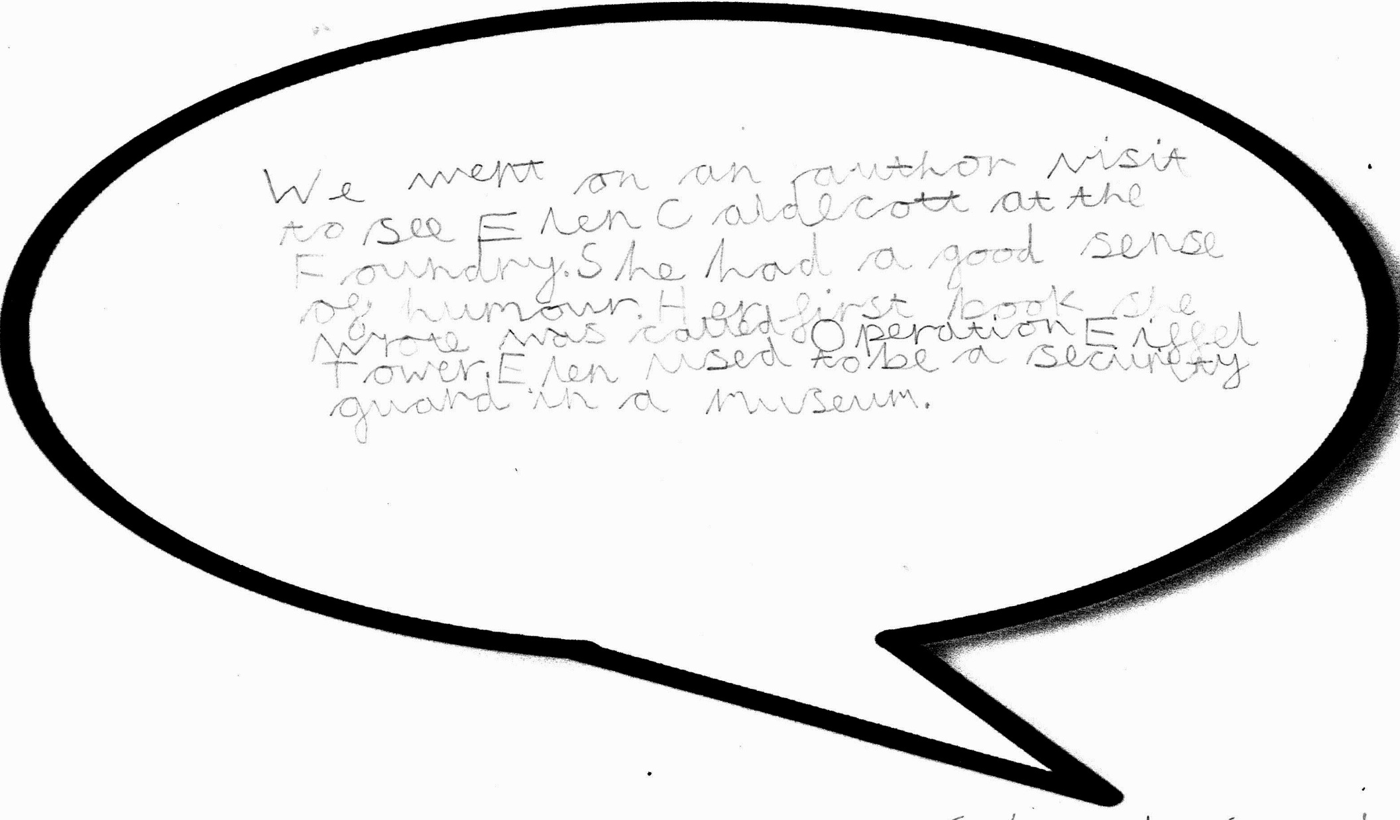
L.I. To give an opinion and justify it

Slide 38
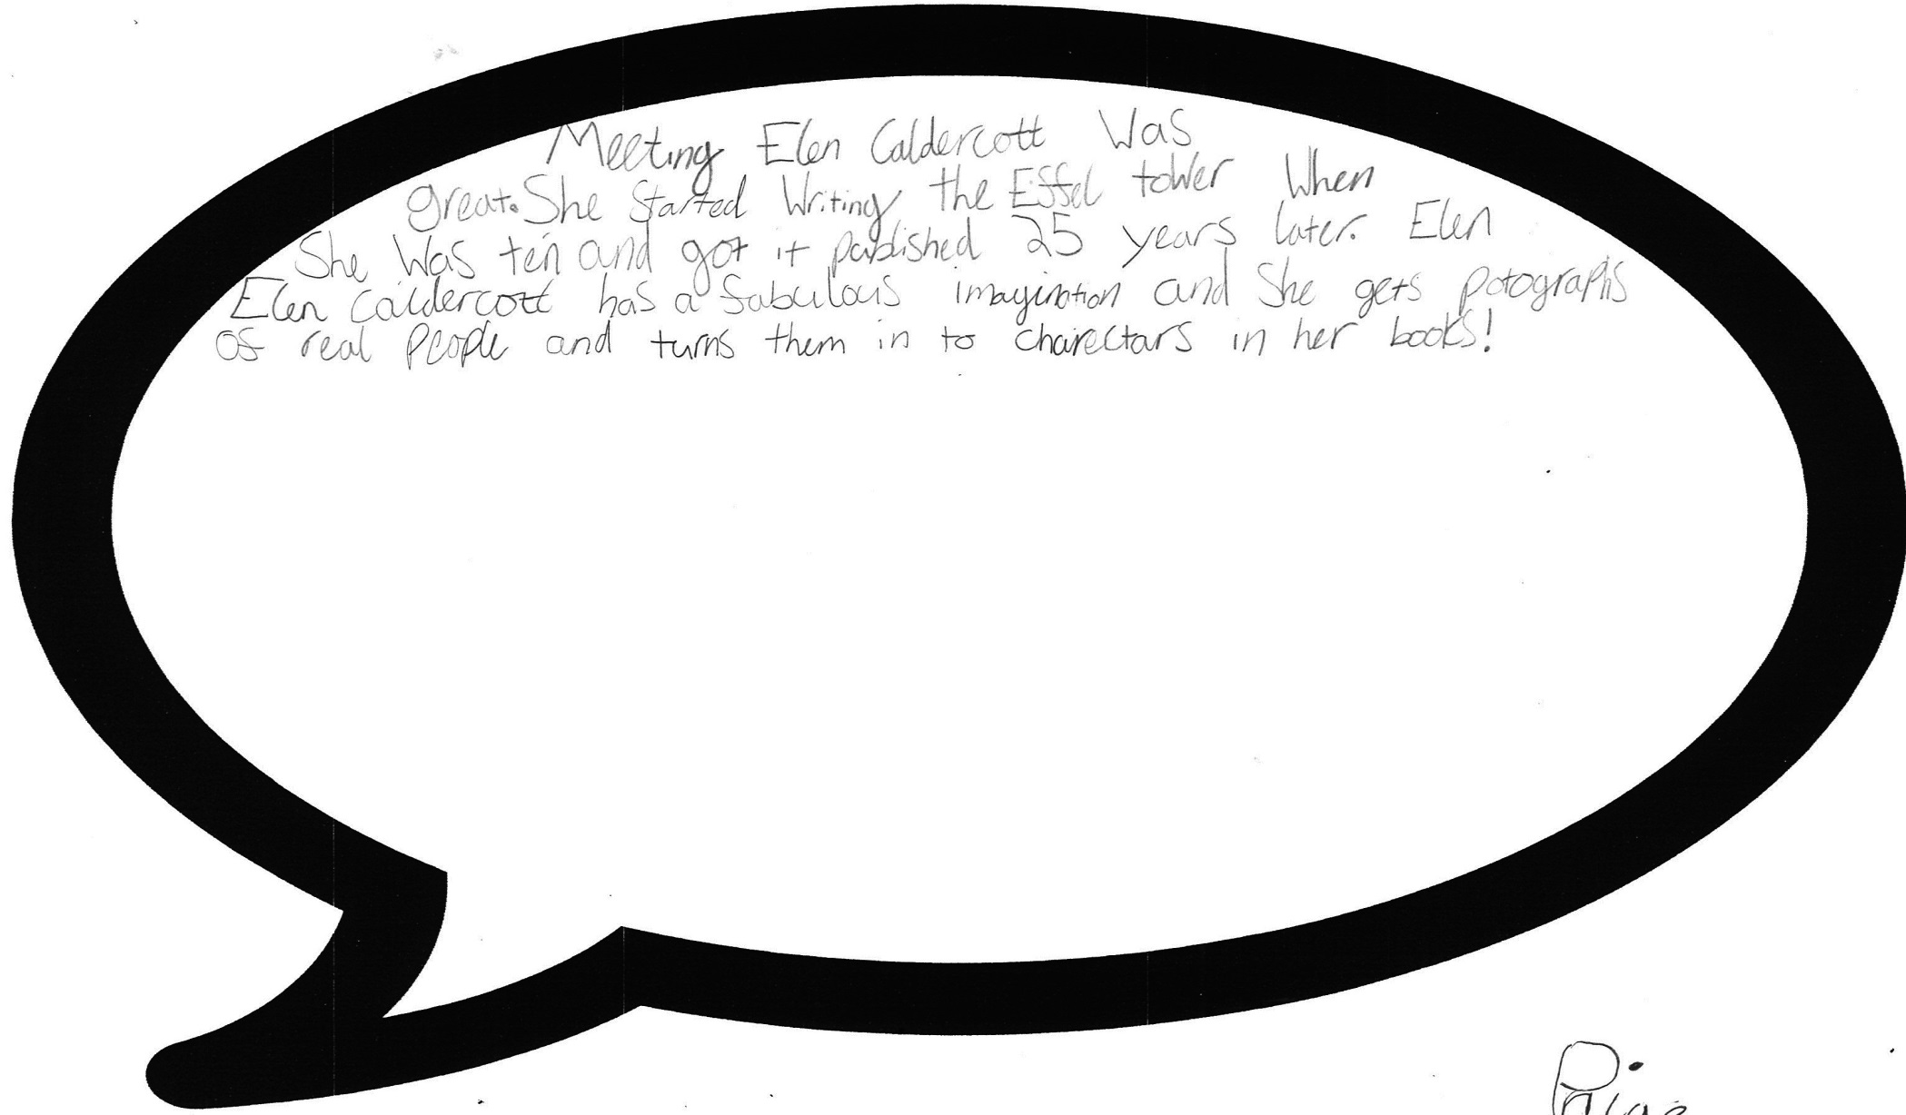
L.I. To give an opinion

Slide 39
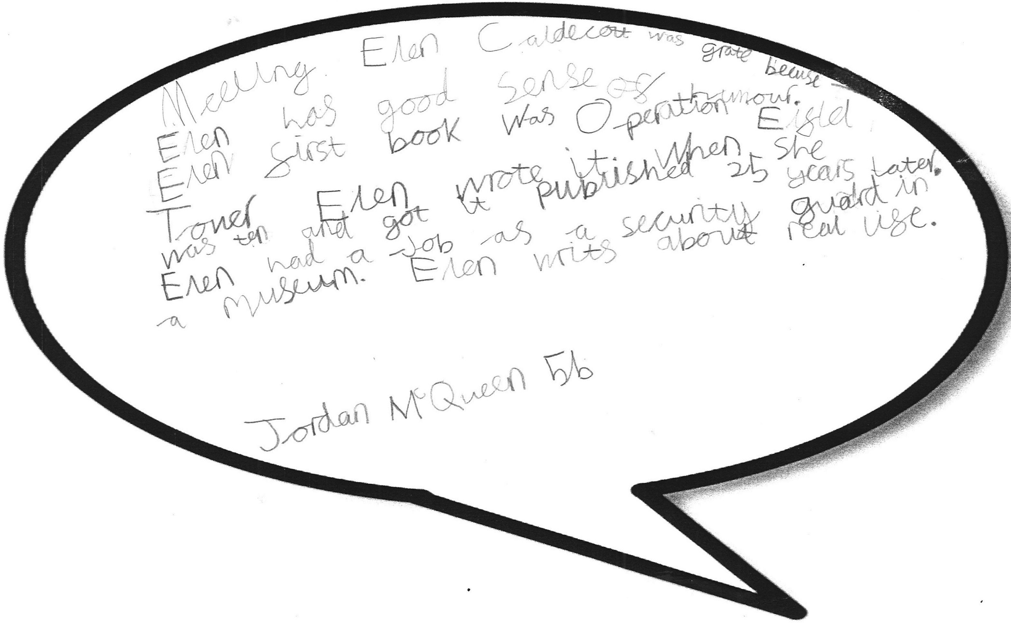
L.I. To give an opinion

Slide 40
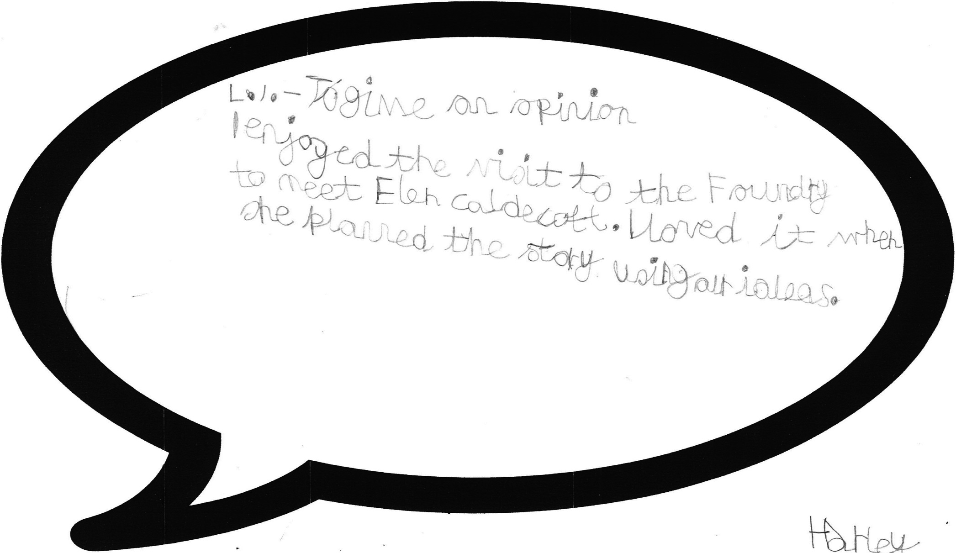
L.I. To give an opinion

Slide 41
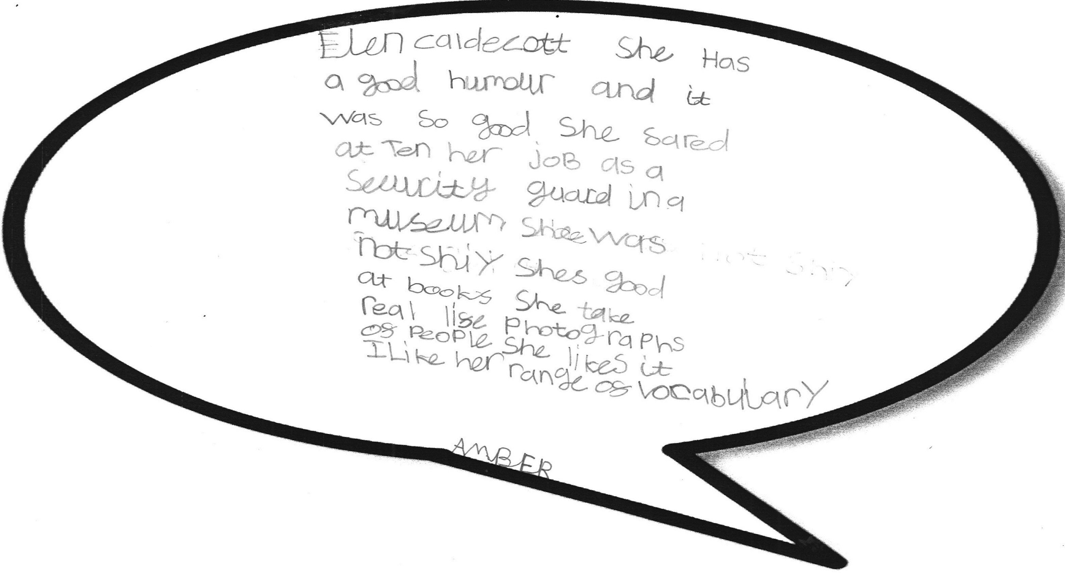
L.I. To give an opinion

Slide 42
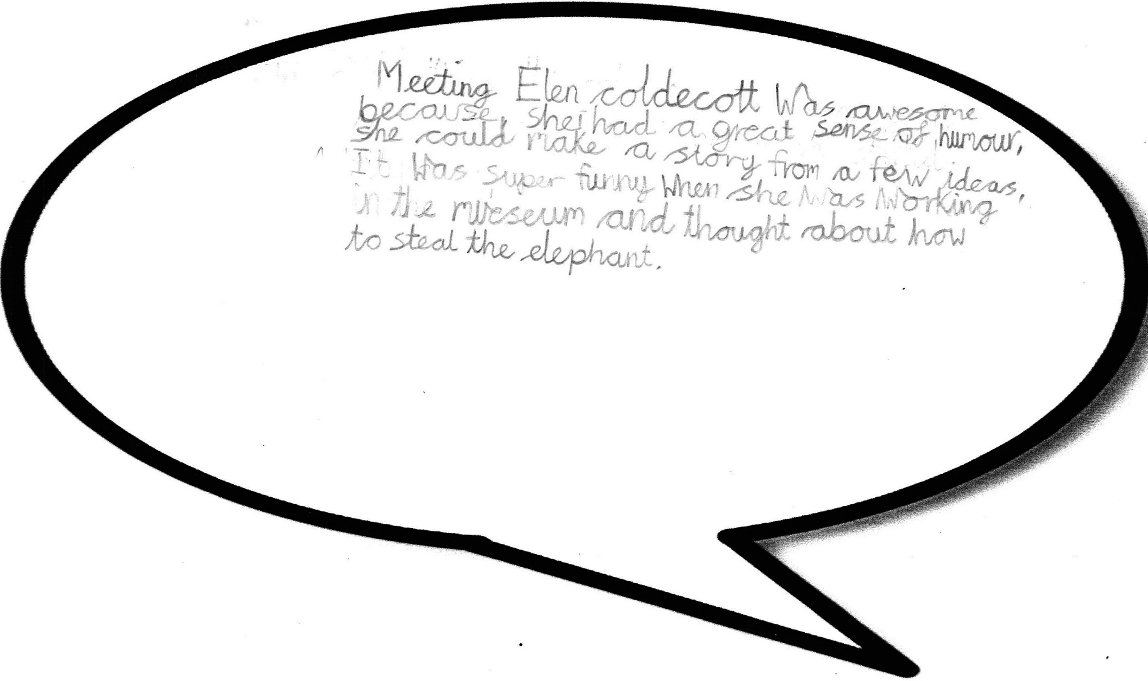
L.I. To give an opinion

