Slide 1
Sharing diagnosis
examples on how I have done it in the past with different levels of pupils

Slide 2
The pupil’s voice….
I feel confident when I get to be with all my friends. I like to feel as if the teachers are looking after me by supporting me with my difficulties such as making new friends, homework and school work.

Slide 3
Primary 3
Very articulate
Several misconceptions about Aspergers
Theses misconceptions were impacting on his school work

Slide 4
What I think.
My Asperger’s makes me so smart, but it’s not so smart to me until I recognise it makes smartness to me
My Asperger’s I know a little bit but not too much because my dad says that it would just go unuse (just leave it in your head and not use it anymore)
If someone walked to someone like me and just say Asperger’s it would make me feel if no-one likes me and sad.
My work has to go down again so I can my Asperger’s doesn’t go away and I would have to think, think, think, about my work

Slide 5
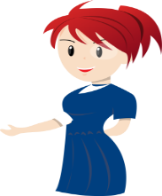
What I know.
My Asperger’s doesn’t defend my concentration very well

Slide 6
What can help me.
I could wear ear defenders

Slide 7
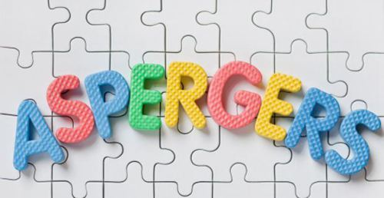
My Asperger’s makes me so smart
Not true
X
You are a smart boy.
You also has Asperger’s

Slide 8
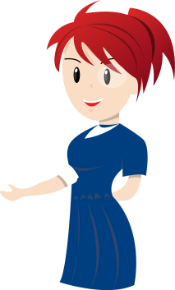
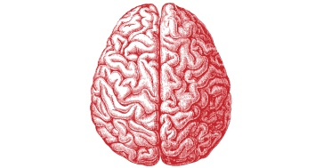
Olly, you have smartness
You are a clever boy, you have a clever brain

Slide 9
You also have ASD
I will show you about Asperger's a little bit at a time
You have Asperger’s

Slide 10
At school, I like…
Being friends
People to be respectful
And not to fight
Play with my friend, Jason

Slide 11
My Asperger's will not go away
You will not lose your Asperger’s and have to do more thinking if you try hard at school

Slide 12
Your Asperger’s makes your hearing more sensitive
Squeak!

Slide 13
My Asperger’s makes my hearing extra sensitive
I will try to use my clever brain
To help me concentrate

Slide 14
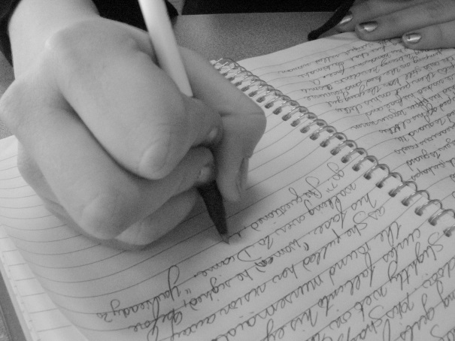
The adults know that I find it hard when I am…
Writing sentences
She tries and like helps me
Mrs R__________ comes and does sentences and reading and problem solving with me

Slide 15
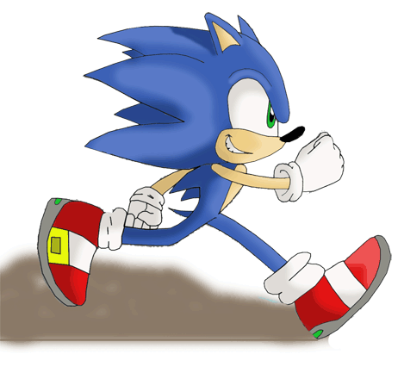
What’s a “me” thing?
I am clever
I am a fast runner

Slide 16
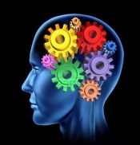
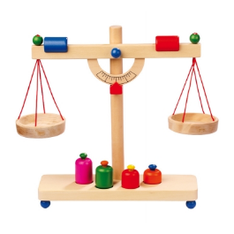
What’s an “Asperger’s” thing?
It makes my hearing extra sensitive
It is harder to concentrate on some things
It can make my brain think differently, but the same greatness as everybody else

Slide 17
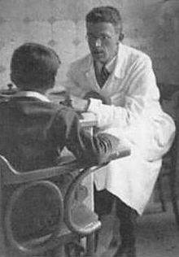
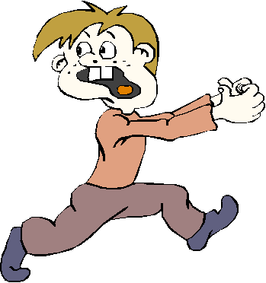
What is Asperger’s?
Is was discovered 163 years ago in another country by Dr Hans Asperger
Asperger’s doesn’t go away
It helps me to see the world differently from other people
“When my feelings are gone I feel like a slug on a sofa”

Slide 18
Primary 7
Well supported throughout his school career
Medium level of self awareness and agency

Slide 19
Me and my Autism
Most of the time I don’t mind….
Watching television allows me to let my creativity run wild – thinking about what’s going to happen next, and stuff like that…

Slide 21
contents
The Asperger children’s Toolkit:
Autism is amazing because…
Autism is tricky because…
Meltdowns and shutdowns
The “Brain Guru”
The “Sensory Detective”
The “Social Scientist”

Slide 22
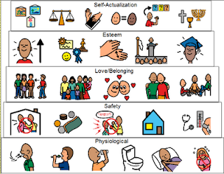
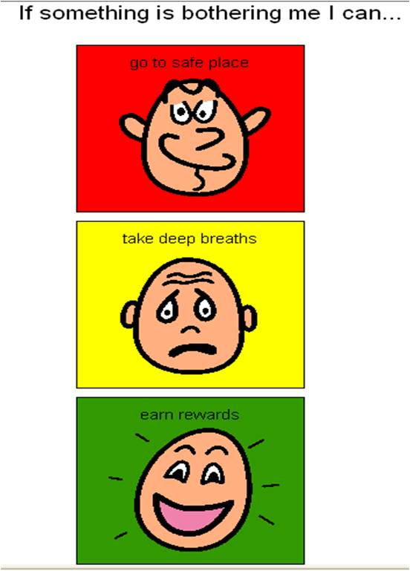
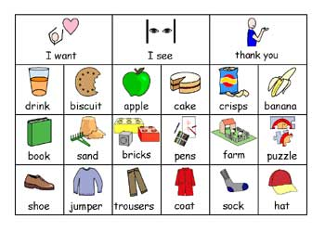
Autism is amazing because…
It usually helps us to respond to visual stimulation (understand and remember what we see) very well!
When I was younger pictures helped me to understand what the teachers were asking me to do.

Slide 23
Autism is amazing because…
We usually have a highly developed thinking way (my skills are reading, creative writing, dancing, science, good memory)
I am a visual thinker because despite me not really liking all art stuff, I am good at, and prefer, making my own sketches. Seeing pictures help me to get a visual idea of what I am doing.
I am a verbal thinker because of my good memory and I am able to explain things to teachers in a situation where I am not feeling too good.

Slide 24
Autism is tricky because
CHALLENGES INCLUDE:
Overcoming anxiety
Understanding other people
Friendship and trust
Understanding emotions
Sometimes I tend to react when I’m annoyed or just super angry.
Sometimes I tend to get rather anxious and intimidated about things I struggle with.

Slide 25
Autism is tricky because of sensory issues
I am oversensitive!
Things near my neck
Feelings around a rollercoaster
Getting wet, unless it is for a good reason (bathing or swimming)

Slide 26
Meltdowns: what causes them?
Sometimes it’s a bit tricky there are many reasons for a meltdown (when I was younger I always wanted to win at games, but now I can take it)
Loud noises and sensory overload (I am fine with my class, I am used to their noise)
Anxiety – sometimes when I am really pressured I can get a bit of a meltdown
tight arguments (intense arguments between friends can really get at me)
Trying not to react when feeling annoyed (like the Red Beast)

Slide 27
Pressures in my life
Sometimes making choices (really hard ones)
Sometimes come back to school after a long holiday and there are questions and I can’t remember the answers (such as what is a simile – I do know what it is but if I am not in school for a long time, I can’t remember)
Sometimes my sister calls me names and stuff and I am really pressured trying not to react.
When my sister is annoyed in the morning she just takes it out on me, and I don’t know why
I find it really hard to remember my schedules (I have to go to Samba band, I know it is at lunch time but I can’t remember what time)

Slide 28
What would really help
Samba time written down for me to have in my pocket
I don’t l know if there is anyone else who I know who is doing it. I am curious to know.

Slide 29
Meltdowns: what do they look like?
I sometimes frown
Sometimes my fists are clenched really tightly
I am not very talkative, I am usually very quiet
Sometimes if it really is annoying me I sometimes get quite aggressive unfortunately (I sometimes get physical. It is not something I am not very proud of)

Slide 30
Meltdowns: how to deal with it
I usually just walk away and go to my own space (sometimes I say, I just want to be by myself)
Sometimes I try to take my mind off it
I sometimes just put my hand in my pockets (when I feel like being physical) to stop myself from hurting somebody, I don’t want that
My parents sometimes come to my room and talk to me about it
Sometimes I talk to the adults at school about whatever is bugging me

Slide 31
The “Brain Guru”
When I feel anxious my brain sends a message to all of the other parts of my body warning them that something bad might happen.
You can actually change the way your mind feels about it, by using some amazing mind control methods on yourself.
Regular physical exercise is an antidote to stress
Blowing on the back of your hand can reduce anxiety
A firm cuddle can reduce nervous feelings
Tracking your finger with your eyes can reduce worry

Slide 32
Primary 6
Well supported throughout his school career
High level of self awareness
High level of motivation to be proactive

Slide 33
Checking in
Is my thinking relaxed?
Is there something I need to talk about?
Am I feeling calm?
Do I need help with something?
Is there something I need to get ready for?

Slide 34
Boundaries Quiz: what can you remember?
The boundary around your body is your skin.
It keeps the good in and the bad out.
My body, my thoughts, my beliefs my feelings are all part of me
Other people also have thoughts, feelings and different beliefs.
Other people also have boundaries

Slide 35
We are together as a family, but we are all separate people
My father
My mother
Myself

Slide 36
We all have our own responsibilities
Remember! Mum and Dad are like a team; who together, as the adults, who have responsibilities for caring for their children
My father
My father’s responsibilities are to make sure we have enough money for food, drink, gas, electricity, etc. He makes sure we have enough money in our bank account, and pays bills and council taxes. My dad is the sole protector and provider.
My mother
My mother’s responsibility is to make sure we have a clean house, and to make sure we have food on our plate. She is my carer, and also looks after my two older sisters.
It’s not me who looks after them, it’s them who look after me!
Myself
My responsibility is to get an education, get a degree and get a job (when I am much older, just to clarify!)

Slide 37
We all have our own responsibilities
My father
My mother
Myself

Slide 38
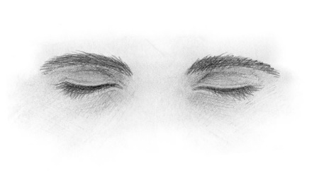
Learning to take charge of your thoughts and emotions
The best thing I have ever done…
1,2,3,4,5

Slide 39
Sharing their diagnosis with peers….

Slide 40
Me behind the mask of being shy
My social anxiety
Sensory Processing Disorder
My diagnosis: How it happened
Things I do in my mind

