Slide 1
Self -regulation
What CAN I control?
What CAN’T I control?
Exploring its possibilities and its limits
I had a drink of water, because that’s one of my strategies.

Slide 2
Where does it all fit in?
I can choose an appropriate action to respond to others
I can choose an appropriate response to situations I find challenging
I can express my feelings appropriately (e.g. using words, facial expressions, gestures)
I can say how my actions have affected other people
I can acknowledge and accept that others have a different point of view to my own and I can disagree respectfully with others
…
Notes:
Thinking about the SELF framework

Slide 3
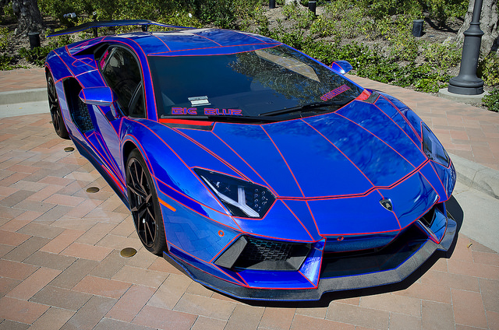
How fast is my engine?
Self-monitoring arousal levels
and
regulating them to suit the context
Notes:
We have used the idea of a car, but other things could be used to help pupils explore their awareness of why and when they feel calm, excited, over-excited, lethargic or tired, as well as how to change between these states to suit what context they are in.

Slide 4
Sometimes my engine is just right…
I can play happily with my friends
I can remember to do good sitting
I remember to put my hand up when I speak
I can complete independent work
This is the best way to be for getting things done and feeling happy
Notes:
Here we are referring to a productive, optimal level of alertness.

Slide 5
Sometimes my engine is very slow
Sometimes I feel sleepy
Sometimes I am tired
I feel like I have no energy to do things
This is good for relaxing and resting, but not for getting things done well
Notes:
We invited the pupil to think about their own experience of feeling slow.

Slide 6
What makes my engine very slow?
Mine is when I'm out of breath
When I have a virus that affects my lungs
When I am reading a book
When it is talking time
When I am building a puzzle
This is good for relaxing and resting, but not for getting things done well
Notes:
This is a good stage to get ideas from what the pupil is saying, which you can then use as proactive strategies when their “engines are too fast”.

Slide 7
How can I get back up to just right?
I could have a drink of water
I could get my face washed
I could “fast feet” (a basketball warm up)
This is the best way to be for getting things done and feeling happy
Notes:
We were very impressed with this pupil’s ability to come up with suggestions only minutes after being introduced to the concept of self-regulation.

Slide 8
Sometimes my engine is too fast
That’s when I show not safe behaviour
Too fast for working when I wonder too much about what’s happening
This is tricky for me when I am trying to do the right thing.
Notes:
This can be due to a number of factors, such as feeling angry, over-excited, over-stimulated or overtired. We have come across this also in children with acquired brain injury. As practitioners, it is useful for us to be aware of the early warning signs of “ a too fast engine” in individuals, as it can be an opportunity to catch it early and offer strategies to calm down before it gets out of control. Over time, as the pupil becomes more self aware of how it feels to “be too fast” and “what slows me down back to OK” they can gradually take more ownership of the process.

Slide 9
What makes my engine too fast?
when I'm excited
Playing tag (tig)
When I feel angry
When I am worried
This is tricky for me when I am trying to do the right thing.
Notes:
This is not the first time we have heard of pupils’ “engines getting too fast” due to a game they were enjoying. Sometimes we think of it being a matter of “taking things too far”. This can be due to a blurring of the lines between fantasy and reality, fear of losing, or sometimes due to acquired brain injury.

Slide 10
How can I get back down to just right?
I could have a movement break
I could build a puzzle
I could have a drink of water
This is the best way to be for getting things done and feeling happy
Notes:
In the past, we have come across children who “calm down” after a sensory experience, such as chewing something, doing press ups against a wall or pushing something heavy, and this can then be used as a strategy as needed. Mindfulness could be useful if the “engine speed” is due to anxiety.

Slide 11
Measuring improvement/effectiveness over time
Reduction in frequency of unregulated levels
Shorter recovery time
Increase in agreeing to use a strategy
Increase in responding to a prompt to use a strategy
Increase in independence asking for/using strategy
Notes:
It is always useful and encouraging to be able to see measurable evidence of progress over time….

Slide 12
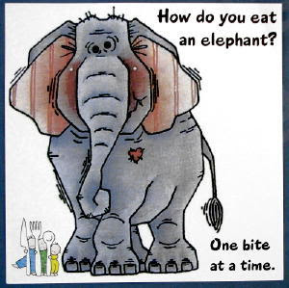
Recognising what I CAN change….. and what to think/do about the things I can’t…

Slide 13
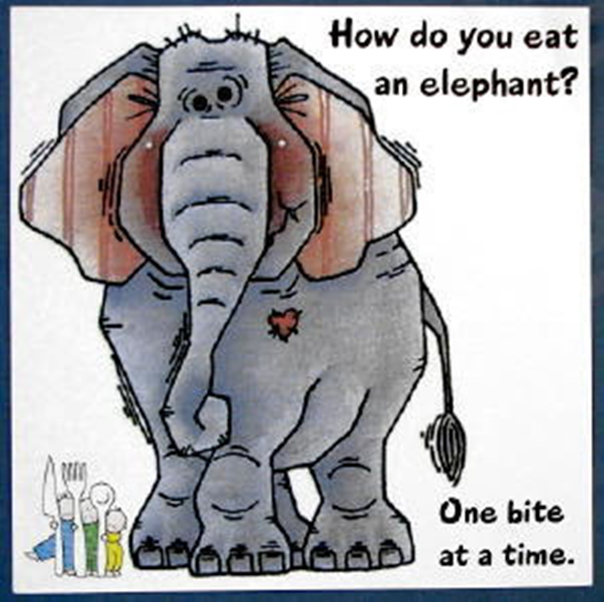
Changing the things I CAN change
Sometimes I cannot change things and people outside me…
…but I CAN change things inside me!
Thoughts, feelings, body sensation, behaviour
Notes:
This content is based on “Living life to the full” by Dr Chris Williams, Emeritus Professor of Psychosocial Psychiatry University of Glasgow. There is a children’s version called We eat elephants….

Slide 14
In a situation…
Which I sometimes cannot control
Illness
Changes at School (My teacher: Away)
Fire Alarms
Behaviour of Other People

Slide 15
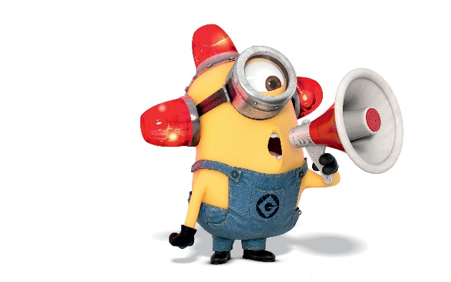
I can change my thoughts…
Actually! They are doing this so we can know what the protocol is! They’re saving our lives!
Rewriting the narrative…
Notes:
This was in reference to scary fire drills. Another example: When Hazel’s dad passed away, many of his friends and colleagues offered her mum their services, such as maintaining her front garden for free. Before she could politely decline, Hazel pointed out that she would be depriving them of an opportunity to show their love for her dad in a practical way. She saw things differently then and accepted the help.
Another example: when Hazel’s father died and people rallied to help her mum, such as offering to maintain the front garden, etc, before her mum could politely refuse, Hazel said “This is their way to show their love for Dad in a practical way”

Slide 16
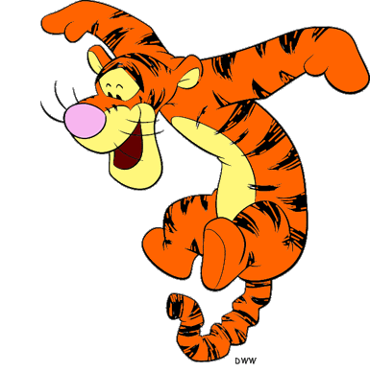
I can use my thoughts to change my feelings….
Address the fear, anger, disappointment or …..
B
O
U
N
C
E
Move into a sense of security or….
Notes:
Thinking about BounceBack!

Slide 17
I can use my feelings to change how my body feels…
Phew! The worry is gone, so now I’m going to relax…

Slide 18
I can use how my body feels to change my behaviour….
Regular physical exercise is an antidote to stress
Blowing on the back of your hand can reduce anxiety
A firm cuddle can reduce nervous feelings
Tracking your finger with your eyes can reduce worry
Notes:
Using tried and tested ways to slow down a heartbeat or release “feel good” hormones

Slide 19
I can use my behaviour to change my thoughts..
When the panic sets in, the first thing the comes to my mind is, “Who do I talk to about this?”. I go over to them, and I let them know about why I feel scared. The teacher/person will help me out – and I use my strategies at that time.
Notes:
We think this pupil articulated it very well!

Slide 20
Making it manageable….

Slide 21
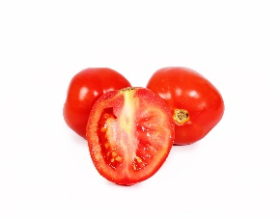
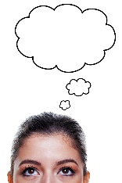
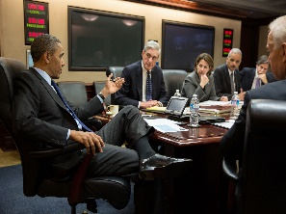
4 steps for making a plan
The Problem:
Maths Group – Today and Friday
Step One: Break a problem in to little slices
Cutting Station
Step Two: Writing down all of my ideas
Conference Room (deciding on possibilities and options)
Step Three: Choose one idea
Media Room (where the mind will be informed to make a decision)
Step Four: Check the plan
Decision Room (meeting with cabinet to discuss the right option – and whether we can do it on our own
Notes:
We love the way this pupil chose to think about the process of making a plan to address a challenging situation!

Slide 22
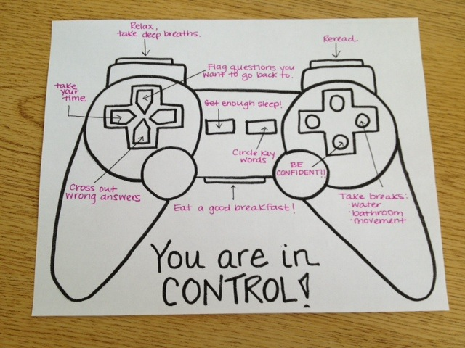
CONTROL!
In practise
Notes:
This is useful for pupils who present with challenging behaviour which is controlling in nature.

Slide 23
Considering who controls what and where
 | I am able to control | I share control | I am unable to control
WHEREVER I AM | My words – what I say Thoughts, actions, ideas Play, behaviour, efforts How I react to situations Who I am friends with How I treat others How I use my time The words I use Whether to tell the truth | choices | Other peoples; Words – what they say Thoughts Actions Ideas Play Behaviour Efforts
AT HOME | What I play with | When I go to sleep What I have to eat When I play | Where I live
AT SCHOOL | Who I am friends with | When I am not well, I don’t go to school. What I learn Where I sit = who I work with | That I have to go to school every day. When the school day starts, when the breaks are Who my teacher is

Slide 24
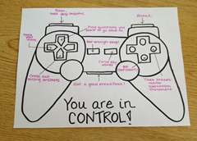
An exercise in sorting through….
I control
I share control
I cannot control

Slide 25
Recognising and sorting in terms of control
What is control – something I can change
How does it feel when I am in control
How does it feel when I am not in control
Weather, time, traffic
Past, Future
Within our lives, there are many things we have control of.
We can control our behaviour.
We can control who we speak to and when.
We are in control of our actions.
When we are children, the control is given to the adults in our lives, our parents, our teachers and adults who have positions of authority such as doctors, police and judges.
There are decisions that are made about our lives which are control from society and are written within law.
We are bound by law to follow societies rules.
One of the rules is that it is a legal requirement that all children up to the age of 16 must be educated.
A parent has a requirement to send their child to school.
Most children are educated within schools.
The adults within my life are very aware that going to school causes me anxiety.
The adults are aware that I would rather not go to school.
Going to school is not something in my life that I can control.
Going to school is not something my parents are in control of.
The adults hope to find ways to reduce some of my anxiety for example by creating a smaller learning environment.

Slide 26
Why do adults have more control?
(Pupil) thinks because that’s their job
Adults responsibility is to keep children safe.
Adults responsibility is to encourage children to be happy and try to not be sad
Notes:
This pupil is beginning to develop a sense of who is in control and why. This is beginning to have a direct impact on attitude and behaviour.

Slide 27
What can we as practitioners take from this?

