Slide 1
ASD Advisors Chris Atherton & Annie MCgAULEy
16th November 2018

Slide 2
Agenda Based on the evaluations from May 2018
What you said……
Pupil perceptions
Role as ASD Advisors ; Practical issues / Challenges
Revisit social stories
Time to discuss current concerns / behavioural challenges / case studies
Sharing a diagnosis
Emotional Regulation
Nurture and attachment – Next Time
Using video to show good practice e.g. SULP groups – Next Time

Slide 3
ASD Advisors May 2018……
Lego Therapy
Parents perceptions
Communication - scenarios
Luke Beardon – changing perceptive of autism

Slide 4
Pupil Perceptions

Slide 5
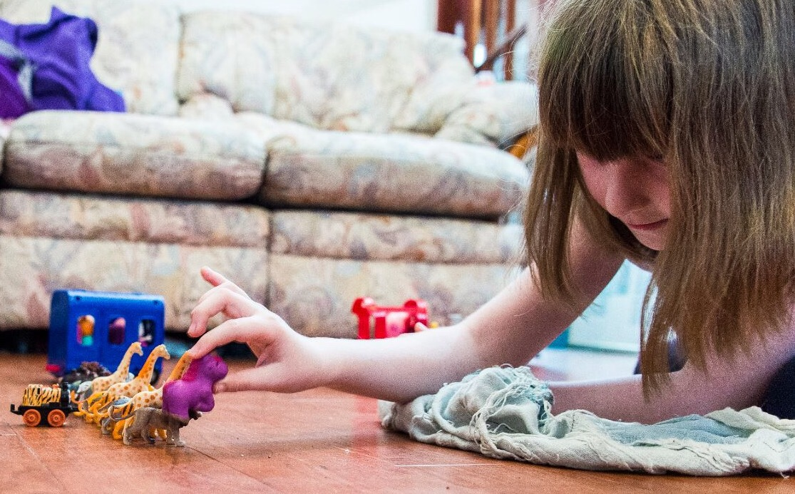
Pupil Perceptions A Day In Mainstream School For My Autistic Daughter Sept 13, 2017 by miriamgwynne
written with her full consent and approval to help others see how challenging mainstream can be
Morning preparation
I wake up and come downstairs
and try not to think about school
too much. I get my iPad or toys and
set them up just how I like it. I know I need to get dressed and eat but until things are ‘right’ I can’t think about those things.
I need to do one thing at a time so please leave me alone. Let me do it my way. Constantly asking me questions is so stressful as is nagging me about time. By the time we need to leave I am already stressed and anxious.

Slide 6
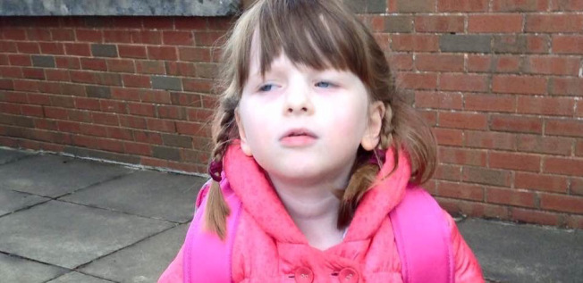
In the playground
I am scanning.
This is so hard to see who I need to see when everyone is dressed the same and moving around.
The noise, the unpredictable movements, the bags on the ground…that’s a lot to take in for me.
I only want to find my best friend and the longer it takes to find her the more I get worried.
What if she is off sick?
What if she has an
appointment today?

Slide 7
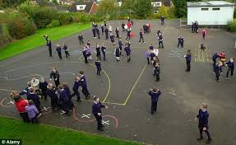
The bell
Bells panic me.
They mean I have to move somewhere quickly and I sometimes get stressed.
Bells mean pressure and children running and they might push me over.
I stand in my line and face forwards making sure I don’t look at anyone.
The teachers shout about not talking and standing straight but I am doing those already and not sure what I should be doing differently.
I turn to see if everyone else is doing what I am doing and now my class is pulled up
for me facing the wrong way!
I feel to blame. I feel so anxious.
I feel different.

Slide 8
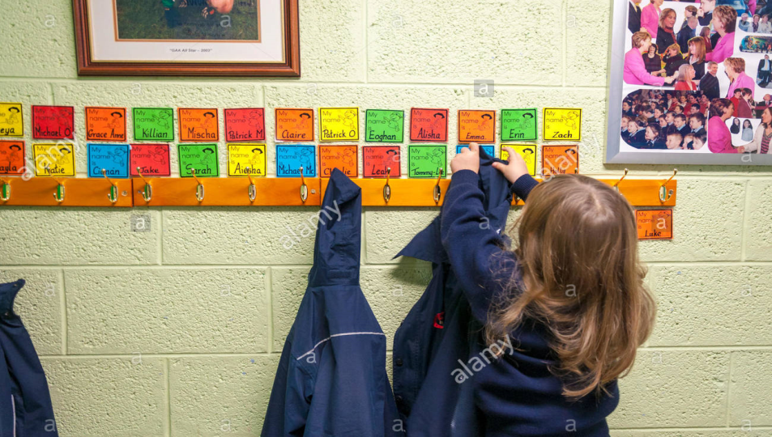
Getting to class
I have to remember to put my bag one place, my packed lunch somewhere else and then hang my coat on the right peg.
It can be confusing to remember all that while others are talking and moving all around me and the lights are so bright inside.
Sometimes I wait until most of the others are in the class but then I worry I will get shouted at for taking too long! Sometimes I forget I have my school bag as it is on my back and I can’t see it!
How can everyone else
do this so quickly and easily
and I can’t?

Slide 9
Class
I listen so much.
In fact I listen so hard to everything that sometimes I can’t do my work because I need to stop and listen to everything the teacher says in case she is talking to me.
I want to write neat because I don’t want a row but then they say I need to work faster and I can’t do fast and neat.
It is hard to concentrate with others so close to me.
They move about and talk and
turn pages and it is so
distracting sometimes.
The walls have so much stuff
on them,
I can hear the tap dripping and
I can hear people walking about.

Slide 10
I am scared to talk in case I get in trouble.
Sometimes I just can’t do the work.
Yesterday they wanted us to do a senses poem about fireworks.
They told me to imagine being at a bonfire with fireworks but how can you do that if you have never been to a bonfire before? I haven’t.
They told me to write about what I would touch but you are not allowed to touch fireworks so I can’t write anything.
They told me to write what I can smell but all I can smell right now is disgusting school
dinners and I can’t even spell that.
I just leave that one too.
Then the teacher gets me in
trouble for not doing the task.
I want to cry. The tears won’t come out.

Slide 11
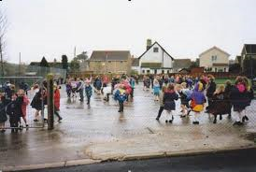
Playtime
I don’t understand this bit.
You play with toys so why call it
playtime when there are no toys?
Just call it ‘talk time’ or
‘stand in the playground time’ instead.
I take my own toys out. Then it rains and we have to come inside and I can’t play with my toys and it is so confusing for me. I don’t like changing things.
I get cold at playtime because it is hard to fasten my coat and if I take my time the people tell me to hurry up and go outside so I just can’t fasten it up now.
I have one area I like to stand and play with my one friend. We play the same game every day. We like it that way.
I want to play with others but I can’t because I don’t understand what they are playing. They don’t have toys. I can’t work out made up games like that.

Slide 12
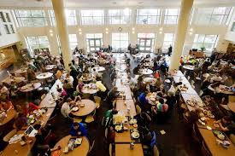
Lunchtime
Lunchtime is horrible.
We have a short time for everyone in the whole school to eat and they want us all to line up and take turns and sit at huge tables with other children I don’t know.
I just want to sit down and get time to eat and not have to hear chatter and smell what everyone else has that I don’t like.
It is far too noisy and busy and
yet no-one will open my
yoghurt or peel my banana.
I feel lost and confused
and just want out of there.

Slide 13
P.E I hate PE so much.
I never know what we are going to do.
Sometimes we do balls and sometimes running and sometimes sports.
I hate it all. I know I can’t do it and people laugh.
How can I catch a ball when there is so much else going on in the same hall at the same time?
I can’t focus.
I am so cold. My legs don’t like not having trousers on. My arms miss my cardigan so much.
I once fell and hurt myself in PE so I don’t run now because running is dangerous plus they
said at assembly to not run in school
so I don’t run.
Then they tell me to run and I want to
ask ‘but you said not to run in school’
but my voice won’t work.
I want to cry. The tears won’t come.

Slide 14
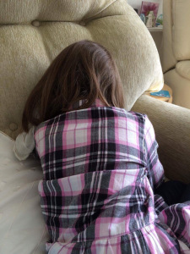
I do like school.
I like learning and I like doing work.
I like having a desk and I really want to be star of the week.
I like the other children though I don’t know if they like me.
Mum, I want to tell you about things that have bothered me like being told to work quicker or not eating.
I am tired from it all and
now I feel safe.
I want to cry. This time the tears will
come so please let them.

Slide 15
https://www.youtube.com/watch?v=6fy7gUIp8Ms

Slide 16
Pupil Perceptions
What will we do next……
What would you like us to do next…

Slide 17
ASD Advisor Role

Slide 18
What is your role as an ASD Advisor?
Group discussion
What are the practical issues / challenges and possible solution of your role?
Who is new to the role?
SWOT analysis
What do you feel is the expectations of colleagues?

Slide 19
Strengths What does the role bring to the school? | Weakness What are the challenges in your role?
Opportunities What opportunities does the role bring to your school? | Threats What prevents you from completing your role and how could this change?

Slide 20
Social Stories

Slide 21
Revisit social stories
Why do we use social stories?
help pupils with autism to 'read' and understand social situations
improved understanding of events and expectations”

Slide 22
Introductory sentence: make it personal (not always needed)
My name is…..
Descriptive sentence(s): describe the behaviour, social situation, setting
Sometimes I….
Perspective sentence(s) : present other’s people point of view / feelings and acknowledge the child’s own feeling
Other people may think / Other people may feel….
Directive sentence(s): provide instructions in a positive manner on what could be done instead
I will try / or I will if they find the word try not clear….
Affirmative sentence(s): enhance the meaning of the previous sentence
I will do my best to… This will….. Or this will mean
More descriptive than directive sentences

Slide 23
Identify a specific goal e.g. To teach a routine. To explain a situation/event
The general rule is 1 issue = 1 story.
Decide on a format e.g. appropriate to the pupil’s level of ability, and/or age
Text
Text & pictures
Single sheet
Book
Enough descriptive and perspective sentences to ensure there is sufficient information about the situation without being overloaded with unnecessary detail.
One directive sentence so not overwhelm (may not even be necessary)
Where appropriate, the pupil’s interests can be included
Avoid mentioning negative behaviour or directly criticising the pupil
Use words like ‘sometimes’

Slide 24
HOW TO WALK TO CLASS
When playtime is over or when we have finished an activity in another room, it’s time to go back to class.
My teacher asks all the children to line up, so that we can walk back to class together.
Sometimes my friends and I get excited when we line up.
We might push each other or we might try to run back to class.
It’s o.k. to get excited, but it’s important to try to stay in line and walk calmly and sensibly.
Running on the way to class can cause accidents and my friends or I could get hurt.
If I want to run, I can run during playtime.
When we line up and walk calmly, my teacher is happy.
She knows we are trying our best.

Slide 25
Social Stories
What will we do next…….
Email stories to be reviewed
Upload stories onto the blog

Slide 26
Solution Circles

Slide 27
Sharing diagnosis
examples on how I have done it in the past with different levels of pupils

Slide 28
Pupil Perception Sharing diagnosis
When to tell a child? Parents may fear:
their child will not understand,
their child may lose some of his/her options in life,
their child will become angry or depressed because they have a disability
the child (or others) will use the disability as an excuse for why they can not do something,
the child will think of themselves (or others will think of the child) as a complete failure with no hope for a positive future.

Slide 29
Parent’s decision whether to share information
No exact age or time
May be asking questions such as why cant I do that? What is wrong with me?
Set a positive tone and attitude about uniqueness
Individualized and meaningful to them.
Not to be given too much information
Start with the questions asked
Check understanding
Books written by children
Begin with the positive aspects of ASD
Let them know they are not alone

Slide 30
I am Special -
Programme for pupils:
to express how they feel about their diagnosis
gain a greater insight to their challenges
awareness that there are other individuals who express similar challenges
https://autism.sesamestreet.org/video/amazing-1-2-3/
Notes:
series of specially designed worksheets included on an accompanying CD.
wide range of topics including how the brain works, physical characteristics and likes and dislikes.
build up a unique and personal book about the individual on the autism spectrum

Slide 31
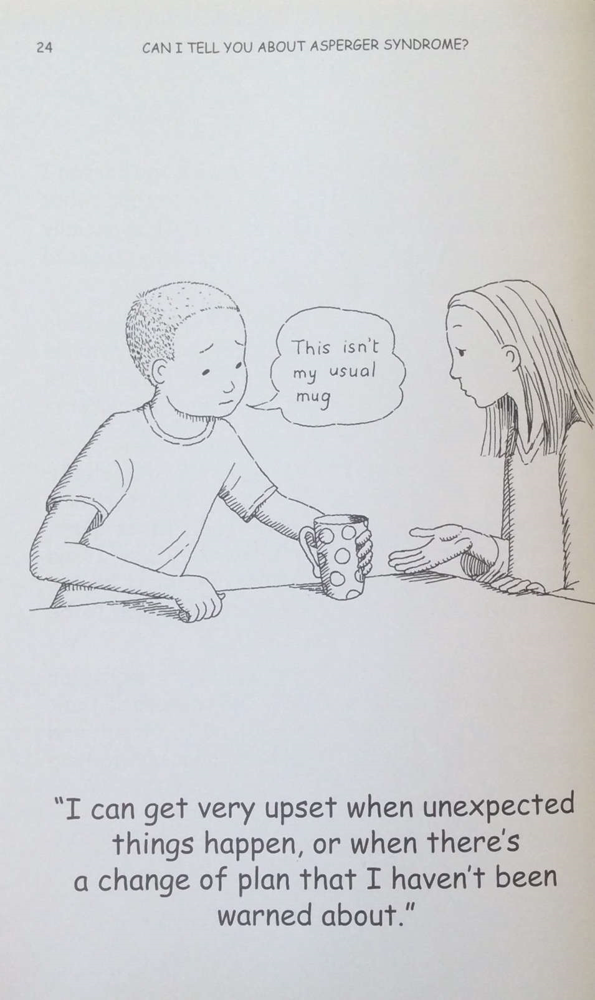
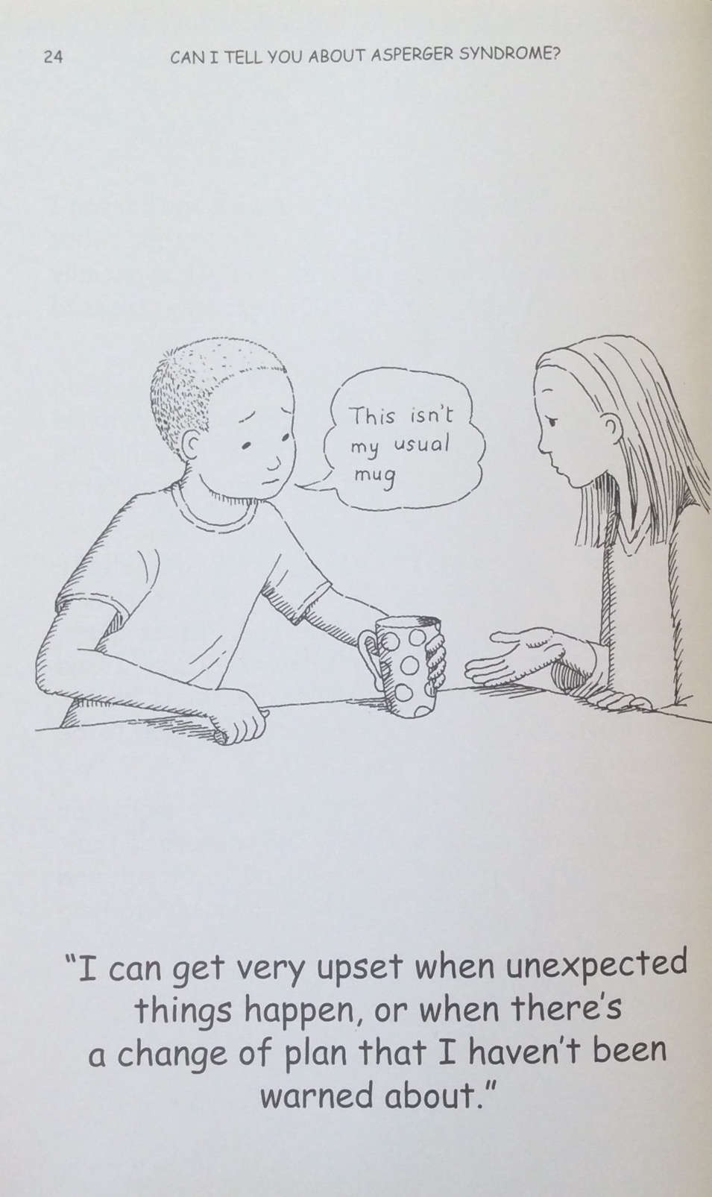

Slide 32
https://www.youtube.com/watch?v=hZUj0Lp9Oro

Slide 33
The pupil’s voice….
I feel confident when I get to be with all my friends. I like to feel as if the teachers are looking after me by supporting me with my difficulties such as making new friends, homework and school work.

Slide 34
Primary 3
Very articulate
Several misconceptions about Aspergers
Theses misconceptions were impacting on his school work

Slide 35
What I think.
My Asperger’s makes me so smart, but it’s not so smart to me until I recognise it makes smartness to me
My Asperger’s I know a little bit but not too much because my dad says that it would just go unuse (just leave it in your head and not use it anymore)
If someone walked to someone like me and just say Asperger’s it would make me feel if no-one likes me and sad.
My work has to go down again so I can my Asperger’s doesn’t go away and I would have to think, think, think, about my work

Slide 36
What I know.
My Asperger’s doesn’t defend my concentration very well

Slide 37
What can help me.
I could wear ear defenders

Slide 38
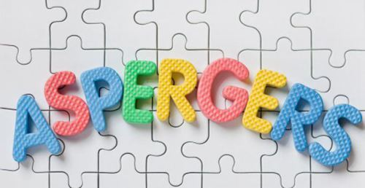
My Asperger’s makes me so smart
Not true
X
You are a smart boy.
You also has Asperger’s

Slide 39
Olly, you have smartness
You are a clever boy, you have a clever brain

Slide 40
You also have ASD
You have Asperger’s
I will show you about Asperger's a little bit at a time

Slide 41
At school, I like…
Being friends
People to be respectful
And not to fight
Play with my friend, Jason

Slide 42
My Asperger's will not go away
You will not lose your Asperger’s and have to do more thinking if you try hard at school

Slide 43
Your Asperger’s makes your hearing more sensitive
Squeak!

Slide 44
My Asperger’s makes my hearing extra sensitive
I will try to use my clever brain
To help me concentrate

Slide 45
The adults know that I find it hard when I am…
Writing sentences
She tries and like helps me
Mrs R__________ comes and does sentences and reading and problem solving with me

Slide 46
What’s a “me” thing?
I am clever
I am a fast runner

Slide 47
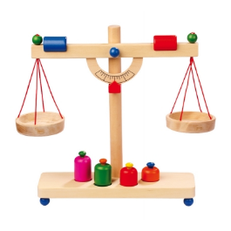
What’s an “Asperger’s” thing?
It makes my hearing extra sensitive
It is harder to concentrate on some things
It can make my brain think differently, but the same greatness as everybody else

Slide 48
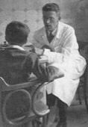
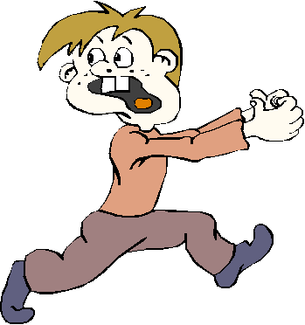
What is Asperger’s?
Is was discovered 163 years ago in another country by Dr Hans Asperger
Asperger’s doesn’t go away
It helps me to see the world differently from other people
“When my feelings are gone I feel like a slug on a sofa”

Slide 49
Primary 7
Well supported throughout his school career
Medium level of self awareness and agency

Slide 50
Me and my Autism
Most of the time I don’t mind….
Watching television allows me to let my creativity run wild – thinking about what’s going to happen next, and stuff like that…

Slide 52
contents
The Asperger children’s Toolkit:
Autism is amazing because…
Autism is tricky because…
Meltdowns and shutdowns
The “Brain Guru”
The “Sensory Detective”
The “Social Scientist”

Slide 53
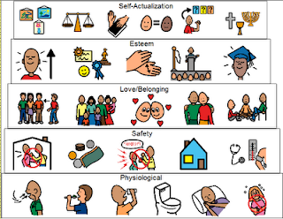
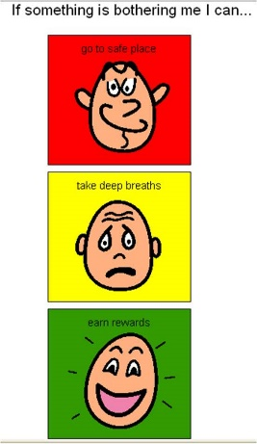
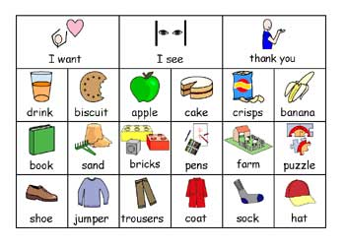
Autism is amazing because…
It usually helps us to respond to visual stimulation (understand and remember what we see) very well!
When I was younger pictures helped me to understand what the teachers were asking me to do.

Slide 54
Autism is amazing because…
We usually have a highly developed thinking
way (my skills are reading, creative writing, dancing, science, good memory)
I am a visual thinker because despite me not really liking all art stuff, I am good at, and prefer, making my own sketches. Seeing pictures help me to get a visual idea of what I am doing.
I am a verbal thinker because of my good memory and I am able to explain things to teachers in a situation where I am not feeling too good.

Slide 55
Autism is tricky because
CHALLENGES INCLUDE:
Overcoming anxiety
Understanding other people
Friendship and trust
Understanding emotions
Sometimes I tend to react when I’m annoyed or just super angry.
Sometimes I tend to get rather anxious and intimidated about things I struggle with.

Slide 56
Autism is tricky because of sensory issues
I am oversensitive!
Things near my neck
Feelings around a rollercoaster
Getting wet, unless it is for a good reason (bathing or swimming)

Slide 57
Meltdowns: what causes them?
Sometimes it’s a bit tricky there are many reasons for a meltdown (when I was younger I always wanted to win at games, but now I can take it)
Loud noises and sensory overload (I am fine with my class, I am used to their noise)
Anxiety – sometimes when I am really pressured I can get a bit of a meltdown
tight arguments (intense arguments between friends can really get at me)
Trying not to react when feeling annoyed (like the Red Beast)

Slide 58
Pressures in my life
Sometimes making choices (really hard ones)
Sometimes come back to school after a long holiday and there are questions and I can’t remember the answers (such as what is a simile – I do know what it is but if I am not in school for a long time, I can’t remember)
Sometimes my sister calls me names and stuff and I am really pressured trying not to react.
When my sister is annoyed in the morning she just takes it out on me, and I don’t know why
I find it really hard to remember my schedules (I have to go to Samba band, I know it is at lunch time but I can’t remember what time)

Slide 59
What would really help
Samba time written down for me to have in my pocket
I don’t l know if there is anyone else who I know who is doing it. I am curious to know.

Slide 60
Meltdowns: what do they look like?
I sometimes frown
Sometimes my fists are clenched really tightly
I am not very talkative, I am usually very quiet
Sometimes if it really is annoying me I sometimes get quite aggressive unfortunately (I sometimes get physical. It is not something I am not very proud of)

Slide 61
Meltdowns: how to deal with it
I usually just walk away and go to my own space (sometimes I say, I just want to be by myself)
Sometimes I try to take my mind off it
I sometimes just put my hand in my pockets (when I feel like being physical) to stop myself from hurting somebody, I don’t want that
My parents sometimes come to my room and talk to me about it
Sometimes I talk to the adults at school about whatever is bugging me

Slide 62
The “Brain Guru”
When I feel anxious my brain sends a message to all of the other parts of my body warning them that something bad might happen.
You can actually change the way your mind feels about it, by using some amazing mind control methods on yourself.
Regular physical exercise is an antidote to stress
Blowing on the back of your hand can reduce anxiety
A firm cuddle can reduce nervous feelings
Tracking your finger with your eyes can reduce worry

Slide 63
Primary 6
Well supported throughout his school career
High level of self awareness
High level of motivation to be proactive

Slide 64
Checking in
Is my thinking relaxed?
Is there something I need to talk about?
Am I feeling calm?
Do I need help with something?
Is there something I need to get ready for?

Slide 65
Boundaries Quiz: what can you remember?
The boundary around your body is your skin.
It keeps the good in and the bad out.
My body, my thoughts, my beliefs my feelings are all part of me
Other people also have thoughts, feelings and different beliefs.
Other people also have boundaries

Slide 66
We are together as a family, but we are all separate people
My father
My mother
Myself

Slide 67
We all have our own responsibilities
Remember! Mum and Dad are like a team; who together, as the adults, who have responsibilities for caring for their children
My father
My father’s responsibilities are to make sure we have enough money for food, drink, gas, electricity, etc. He makes sure we have enough money in our bank account, and pays bills and council taxes. My dad is the sole protector and provider.
My mother
My mother’s responsibility is to make sure we have a clean house, and to make sure we have food on our plate. She is my carer, and also looks after my two older sisters.
It’s not me who looks after them, it’s them who look after me!
Myself
My responsibility is to get an education, get a degree and get a job (when I am much older, just to clarify!)

Slide 68
We all have our own responsibilities
My father
My mother
Myself

Slide 69
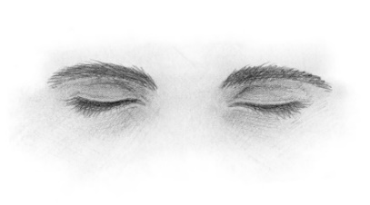
Learning to take charge of your thoughts and emotions
The best thing I have ever done…
1,2,3,4,5

Slide 70
Sharing their diagnosis with peers….

Slide 71
Me behind the mask of being shy
My social anxiety
Sensory Processing Disorder
My diagnosis: How it happened
Things I do in my mind

Slide 72
What we still need to do….
Nurturing and attachment
Using video to show good practice.

Slide 73
Pupil perception diagnosis
What we will do next……
What would you like to be covered next…..

Slide 74
Lunch

