Slide 1
Supporting children with autism in the Early Years.
Chris Atherton & Ainsley McGoldrick
East Renfrewshire Educational Psychology Service

Slide 2
Discussion
What is autism spectrum disorder?

Slide 3
What is autism spectrum disorder?
DSM V definition
“persistent difficulties with social communication and social interaction”
“restricted and repetitive patterns of behaviours, activities or interests” (this includes sensory behaviour)
present since early childhood, to the extent that these “limit and impair everyday functioning”
Source: NAS

Slide 4
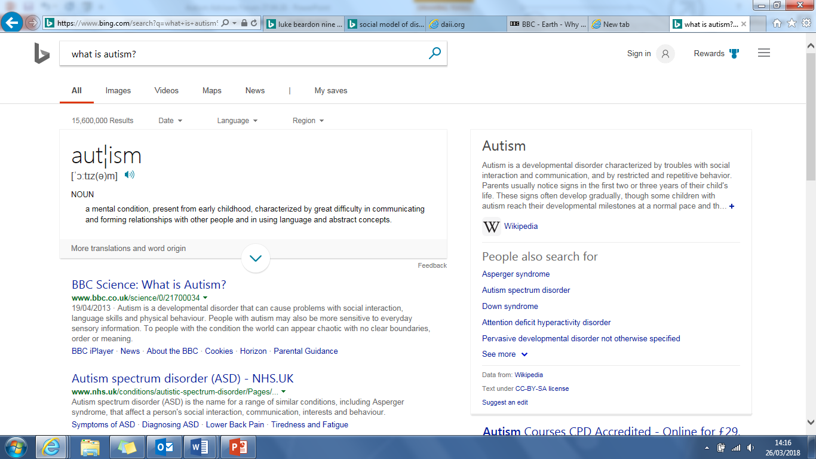

Slide 5
“What has it got to do with psychiatry?
It’s not a diseases or an illness.
It’s a different cognitive state.”
Dr Luke Beardon
The Autism Centre, Sheffield Hallam University

Slide 6
“persistent difficulties with social communication and social interaction”
http://www.bing.com/videos/search?q=sheldon+cooper+sarcasm+sign&view=detail&mid=025EEDB81834BB35070B025EEDB81834BB35070B&FORM=VIRE&adlt=strict
http://www.bing.com/videos/search?q=friendship+algorithm&adlt=strict&view=detail&mid=9E8D1FE6E107A918DB609E8D1FE6E107A918DB60&FORM=VRDGAR

Slide 7
Language and Communication
Pragmatic
Literal
Semantic

Slide 8
“restricted and repetitive patterns of behaviours, activities or interests”
http://www.bing.com/videos/search?q=fun+with+flags&adlt=strict&view=detail&mid=F69398E6F236F697EE36F69398E6F236F697EE36&FORM=VRDGAR
http://www.bing.com/videos/search?q=sheldon+cooper+routine&adlt=strict&view=detail&mid=B080132947EB01F04E93B080132947EB01F04E93&FORM=VRDGAR

Slide 9
Identifying Autism
Common Traits and Challenges

Slide 10
Common Traits and Challenges
Delayed speech development (age and stage)
Lack of response to other’s speech (including own name)
Stereotyped and repetitive use of language
Pronoun reversal (saying ‘you’ for ‘I’)
Idiosyncratic use of words – describing and not naming, own statements
Literal interpretation of language
Seldom initiates or sustains ‘normal’ conversation
Dominates conversation and doesn’t ‘turn take’
Differences in speech - pitch, stress, intonation and understanding of voice prosody

Slide 11
Common Traits and Challenges
Different use of and understanding of non-verbal communication – facial expression, gesture
Developing and sustaining friendships can be a challenge
Understanding the social elements of friendships
Less motivated to interact – too tricky and unpredictable
‘Inappropriate’ comments and actions
Low awareness of proximity to others (variable – hyper and hypo sensitive)
Doesn’t seem to recognise or respond to other people’s feelings including the impact of their actions
Expects other people to know their thoughts, experiences and feelings.
Sensory sensitivities – hypo and hyper across the seven senses

Slide 12
Common Traits and Challenges
Interaction and story-telling often ‘scripted’ – based verbatim on observation of others / familiar tv programmes and films
Requires direction to make choices in activities and manage unstructured time
Special interests may become all encompassing (sometimes not age and stage appropriate – can lead to embarrassment / isolation)
Hates rules to be broken
Changes to routines / expectations causes anxiety
Some difficulty with sequencing routines / procedures and organising belongings
Difficulty seeing and /or respecting another person’s point of view

Slide 13
Common Traits and Challenges
Quickly hits the panic button
Intense negative emotional reaction towards the emotions of others
Giving up quickly ends the pain
Fear of making a mistake / need for perfection - If I don't try, I don't make a mistake. Mistakes prove you are stupid (Fixed mindset) and might be ridiculed
Phobic reactions – set mindset about these that are difficult to shift
For some - intellectual arrogance and narcissistic personality traits (Sherlock syndrome)

Slide 14
Common Traits and Challenges
Point out errors of others as they have broken the rules
Self perception as an adult (don’t differentiate)
Need / desire to do things my way - predictability
Last to know and seek help if on the wrong track

Slide 15
Visualizer
Strong perceptual reasoning skills
More classic ASD profile.
Interest lies in a world with pictures / patterns and logic
Language develops slowly - incompletely
Verbal reasoning skills are weaker
Weak auditory processing – words and meaning disappear
Show me don’t tell me
Emotional vocabulary is limited

Slide 16
Verbalizer
Strong verbal reasoning skills
Interest in the written word / vocabulary / information
World of emotional literacy - thoughts and feelings
Processing time needed for linguistic, cognitive and social activities
‘If I wait, I'll forget’ – ends up interrupting
Yet – hates being interrupted!
Ask three before me (friends / peers) - doesn't work
Delay in response to an act, reaction might come hours or days later.
Need time to identify internal emotions
Be prepared for a delay in response! Don’t ask again – that resets the process…

Slide 17

Temple Grandin
“Fear is the main emotion in autism”

Slide 18
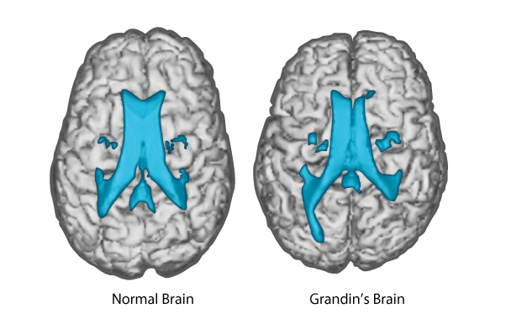
Temple Grandin
Notes:
Highlights enhanced connections to the visual part of the brain

Slide 19
Result
The social world can become extremely difficult for the person to navigate
Attempts to communicate are misinterpreted by others
Attempts to understand the communication of others is undermined
A system for navigating the social world is not effective / consistent enough
The social world is a place where I am not safe – fear, anxiety, stress = cognitive rigidity
Less options to choose from – most effective is to sabotage = I AM BACK IN CONTROL

Slide 20
Anxiety increases cognitive rigidity

Slide 21
Closure
Remember that people with ASD can find transitions tricky
The idea of ‘finished’
Moving on between preferred and non preferred activities.
When will this (activity / work) end?
How will I know?
I am being interrupted
I need to complete this
Having an end leads to a feeling of closure = reduced anxiety
https://www.youtube.com/watch?v=t9Av2l4t0U4

Slide 22
Let’s look a little deeper
Cognitive Theories in Autism

Slide 23
Extreme Male Brain
Empathic v Systematic Brain
The drive to identify emotions within our experiences vs the drive to identify patterns and a logic within our experiences
Extreme male brain can become…a logically driven brain
The ability to see and identify patterns
The ability to be logical
The ability to identify and create systems
The ability to see how things connect

Slide 24
https://www.youtube.com/watch?v=nRoxCqCd77E

Slide 25
Context Blindness / Specificity
Difficulty understanding how meaning relates to a given situation.
Can become…context accuracy
The ability to recognise that each situation is different – to see variance – to see that each specific context in isolation is unique

Slide 26
http://www.bing.com/search?q=oasis+stand+by+me&src=IE-TopResult&FORM=IETR02&conversationid=&adlt=strict

Slide 27
What is your core belief?
Only one of these is ever helpful…
The child is doing it on purpose?
The child is doing their best?

Slide 28
Meeting the Needs of Pupils with Autism

Slide 29
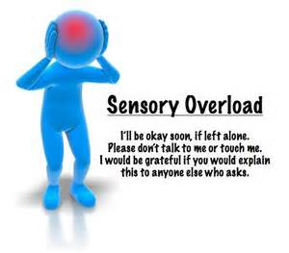
Experience it
https://www.youtube.com/watch?v=Lr4_dOorquQ
Notes:
1m 24s

Slide 30
What Can We Do?
Social Communication
Sensory Needs
Flexibility of Behaviour
What do you already do to support children with ASD or based on what we now know what else could you be doing?

Slide 31
Creating an Early Years Environment which Reduces Anxiety
make it predictable
make it visual
make it consistent
make it easy to process
make it explicit

Slide 32
Make it Visual
Knowing what to expect reduces anxiety
Language processing difficulties affects the ability to understand verbal instructions
Words ‘disappear’ – symbols / pictures can be held on to
Nature of the visual can be flexible to fit the need:
  Real objects
  Tactile symbols / object of reference, for example swimming trunks, packaging, food labels
  Photographs
  Miniatures of real objects
  Coloured pictures
Notes:
All children will benefit from a visual timetable
= knowing what to do and what is next reduces anxiety

Slide 33
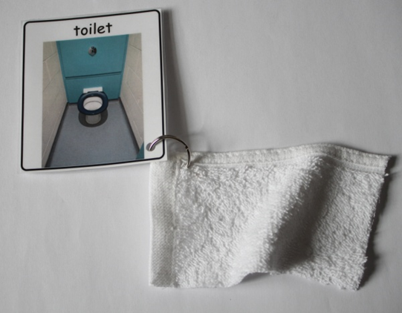
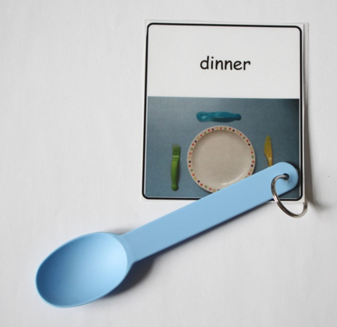
Stages and Purposes of Visuals
Symbolise the environment
Visualise routines e.g. snacktime, handwashing
Song or story choice
Objects of Reference
Personalised ‘Now’ boards
Personalised ‘Now and Next’ boards
Visual timetables
Develop language
Emotional Regulation
Social Stories
Restoring Relationships
Notes:
Not just jumping straight to now and next but thinking about the purpose of the visual
It is to:
Encourage the child to move about more activities
Develop language
Teach particular skills
Enhance development in specific areas

Slide 34
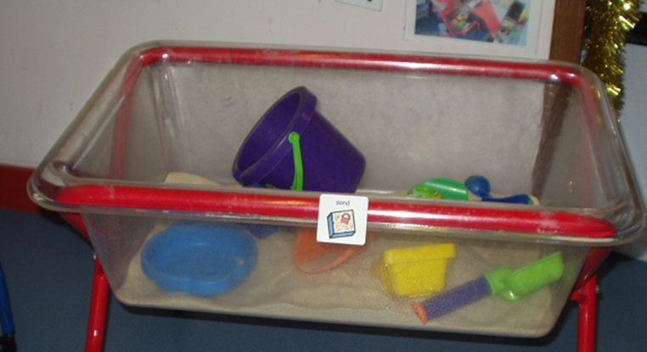
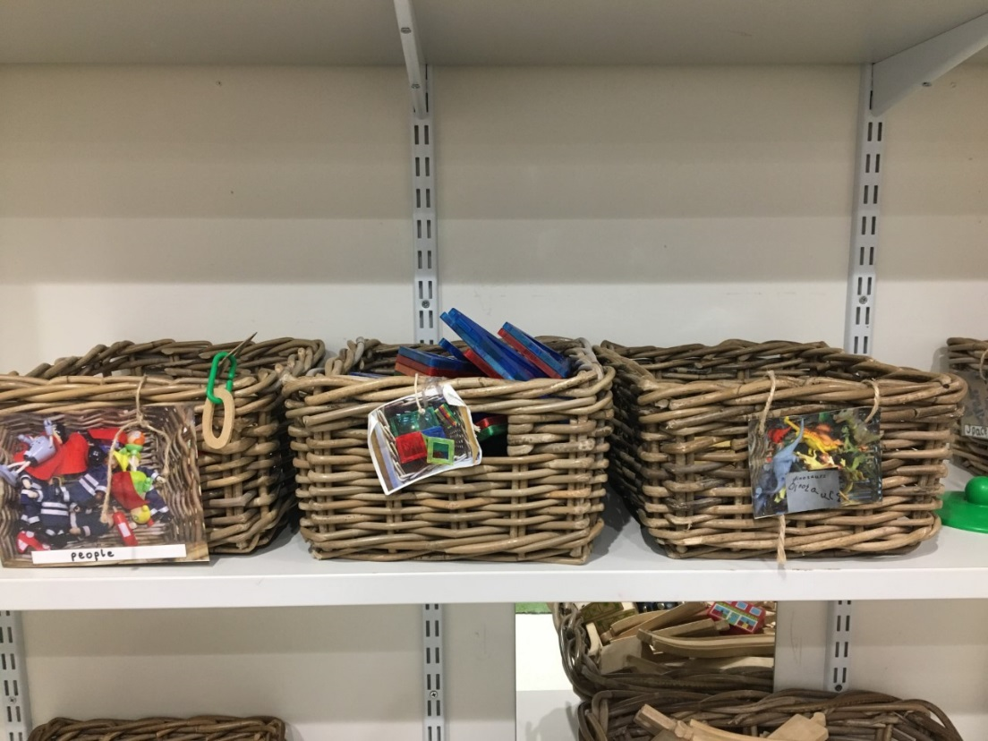
Symbolise the Environment

Slide 35
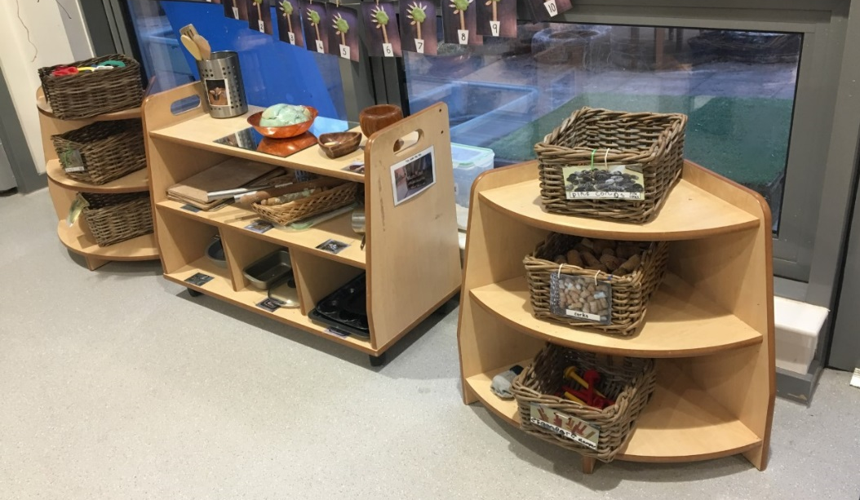

Slide 36
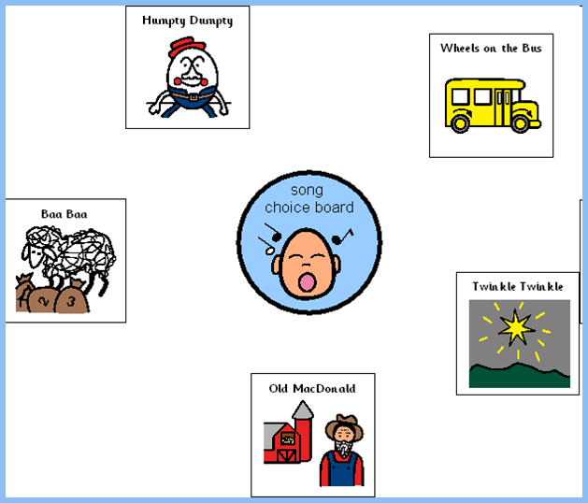
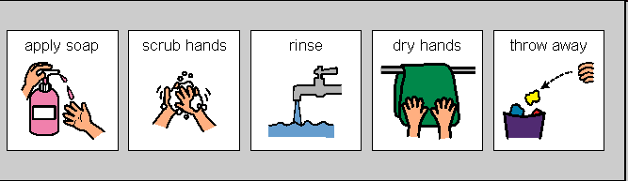
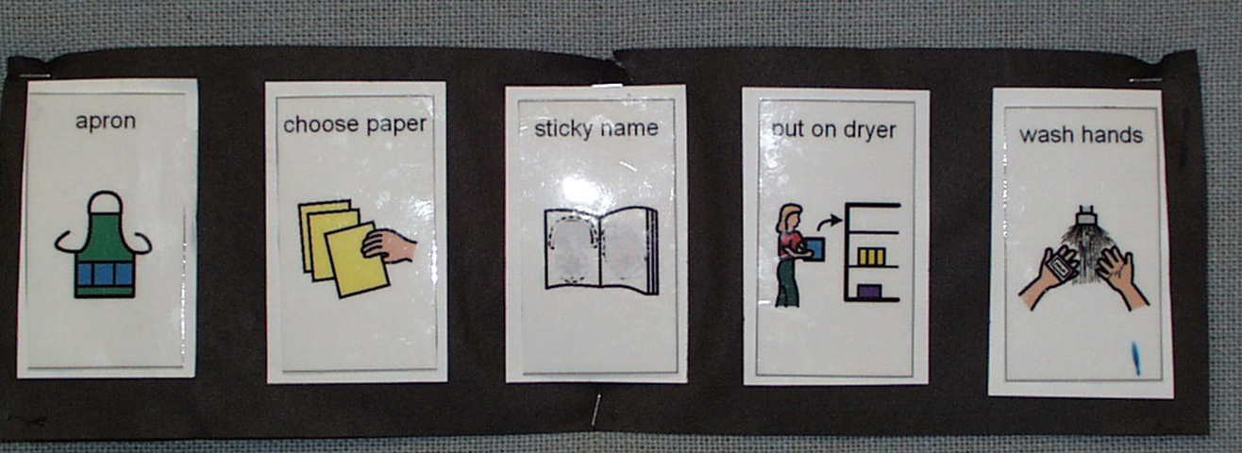
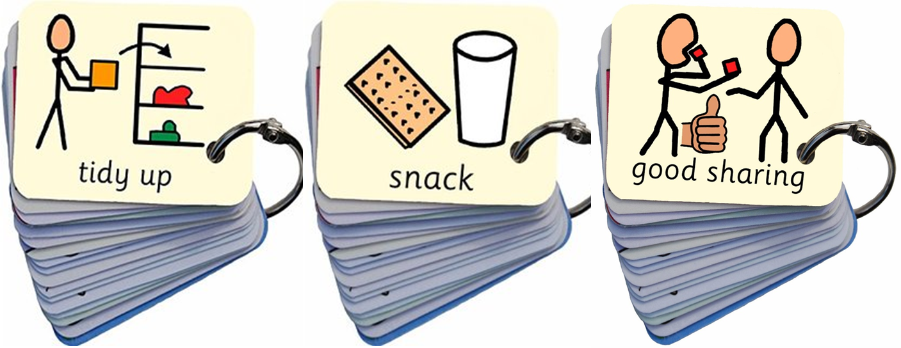
Make it Predictable - Symbolise Routines

Slide 37
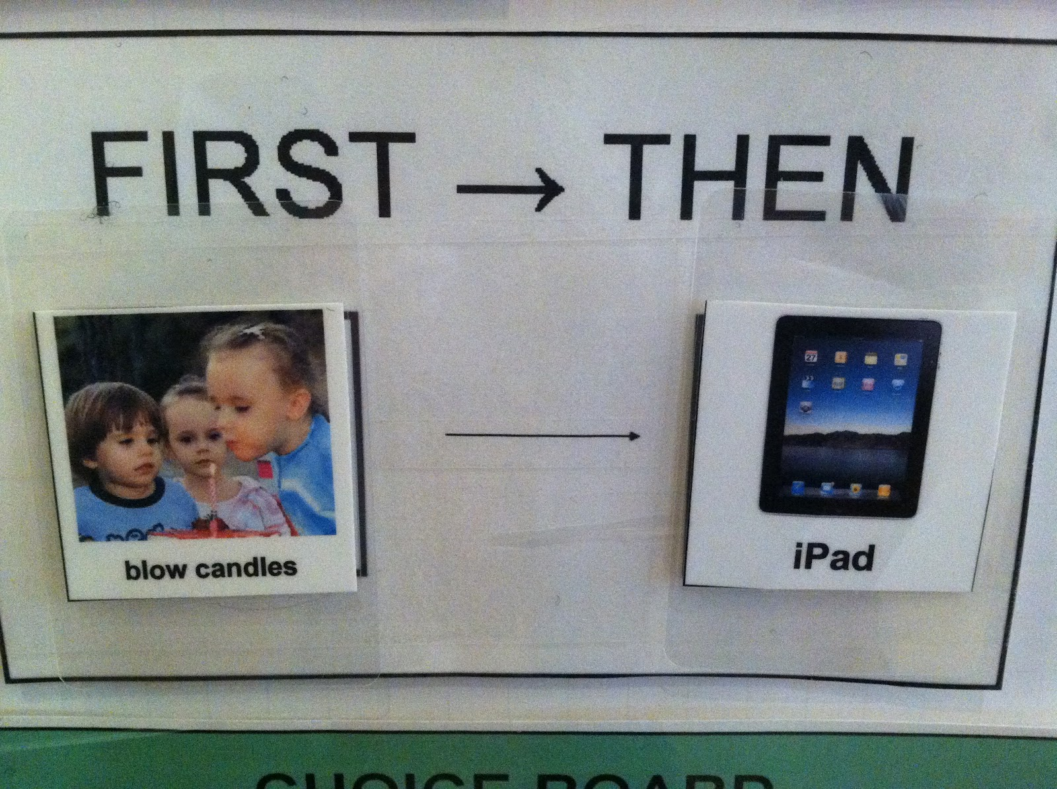
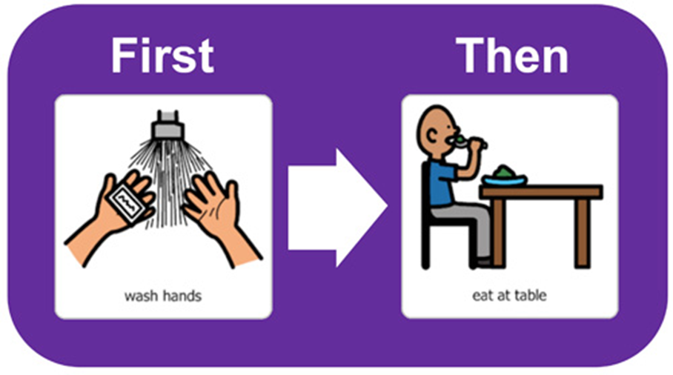

Start with Now and build up to now/next
Helps understanding of a 2 step sequence
Reduces uncertainty of what is coming next and what is expected
Use as a motivator for less preferred activities
Encourages the child to move between activities
Personalised photographs or google images?
Notes:
Provide a concrete source of information regardless of noise levels etc.
Help to break down instructions into manageable chunks of information
Provide a clear message about the daily routine – what there is to look forward to and how many tasks there are left

Slide 38
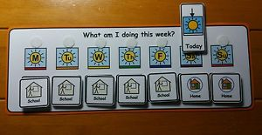
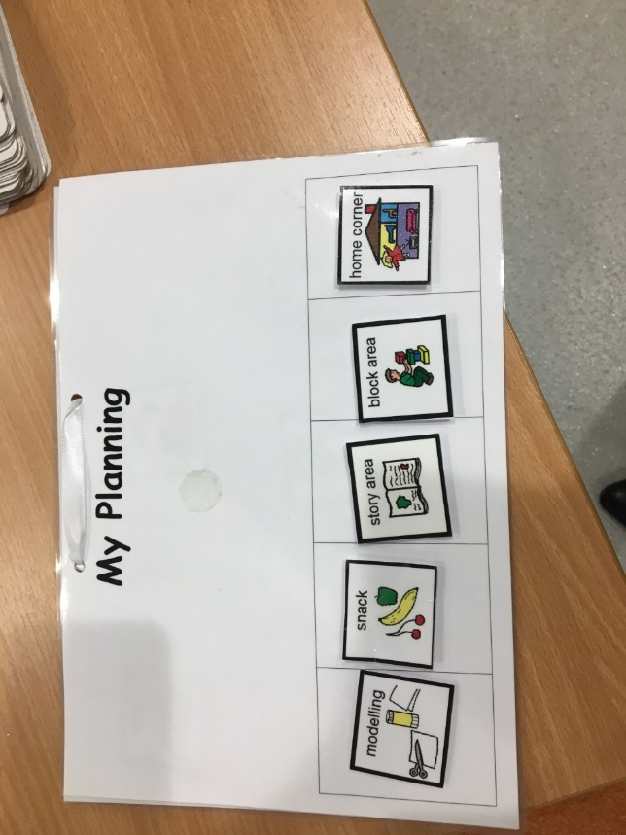
Visual Timetables
  Using a visual timetable to provide a structure- a clear beginning middle and end point
  The child knows what to expect
  Helps with transitions – remove each activity as its completed (finished box?)
  Can use at nursery and home
Notes:
Knowing what to do now and what to do next reduces anxiety. Words ‘disappear’ – symbols / pictures can be held on to
The person should always know:-
Where do I have to be?
What am I doing?
How much do I have to do?
When will I know when I have finished?
What will I do next?
Things must have a beginning, middle and a clear ending.
Children respond best in a structured environment where things are organised and clearly labelled.

Slide 39
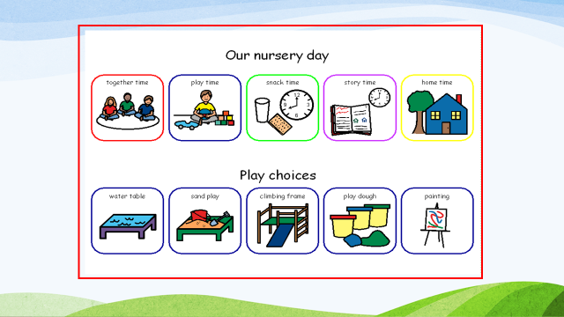

Slide 40
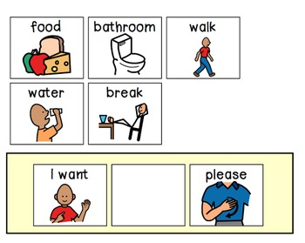

Make it Easy to Process – Developing Language
Use simple consistent language
Use the child's name at the beginning of the instruction
Allow processing time
Model their language rather than ask questions
Check for understanding
Positive correction – reflect back the correct word or phrase
Notes:
Visuals support communication, show simple sentence structure and learn appropriate tone.

Slide 41
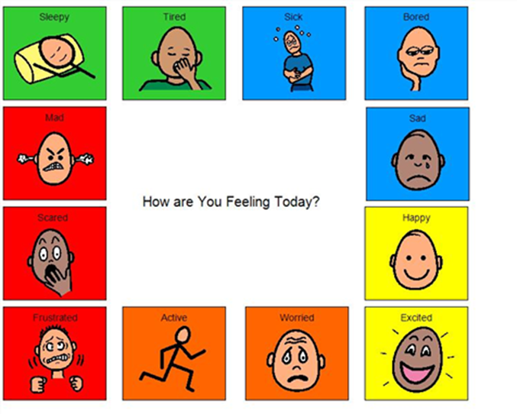
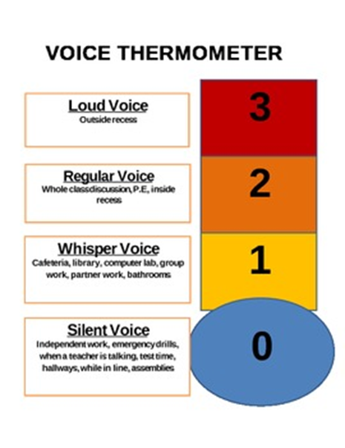
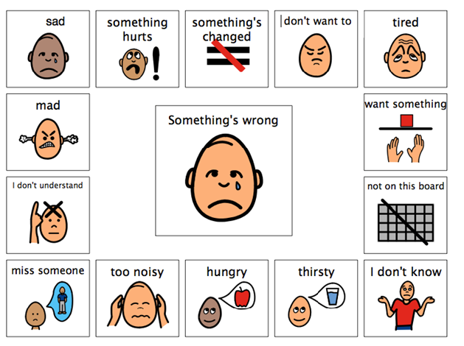
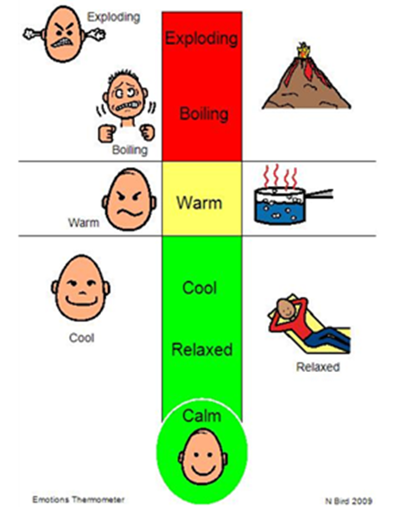
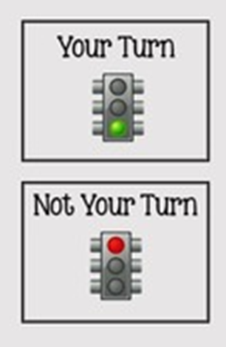

Supporting Emotional Regulation
Notes:
Some children will make progress with this just by consistently using visuals and reducing the anxiety in the nursery environment. Others will require specific teaching of skills.

Slide 42
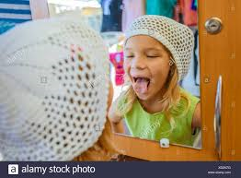
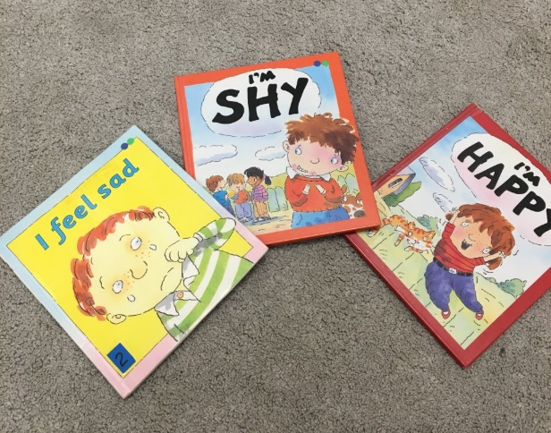
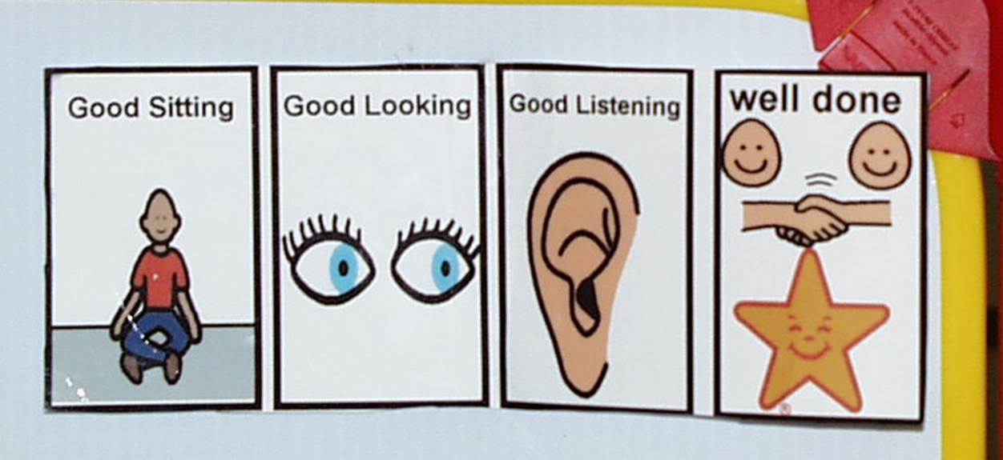
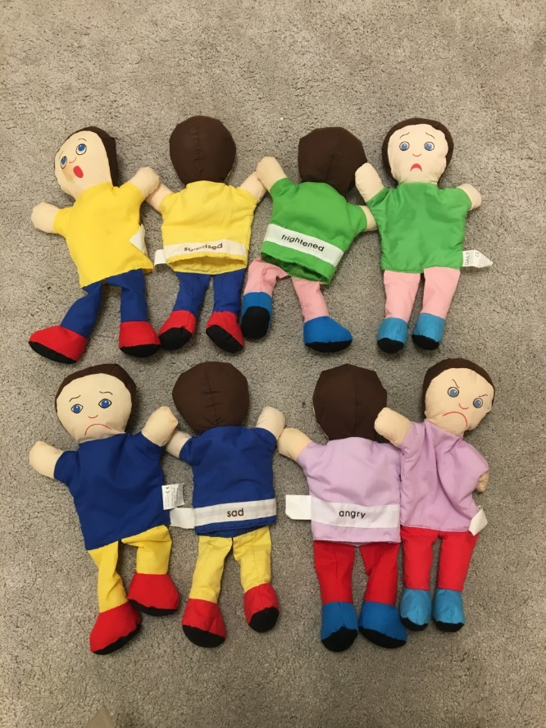

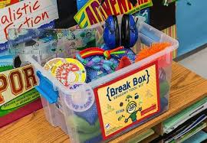
Supporting Emotional Regulation

Slide 43
Points to Consider
Can symbols be seen?
Are they in a distraction free area?
Are they used consistently?

Slide 44
Make it Explicit – Social Stories
Visually teaches the rules of a situation
Can be modified to suit the child’s interests, developmental stage and communication needs
Read regularly and during times when the child is relaxed
Can be linked to a reward system

Slide 45
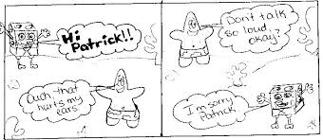
Make it Explicit – Social Stories

Slide 46
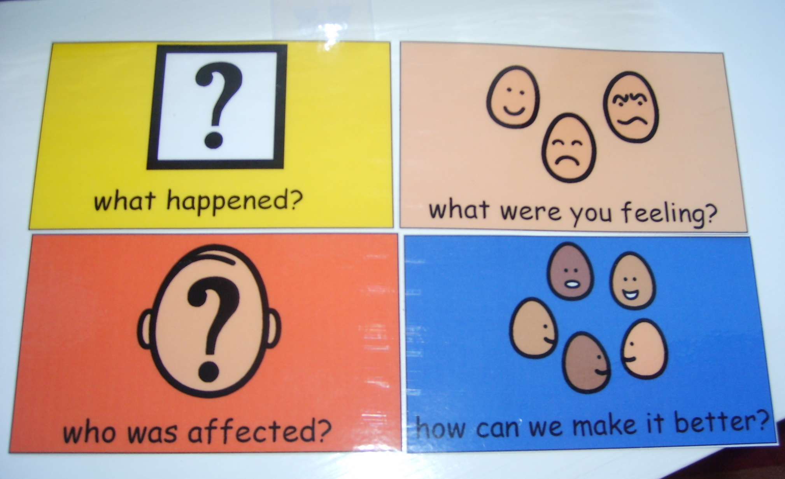
Make it Explicit – Restorative Conversations

Slide 47
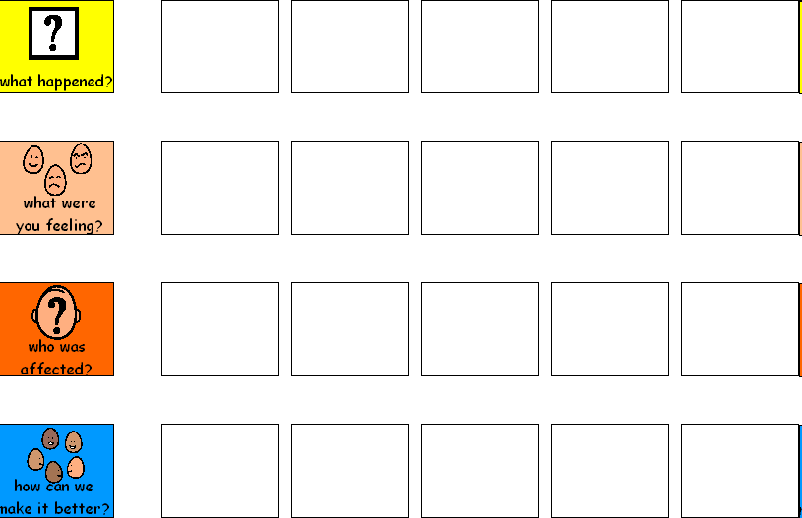
Give consistent prompts for discussion / resolution…

Slide 48
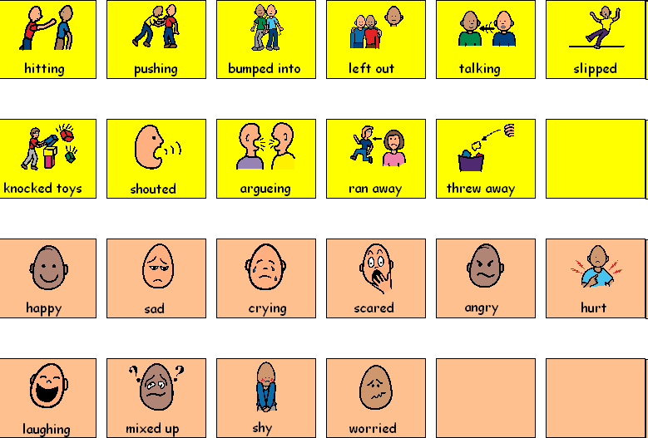
What happened and how did it feel…

Slide 49
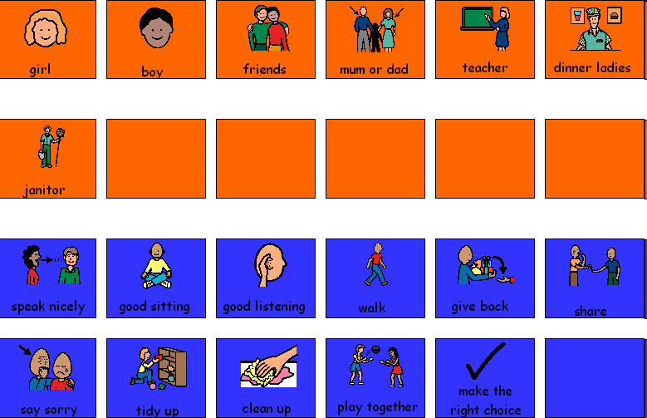
Who was affected and how
can we make it better…

Slide 50
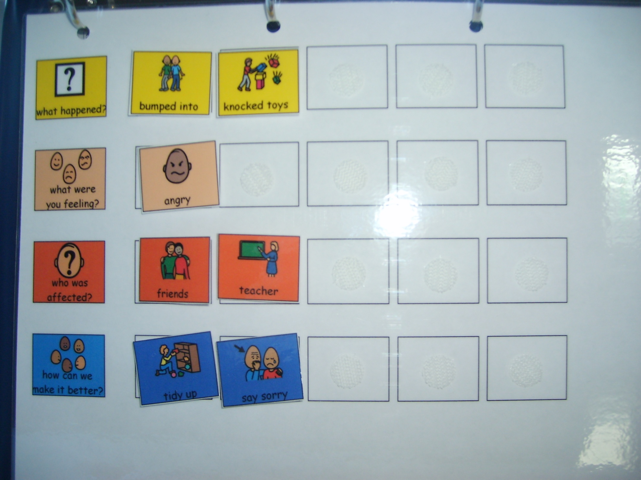

Slide 51
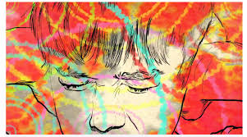
Considering Sensory
Needs

Slide 52
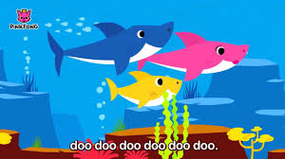
Considering Sensory Needs
What does it feel like for you when:
  You don’t get your coffee in the morning (or someone stops you from getting it)???
  One kid is asking you to do something, the other is singing ‘Baby Shark’ on repeat, you’re on an important call and the cooker beeps tell you dinner is ready!?
Sensory needs are a part of a child’s physiological makeup
  Assess what the child needs – what is the child seeking from that experience
  Consider safe and appropriate ways for the child to meet that need

Slide 53
Considering Sensory Needs – Examples
Remember to use visuals to cue/plan/transition
I need to shut out noise or other senses – ear defenders; black out tent; planned time away from the group; sensory room
I need to make a mess with water/sand/slime – define an area for messy play
I need to touch – make a sensory box with different materials
I need to taste/bite – provide alternative food items to taste or chewable items
I need deep touch – provide tight cuddles (set time limits); fill a rucksack with items for the child to carry; keep a supply of heavy blankets

Slide 54
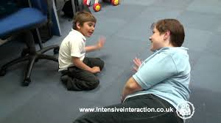
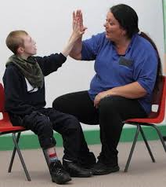
Intensive Interaction:
Learning through Social Connection

Slide 55
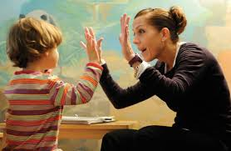
BY LEARNING THEIR LANGUAGE WE CAN START TO TALK TO THEM!
Notes:
Why do children with ASD/communication difficulties stim or use repetitive behaviours? – seeking feedback, trying to control their world, focusing on one activity to reduce the confusion of the outside world, feels safe – BY LEARNING THEIR LANGUAGE WE CAN START TO TALK TO THEM

Slide 56
What Does this Mean in Practice?
Place yourself where you can be seen but not directly in front of the child
Observe the child’s repetitive, purposeful behaviours – if he is:
  Banging his head – bang with your fist & copy the rhythm
  Biting his hand – put your hand in your mouth (biting is not necessary!)
  Rocking back and forth – rock back and forth matching the rhythm
  Clicking fingers – click your fingers
  Making a noise with his mouth or other part of his body – try to recreate the sound with the same tempo, volume, rhythm
Match your child’s rhythm – slow and steady or fast and energetic – this may give you information on the child’s mood
Persevere – you may not get it right 1st time!

Slide 57
Progression of Interaction
Watching
Matching
Responding
Attunement
Respecting
Introducing
Turn Taking
Attention Shifting
Notes:
Responding – In responding mode you pause after behaviours to demonstrate you expect a response – building blocks of turn taking/interaction

Slide 58
Sasha and Riana
https://www.youtube.com/watch?v=qkJKktBaTRY
https://www.youtube.com/watch?v=UvIEwUbzF4c

Slide 59
Social Communication Assessment and Planning: THE SELF
Social Interaction
  Social conversations
  Social conventions
  Social play
  Friendships
  learning
Emotional Literacy
  Self awareness
  Awareness of others
  Self management
Language and Communication
  Listening
  Talking
  Understanding
Flexibility
  Accepting another’s point of view
  Coping with change
  Obsessions vs interests

Slide 60
Task: Apply appropriate strategies to your SMART targets
Date | Short term target | Strategies | Evaluation
Aug– Dec | I can take turns with another child on some occasions with full adult support | Staff will create opportunities to practice turn taking such as having one toy with 2 children KW will model turn taking Use a timer
Jan– April | I can take turns during play with another child on most occasions with some adult support | Staff will use a timer to indicate turns during play where necessary and work towards providing only a verbal prompt Staff will try to notice turn taking during free play and provide positive feedback “good sharing” Staff will use a sharing visual

Slide 61
Reflection
What do you think staff in your establishment do well to support children with ASD?
What one thing are you going to do differently or try after today?

