Slide 1
Superpowers

Slide 2
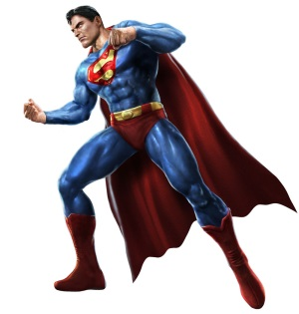
If I had a superpower….

Slide 3
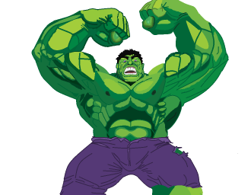
If I had a superpower….

Slide 4
If I had a superpower….

Slide 5
My Super target:
I can cope with challenging situations by using my superpowers!

Slide 6
Superhero School
Meet the pupils
Happy Harry
Lightning Lizzy
Stretchy Sue

Slide 7
Happy Harry
He finds it hard to be calm and happy when things don’t go his way
He is a bit like me because ….

Slide 8
Lightning Lizzy
She finds it hard to slow down a bit

Slide 9
Stretchy Sue
She finds it difficult to be flexible when she has to do something someone else's way or share

Slide 10
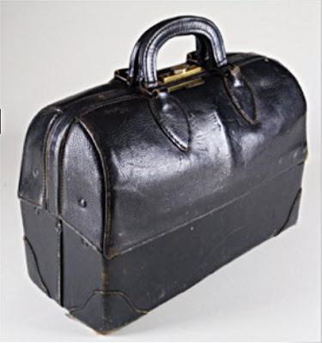
Superpowers

Slide 11
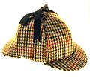
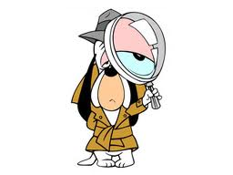
Being a detective
superpowers

Slide 12
What I know about myself…
I can’t do these things when I am frustrated because I am just too angry.
I need time to calm down first, then I can try the superpowers

Slide 13
“Calming down” sequence
If you are feeling like a 3, 4 or 5 and need to get down to a 1 or2
wall press ups carry something heavy for 1 minute press hands together
breathe in slowly, counting on your fingers up to 5 breathe out slowly, counting on your fingers up to 5
sit and squeeze your own legs firmly, counting up to 5
have a drink of water

Slide 14
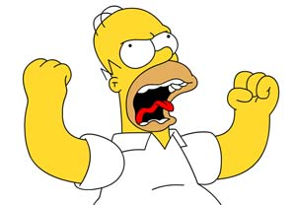
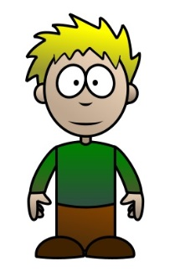
Using Superpowers to sort Frustration
Feeling upset
Feeling annoyed
Feeling i can’t change something I don’t like
I felt frustrated because my sister was being sick on me

Slide 15
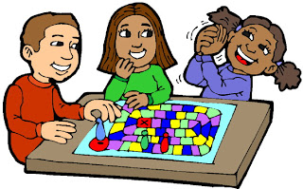
Superpower 1. take a deep breath

Slide 16
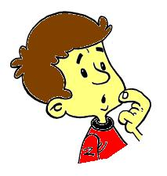
Close your eyes and think of blowing bubbles

Slide 17
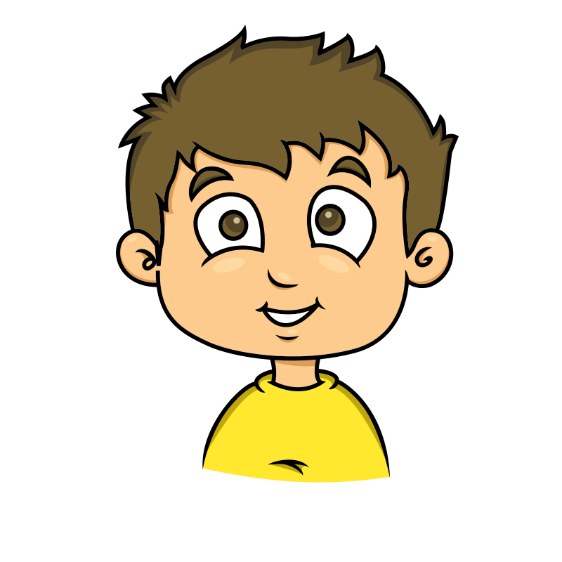
Superpower 2: make a mantra

Slide 18
Think of something I can tell myself to help me feel a bit better

Slide 19
Super Power 3:

Slide 20
Super Power 4:
I am thinking of puppies

Slide 21
Super Power 5:
Crumple up your worries

Slide 22
Super Power 6:
Throw away your worries

Slide 23
Super Power 7:
Make a worry box

Slide 24
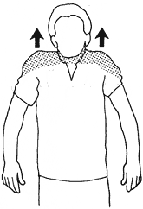
Super Power 8:
Push your wiggles

Slide 25
Super Power 9:
Squeeze your wigglres

Slide 26
Super Power 10:
Squash your wiggles

Slide 27
Super Power 11
cocoon

Slide 28
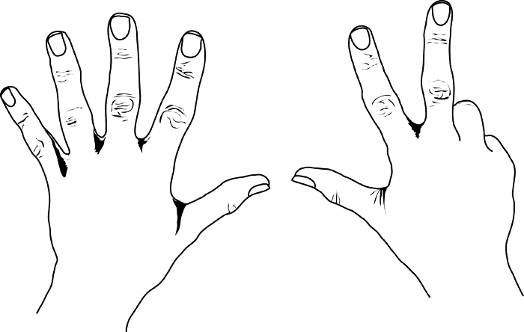
Super Power 12
Stop and count:
1,2,3,4,5,6,7,8,9,10

Slide 29
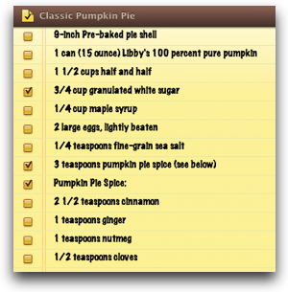
Superpower 13
Make a list

Slide 30
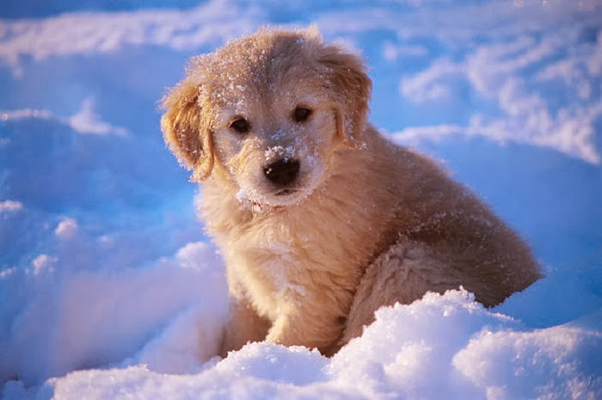
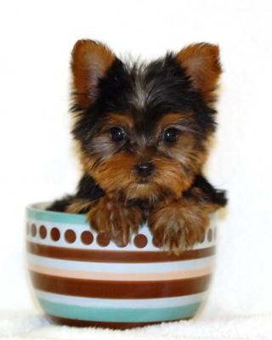
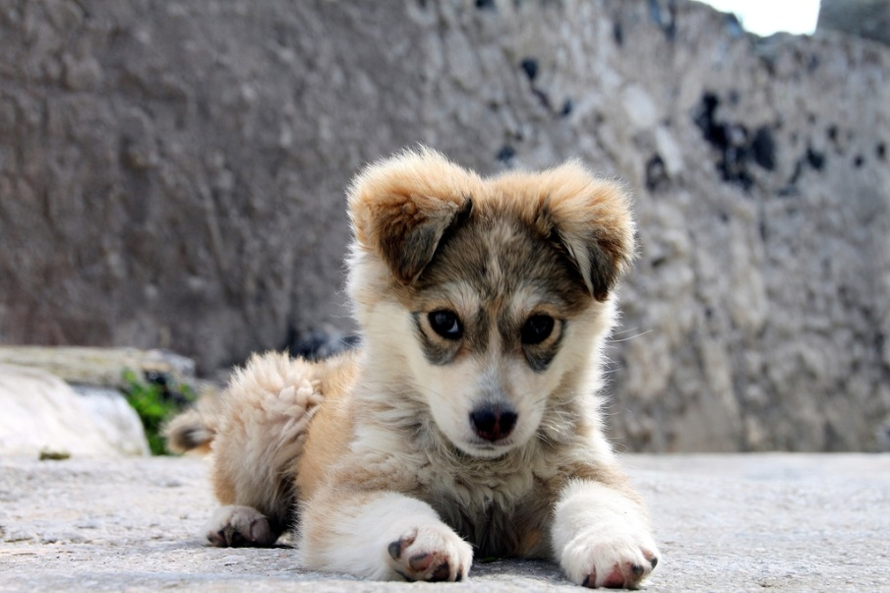
Super power 14
Take yourself to a happy place inside

Slide 31
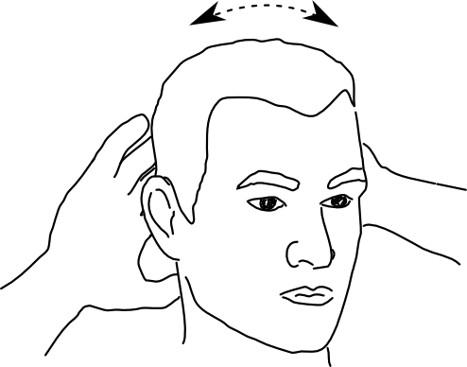
Super Power 15
Give yourself a head massage

