Slide 1
name
Feelings

Slide 2
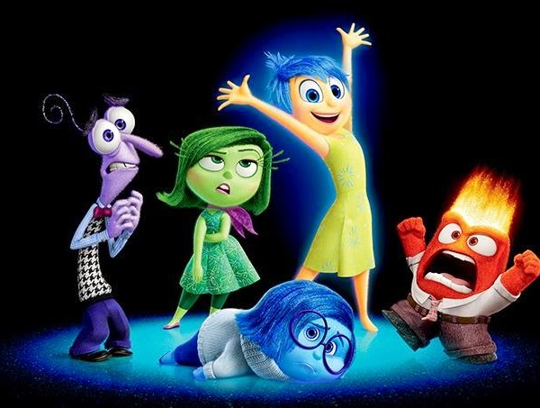
I saw Inside Out ……..

Slide 3
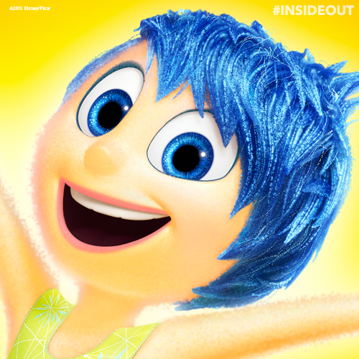
I am feeling happy…
when …

Slide 4


When I am happy
My body feels …
My arms and legs feel ….

Slide 5

What makes other people happy?
…
…
…
…
…

Slide 6
Happy at school
When I …
…
.
..
….
.
..

Slide 7
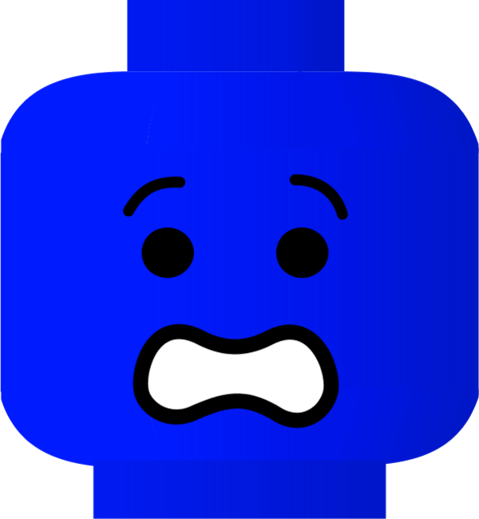
I sometimes feel scared…
when I ….

Slide 8

When I feel scared…
My brain is …
…… tummy
Hands feel ……
Legs …..

Slide 9
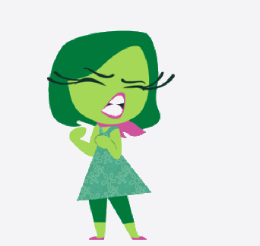
I feel disgusting…
when I ….

Slide 10

I feel calm
when I …..

Slide 11
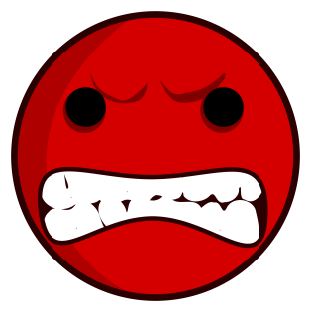


Calm

Slide 12
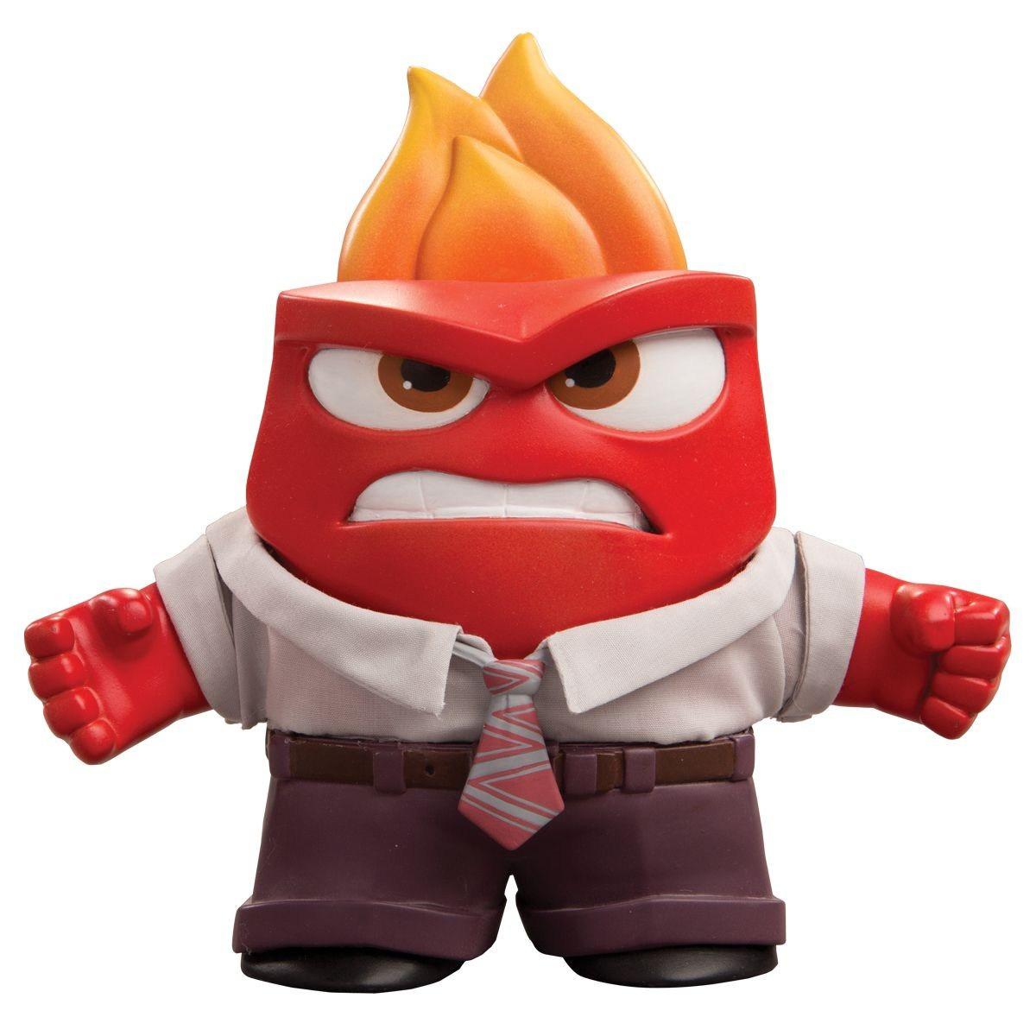

I feel angry
when ….

Slide 13
I felt angry in class today
because….

Slide 14
I (what I did)

Slide 15
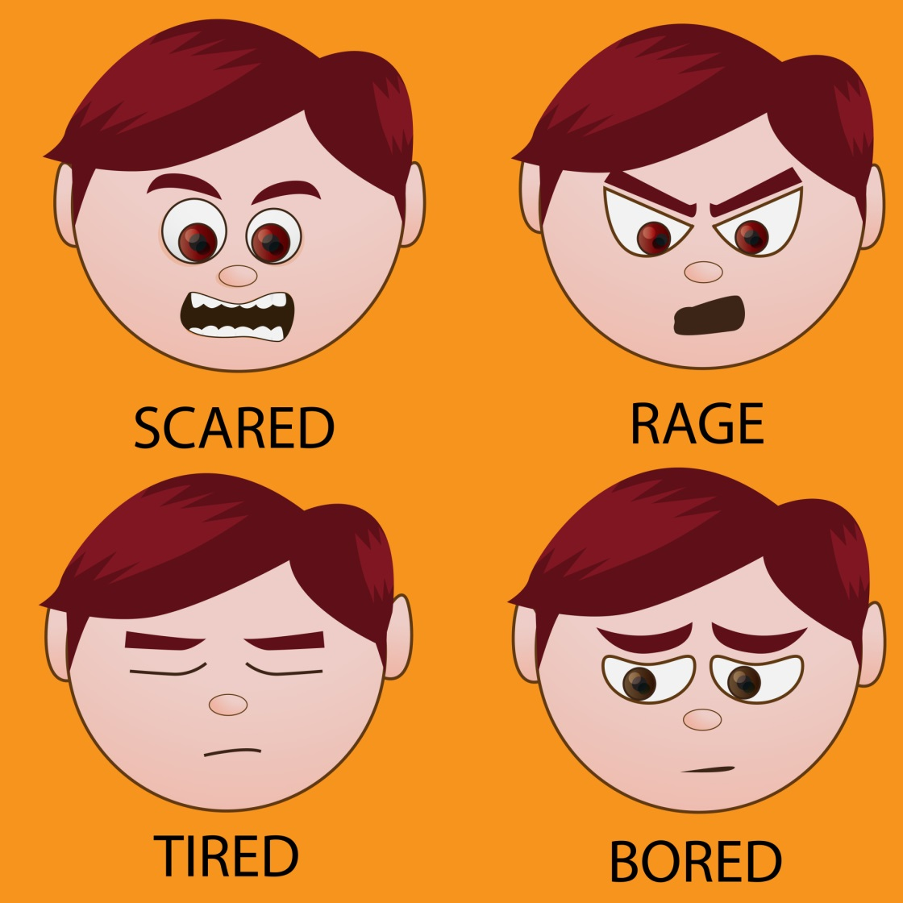

I can use my words
uuuuu
g
I feel angry because

Slide 16
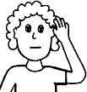

Then the adult will listen to my words
I just want to listen and help you

Slide 17
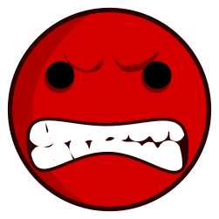
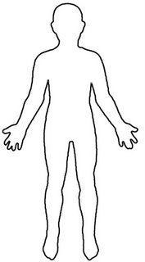
Angry
…. eyes
……mouth
……tummy
Hands feel ……
….. feet

Slide 18
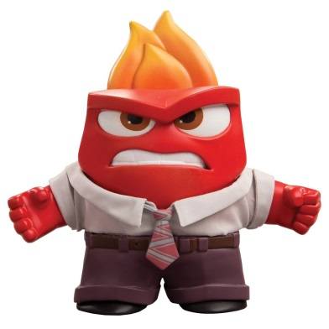
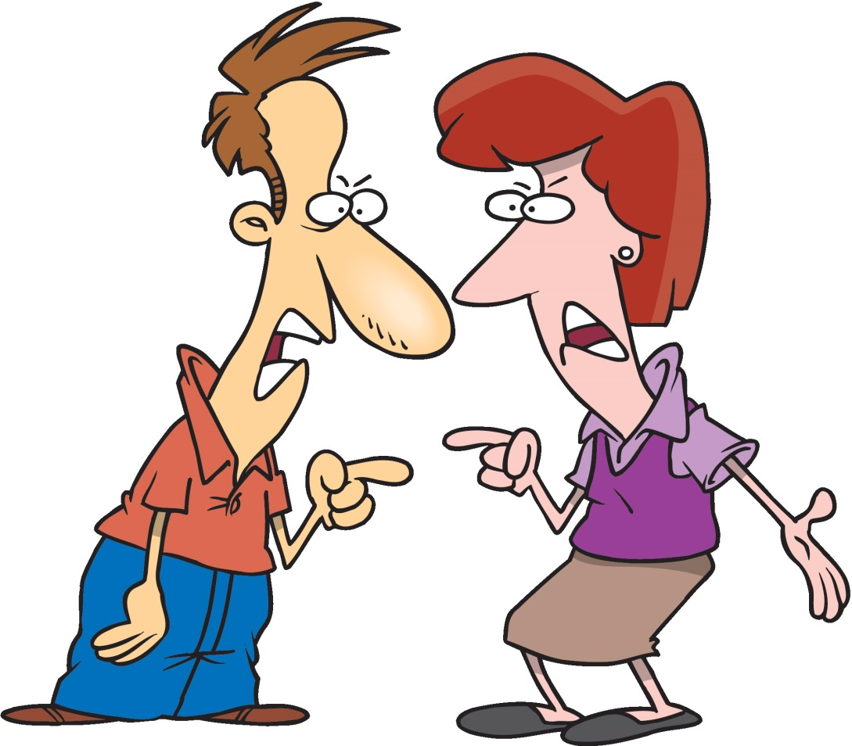
We all feel angry sometimes
Ladies and men get angry sometimes
Where did you put my phone!!!?
I put it under the car so you couldn’t get it!!

Slide 19
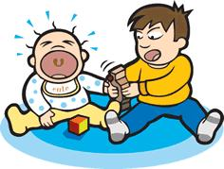
We all feel angry sometimes
Boys and babies get angry
Give me my toy back!!
Waaa!

Slide 20
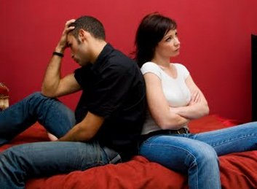
We all feel angry sometimes
Girls and boys get angry

Slide 21

We all feel angry sometimes
Feeling angry sometimes is normal
I feel angry if someone …..
I feel angry if someone takes something away from me like ……

Slide 22




We all feel angry sometimes
It is OK to feel angry
But:
Don’t punch people in their belly, like Lewis
I feel angry because I want to print out a Zoe Kelly.
Don’t turn on the Internet and print naughty stuff out
Calm down by telling Mrs Stewart what is wrong

Slide 23
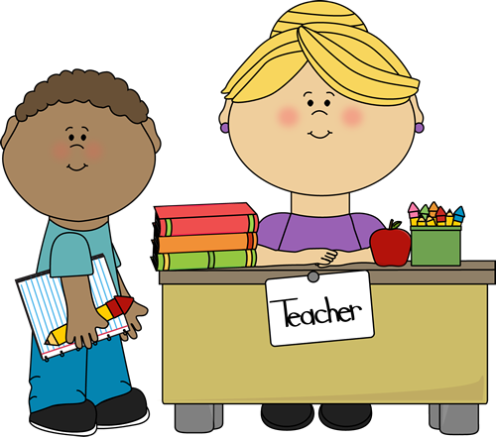

Feeling angry
No you can’t……
I feel angry because I want to …...

Slide 24
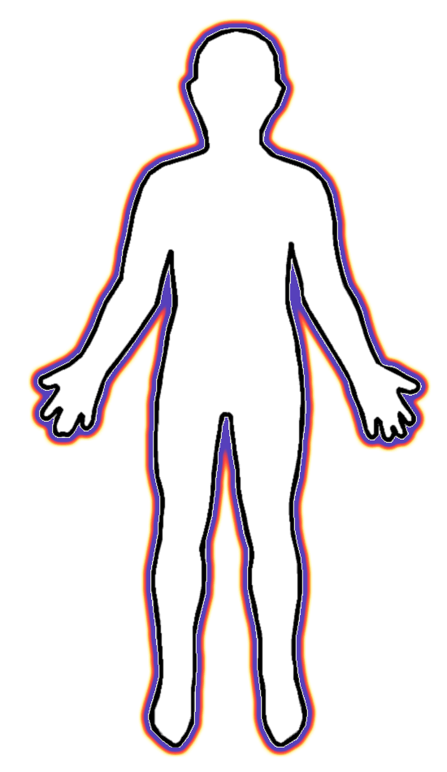




Feeling angry
Don’t hurt people
Don’t break things

Slide 25


Feeling angry
I WANT TO HIT YOU BECAUSE I WANT TO BE A ANGRY PERSON
Don’t hurt feelings
Don’t hurt others

Slide 26

Feeling angry
I WANT TO PUNCH PO ON YOU
Don’t hurt BODIES
Don’t hurt others

Slide 27

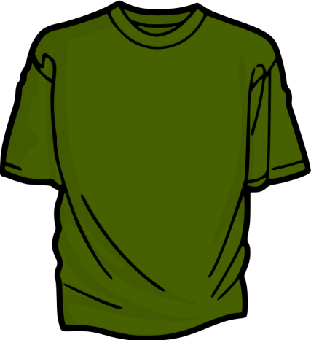

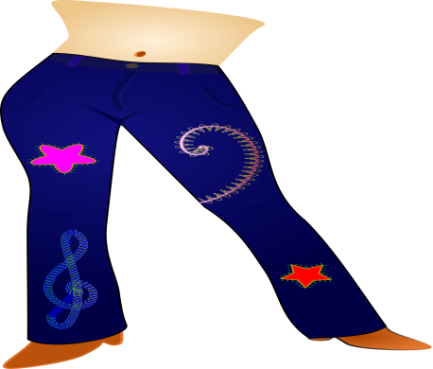
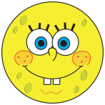
Feeling angry
I feel angry because…
I am listening to you
Use your words

Slide 28
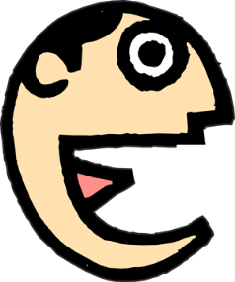

I can use my words
I felt
I ….
Because …..
Next time ……..I can tell …..

Slide 29
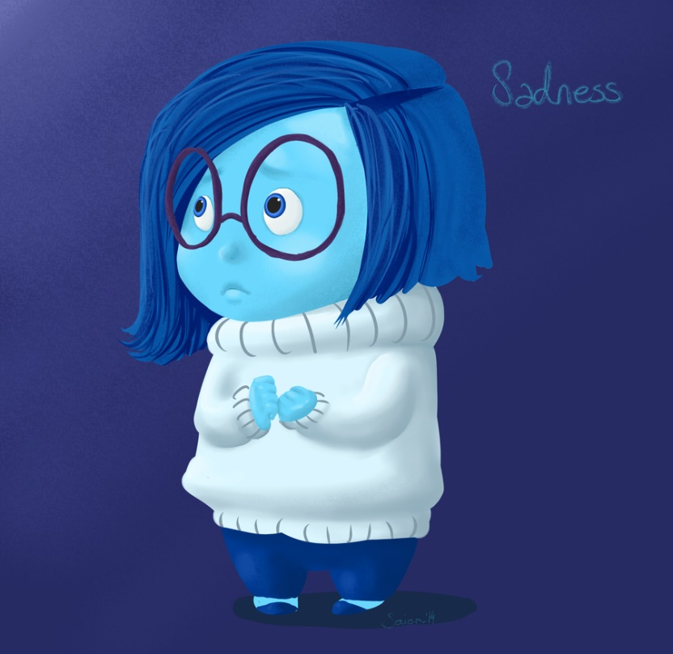

I feel sad….
When ……

Slide 30

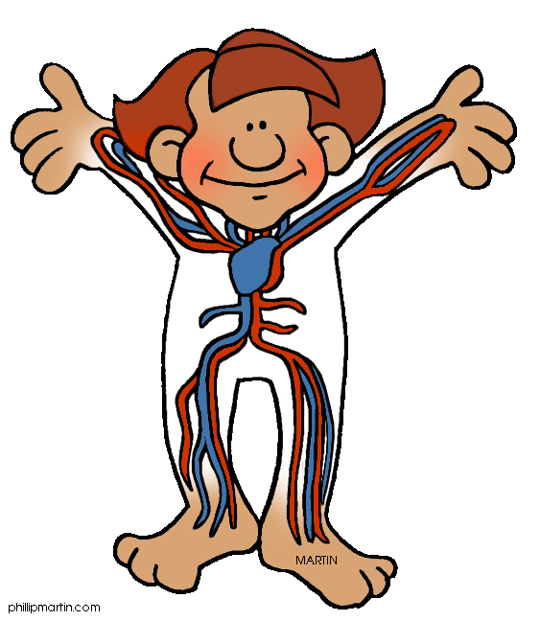
When I am sad
…… eyes
………..throat
Tummy feels ……

Slide 31
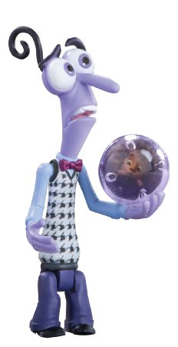
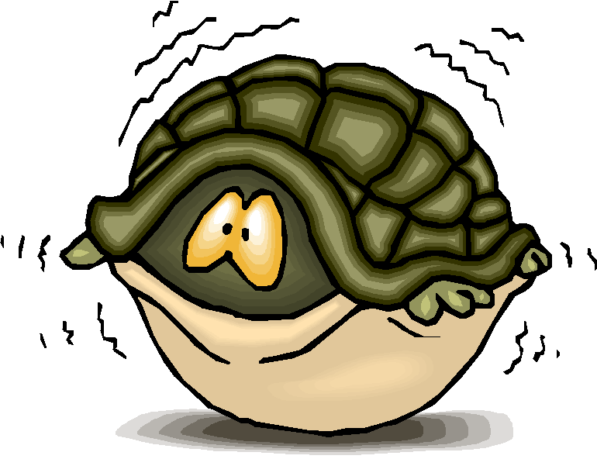
I am worried when …
…….

